Slide 1
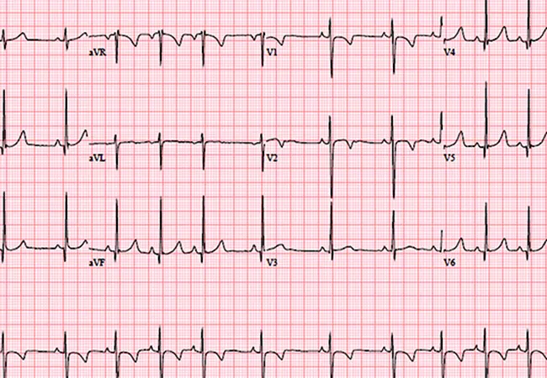
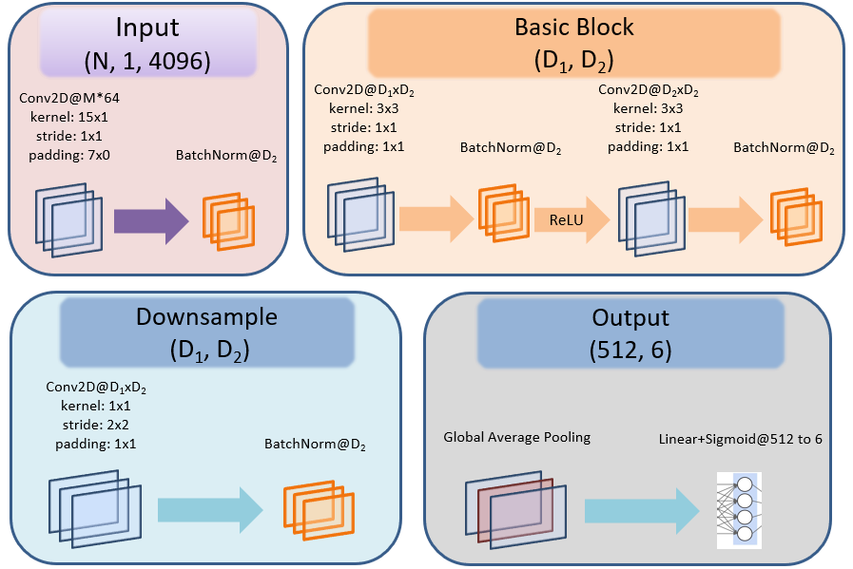
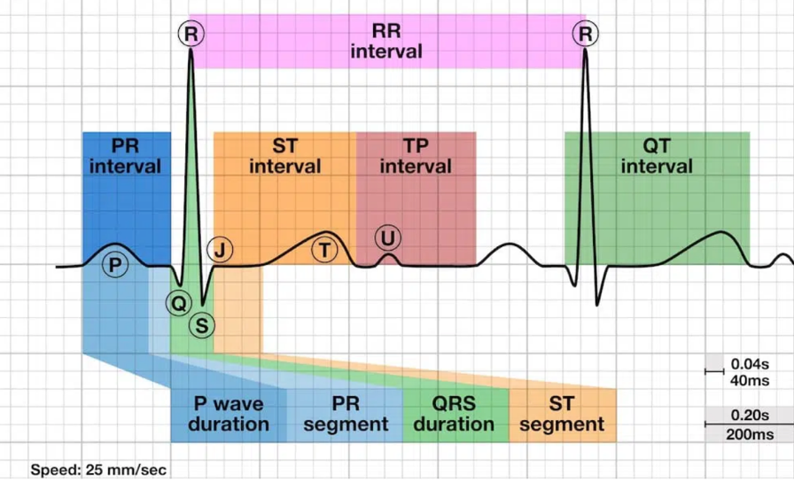
The Impact of ECG Channel Reduction on Multi-Label Cardiac Diagnosis
D. Alexandrov and J. Picone
Neural Engineering Data Consortium
Temple University

Slide 2
Abstract
Research Question:
What are the preprocessing requirements for electrocardiogram (ECG) data when using deep learning models, and how does channel reduction impact model performance and diagnostic accuracy?
Methodology:
ResNet18 model on TNMG CODE Corpus
Systematic comparison of 8 vs. 12 channel ECG data
Ablation analysis to determine channel importance
Findings:
Derived ECG channels showed minimal or a detrimental effect
Model performance consistently decreased with more channels
Deep learning models are effective using raw ECG data
Impact:
Challenges traditional ECG preprocessing assumptions
Reduces effort needed for machine learning (ML) system development
Enables improved medical diagnostics

Slide 3
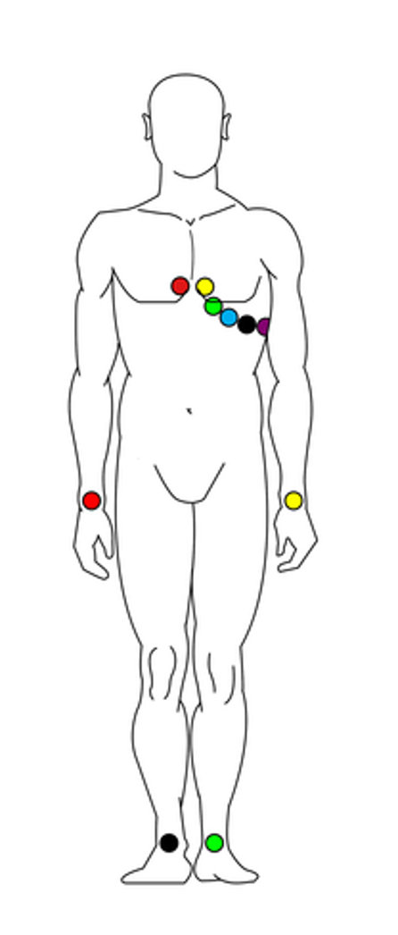
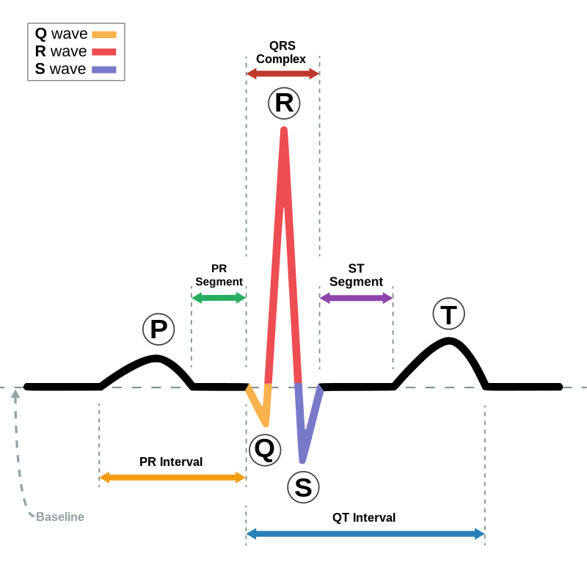
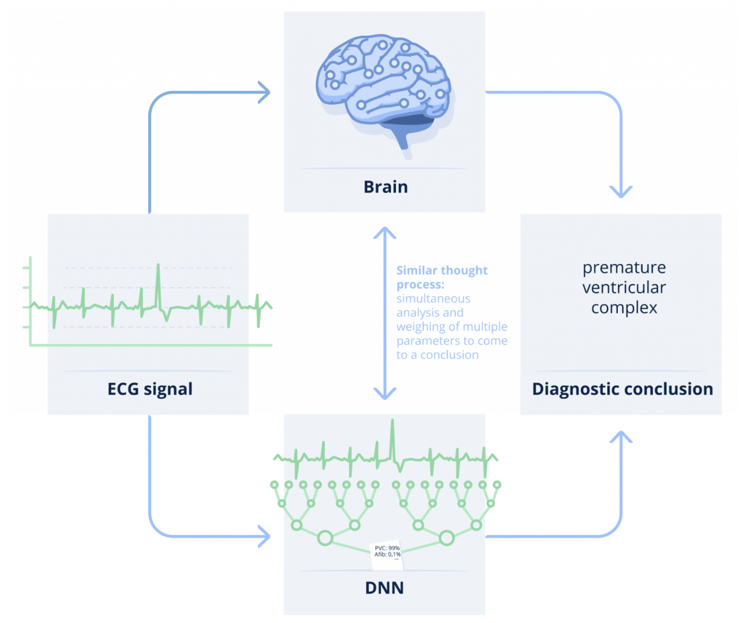
Introduction
Traditional ECG Processing:
Cardiologists rely on preprocessed ECG data and derived channels
Current methods combine raw signals through linear combinations
Preprocessing steps can mask or eliminate subtle diagnostic patterns
Deep Learning Advantages:
Neural networks excel at extracting complex features autonomously
Can process raw physiological signals without manual engineering
Potential to identify patterns lost in traditional preprocessing
Streamlines diagnostic pipeline while preserving signal integrity

Slide 4
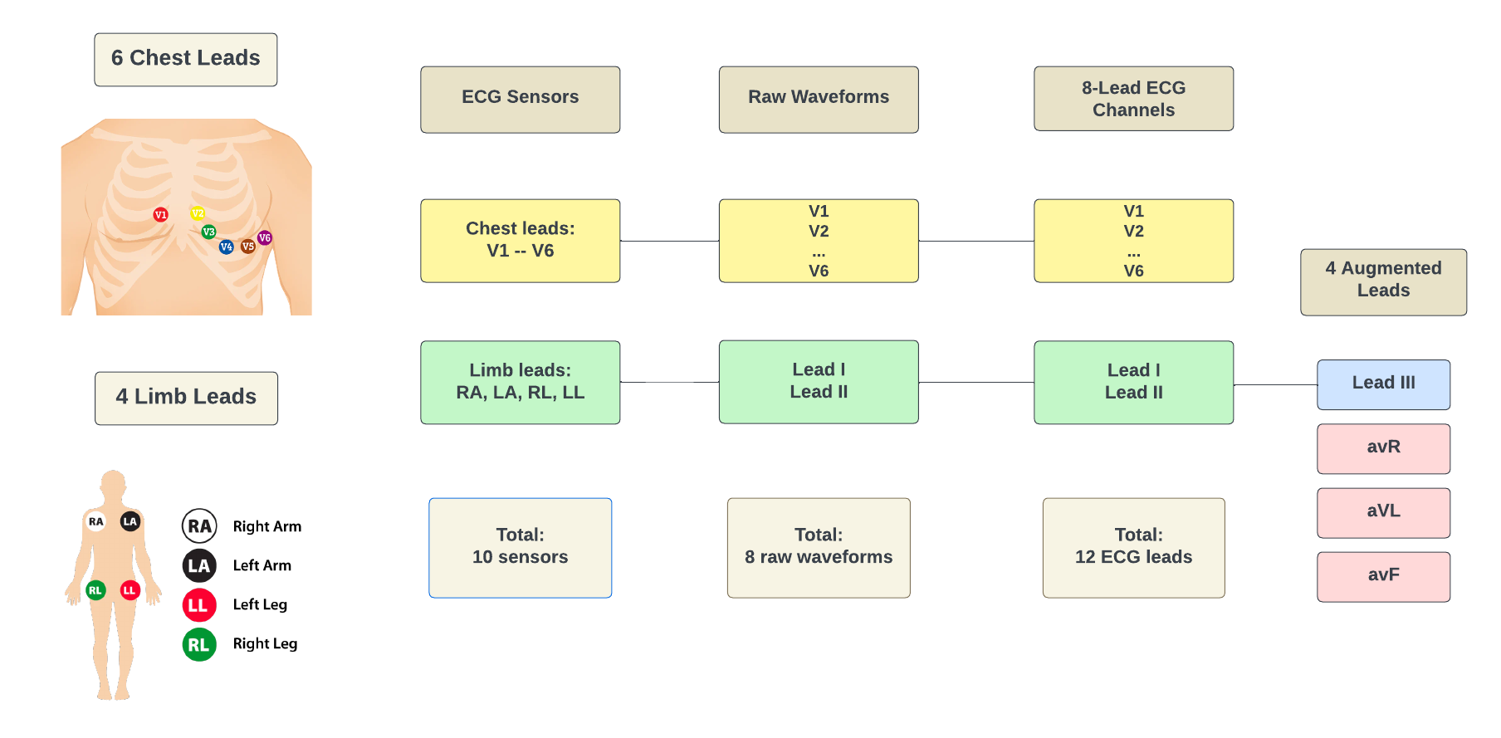
ECG Lead Systems and Signal Processing
Standard 10-Lead ECG:
6 precordial leads (V1-V6) on chest
4 limb leads on arms and legs (RA, LA, LL, RL-ground)
Records 8 raw waveforms ($V1–V6$, $DI = LA−RA$, $DII = LL−RA$)
Derived Channel Calculation:
$$DIII=\left(DII−DI\right) \\ aVR={\left(DI+DII\right)}/2 \\ aVL=({DI−DII)}/2 \\ aVF=(DII −DI)/2$$

Slide 5
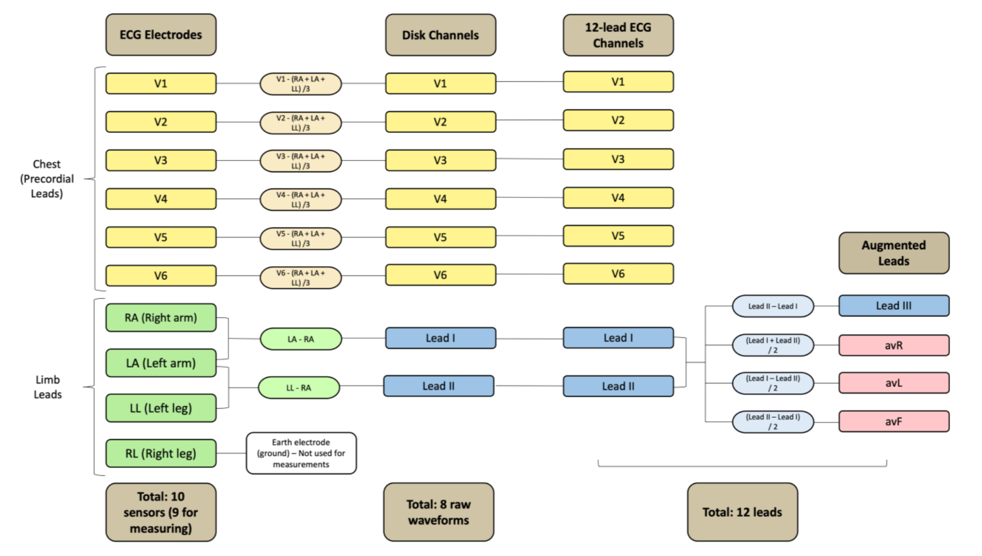
A 12-Channel ECG

Slide 6
The TNMG CODE Corpus
Dataset Overview:
Telehealth Network of Minas Gerais (TNMG)
Clinical Outcomes in Digital Electrocardiography (CODE) group
Comprehensive ECG collection (2010-2016)
Coverage: 811 counties in Minas Gerais, Brazil
Total records: 6,716,317 annotated ECGs
Patient population: 1,558,749 unique individuals
Evaluation Dataset (“Golden Dataset“):
827 carefully selected ECG recordings
Annotation protocol:
Initial review by two independent cardiologists
Disagreements resolved by third specialist consultation
Consensus-based final annotations
Labeled for six specific cardiac abnormalities
Serves as high-quality benchmark for model evaluation

Slide 7
Annotations in TNMG
First-degree Atrioventricular Block (1dAVb): A delay in the conduction of electrical impulses from the atria to the ventricles.
Right bundle branch block (RBBB): A condition where the right side of the heart's electrical conduction system is impaired.
Left bundle branch block (LBBB): A condition where the left side of the heart's electrical conduction system is impaired.
Sinus bradycardia (SB): A slower-than-normal heart rhythm, defined as a heart rate below 60 beats per minute in adults.
Atrial fibrillation (AF): An irregular heart rhythm, characterized by chaotic electrical activity.
Sinus tachycardia (ST): A higher-than-normal heart rhythm, defined as a heart rate above 100 beats per minute in adults.

Slide 8
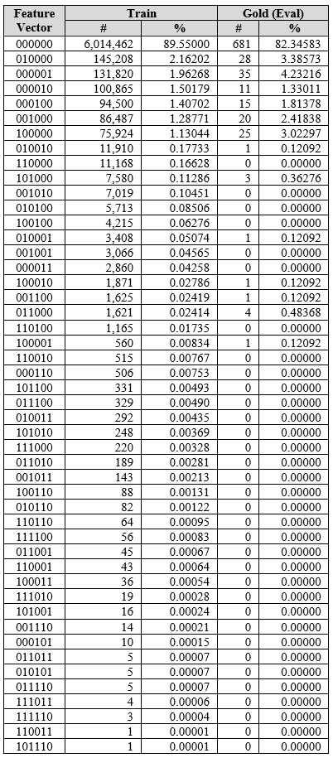
Dataset Imbalance
Distribution Analysis:
Binary feature vectors track presence/absence of six conditions (1dAVb, RBBB, LBBB, SB, AF, ST).
The vast majority of records in both training and evaluation sets are healthy cases.
Single disease occurrences represent less than 10% of total dataset.
Multiple disease combinations appear in very, very small fractions, yet this is what makes this problem challenging.
The gold standard evaluation dataset particularly lacks representation of multiple disease cases.
Impact on Model Development:
Severe imbalance creates training challenges (e.g. risk of model bias towards healthy cases)
Harder to detect multiple concurrent conditions
Limited examples of multiple diseases affects a model's ability to learn disease interactions

Slide 9
Relevant Prior Art
Foundational Study:
Ribeiro et al. [5]:
Modified ResNet model trained on 2M+ ECG exams using a 12-lead ECG
Preprocessing steps:
400 Hz resampling
Zero-padding to 4096 samples
Derived channel inclusion
Z-score normalization
Results outperformed cardiology residents
Did not investigate preprocessing impact
Recent Lead Reduction Studies:
Pastika et al. [6]:
8-lead ECGs for body mass index prediction
Demonstrated viability of reduced leads
von Bachmann et al. [7]:
8-lead approach for electrolyte prediction
Limited exploration of lead reduction rationale
Noted redundancy in derived channels

Slide 10
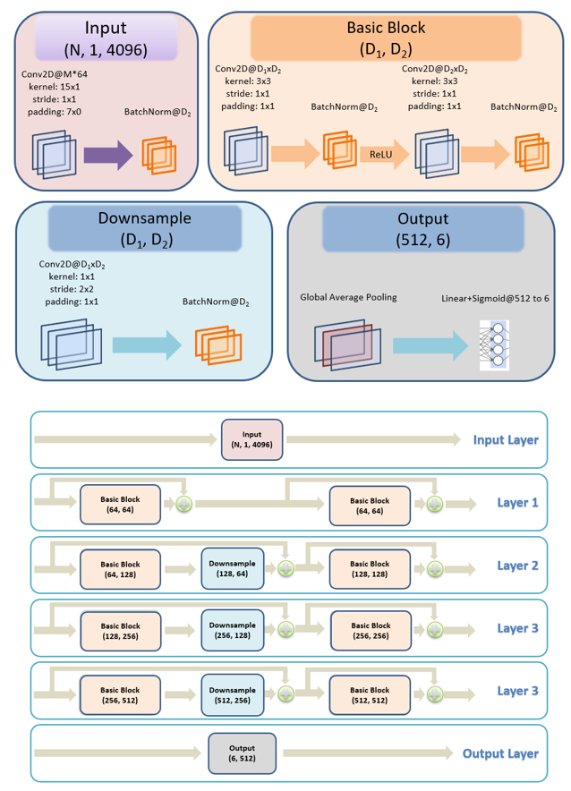
ResNet18 Model Implementation
Data Preprocessing:
Time-series ECG data converted to 3D tensors
Zero-padding to $4,096$ samples
Z-score normalization for standardization
Final tensor shape: $(N, 1, 4096)$
$N = number of ECG channels (8 or 12)$
Singleton dimension for temporal processing
Model Modifications:
Adapted ResNet18 for multi-label classification
Modified first layer for 8/12 channel input
Final layer outputs 6 condition probabilities
Sigmoid activation for multi-label output
Training Parameters:
Adam optimizer
Learning rate: $0.001$
Binary Cross-Entropy loss:
$$BCE\left(y, ŷ\right)= −\frac{1}{n}\sum_{i=0}^{n−1}{\begin{aligned}\left[y_{i}\log\left(ŷ_{i}\right)+\left(1−y_{i}\right)\log\left(1−ŷ_{i}\right)\right] \end{aligned}}$$
where:
$$n= number of classes$$
$$y_{i}= true label$$
$${\hat{y}}_{i}= predicted probability$$

Slide 11
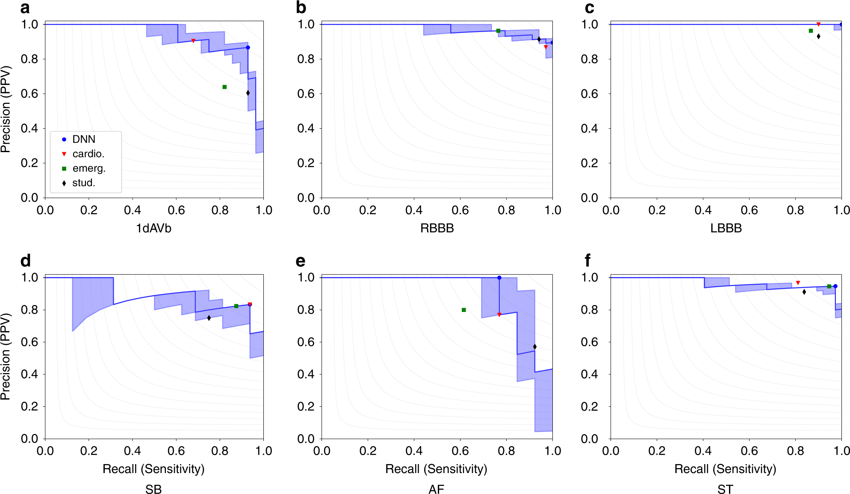
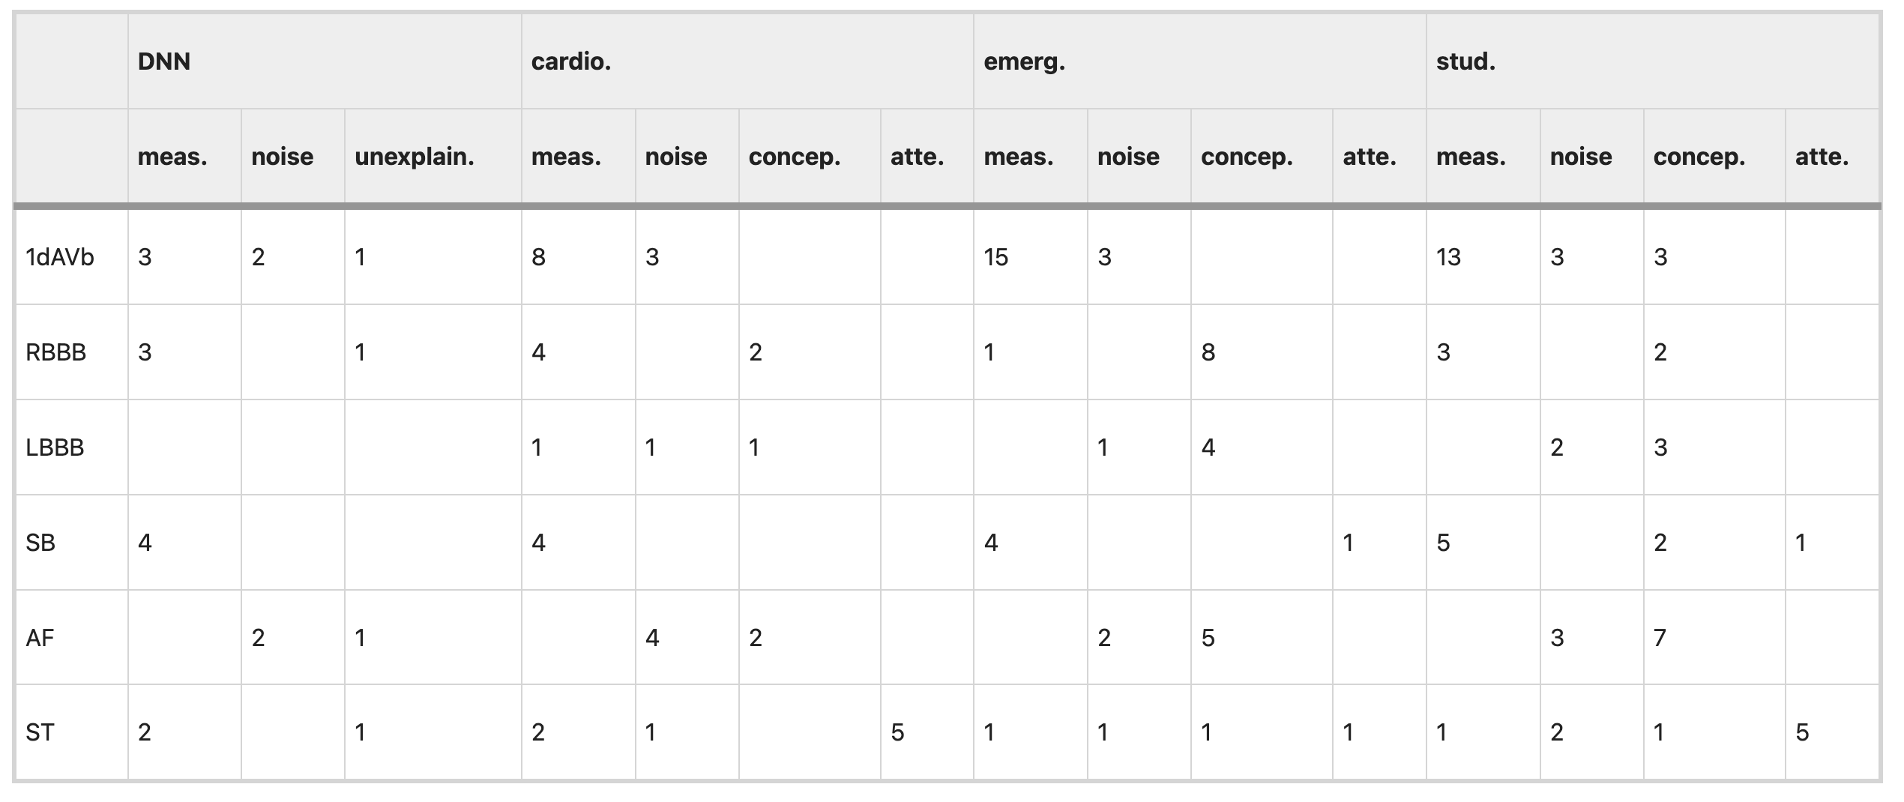
Training Process and Performance Metrics
Training Parameters:
Epochs: 10, batch size: 32
Monitored: training/validation losses, accuracy, F1 scores
Evaluated both raw and minimally preprocessed signals
Performance Metrics:
Multi-label classification requires comprehensive metrics
Primary metrics: Micro and Macro F1 scores
Micro F1 Score:
$Micro F1=2 ∗ \frac{\left(Precision ∗Recall\right)}{\left(Precision+Recall\right)}$,
$Precision= \frac{TP}{TP+FP}$,
$Recall=\frac{TP}{TP+FN}$ .
Counts true positives (TP), false positives (FP), false negatives (FN)
Weights frequent classes more heavily
Macro F1 Score:
Calculates F1 independently for each class • Averages scores across classes
Gives equal weight regardless of class frequency • Better for imbalanced datasets

Slide 12
Experimental Design
Dataset Configurations:
Four training set sizes: 2K, 20K, 200K, 2,000K
Each tested with 8 and 12 channels
12-channel preprocessing: 400 Hz resampling, 2x amplitude scaling
Development Set Structure:
Fixed 5,000 records for all experiments
Balanced distribution:
4,000 records: single conditions and healthy cases
750 records: two conditions
249 records: three conditions
1 record: four conditions
Evaluation Method:
Separate ResNet18 model for each experiment
Performance tested on golden dataset
Development set monitored for overfitting
Class balance maintained where possible
Larger datasets required more healthy records

Slide 13
Results
Channel Performance:
8-channel models consistently outperformed 12-channel models
Performance gap largest in smaller datasets
Difference decreased with larger training sets
Dataset Size Impact (2,000K Records):
Significant performance decline in both configurations
Root cause: Class imbalance issues
Higher proportion of healthy records skewed predictions
Model bias toward majority class
Reduced accuracy for rare condition combinations
Development vs. Evaluation Performance:
2,000K models:
Poor performance on balanced development set
Better performance on evaluation set
Explained by similar healthy record distribution in training and evaluation
Highlights critical importance of dataset composition
Demonstrates impact of class balance on model reliability
Train Size | No. Chans | Train | Dev | Eval
2K | 8 | 0.8810 | 0.7024 | 0.5029
2K | 12 | 0.8690 | 0.7050 | 0.2127
20K | 8 | 0.8870 | 0.8288 | 0.7022
20K | 12 | 0.8812 | 0.8366 | 0.5509
200K | 8 | 0.9310 | 0.8461 | 0.8421
200K | 12 | 0.9286 | 0.8545 | 0.7956
2,000K | 8 | 0.8809 | 0.7787 | 0.8649
2,000K | 12 | 0.8787 | 0.7708 | 0.8522

Slide 14
Variance Experiments
Variance Experiments:
Tested 8-channel data with 2K, 20K, 200K datasets
5 independent training runs per size
Different random seeds for each run
Evaluated data shuffling and model initialization impact
Statistical Significance (95% Confidence):
2K dataset: F1 difference > 0.0174 significant
20K dataset: F1 difference > 0.0054 significant
200K dataset: F1 difference > 0.0017 significant
Standard deviation decreases with larger datasets
Key Implications:
Deep learning systems are highly sensitive to randomization
Reproducibility remains a significant challenge
8-channel performance statistically equivalent to 12-channel
Suggests deep learning can replace traditional signal processing
Model learns necessary feature extraction independently
Data | Train | Dev | Eval
2K 8 Channels (1) | 0.8898 | 0.7235 | 0.4596
2K 8 Channels (2) | 0.8747 | 0.7047 | 0.4569
2K 8 Channels (3) | 0.8766 | 0.7074 | 0.5111
2K 8 Channels (4) | 0.8892 | 0.7163 | 0.4426
2K 8 Channels (5) | 0.8720 | 0.6876 | 0.5251
StDev | 0.0084 | 0.0136 | 0.0366
20K 8 Channels (1) | 0.8887 | 0.8187 | 0.7335
20K 8 Channels (2) | 0.8852 | 0.8132 | 0.7214
20K 8 Channels (3) | 0.8880 | 0.8229 | 0.6897
20K 8 Channels (4) | 0.8884 | 0.8241 | 0.6729
20K 8 Channels (5) | 0.8882 | 0.8243 | 0.6905
StDev | 0.0014 | 0.0047 | 0.0249
200K 8 Channels (1) | 0.9312 | 0.8534 | 0.8251
200K 8 Channels (2) | 0.9298 | 0.8523 | 0.8278
200K 8 Channels (3) | 0.9307 | 0.8510 | 0.7831
200K 8 Channels (4) | 0.9318 | 0.8451 | 0.8278
200K 8 Channels (5) | 0.9298 | 0.8481 | 0.7752
StDev | 0.0009 | 0.0034 | 0.0263

Slide 15
Ablation Analysis
Ablation Process:
Systematically evaluates each channel's importance
Tests model performance when channels are “damaged”
Reveals which features are truly essential
Methodology:
Start with fully trained model
For each channel:
Randomly scramble channel's data
Keep other channels intact
Measure performance drop
Repeat 250 times for reliability and average the results
Calculate importance:
Higher performance drop = More important channel
Negative impact = Channel potentially harmful
Near-zero impact = Redundant channel

Slide 16
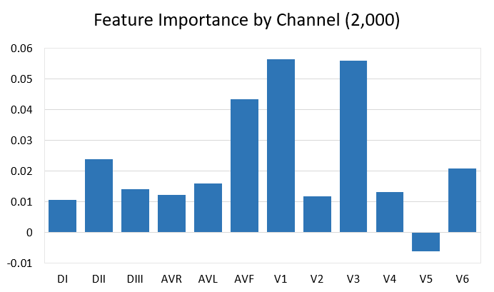
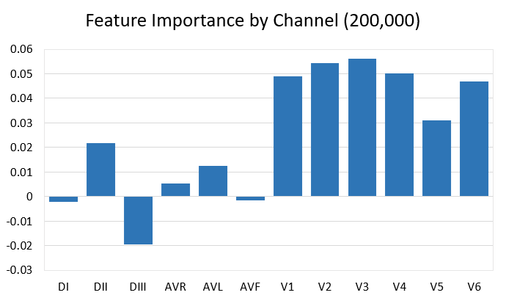
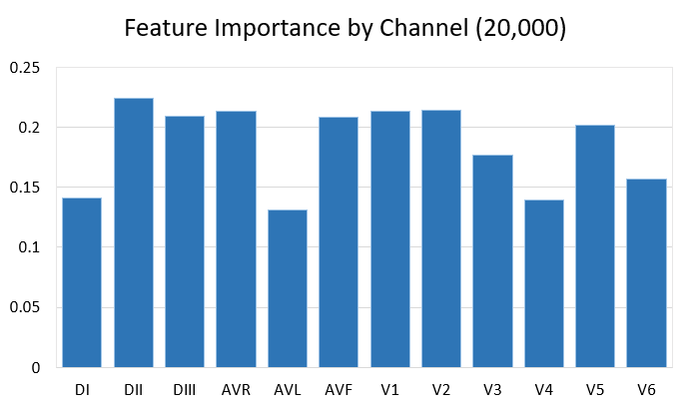
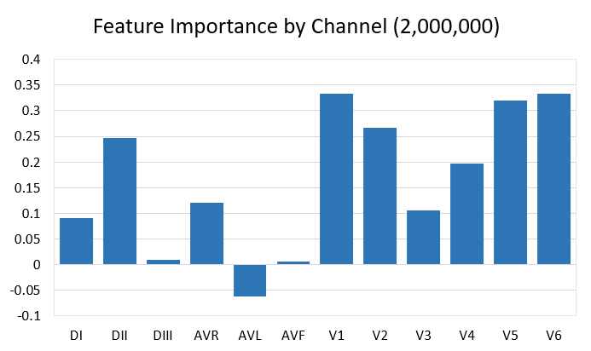
Ablation Analysis Results

Slide 17
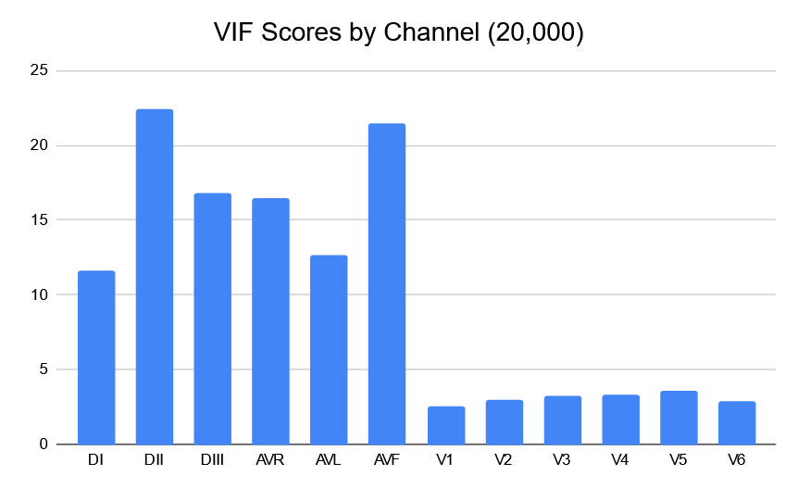
Variance Inflation Factor (VIF) Analysis
Variance Inflation Factor (VIF) Analysis:
Conducted on 20,000 balanced ECG recordings
Measures how much variables overlap/correlate
Higher VIF = More redundant information
Standard threshold: VIF > 5.0 indicates high redundancy
How VIF Works:
Regresses each variable against all others
Measures increase in variance due to correlations
$VIF = 1/(1−R²)$ where $R²$ is from regression
Example: VIF of 4 means 4x more variance due to correlation
Results:
Limb Leads (DI, DII):
Very high VIF: 11.64 - 22.38
Shows severe redundancy
Derived Channels (DIII, aVR, aVL, aVF):
High VIF: 12.69 - 21.48
Confirms redundant information
Precordial Leads (V1-V6):
Low VIF: 2.60 - 3.63 (well below 5.0 threshold)
Indicates unique, independent signals

Slide 18
Conclusions and Future Work
Key Findings:
ECG preprocessing may be unnecessary for deep learning
Raw signal models outperform preprocessed ones
Derived channels show minimal or negative impact
Deep learning can extract features without manual engineering
Simpler approach yields more robust results
Research Impact:
Challenges traditional ECG analysis assumptions
Demonstrates deep learning's pattern extraction capability
Suggests streamlined diagnostic pipeline
Potential for more accurate cardiac diagnosis
Reduces complexity in model development
Future Work:
Additional 8-channel experiments planned
Compare raw vs. preprocessed 8-channel signals
Isolate preprocessing effects on primary leads
Evaluate impact without derived channels
Focus on raw signal processing optimization

Slide 19
Acknowledgements
We would like to express our gratitude to Ribeiro et al. for providing the TNMG CODE dataset used in this study, which was instrumental in our analysis.
This material is based upon work supported in part by the by the Temple University Office of the Vice President for Research, and by the Temple University College of Science and Technology Research Experience for Undergraduates program. Any opinions, findings, and conclusions or recommendations expressed in this material are those of the author(s) and do not necessarily reflect the views of Temple University.

Slide 20
Selected References
K. He et al., “Deep Residual Learning for Image Recognition,” in Proceedings of the IEEE/CVF Conference on Computer Vision and Pattern Recognition (CVPR), 2016.
V. Khalkhali et al., “Low Latency Real-Time Seizure Detection Using Transfer Deep Learning,” in Proceedings of the IEEE Signal Processing in Medicine and Biology Symposium (SPMB), 2021.
M. Bagritsevich et al., “Annotation of the Fox Chase Cancer Center Digital Pathology Corpus,” in Proceedings of the IEEE Signal Processing in Medicine and Biology Symposium, 2024.
A. Paroya et al., “Cardiovascular Disease Detection Using 12-Lead Electrocariodgram (ECG) Machine Learning,” in Senior Design I, College of Engineering, Temple University, 2023.
A. H. Ribeiro et al., “Automatic diagnosis of the 12-lead ECG using a deep neural network,” Nature Communications, 2020.
L. Pastika et al., “Artificial intelligence-enhanced electrocardiography derived body mass index,” npj Digital Medicine, 2024.
P. von Bachmann et al., “Evaluating regression and probabilistic methods for ECG-based electrolyte prediction,” Scientific Reports, 2024.
D. P. Kingma and J. L. Ba, “Adam: A Method for Stochastic Optimization,” International Conference on Learning Representations, 2015.
A. Mao et al., “Cross-Entropy Loss Functions: Theoretical Analysis and Applications,” International Conference on Machine Learning, 2023.
I. C. Mogotsi, “Introduction to information retrieval,” Information Retrieval, 2010.
R. Meyes et al., “Ablation Studies in Artificial Neural Networks,” 2019.
M. H. Graham, “Confronting Multicollinearity in Ecological Multiple Regression,” Ecology, 2003.

