Slide 1
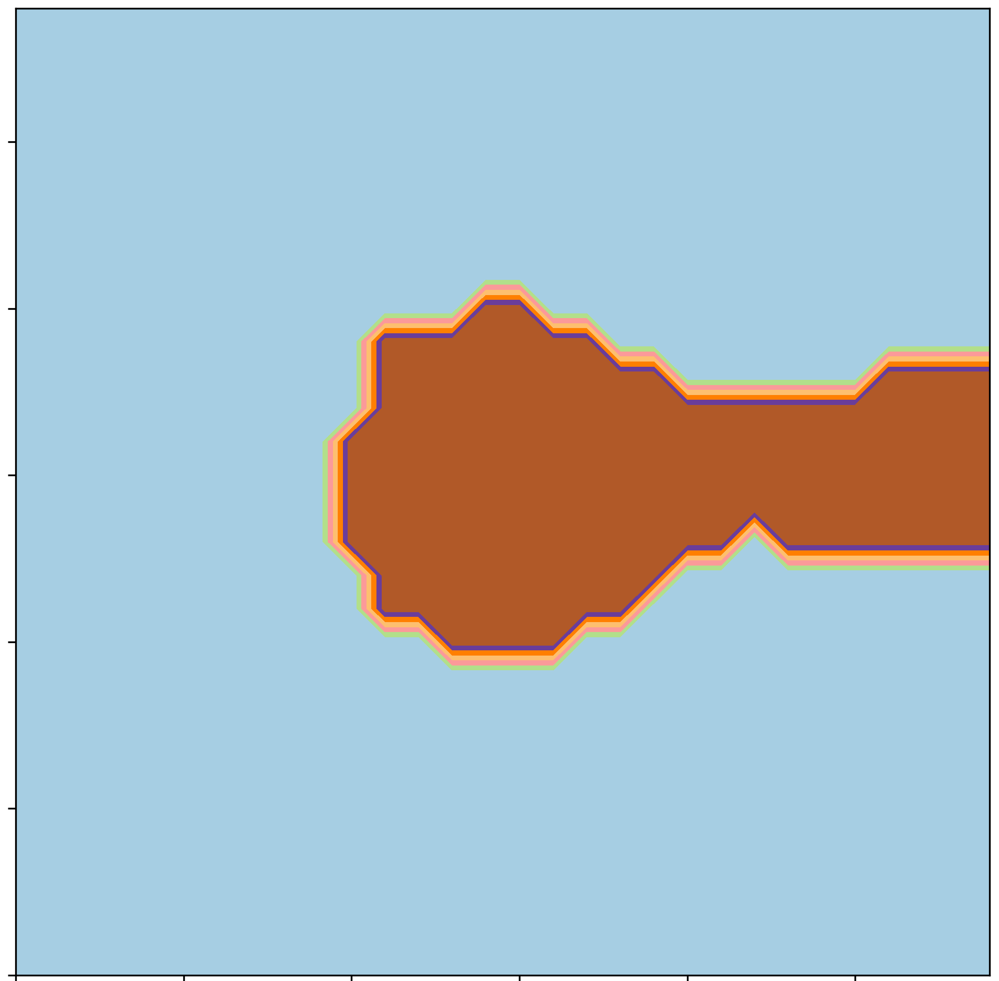
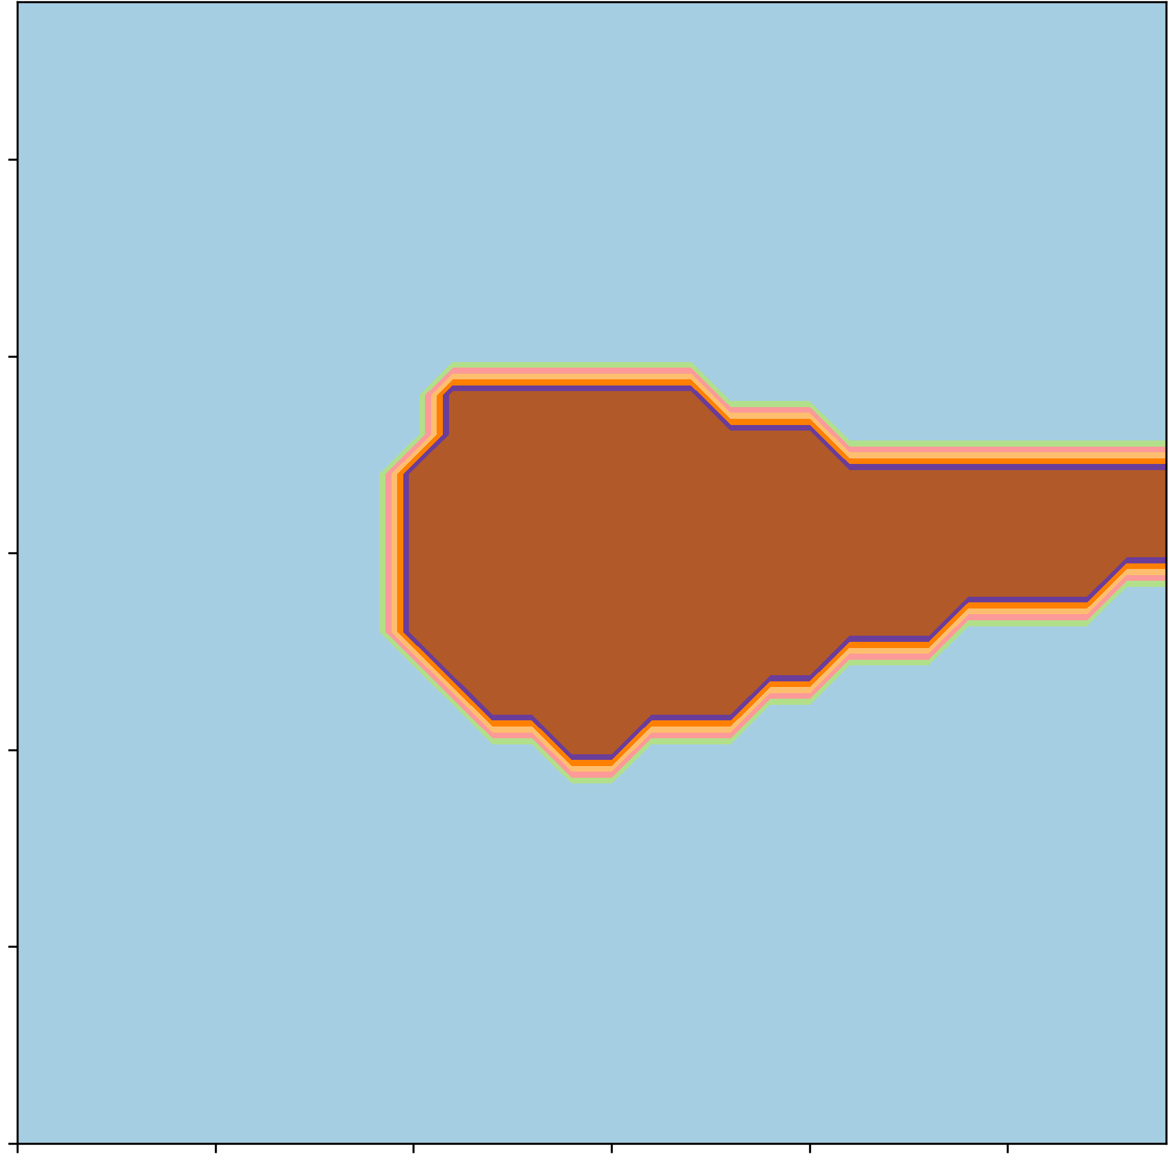
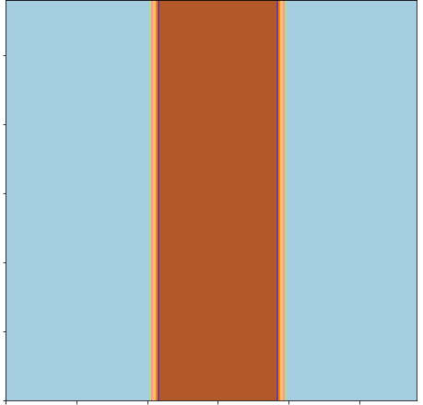
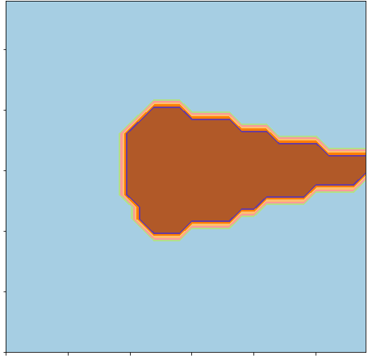
MLP-M1
MLP-M2
1.0
0.0
-1.0
MLP-A1
MLP-A2
1.0
0.0
-1.0
-1.0
-1.0
Class 0
Class 1
0.0
0.0
1.0
1.0

