Slide 1
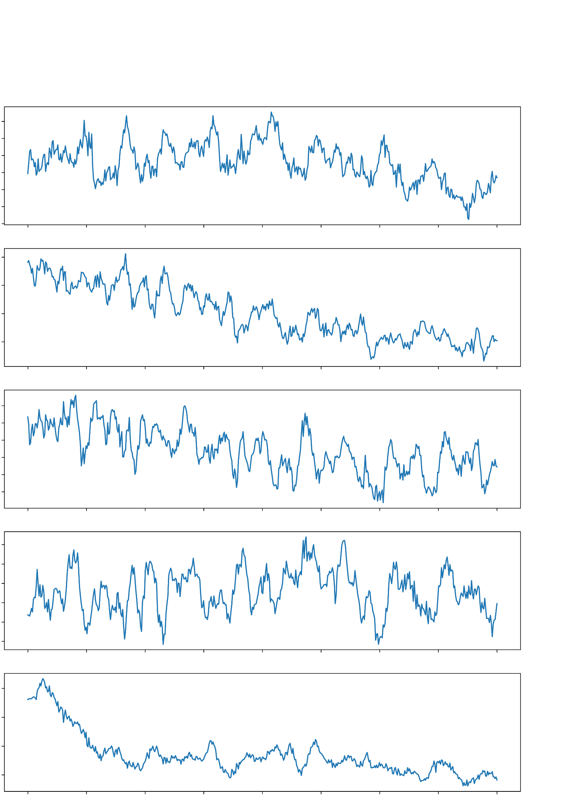
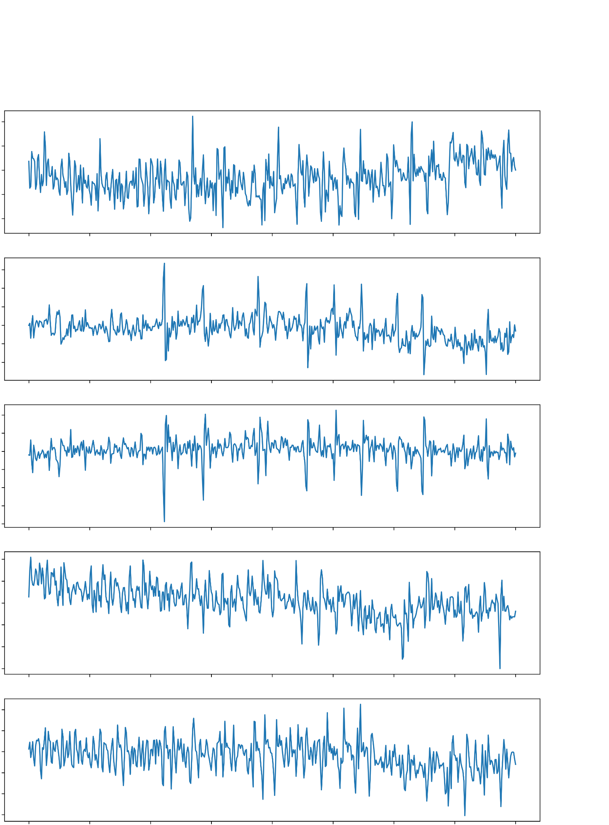
FP1-F7
F7-T3
T3-T5
T5-O1
FP2-F8
3.0
4.0
5.0
3.0
4.0
5.0
BCKG
SEIZ

Slide 2
FP1-F7
F7-T3
T3-T5
T5-O1
FP2-F8
3.0
4.0
5.0
3.0
4.0
5.0
BCKG
SEIZ

