Slide 1
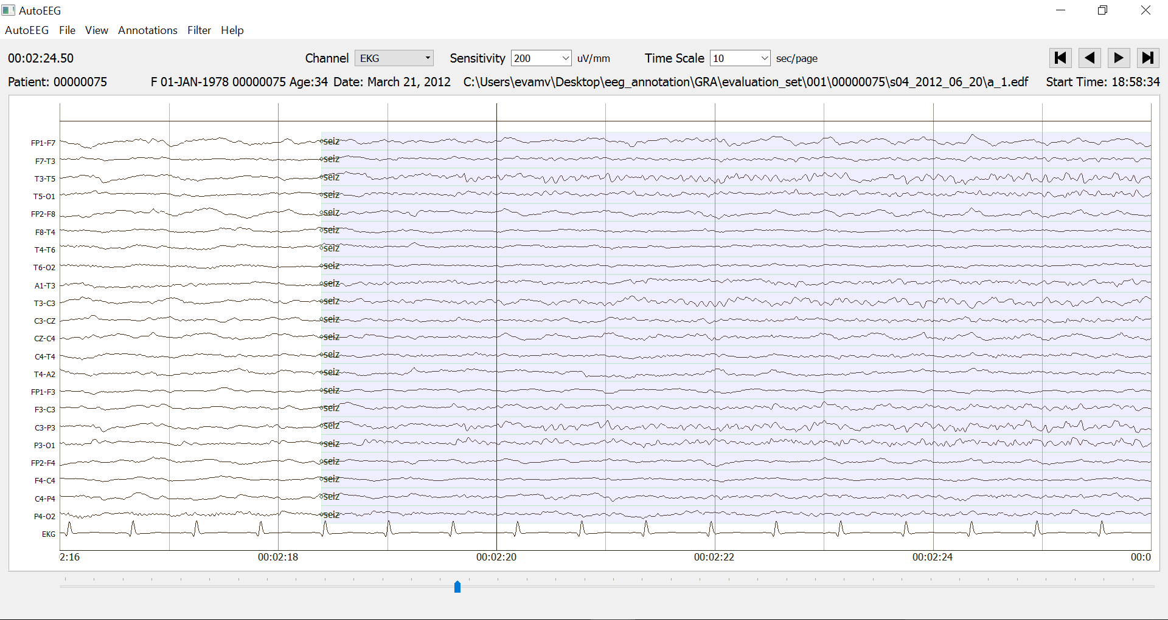
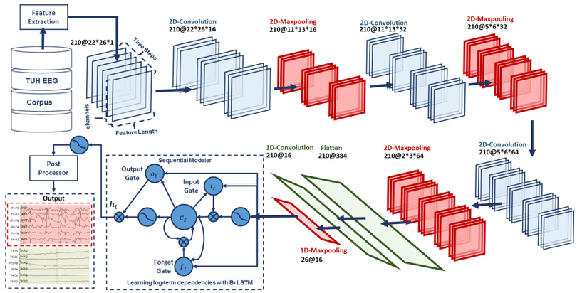
GATED RECURRENT NETWORKS
FOR SEIZURE DETECTION
M. Golmohammadi, S. Ziyabari, V. Shah, E. Von Weltin, C. Campbell, I. Obeid and J. Picone
Neural Engineering Data Consortium
Temple University

Slide 2
Abstract
Recurrent Neural Networks (RNNs) with sophisticated units that implement a gating mechanism have emerged as powerful technique for modeling sequential signals such as speech, images or electroencephalography (EEG).
A significant big data resource, known as the TUH EEG Corpus, has recently become available for EEG research, creating a unique opportunity to evaluate these recurrent units on the task of seizure detection.
In this study, we compare two types of recurrent units: long short-term memory units (LSTM) and gated recurrent units (GRU).
These are evaluated using a state of the art hybrid architecture that integrates Convolutional Neural Networks (CNNs) with RNNs.
We also investigate a variety of initialization methods and show that initialization is crucial since poorly initialized networks cannot be trained.
Furthermore, we explore regularization of a convolutional gated recurrent network (CGRN) to address the problem of overfitting.
Our experiments revealed that CNN/LSTM networks can achieve significantly better performance than CNN/GRU networks. This architecture delivers 30% sensitivity at 6 false alarms per 24 hours.

Slide 3
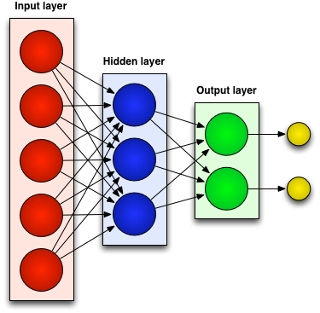
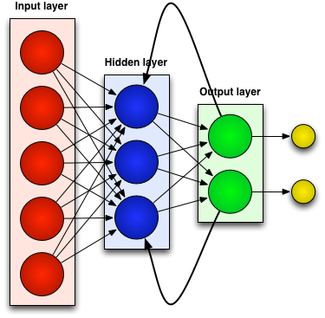
Neural Networks
There are two kinds of neural networks:
Feedforward Neural Networks:
Connections between the units do not form a cycle.
Allow signals to travel one way only; from input to output.
Recurrent Neural Networks:
Connections between units form cyclic paths
Networks can have signals traveling in both directions by introducing loops in the network.

Slide 4
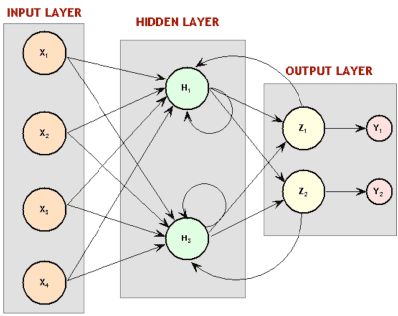
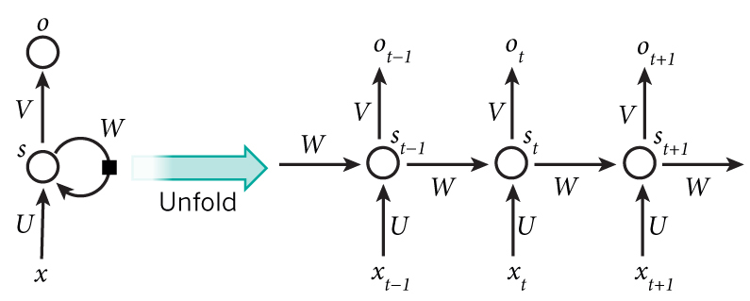
Recurrent Neural Network (RNN)
A neural network with memory.
Captures the dynamics of sequences via cycles in the network of nodes.
Receives inputs, updates the hidden states depending on the previous computations, and makes predictions for every element of a sequence.
RNNs have been very successful for sequential tasks such as speech and handwriting recognition.
They maintain a state vector that implicitly contains information about the history of all the past elements of a sequence.
Notes:
RNNs are called recurrent …
We can consider RNNs as …
RNNs are very …

Slide 5
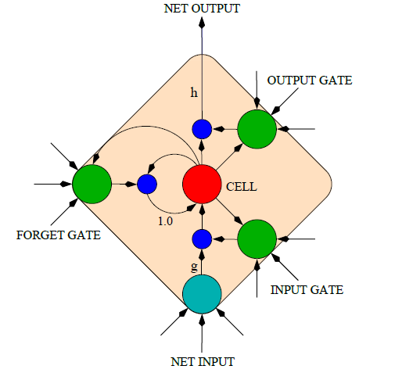
Long Short-Term Memory (LSTM)
An LSTM is a gated recurrent neural network, capable of learning long-term dependencies.
An LSTM can learn to bridge time intervals in excess of 1000 steps:
This is achieved by multiplicative gate units that learn to open and close access to the constant error flow.
These gates allow the cells to keep and access information over long periods of time.
LSTM networks introduce a new structure called a memory cell.
Each memory cell contains four elements:
Input gate
Forget gate
Output gate
Neuron with a self-recurrent connection.
LSTM Memory Cell

Slide 6
LSTM Equations
$i_{t}$: input gate, how much of the new information will be let through the memory cell.
$f_{t}$: forget gate, responsible for information should be thrown away from memory cell.
$c_{t}$: internal memory of the memory cell.
$o_{t}$: output gate, how much of the information will be passed to expose to the next time step.
$s_{t}$: block output at time instance t
$x_{t}:$input at time t
$i_{t}= σ\left({U^{i}x}_{t}+W^{i}s_{t−1}+p^{i}∘c_{t−1}+b^{i}\right)$
$f_{t}= σ\left({U^{f}x}_{t}+W^{f}s_{t−1}+p^{f}∘c_{t−1}+b^{f}\right)$
$c_{t}=f_{t}∘c_{t−1}+i_{t}∘g({U^{c}x}_{t}+W^{c}s_{t−1}+b^{c})$
$o_{t}= σ\left({U^{o}x}_{t}+W^{o}s_{t−1}+p^{o}∘c_{t}+b^{o}\right)$
$s_{t}= o_{t}∘g(c_{t})$

Slide 7
LSTM Equations
$U^{∗}:$ the weight matrices applied on input
$W^{∗}:$the weight matrices applied on recurrent hidden units
$σ\left(.\right):$sigmoid activation functions
$g\left(.\right)$: tangent activation functions
$p^{∗}:$peep-hole connections
$b^{∗}:$biases
$∘:$ element-wise product
$i_{t}= σ\left({U^{i}x}_{t}+W^{i}s_{t−1}+p^{i}∘c_{t−1}+b^{i}\right)$
$f_{t}= σ\left({U^{f}x}_{t}+W^{f}s_{t−1}+p^{f}∘c_{t−1}+b^{f}\right)$
$c_{t}=f_{t}∘c_{t−1}+i_{t}∘g({U^{c}x}_{t}+W^{c}s_{t−1}+b^{c})$
$o_{t}= σ\left({U^{o}x}_{t}+W^{o}s_{t−1}+p^{o}∘c_{t}+b^{o}\right)$
$s_{t}= o_{t}∘g(c_{t})$

Slide 8
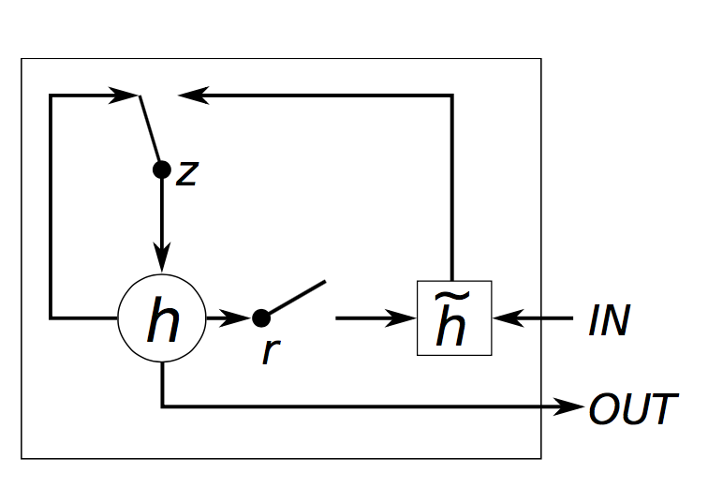
Gated Recurrent Unit (GRU)
GRU architecture is similar to LSTM but without a separate memory cell.
Unlike LSTM, a GRU does not include output activation functions and peep-hole connections.
It also integrates the input and forget gates into an update gate, $z_{t}$, to balance between the previous activation,$h_{t−1}$, and the candidate activation,${\tilde{ h}}_{t}$.
The reset gate, $r_{t}$, allows it to forget the previous state.
GRU equations:
$$r_{t}= σ\left({U^{r}x}_{t}+W^{r}h_{t−1}+b^{r}\right)$$
$$z_{t}= σ\left({U^{z}x}_{t}+W^{z}h_{t−1}+b^{z}\right)$$
$$h_{t}= g({U^{s}x}_{t}+r_{t}∘\left(W^{s}h_{t−1}\right)+b^{s}$$
$$h_{t}= z_{t}∘h_{t−1}+\left(1− z_{t}\right)∘ {\tilde{h}}_{t}$$

Slide 9
CNN/RNN Architecture
A hybrid architecture that integrates Convolutional Neural Networks (CNNs) used for temporal and spatial context analysis, with RNNs used for learning long-term dependencies.
Integrates 2D CNNs, 2D max-poolings, 1D CNNs, 1D max-poolings and RNNs.

Slide 10
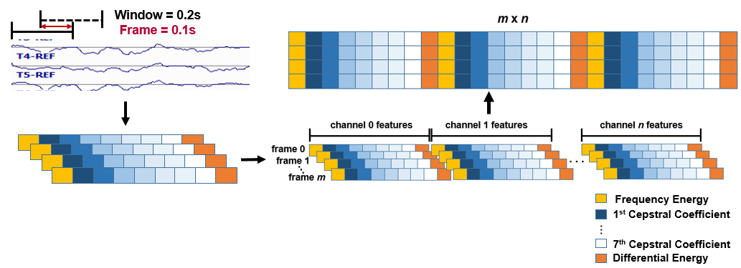
Feature Extraction
A 22-channel EEG is transformed into 22 independent feature streams using standard Linear Frequency Cepstral Coefficients (LFCCs).
We analyze the signal in 1-sec epochs, and further divide this interval into 10 frames of 0.1 secs each so that features are computed every 0.1 seconds using 0.2-second analysis windows.
The output of our feature extraction process is a feature vector of dimension 26 for each of 22 channels, with a frame duration of 0.1 secs.

Slide 11
Data Preparation For CNNs
In our optimized system, the window duration is 21 seconds.
10 feature frames per second
with feature length of 26.
22 Channels
21 seconds
Input data to the first layer of CNNs is composed of frames:
W = 26: length of a feature vector
H = 22: number of EEG channels
N = 1: number of color channels
T = 210: the window length x the number of frames per/second

Slide 12
Two-Dimensional Convolutional Neural Networks
CNNs are comprised of convolutional layers along with subsampling layers which are followed by one or more fully connected layers or RNNs.
In the case of 2D CNNs that are common in image and speech recognition, the input to a convolutional layer is W × H × N data (e.g. an image) where W and H are the width and height of the input data, and N is the number of channels (e.g. in an RGB image, N = 3).
First 2D convolutional layer filters 210 frames (T = 21 × 10) of EEGs distributed in time with a size of 26 × 22 × 1 (W=26, H=22, N=1) using 16 kernels of size 3 × 3 and with a stride of 1.
The first 2D max pooling layer takes as input a vector which is 210 frames distributed in time with a size of 26 × 22 × 16 and applies a pooling size of 2 × 2.
This process is repeated two times with two 2D convolutional layers with 32 and 64 kernels of size 3 × 3 respectively and two 2D max pooling layers with a pooling size of 2 × 2.

Slide 13
One-Dimensional Convolutional Neural Networks
1D convolution layer (e.g. temporal convolution) creates a convolution kernel that is convolved with the layer input over a single spatial (or temporal) dimension to produce a tensor of outputs.
The output of the third max pooling layer is flattened to 210 frames with a size of 384 × 1.
A 1D convolutional layer filters the output of the flattening layer using 16 kernels of size 3 which decreases the dimensionality in space to 210 × 16.
Apply a 1D maxpooling layer with a size of 8 to decrease the dimensionality to 26 × 16.
This output becomes the input to a deep bidirectional LSTM network.
Periodically inserting a pooling layer in between successive convolutional layers reduces the spatial and temporal size.
Reduces the number of parameters and amount of computation.
Controls overfitting.

Slide 14
Deep Bidirectional LSTM Networks
The input dimension to the deep bidirectional LSTM network is 26 × 16.
The dimensionality of the output space for the first and second LSTM is 128 and 256 respectively.
The output of the last bidirectional LSTM layer is fed to a 2-way sigmoid function which produces a final classification of an epoch.
Epochs are typically 1 sec in duration.
Regularizations are used in first two layers of CNNs.
To increase nonlinearity, Exponential Linear Units (ELU) are used.
Adam is used in the optimization process along with a mean squared error loss function.
A stateless LSTM configuration is used where the internal state is reset after each training batch.
Applying stateful LSTM was not successful, since we cannot leverage shuffling data.

Slide 15
TUH EEG Seizure Subset
Contains over 30,000 sessions collected from 16,000+ patients over period of 14 years at Temple University Hospital.
Deidentified medical reports are available that include a brief patient history and a neurologist’s findings.
EEG data is stored in EDF files and contains anywhere from 19 to 128 channels. In this study we use a standard 10/20 channel configuration.
A subset of this data focused on seizure detection was released that includes a 50-patient evaluation set and a 64-patient training set (publicly available at: https://www.isip.piconepress.com/projects/tuh_eeg/).
Description | TUHS
 | Train | Eval
Patients | 64 | 50
Sessions | 281 | 229
Files | 1,028 | 985
Seizure (secs) | 17,686 | 45,649
Non-Seizure (secs) | 596,696 | 556,033
Total (secs) | 614,382 | 601,682

Slide 16
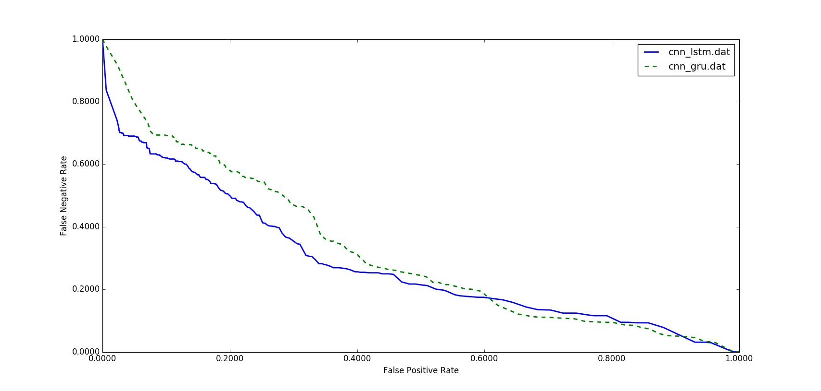
Performance of Convolutional Recurrent Neural Networks
These systems were evaluated using a method of scoring popular in the EEG research community known as the overlap method.
In lower false positive rates, CNN/LSTM has significantly better performance than CNN/GRU.
In the DET curve, we see CNN/LSTM performs better in a region where false alarms are low, which is our region of interest.
While a GRU unit controls the flow of information like an LSTM unit, it does not have a memory unit.
LSTMs can remember longer sequences better than GRUs and outperform it in this task, since seizure detection requires modeling long distance relationships.
System | Sens. | Spec. | FAs per 24 Hrs.
CNN/GRU | 30.8% | 91.5% | 21
CNN/LSTM | 30.8% | 97.1% | 6

Slide 17
Results For Different Initialization Methods
A variety of initialization methods were investigated.
The proper initialization of weights in a convolutional recurrent neural network is critical to convergence.
Initialization with zeros or ones completely stalled the convergence.
FAs for a sensitivity of 30% can change from 7 to 40.
Some initializations can result in the deeper layers receiving inputs with small variances, which in turn slows down back propagation, and retards the overall convergence process.
The best performance is obtained by orthogonal initialization which solves the exploding and vanishing gradient problems by preserving the norm of a vector ‎during matrix multiplications.
Initialization | Sens. | Spec. | FAs
Orthogonal | 30.8% | 96.9% | 7
Lecun Uniform | 30.3% | 96.5% | 8
Glorot Uniform | 31.0% | 94.2% | 13
Glorot Normal | 29.5% | 92.4% | 18
Variance Scaling | 31.8% | 92.1% | 19
Lecun Normal | 31.8% | 92.1% | 19
He Normal | 31.3% | 91.1% | 22
Random Uniform | 30.2% | 90.0% | 25
Truncated Normal | 31.6% | 87.8% | 31
He Uniform | 29.2% | 85.1% | 40

Slide 18
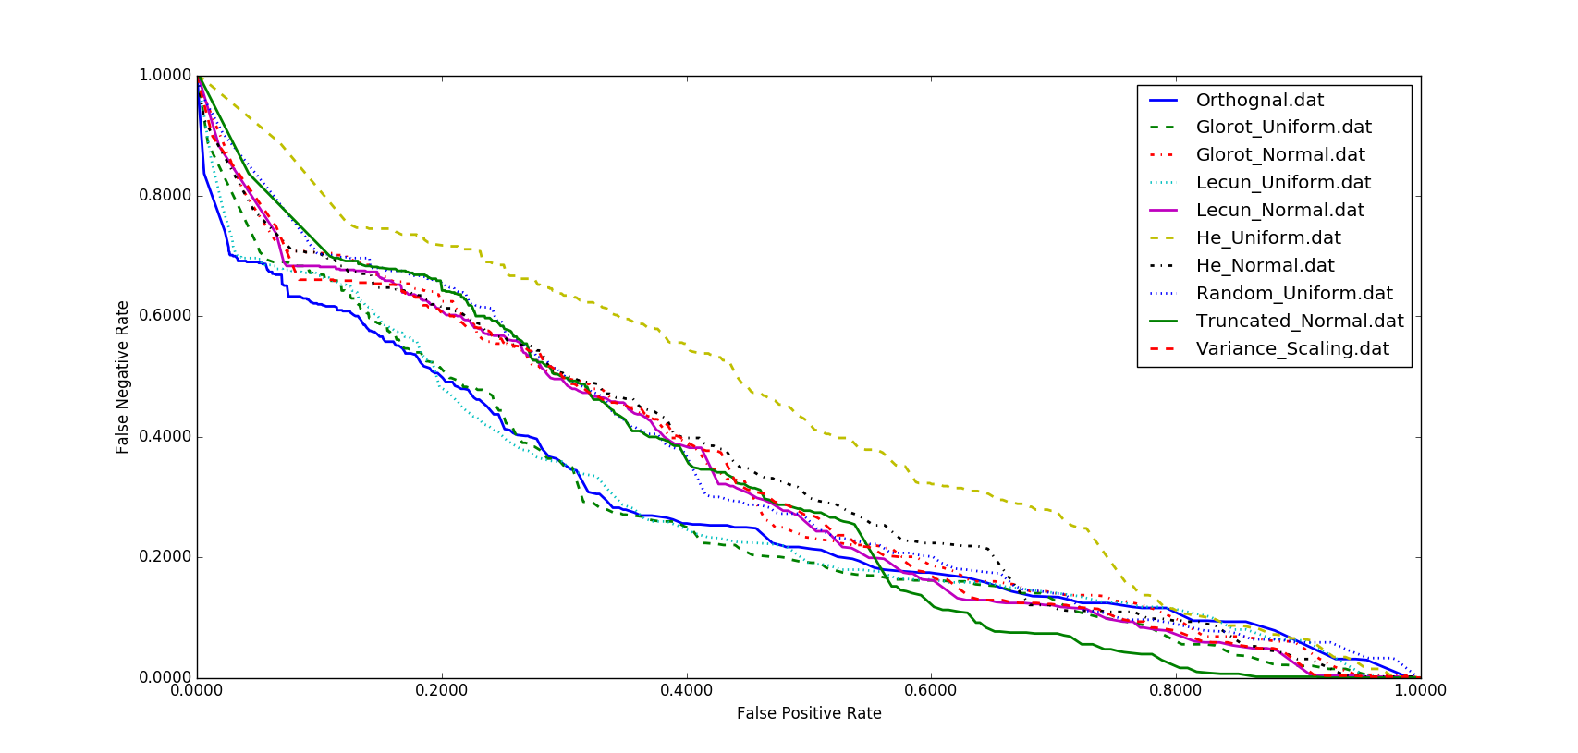
Results For Different Initialization Methods
Most interested in the region where false alarms are low.
He uniform initialization is significantly worse across the board.
Lecun Uniform initialization delivers a performance close to orthogonal initialization.
Orthogonal matrices preserve the norm of a vector ‎and their eigenvalues have absolute value of one. This means that, no matter how many times we perform repeated matrix multiplication, the resulting matrix doesn't explode or vanish.
Also in orthogonal matrices, columns and rows are all orthonormal to one another, which helps the weights to learn different input features.

Slide 19
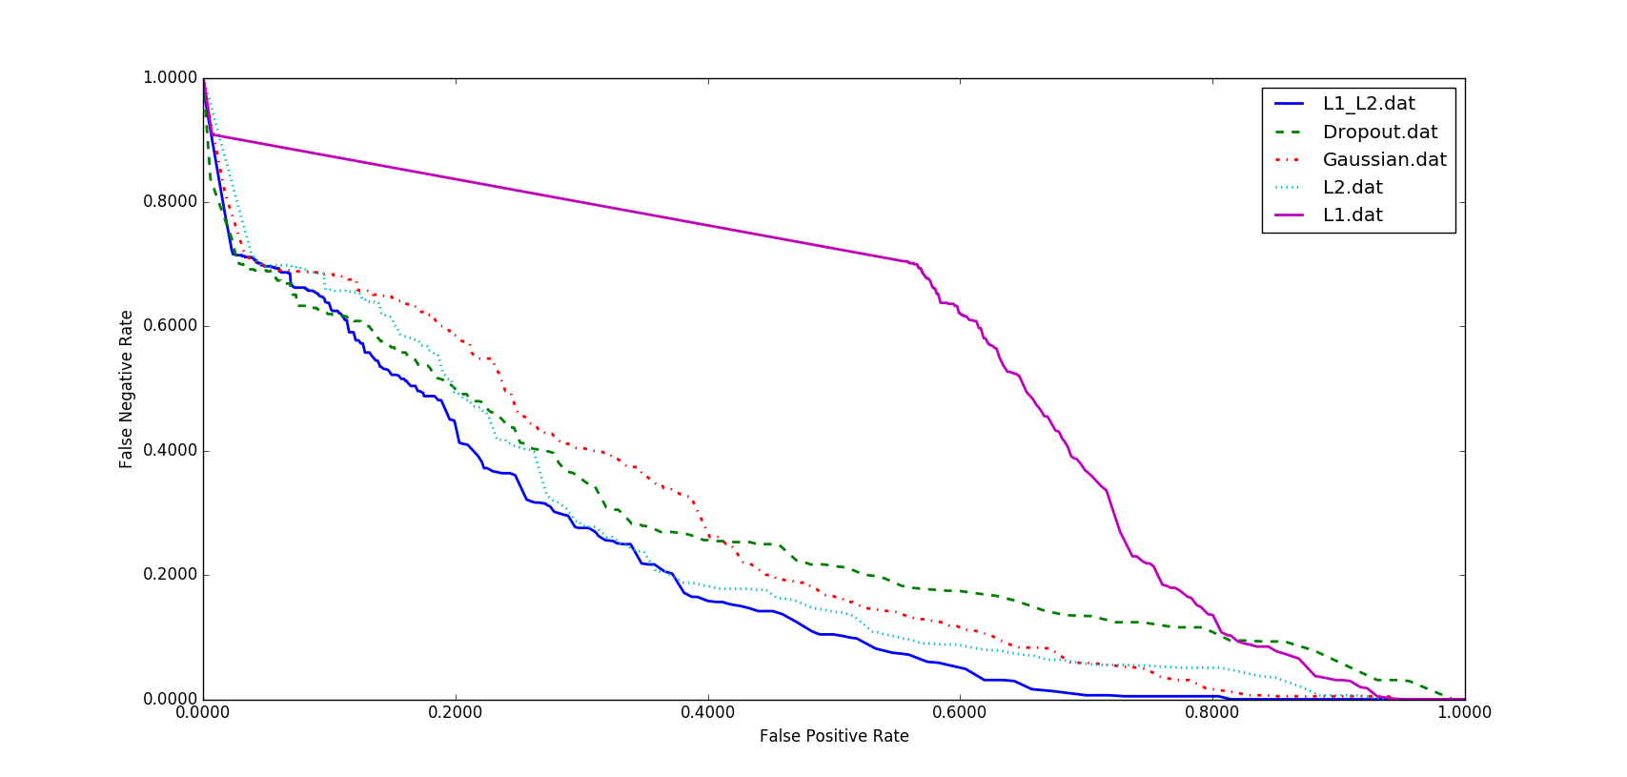
Results For Different Regularizations
Overfitting is a serious problem in deep neural nets.
Five popular regularization methods were investigated to address overfitting.
L1, L2 and L1/L2 techniques apply penalties on layer parameters. These penalties are incorporated in the loss function that the network optimizes.
Zero-centered Gaussian noise were studied as one type of regularization.
Dropout prevents units from co-adapting too much by randomly dropping units and their connections from the neural network during training.
While generally L1/L2 has the best performance, as we move towards a low FA rate, dropout delivers a lower FA rate.
Initialization | Sens. | Spec. | FAs
L1/L2 | 30.8% | 97.1% | 6
Dropout | 30.8% | 96.9% | 7
Gaussian | 30.8% | 95.8% | 9
L2 | 30.2% | 95.6% | 10
L1 | 30.0% | 43.7% | 276

Slide 20
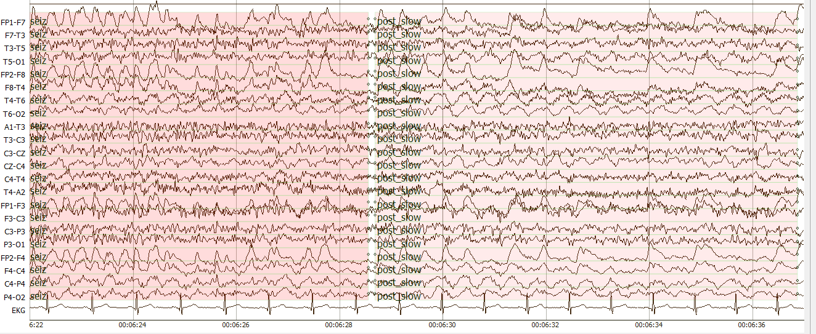
Error Analysis
Primary Error Modalities:
False alarms generated during brief delta range slowing patterns such as intermittent rhythmic delta activity.
Example of a seizure followed by a post-ictal slowing:
Our closed-loop experiments showed us that all the regularizing methods explored in this study are playing an important role in increasing the false alarms of slowing patterns.
Even though dropout is effective in CNNs, when dropout is placed over kernels it leads to diminished results.
Seizure
Slowing

Slide 21
Summary and Future Directions
Summary:
CNN/LSTM outperformed CNN/GRU because unlike GRU, LSTM has a separate memory cell and remembers longer sequences better than GRUs.
Orthogonal initialization provided the best performance because it handles the exploding and vanishing gradient problems.
Future Directions:
An efficient Bayesian convolutional neural network will be explored that places a probability distribution over the CNN’s kernels.
This approach offers better robustness to overfitting of data and improves the robustness of our training process.
We will design a more powerful architecture based on generative adversarial networks and reinforcement learning concepts.
Our goal is to approach human performance which is in the range of 75% sensitivity with a false alarm rate of 1 per 24 hours.
Robust training procedures are needed to make this technology relevant to a wide range of healthcare applications.

Slide 22
Acknowledgments
Research reported in this publication was most recently supported by the National Human Genome Research Institute of the National Institutes of Health under award number U01HG008468.
The content is solely the responsibility of the authors and does not necessarily represent the official views of the National Institutes of Health.
This material is also based in part upon work supported by the National Science Foundation under Grant No. IIP-1622765. Any opinions, findings, and conclusions or recommendations expressed in this material are those of the author(s) and do not necessarily reflect the views of the National Science Foundation.

Slide 23
Brief Bibliography
[1] I. Obeid and J. Picone, “Machine Learning Approaches to Automatic Interpretation of EEGs,” in Biomedical Signal Processing in Big Data, 1st ed., E. Sejdik and T. Falk, Eds. Boca Raton, Florida, USA: CRC Press, 2017.
[2] A. Harati, M. Golmohammadi, S. Lopez, I. Obeid, and J. Picone, “Improved EEG Event Classification Using Differential Energy,” in Proceedings of the IEEE Signal Processing in Medicine and Biology Symposium, 2015, pp. 1–4.
[3] R. Pascanu, T. Mikolov, and Y. Bengio, “On the difficulty of training recurrent neural networks,” in Proceedings of the International Conference on Machine Learning, 2013, no. 2, pp. 1310–1318.
[4] A. Temko, E. Thomas, W. Marnane, G. Lightbody, and G. Boylan, “EEG-based neonatal seizure detection with Support Vector Machines,” Clinical Neurophysiology, vol. 122, no. 3, pp. 464–473, 2011.
[5] A. Graves and J. Schmidhuber, “Framewise phoneme classification with bidirectional LSTM networks,” in Proceedings of the International Joint Conference on Neural Networks, 2005, vol. 4, pp. 2047–2052.
[6] Z. Wu and S. King, "Investigating gated recurrent networks for speech synthesis," 2016 IEEE International Conference on Acoustics, Speech and Signal Processing (ICASSP), Shanghai, 2016, pp. 5140-5144.

