Slide 1
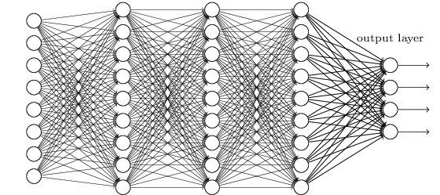
Optimizing Channel Selection for Seizure Detection
V. Shah, M. Golmohammadi, S. Ziyabari, E. Von Weltin, I. Obeid and J. Picone
Neural Engineering Data Consortium
Temple University

Slide 2
Abstract
Clinical scalp EEG records contain many types of artifacts that pose serious challenges for machine learning technology.
Spatial information contained in the placement of the electrodes can be exploited to accurately detect artifacts.
When fewer electrodes are used, less spatial information is available, making it harder to detect artifacts.
In this study, we investigate the performance of a deep learning algorithm, CNN/LSTM, on several channel configurations. Each configuration was designed to minimize the amount of spatial information lost compared to a standard 22-channel EEG.
Baseline performance of a system that used all 22 channels was 39% sensitivity with 23 false alarms.
Systems using a reduced number of channels ranging from 8 to 20 achieved sensitivities between 33% and 37% with false alarms in the range of [38, 50] per 24 hours.
False alarms increased dramatically (e.g., over 300 per 24 hours) when the number of channels was further reduced.

Slide 3
Introduction
Electroencephalography (EEG) is a popular tool used to diagnose brain related illnesses.
The 10-20 system is a universally accepted method for the placement of electrodes for any EEG test or experiment.
Six separate channel configurations were selected to optimize the spatial information specific to the application of seizure detection:
The TUH EEG Seizure Corpus (TUSZ - v1.1.1) was used in this study:
A TCP montage was applied prior to generating features, and standard linear frequency cepstral coefficient (LFCC) features were used.
Seizure Corpus | Version 1.1.1
Dataset | Training set |  | Evaluation set
 | w/seiz | Total | w/seiz | Total
Patients | 71 | 196 | 38 | 50
Sessions | 102 | 456 | 89 | 230
Epochs (sec.) | 51,140 (5.51%) | 928,962 (100.00%) | 53,930 (8.96%) | 601,649 (100.00%)

Slide 4
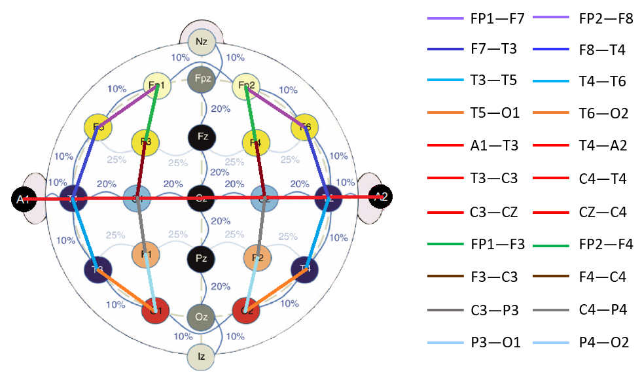
Temporal Central Parasagittal (TCP) Montage
A TCP montage is a type of longitudinal and transverse bipolar montage.
Differential channels, such as FP1-F7 (longitudinal) and C3-CZ (transverse), help in removing static noise and improving spatial information.
Transverse
Longitudinal

Slide 5
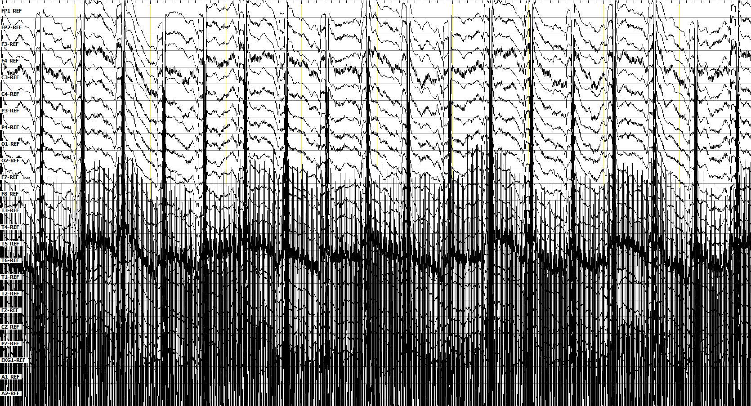
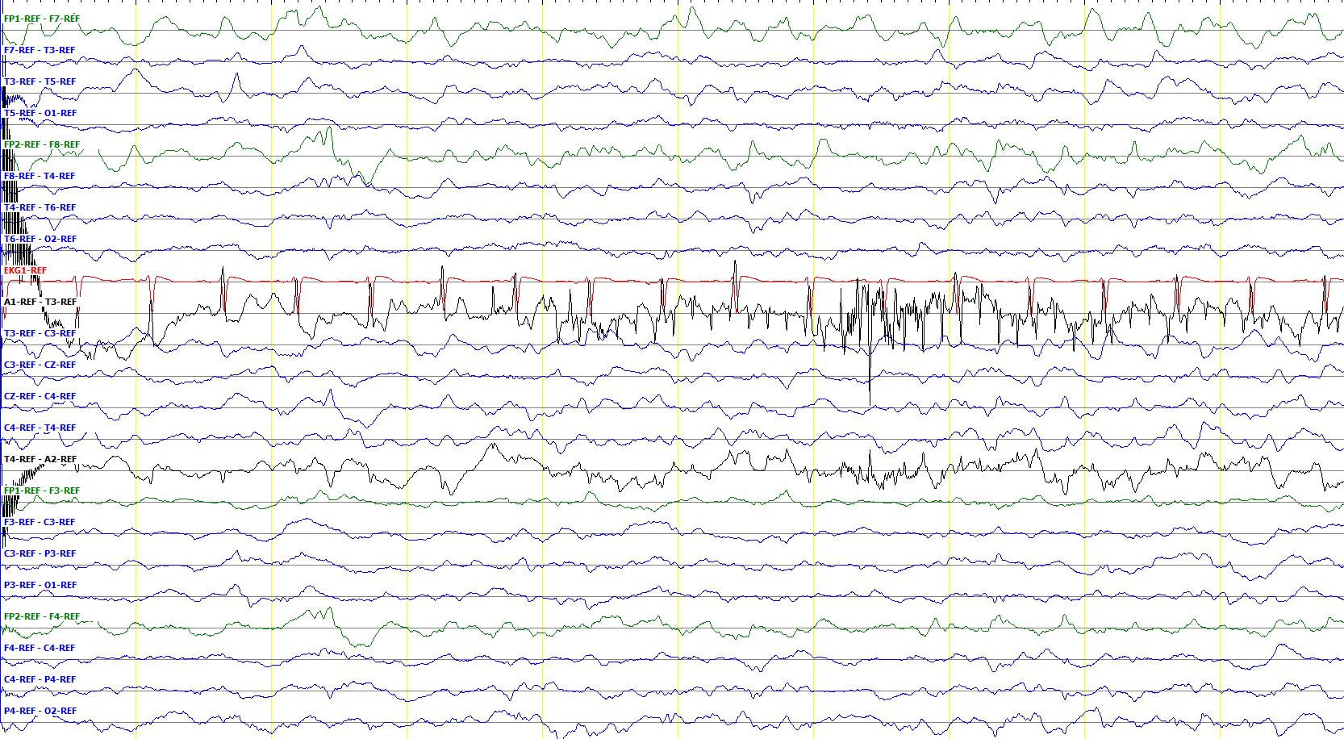
Significance of the Ax Channels
Artifacts
An electrode’s position on the scalp makes it susceptible to specific type of artifacts:
Chewing → T5, T6
Head bobbing → O1, O2
Reference channels Ax are usually noisy because they are attached to the patient’s ears.
Sampled Data
Bipolar montages (TCP) make it easier to differentiate noisy channels from clean signals.
Subtraction of adjacent channels removes noise and makes it easier to determine the locality of an event (e.g., phase reversals)
Artifacts
Phase Reversal
After Application of a TCP Montage

Slide 6
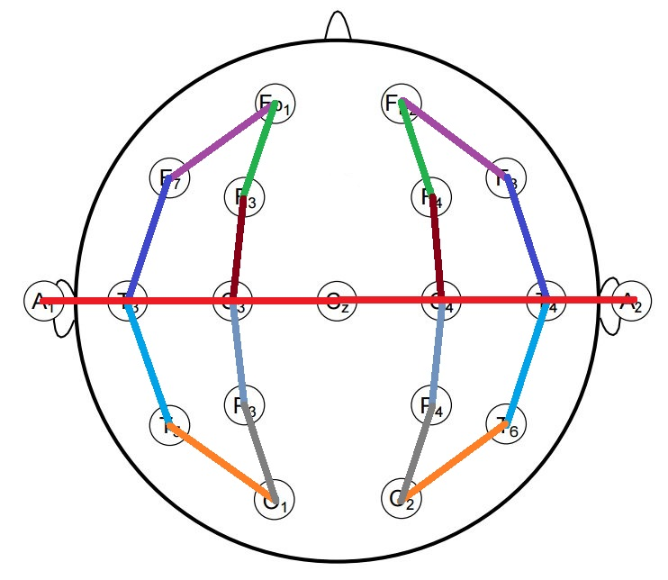
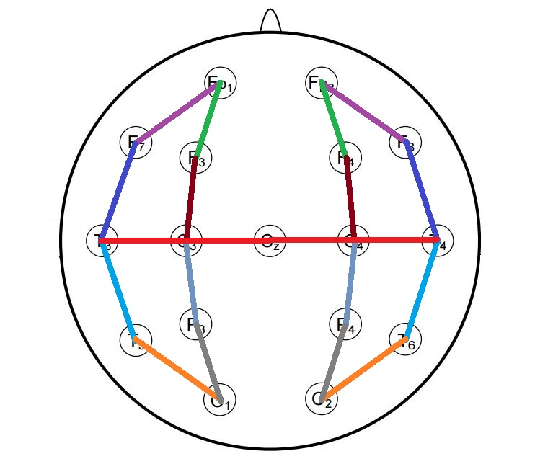
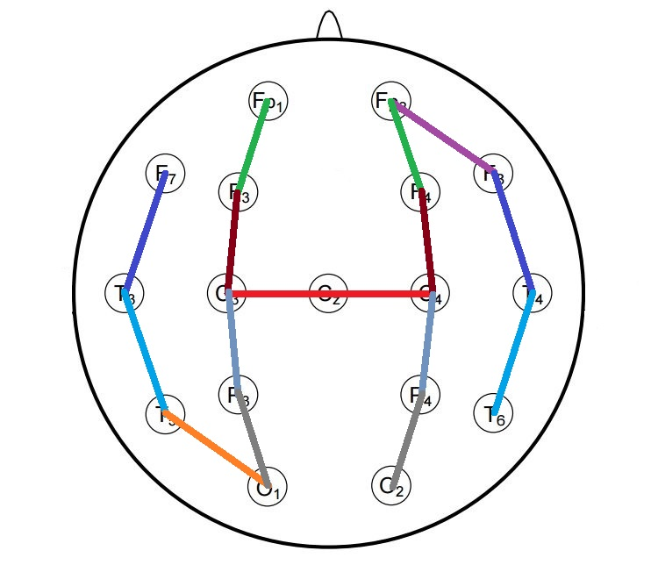
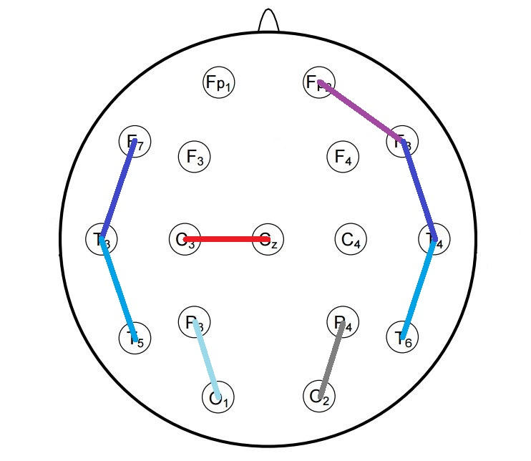
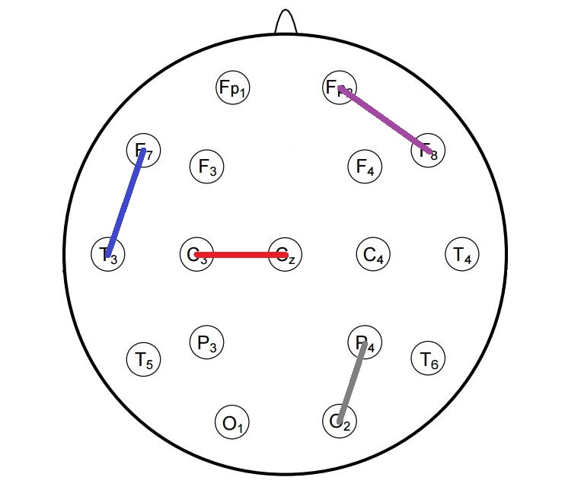
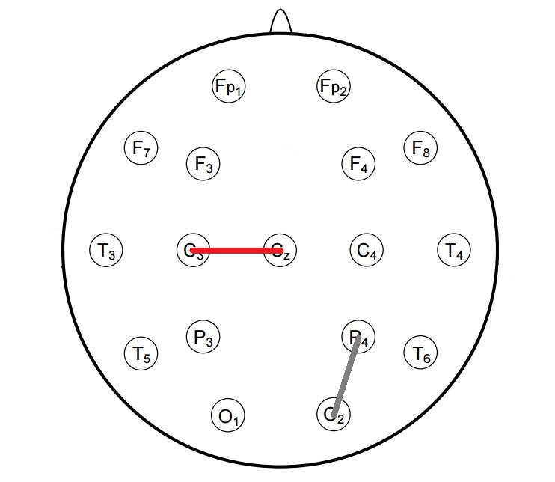
Selecting Channel Configurations
There are too many combinations to do an exhaustive search.
Choose channel configurations based on domain knowledge.
Strategy: maximize spatial information for each channel configuration.
22 Channels
20 Channels
16 Channels
8 Channels
4 Channels
2 Channels

Slide 7
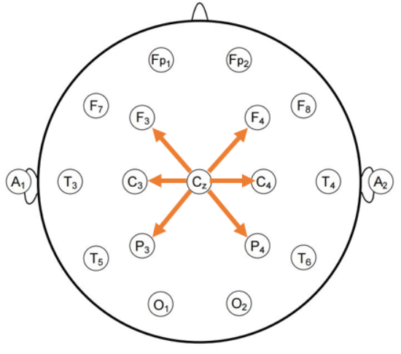
Selecting Channel Configurations
Two criteria were used to explore channel selection:
Maximize the spatial information:
The CZ channel, attached to 6 adjacent electrodes, is used in all configurations to maximize the spatial span of captured events.
Only one binding of an occipital channel is used because an event occurring on one side is likely to be observed on the other side of the hemisphere due to the way the occipital lobe functions.
Subject matter expertise (e.g., seizure detection):
Frontal Polar (FPx) channels are ignored when reducing the number of channels because only 36% of frontal lobe seizures can be observed on scalp EEGs.

Slide 8
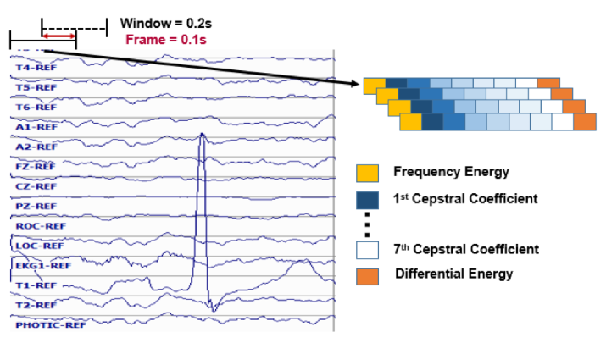
Feature Extraction
Features are calculated from the signal using a window of 0.2 seconds and a frame of 0.1 seconds.
Nine base features comprised of frequency domain energy, 1st through 7th cepstral coefficients, and a differential energy term are computed.
Using these base features, first and second derivative features are calculated, forming feature vectors of dimension 26.

Slide 9
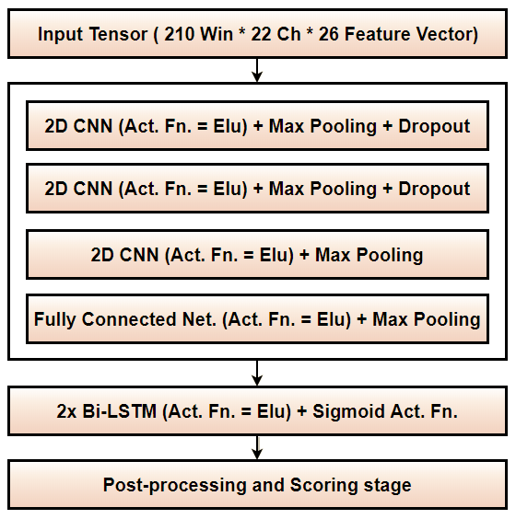
A Hybrid DNN Model – CNN/LSTM
Each Input tensor contains a 21 sec. long window (210 frames) in our optimized CNN/LSTM model.
Convolutional Neural Network (CNN) layers are able to learn the spatial information considering the correlation within the adjacent channels.
Long Short Term Memory (LSTM) layers are able to learn the temporal information.
A max pooling function is added after each CNN layer to reduce the dimensionality of the input tensor.

Slide 10
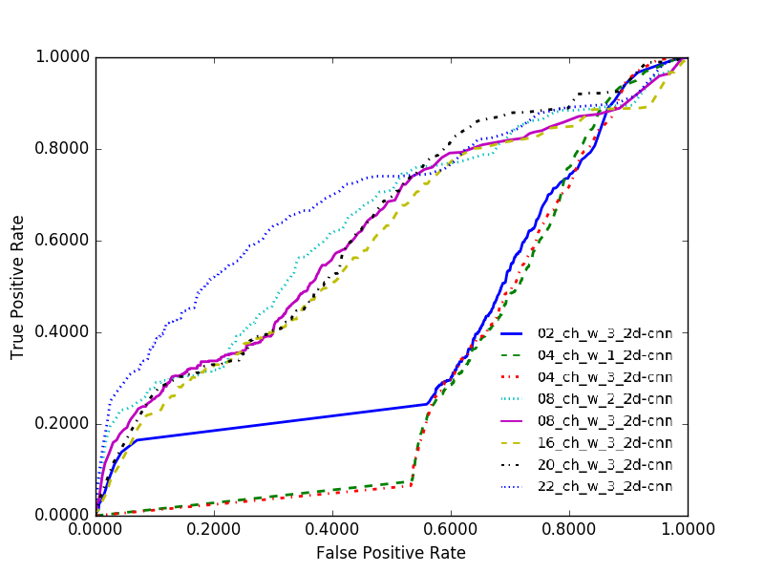
Experimental Results
Ch. | 2D CNN Layers | Sensitivity (%) | Specificity (%) | FA/24 Hours
22 | 3 | 39.15 | 90.37 | 22.83
20 | 3 | 34.54 | 82.07 | 49.25
16 | 3 | 36.54 | 80.48 | 53.99
8 | 3 | 33.44 | 85.51 | 38.19
4 | 3 | 33.11 | 39.32 | 325.54
8 | 2 | 30.66 | 88.79 | 28.57
4 | 1 | 34.09 | 39.00 | 332.15
2 | 3 | 31.15 | 40.82 | 308.74
The full 22 channels yields the best performance.
20-, 16- and 8-channel configurations have similar levels of performance.
4- and 2- channel configurations perform poorly due to the lack of spatial information.
A max pooling function in the CNN layers reduces the dimensionality of the previous layer to half.
This makes it impossible to implement 3 similar CNN layers for 8-, 4- and 2-channel configurations.
Alternative methods are to either remove a CNN layer or keep the dimensions of channels intact.

Slide 11
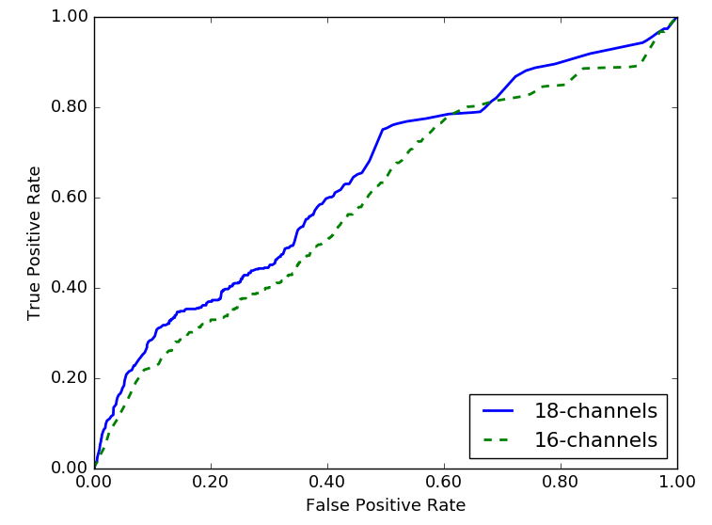
Experimental Results
No. Chan. |  | Sensitivity (%) |  | FA/24 Hours
w/ A_{x} | w/o A_{x} | w/ A_{x} | w/o A_{x} | w/ A_{x} | w/o A_{x}
22 | 20 | 39.15 | 34.54 | 22.83 | 49.25
18 | 16 | 36.65 | 36.54 | 37.33 | 53.99
10 | 8 | 30.94 | 33.44 | 283.18 | 38.19
6 | 4 | 34.36 | 34.09 | 58.15 | 332.15
4 | 2 | 33.06 | 31.15 | 47.53 | 308.74
Performance of the systems with channels spatially near the reference channels (Ax) is improved.
The 4- and 6-channel configurations including Ax perform better because the electrodes near the Ax channels collect additional temporal information.
ROC curve depicted shows that system trained on 18 channels (w/ Ax) performs marginally better than system trained on 16 channels (wo/ Ax).
Poor performance of the system trained on 10 channels is an example of a bad random initialization seed. DL systems are very vulnerable to such issues.

Slide 12
Summary
Maximization of spatial information is an important factor during channel selection:
Systems trained on all (22) channel configurations gave the best performance: 39.15% sensitivity and 90.37% specificity with 22.83 Fas per 24 hours.
Systems trained and evaluated with referential channels perform better than without referential channels.
Network architectures needed to change for the low-order systems (i.e. 2, 4, and 8 channels) because Max pooling layers wouldn’t allow reduction in channel’s dimensions.
Future work:
Random initialization and shuffling of data play an important role in DL systems. We expect to find better generalization methods which hold less dependence on such parameters.
Variation in number of channels required changes in the baseline model. We expect to design a unique model, which will be independent of number of channels.
Discovering the best montage for EEG event classification or eliminating the need for a montage using deep learning.

Slide 13
Acknowledgments
This talk is based in part upon work supported by the National Institutes of Health under Award Number U01HG008468. Any opinions, findings, and conclusions or recommendations expressed in this material are those of the author(s) and do not necessarily reflect the views of the National Institutes of Health.
Research reported in this talk was also supported by the National Science Foundation under Grant No. IIP-1622765.

Slide 14
Brief Bibliography
T. Yamada and E. Meng, Practical Guide for Clinical Neurophysiologic Testing: EEG. Philadelphia, Pennsylvania, USA: Lippincott Williams & Wilkins, 2009.
I. Obeid and J. Picone, “The Temple University Hospital EEG Data Corpus,” Front. Neurosci. Sect. Neural Technol., vol. 10, p. 196, 2016.
I. Obeid and J. Picone, “Machine Learning Approaches to Automatic Interpretation of EEGs,” in Biomedical Signal Processing in Big Data, 1st ed., E. Sejdik and T. Falk, Eds. Boca Raton, Florida, USA: CRC Press, 2017 (in press).
S. Lopez, M. Golmohammadi, I. Obeid, and J. Picone, “An Analysis of Two Common Reference Points for EEGs,” Proc. of the IEEE Signal Processing in Medicine and Biology Symposium, 2016, pp. 1–4.
M. Golmohammadi, V. Shah, S. Lopez, S. Ziyabari, S. Yang, J. Camaratta, I. Obeid, and J. Picone, “The TUH EEG Seizure Corpus,” Proceedings of the American Clinical Neurophysiology Society Annual Meeting, 2017, p. 1.
ACNS, “Guideline 6: A Proposal for Standard Montages to Be Used in Clinical EEG,” Milwaukee, WS, USA, 2006. http://www.acns.org/pdf/guidelines/Guideline-6.pdf.
A. Harati, M. Golmohammadi, S. Lopez, I. Obeid, and J. Picone, “Improved EEG Event Classification Using Differential Energy,” Proceedings of the IEEE Signal Processing in Medicine and Biology Symposium, 2015, pp. 1–4.
M. Golmohammadi, S. Ziyabari, V. Shah, I. Obeid, and J. Picone, “Gated Recurrent Networks for Seizure Detection,” in Proceedings of the IEEE Signal Processing in Medicine and Biology Symposium, 2017, pp. 1–5. https://www.isip.piconepress.com/publications/unpublished/ conferences/2017/ieee_spmb/rnn/.

