Slide 1
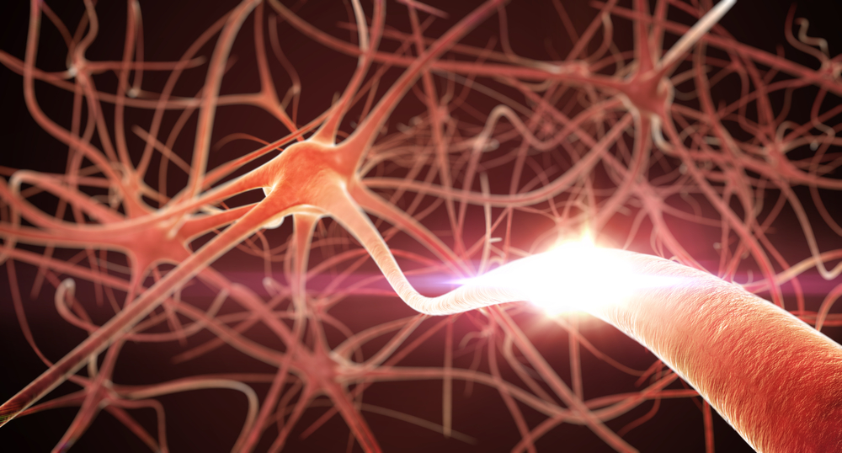
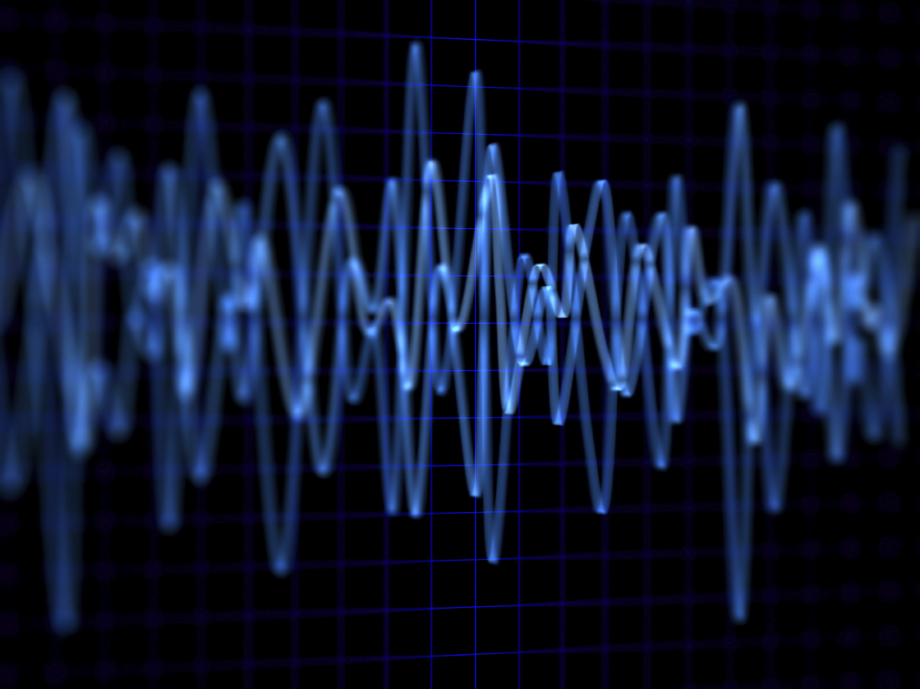
Semi-automated Annotation of Signal Events in Clinical EEG Data
S. Yang, S. López, M. Golmohammadi, I. Obeid and J. Picone
Neural Engineering Data Consortium
Temple University

Slide 2
Abstract
To be effective, state of the art machine learning technology needs large amounts of annotated data. There are numerous compelling applications in healthcare that can benefit from high performance automated decision support systems provided by deep learning technology, but they lack the comprehensive data resources required to apply sophisticated machine learning models. Further, for economic reasons, it is very difficult to justify the creation of large annotated corpora for these applications. Hence, automated annotation techniques become increasingly important.
In this study, we investigate the effectiveness of using an active learning algorithm to automatically annotate a large EEG corpus. The algorithm is designed to annotate six types of EEG events. Two model training schemes, namely threshold-based and volume-based, are evaluated. In the threshold-based scheme the threshold of confidence scores is optimized in the initial training iteration, whereas for the volume-based scheme only a certain amount of data is preserved after each iteration. Recognition performance is improved by 2% absolute and the system is capable of automatically annotating previously unlabeled data.
Given that the interpretation of clinical EEG data is an exceedingly difficult task, this study provides some evidence that the proposed method is a viable alternative to expensive manual annotation.

Slide 3
Introduction
Many EEG-based bioengineering applications do not involve large amounts of data for system evaluation:
“Adaptation in P300 Brain–Computer Interfaces: A Two-Classifier Cotraining Approach” – 5 subjects
“A self-training semi-supervised SVM algorithm and its application in an EEG-based brain computer interface speller system” – 10 subjects
Observations from these reports: error rate reduction between 2% – 15%; addition of unlabeled/auto-labelled data can degrade the performance.
Experiments on small data sets do not produce statistically significant results.
Medicine by its nature deals with statistical outliers and rare events. Rare diseases are often hard to diagnose yet are critical to effective healthcare:
Example: Temple Hospital’s Department of Neurology conducts about 3,000 EEGs per year, and less than 1% of these patients are diagnosed with posterior reversible encephalopathy syndrome (PRES).
It is difficult to build powerful analytics with such small sample sizes.

Slide 4
TUH EEG Corpus
The TUH EEG Corpus:
over 30,000 EEGs from over 16,000 patients in the last 14 years collected in a clinical setting at an urban public hospital;
at least 4 Petabytes of data including raw EEGs and video;
patients range in age from 18 to 90+ with an average of 1.6 EEGs per patient;
publicly available at https://www.isip.piconepress.com/projects/tuh_eeg/.
Impact:
sufficient data to support application of state of the art machine learning algorithms;
patient medical histories, particularly drug treatments, supports statistical analysis of correlations between signals and treatments;
historical archive also supports investigation of EEG changes over time for a given patient;
enables the development of real-time monitoring.

Slide 5
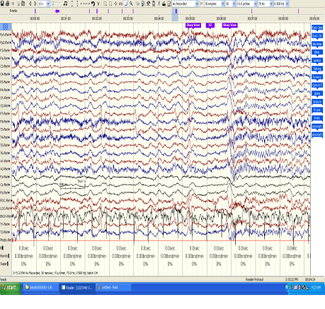
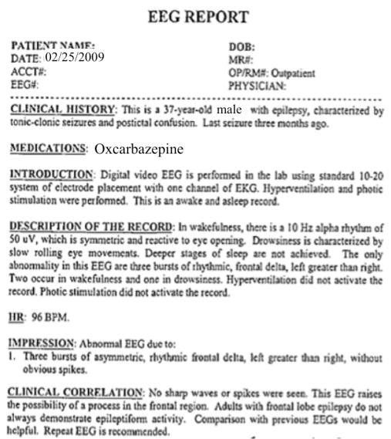
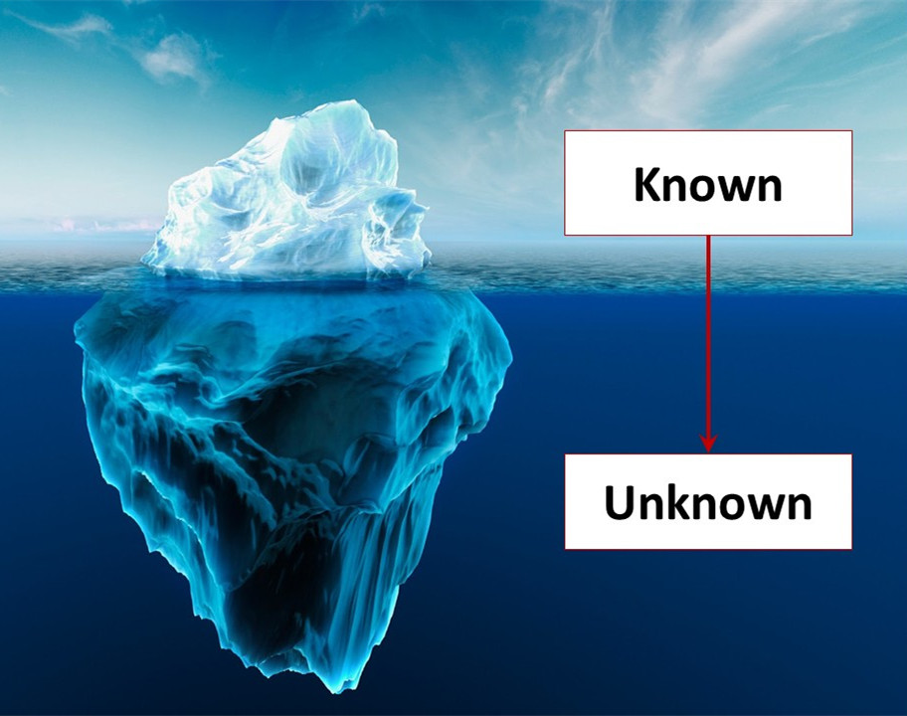
Challenges
In the TUH EEG Corpus:
the EEG signal data is not annotated;
the EEG reports are unstructured;
only a small amount of text and signal data has been annotated.
For data of this scale, it is impossible to annotate the entire database manually:
human expertise is in short supply;
time requirements are significant;
the cost is prohibitive.
Our goal: develop a system that can automate this process.
This is a typical semi-supervised learning problem…

Slide 6
Semi-Supervised Machine Learning
Define the total set of all data as T. Three key subsets of data that play a role in semi-supervised learning are:
$T_{k}$: Data points where the label is known.
$T_{u}$: Data points where the label is unknown.
$T_{c}$: A subset of $T_{u,i}$ that is chosen to be labeled.
The challenge is how to find the optimal $T_{c}$: which judgment do we trust more, human or machine?
Two major types of active learning approaches (need two full sentences):
with the aid of human experts to update the model;
automatically update the model by “bootstrapping”.

Slide 7
Self-Training
Let L be the set of labeled data, U be the set of unlabeled data.
Repeat:
Train a classifier h with training data L.
Classify data in U with h.
Find a subset U’ of U with the most confident scores.
Exclude U’ from U, the remain of U is left for next iteration.
Concatenate L and U’, re-train the model with the augmented data set.
Self-training is historically one of the oldest approaches to semi-supervised learning.

Slide 8
Self-Training vs. Conventional Active Learning
Self-training is designed to search for the “least informative” data points.
Active learning is designed to search for the “most informative” data points.
The self-training process can be completely automated.
Active learning needs human intervention during model updating.
Self-training can go astray in constructing new decision boundaries.
Human intervention in the active learning is time-consuming during the iterative training stage.
The performance of active learning is also debatable.

Slide 9
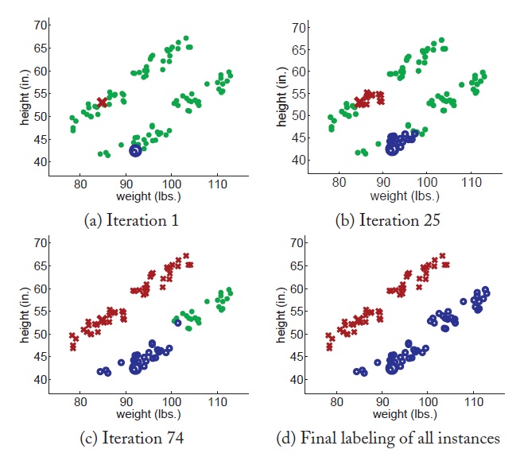
Ideal Self-Training
Propagating 1-nearest-neighbor applied to 100 data instances.

Slide 10
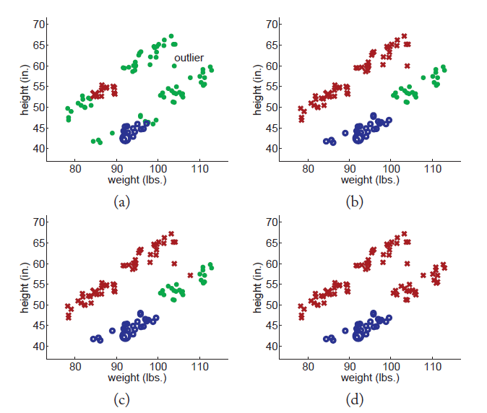
Divergence in Self-Learning
Propagating illustration featuring an outlier: after labeling of all instances, the entire rightmost cluster was mislabeled.

Slide 11
Baseline: Classification of Clinically-Relevant Signal Events
Six events of interest based on multiple iterations with board certified neurologists:
Clinical data contains many artifacts that can easily be interpreted as spikes, such as patient movement.
Manual review of the data is a time-consuming process, especially for long-term EEG recordings.
In ICU applications, real-time response is critical.
Performance requirements for this application is a detection rate above 95% with a false alarm rate below 5%.
Epileptiform | Background
SPSW: Spike and/or sharp waves | ARTF: Artifact
PLED: Periodic lateralized epileptiform discharges | EYEM: eye movement
GPED: Generalized periodic epileptiform discharges | BCKG: Background

Slide 12
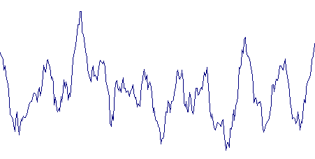
A Generic Self-Training Approach
Feature Extraction
Model Training
$$a_{11}$$
$$a_{22}$$
$$a_{33}$$
Labeled Data
$$a_{12}$$
$$a_{23}$$
$$b_{1}(x)$$
$$b_{2}(x)$$
$$b_{3}(x)$$
Recognition
label
Re-train
Extended Data
Labeled + High Confidence
High Confidence Label Selection
Unlabeled Data
$$p=0.95$$
$p=0.$42
$p=0.$55
Selected label

Slide 13
Sensitivity Analysis
After the first iteration:
Sensitivity improved about 8% absolute for the SPSW class after the first round of re-training.
The sensitivities for GPED and PLED also improved 4% and 6% absolute respectively.
Less effective for the eye movement events (EYEM).
BCKG and ARTF classes suffered a small degradation in performance.
Class | Before | After
GPED | 52.8% | 56.5%
PLED | 54.2% | 60.4%
SPSW | 41.6% | 49.6%
EYEM | 81.8% | 82.1%
BCKG | 72.1% | 71.2%
ARTF | 41.2% | 39.1%

Slide 14
Increasing the Number of Self-Training Iterations
Impact of the number of preserved events on recognition performance as a function of the training iteration.

Slide 15
Re-training Higher Confidence Examples
Preserved SPSW epochs for re-training, the figure depicts the performance after the first iteration.

Slide 16
Optimizing the Threshold
Threshold optimization in the initial iteration, in comparison with the baseline performance.

Slide 17
Two Training Schemes
Comparison of volume-based and threshold-based model training schemes.

Slide 18
Summary and Future Work
After a few iterations, active learning not only allows us to label more EEG signals (about 30,000 new labels) but also improves recognition accuracy about 2%.
Finding the unlabeled subset of the database can be challenging:
Sensitive to outliers.
The data in which we have the most confidence may not be the most optimal data to include in the training process.
An early mistake made by the classifier can reinforce itself by generating incorrectly labeled data.
How to deal with these issues?
Finding the optimal threshold.
Combine self-training with conventional active learning.
Implement a co-training algorithm.

Slide 19
Acknowledgments
This talk is based in part upon work supported by the National Institutes of Health under Award Number U01HG008468. Any opinions, findings, and conclusions or recommendations expressed in this material are those of the author(s) and do not necessarily reflect the views of the National Institutes of Health.
Research reported in this talk was also supported by the National Science Foundation under Grant No. IIP-1622765.
The TUH EEG Corpus effort was funded by (1) the Defense Advanced Research Projects Agency (DARPA) MTO under the auspices of Dr. Doug Weber through the Contract No. D13AP00065, (2) Temple University’s College of Engineering and (3) Temple University’s Office of the Senior Vice-Provost for Research.

Slide 20
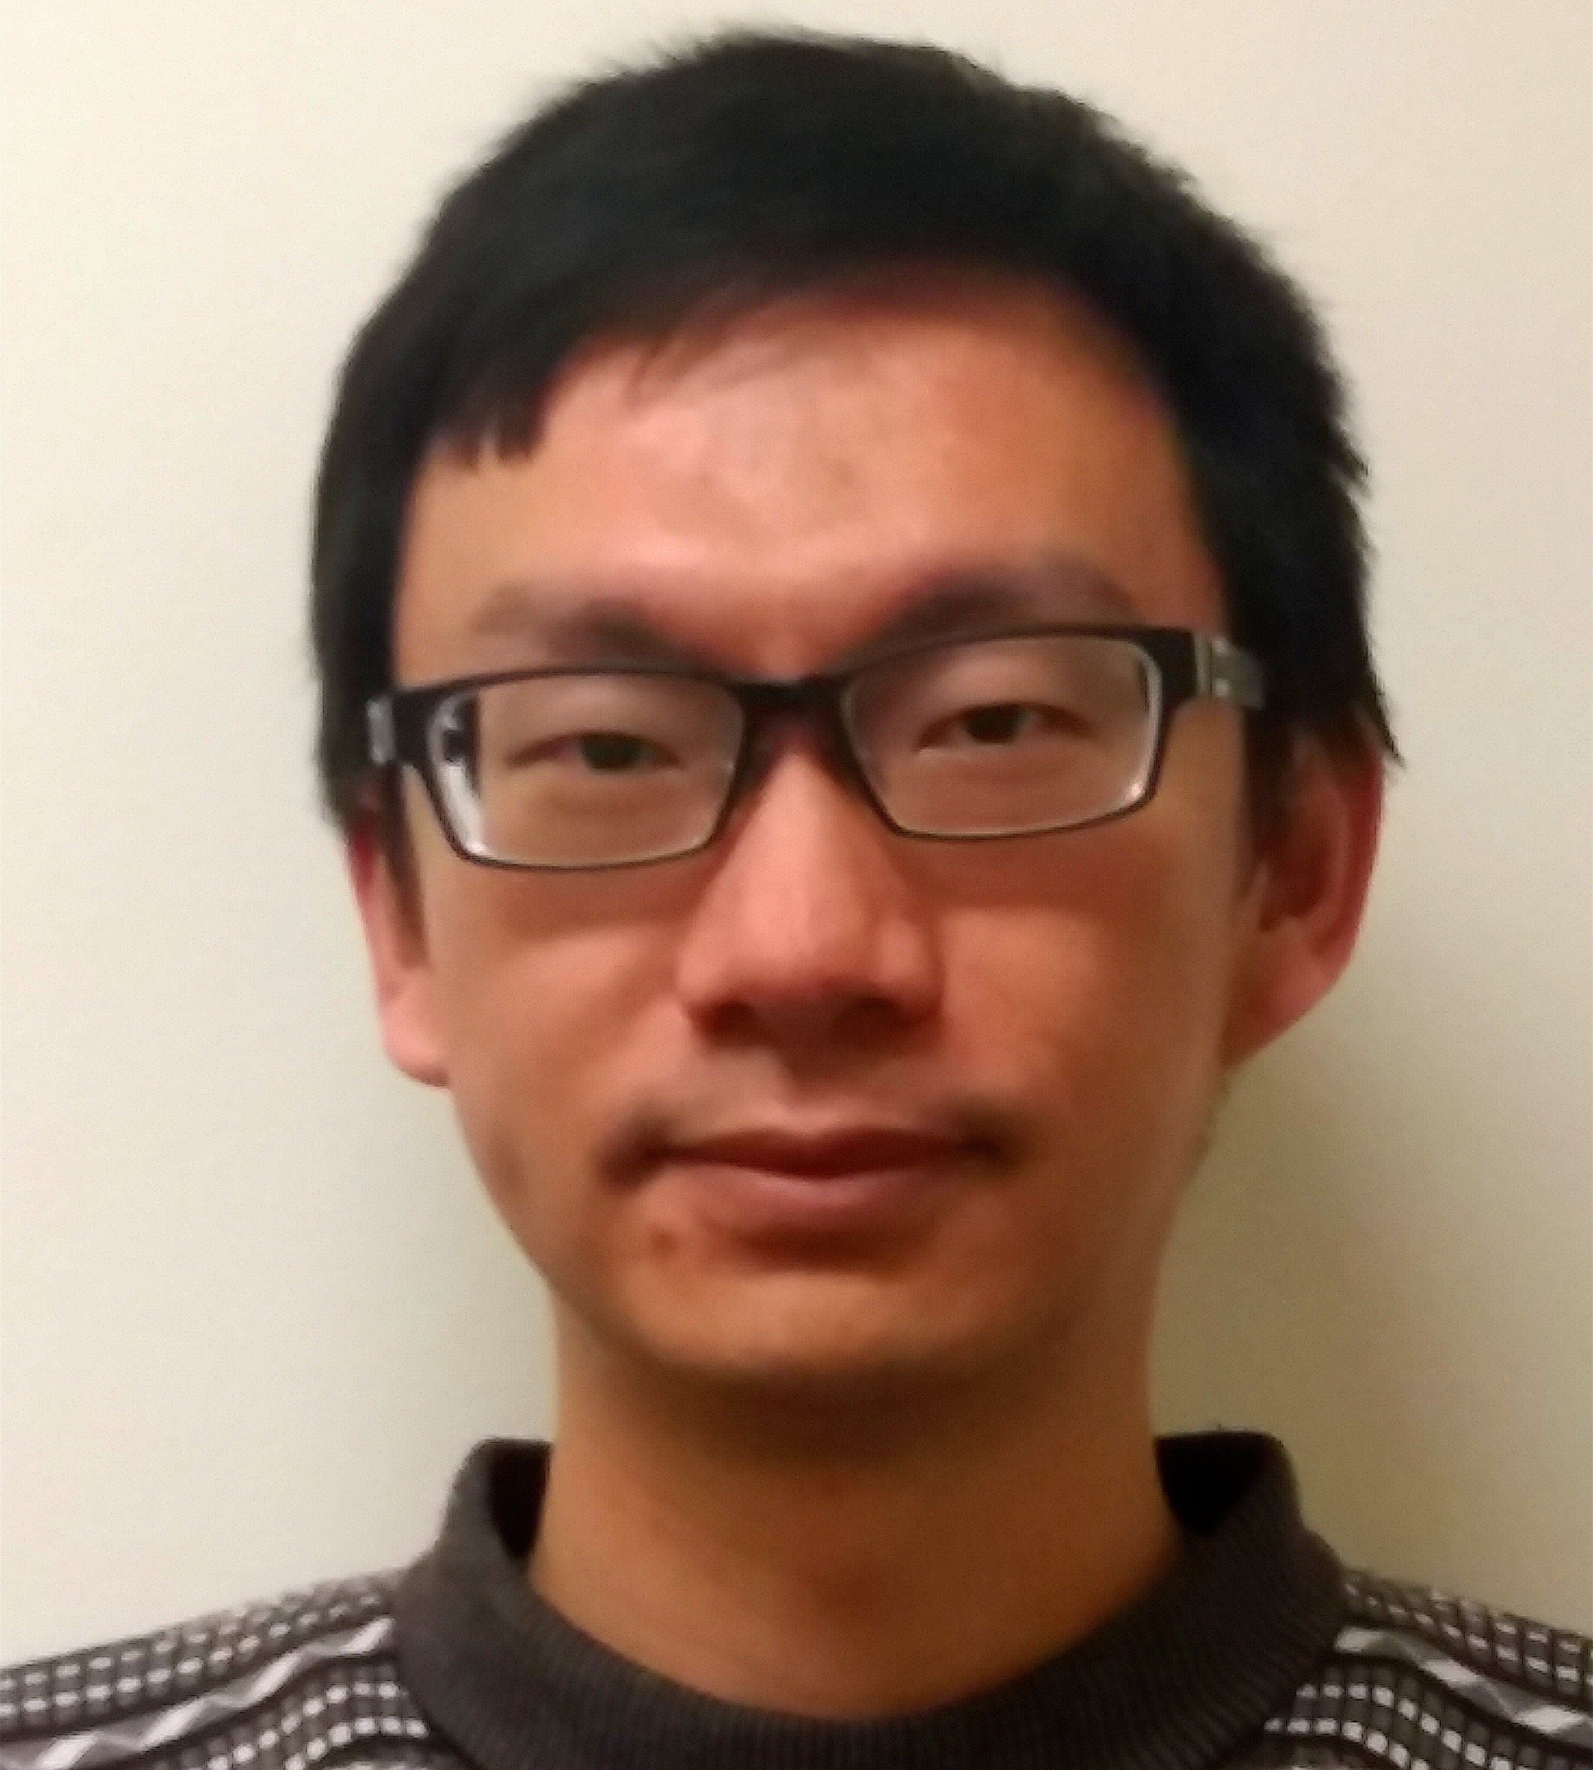
Biography: SU YANG, PhD
Su Yang obtained his PhD in Electronic Engineering from University of Kent, UK in 2016. As a member of the Intelligent Interactions Research Group at the School of Engineering and Digital Arts, his research focused on using EEG for biometric person recognition. During this time, he also worked as a summer intern at IBM in 2014. He has published several journal and conference papers on his research, and also filed a patent with IBM.
Su Yang is now a postdoc at the Neural Engineering Data Consortium (NEDC), located at Temple University. His current research interests include signal processing, pattern recognition, EEG event detection. He is involved in an NIH funded project named “Automatic Discovery and Processing of EEG Cohorts From Clinical Records,” which is a collaboration between Temple University and the University of Texas at Dallas. He serves as the technical project lead and directs research into deep learning methods and the development of natural language processing approaches to data mining of EEG reports.
Su Yang’s hobbies include traveling and taking photos. Table tennis is one of his favorite sports. He also enjoys reading scientific reports as well as modern fiction.

Slide 21
Brief Bibliography
[1] X. Zhu and A. B. Goldberg, Introduction to Semi-Supervised Learning, vol. 3, no. 1. Morgan & Claypool, 2009.
[2] A. Harati, S. Lopez, I. Obeid, M. Jacobson, S. Tobochnik, and J. Picone, “THE TUH EEG CORPUS: A Big Data Resource for Automated EEG Interpretation,” in Proceedings of the IEEE Signal Processing in Medicine and Biology Symposium, 2014, pp. 1–5.
[3] S. Yang, S. López, M. Golmohammadi, I. Obied and J. Picone, “Semi-Automated Annotation of Signal Events in Clinical EEG Data,” in Proceedings of the IEEE Signal Processing in Medicine and Biology Symposium, 2016, pp. 1–5.
[4] Y. Li, C. Guan, H. Li, and Z. Chin, “A self-training semi-supervised SVM algorithm and its application in an EEG-based brain computer interface speller system,” Pattern Recognit. Lett., vol. 29, no. 9, pp. 1285–1294, 2008.
[5] A. T. C. Approach, R. C. Panicker, S. Member, S. Puthusserypady, and S. Member, “Adaptation in P300 Brain–Computer Interfaces: A Two-Classifier Cotraining Approach,” IEEE Trans. Biomed. Eng., vol. 57, no. 12, pp. 2927–2935, 2010.
[6] Fei Xia, a machine Learning course in University of Washington, available at http://faculty.washington.edu/fxia/courses/LING572/

