Slide 1

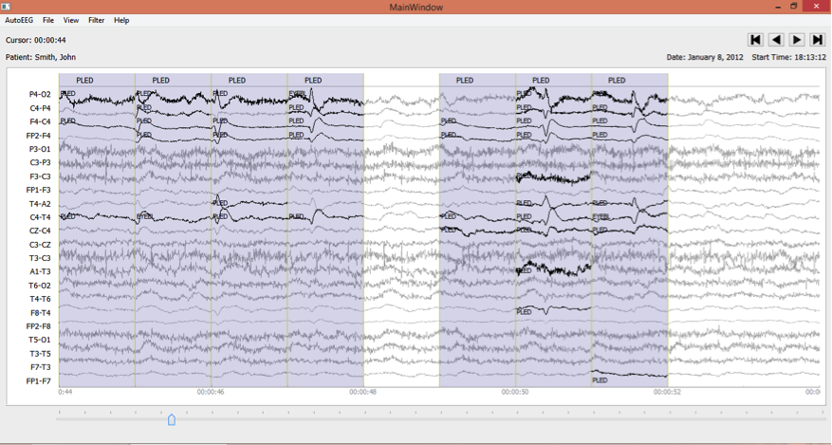
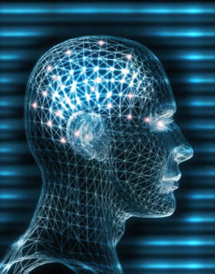

THE TUH EEG CORPUS:
A Big Data Resource for Automated EEG Interpretation
A. Harati, S. López, I. Obeid and J. Picone
Neural Engineering Data Consortium
Temple University
M. P. Jacobson, M.D. and S. Tobochnik
Department of Neurology,
Lewis Katz School of Medicine
Temple University

Slide 2
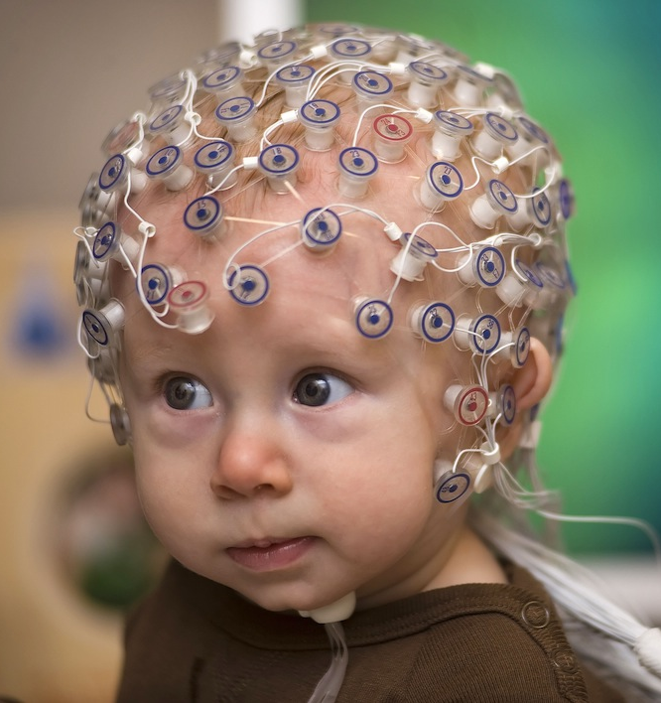
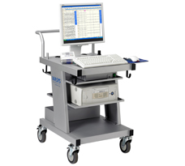
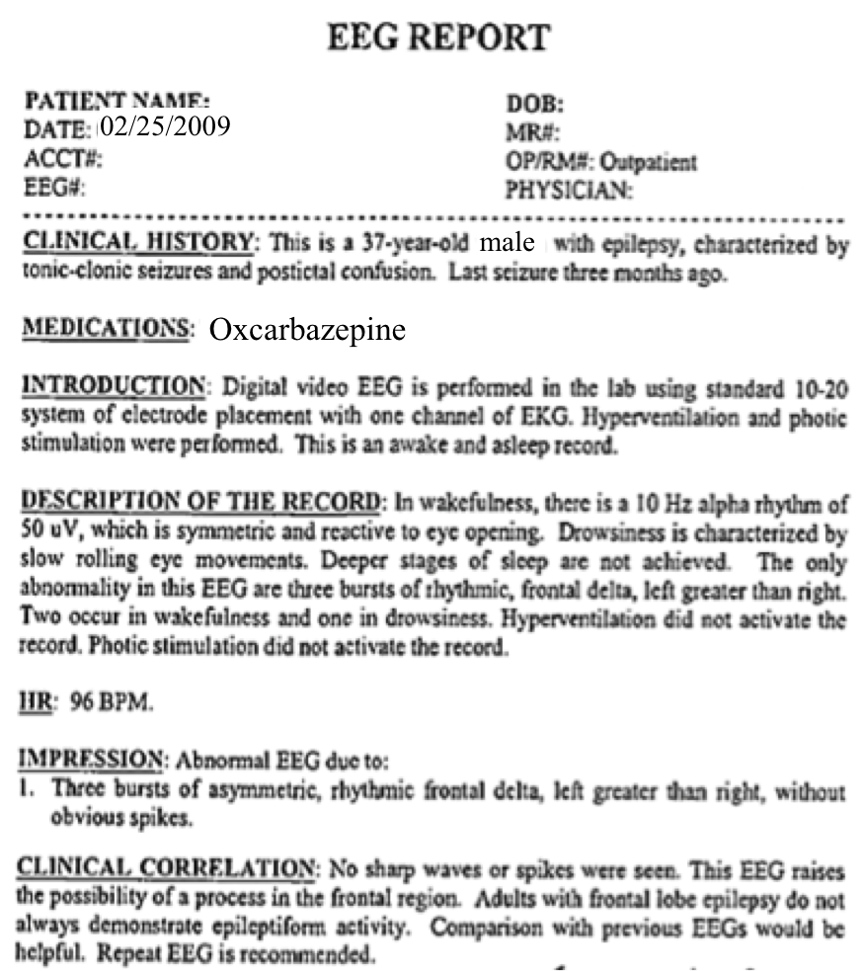
Manual Interpretation of EEGs
  A technician administers a 30−minute recording session.
  An EEG specialist (neurologist) interprets the EEG.
  An EEG report is generated with the diagnosis.
  Patient is billed once the report is coded and signed off.

Slide 3
Automatic Interpretation
Machine learning is used to map signals to event and epoch labels.
Algorithms typically require “truth-marked” data for supervised learning.
Such data is very difficult to create for clinical applications.

Slide 4
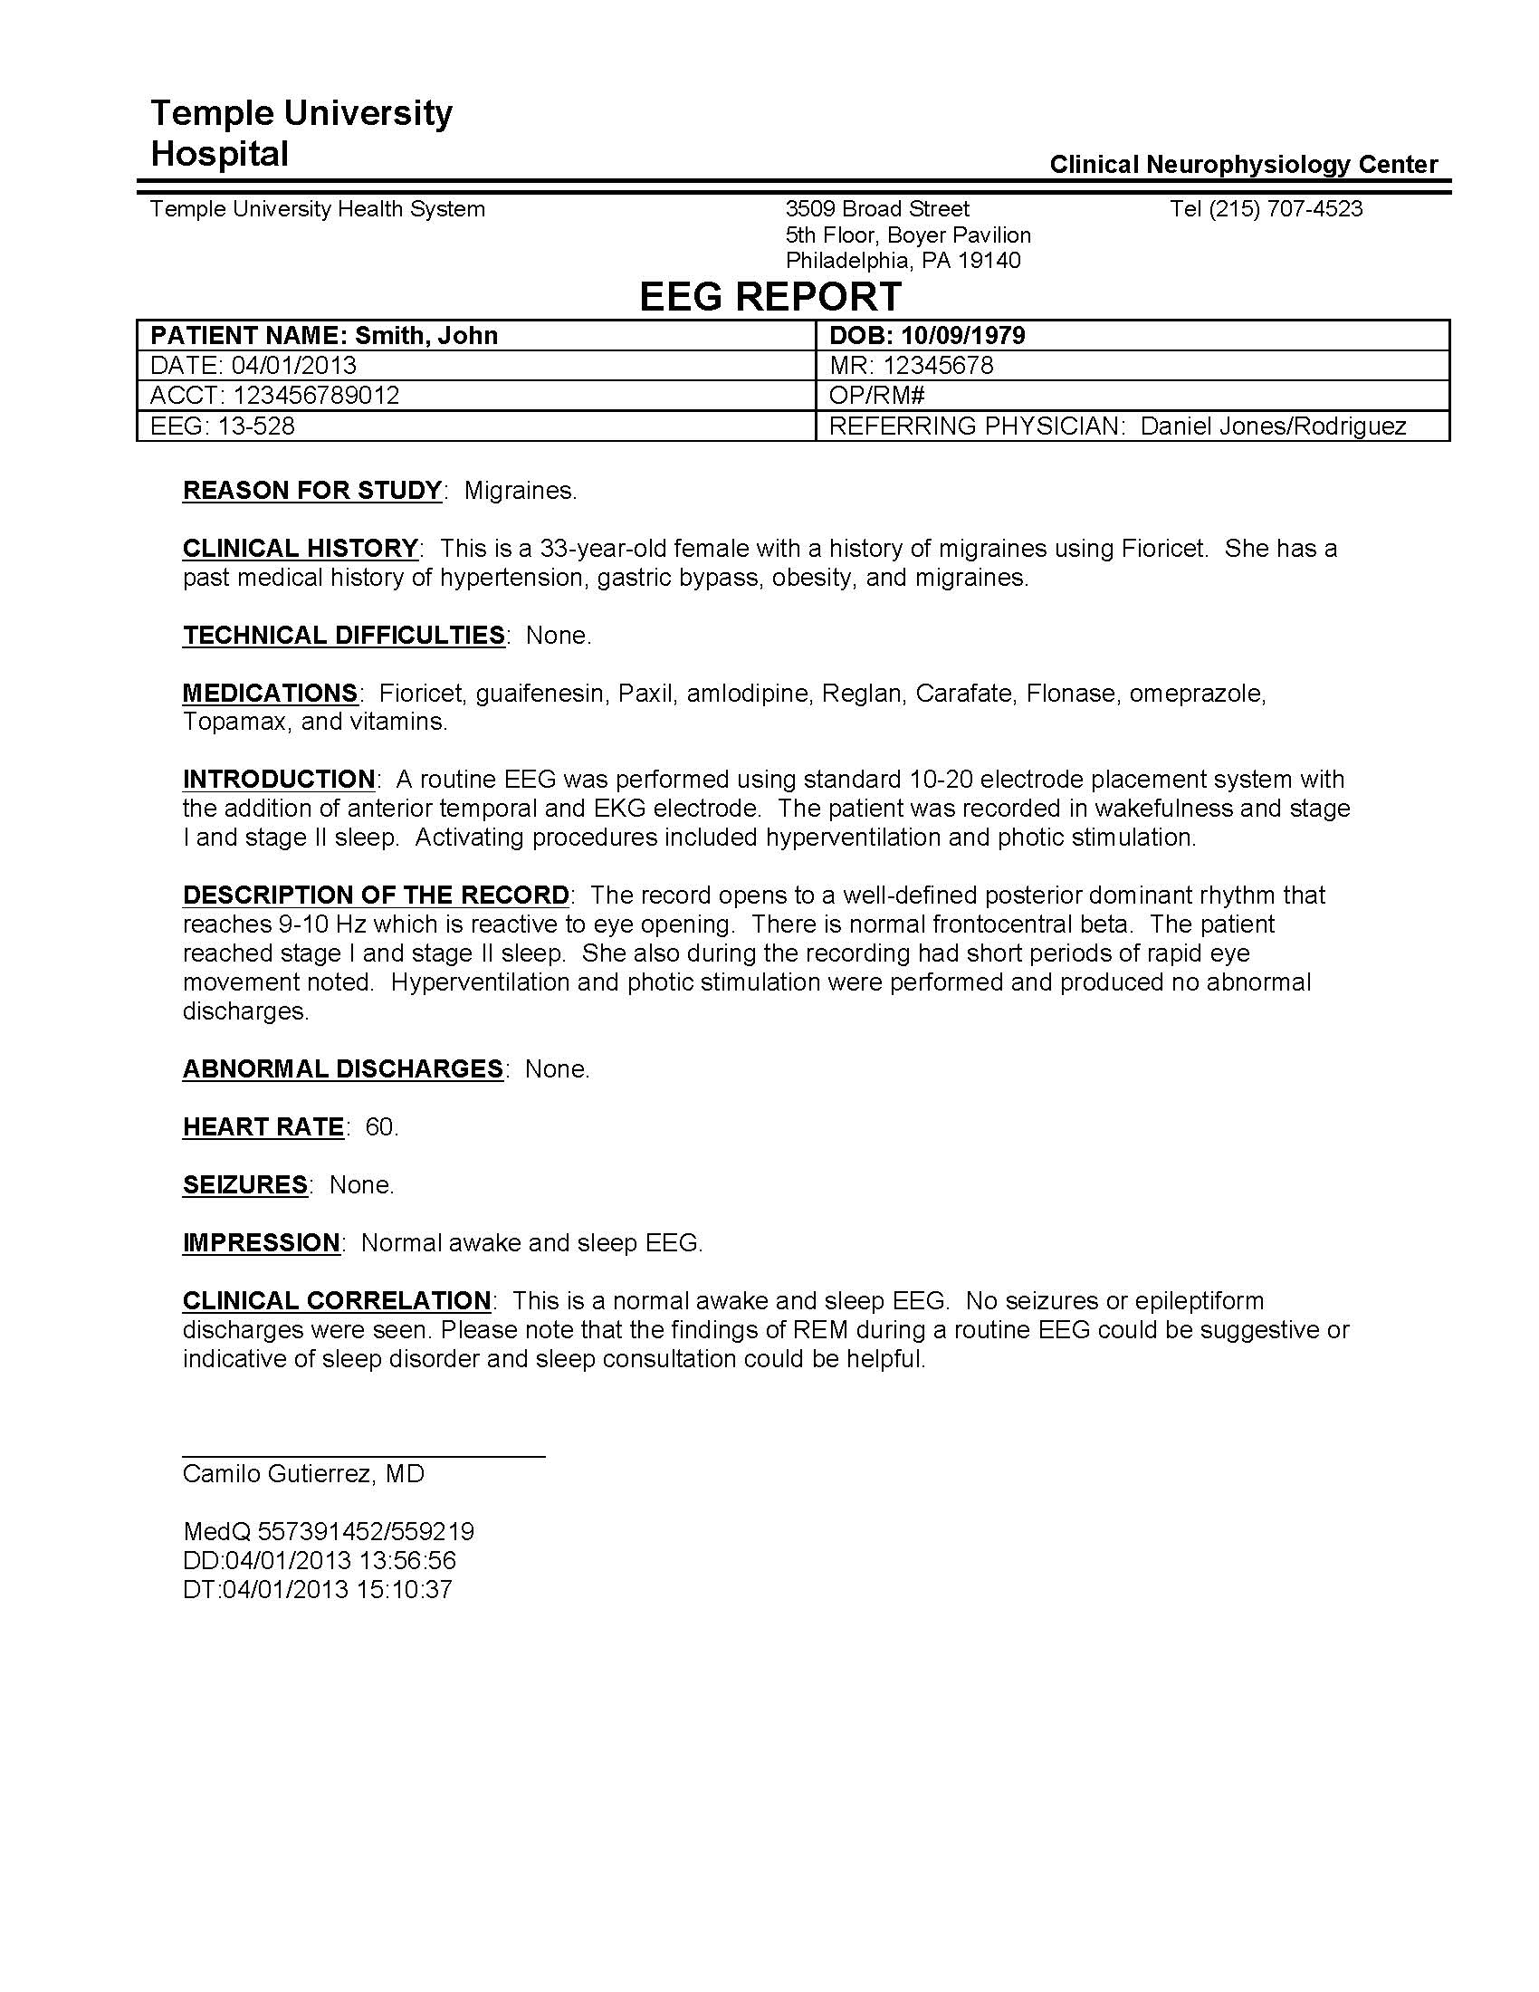
EEG Reports
Two Types of Reports:
Preliminary Report: contains a summary diagnosis (usually in a spreadsheet format).
EEG Report: the final
“signed off” report that
triggers billing.
Inconsistent Report Formats:
The format of reporting
has changed several times
over the past 12 years.
Report Databases:
MedQuist (MS Word .rtf)
Alpha (OCR’ed .pdf)
EPIC (text)
Physician’s Email
Hardcopies (OCR’ed pdf)

Slide 5
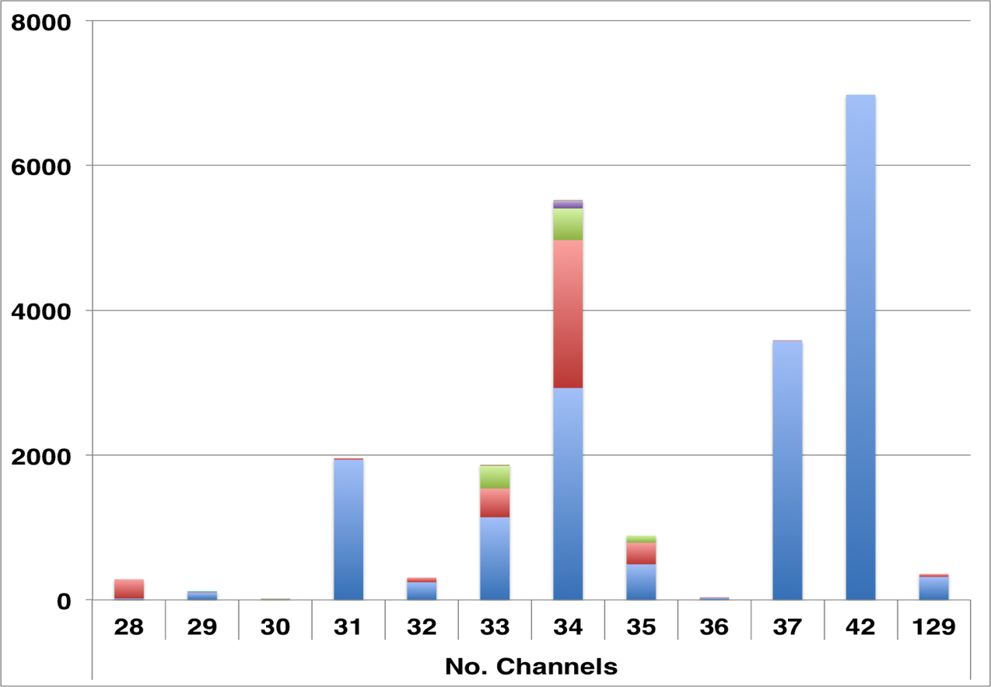
The TUH EEG Corpus
Number of Sessions:
25,000+
Number of Patients:
~15,000
Frequent Flyer: 42 sessions
Age Range (Years):
16 to 90+
Sampling:
Rates : 250, 256 or 512 Hz
Resolution: 16 bits
Data Format:
European Data Format (EDF)
Number of Channels:
Variable
Variations in channels and electrode labels are very real challenges
Number of channels ranges from [28, 129] (one annotation channel per EDF file)
Over 90% of the alternate channel assignments can be mapped to the
standard 10-20 configuration.

Slide 6
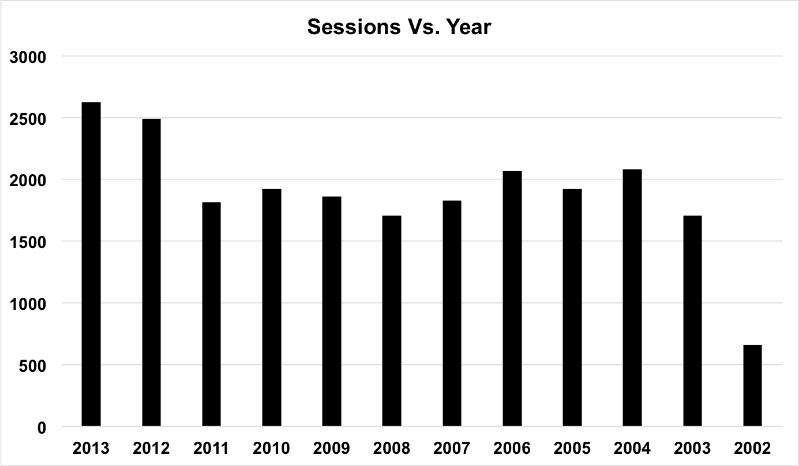
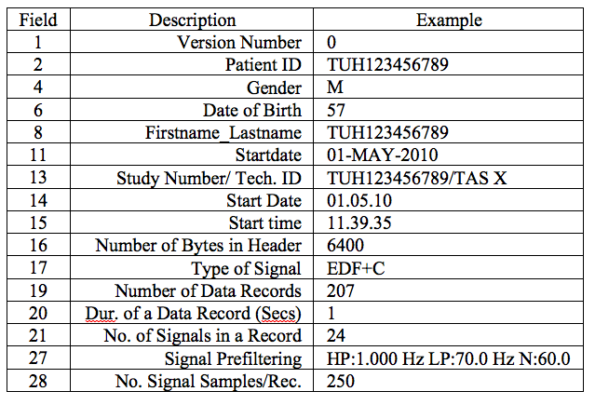
The TUH EEG Corpus
Corpus is growing at a rate of about 2,750 EEGs per year.
Two general types of EEGs:
  Short-term: 20 to 30 minutes
  Long-term: 18 to 36 hours
In 2014, more 40-minute EEGs are being administered.
A sample EDF header.
Data has been carefully deidentified (e.g., removal of medical record number, patient name and exact birthdate)
“Pruned EEGs” are being used.

Slide 7
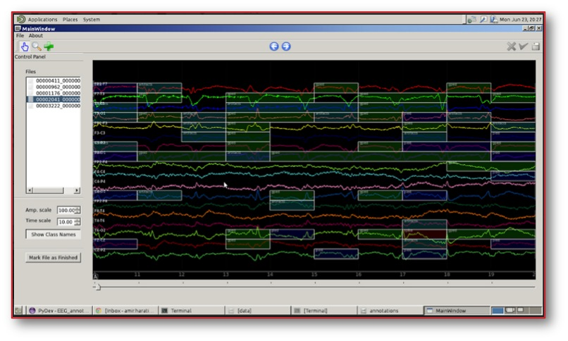
Manual Annotations
  Epileptiforms:
  SPSW: spike and sharp wave
  GPED: generalized periodic epileptiform discharges
  and triphasic
  PLED: periodic lateralized epileptiform discharges
  Background:
  ARTF: Artifact
  EYBL: Eye Blink
  BCKG: Background

Slide 8
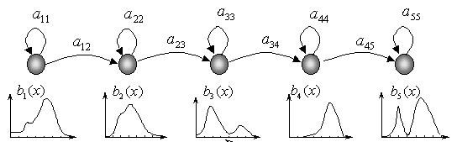
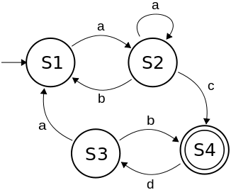
Two-Level Machine Learning Architecture
Feature Extraction
Temporal and Spatial
Context
Sequential Modeler
Post
Processor
Epoch
Label
Epoch
Hidden Markov Models
Finite State Machine

Slide 9
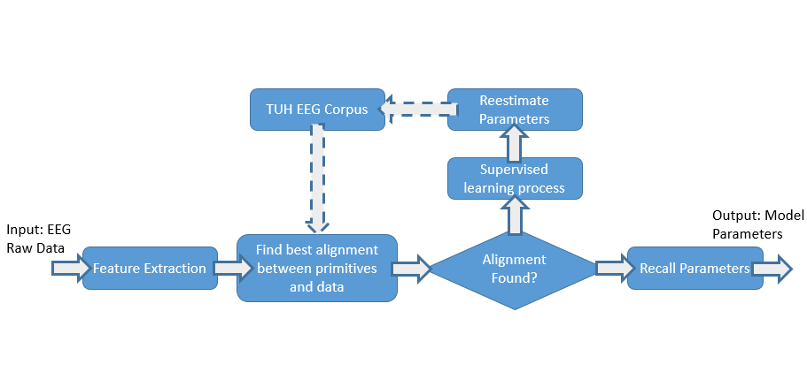
Unsupervised Training Through Active Learning
  Active Learning:
  Seed models with a small amount of transcribed data using reports that clearly indicate the existence of the desired events.
  Classify the data.
  Train models based on generated labels.
  Select high confidence data and iterate.

Slide 10
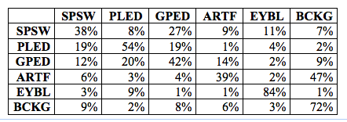
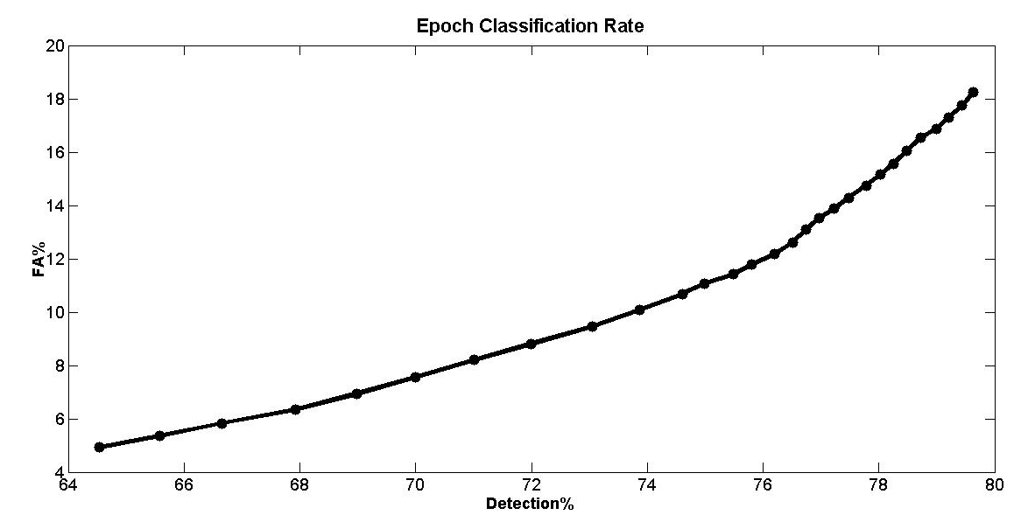
Performance on TUH EEG
A confusion matrix for the HMM-based system on the evaluation data:
Detections and false alarms can be adjusted using confidence measures:
Correct recognitions for the three primary event classes (SPSW, PLED, and GPED) are above 40% though misrecognitions are also about 40%.
To be relevant for clinical use it is not necessary to detect every spike correctly.
A high false alarm rate is of great concern.
The same baseline technology provides state of the art results on epileptic seizure detection (CHB-MIT).
However, that technology performs extremely poorly on TUH EEG.
Performance goal: 95% detection and 5% false alarm.

Slide 11
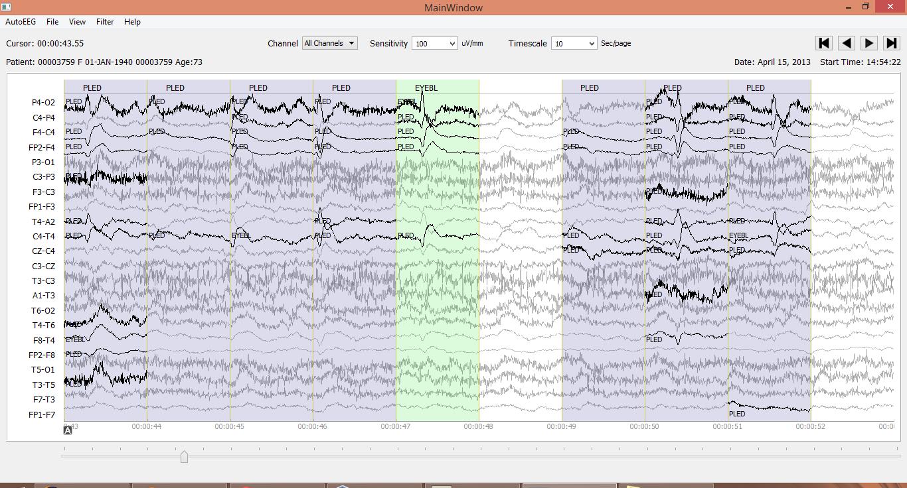
Analysis of Performance
Bayesian problem: an extremely small percentage of the data are SPSW, yet this class is crucial to good clinical performance.
Traditional Bayesian techniques choose to ignore SPSW.

Slide 12
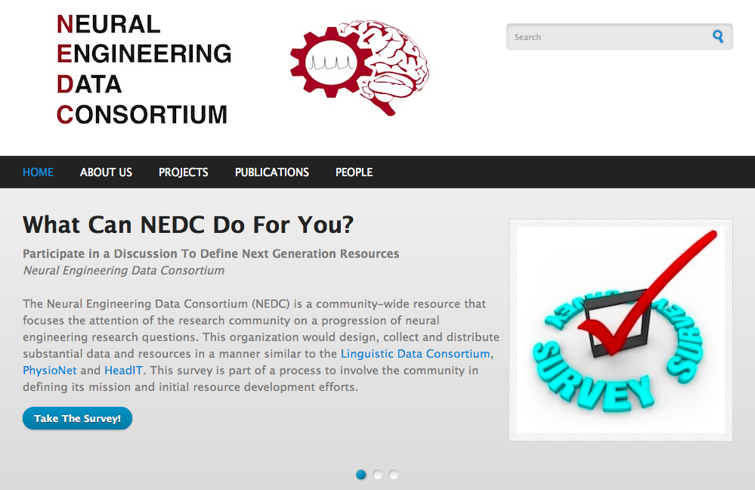

Slide 13
Summary
The TUH EEG Corpus:
  Represents a unique opportunity to advance EEG analysis using state of the art machine learning.
  Under development for two years, with an initial release in February 2014.
  The official release will be done in phases during 1Q 2015, with a maintenance release expected in Summer 2015.
  See http://www.nedcdata.org for more details.
Machine learning results using unsupervised training are promising:
  Baseline performance of a two-level classification system using sequential decoding for event detection are promising: 70% DET / 7% FA.
  More sophisticated systems are under development and delivering much higher performance, approaching the performance needed to be clinically relevant.
  High performance system can run hyper real-time (e.g., 100 times faster than real-time).

Slide 14
Brief Bibliography
[1] Strayhorn, D. (2014). The Atlas of Adult Electroencephalography. EEG Atlas Online. Retrieved January 18, 2014.
[2] Tatum, W., Husain, A., Benbadis, S., & Kaplan, P. (2007). Handbook of EEG Interpretation. (Kirsch, Ed.) (p. 276). New York City, New York, USA: Demos Medical Publishing (available online at Brainmasters Technologies Inc.).
[3] D. Wulsin, Bayesian Nonparametric Modeling of Epileptic Events, University of Pennsylvania, 2013.
[4] S. I. Choi, I. Obeid, M. Jacobson, and J. Picone, “The Temple University Hospital EEG Corpus,” The Neural Engineering Data Consortium, College of Eng., Temple Univ., 2013. [Online]. Available: http://www. isip.piconepress.com/projects/tuh_eeg. [Accessed: 06-Jan-2013].
[5] D. Wulsin, J. Blanco, R. Mani, and B. Litt, “Semi-Supervised Anomaly Detection for EEG Waveforms Using Deep Belief Nets,” in International Conference on Machine Learning and Applications (ICMLA), 2010, pp. 436–441.
[6] J. Picone, “Continuous speech recognition using hidden Markov models,” IEEE ASSP Magazine, vol. 7, no. 3, pp. 26–41, Jul. 1990.
[7] Shoeb, A. H., & Guttag, J. V. (2010). Application of machine learning to epileptic seizure detection. Proceedings of the International Conference on Machine Learning (ICML) (pp. 975-982). Haifa, Israel.

Slide 15
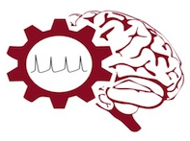
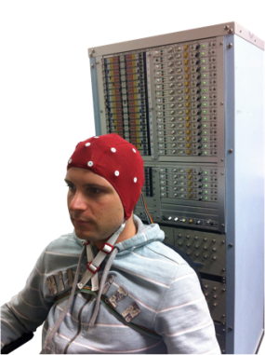
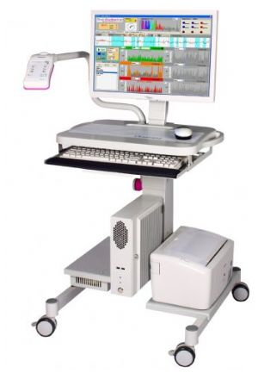
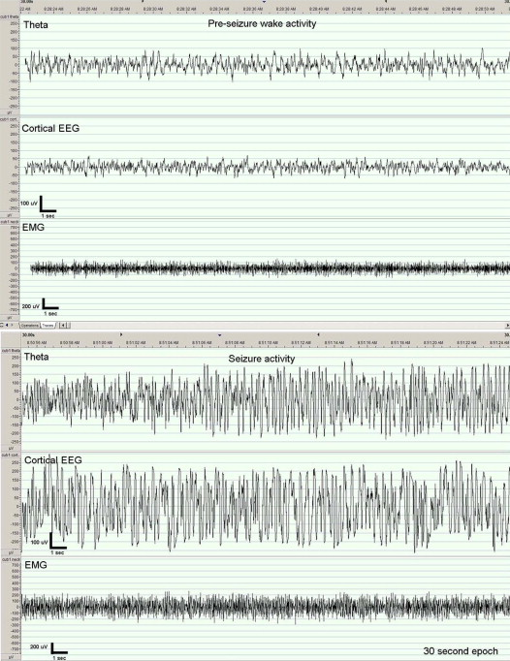
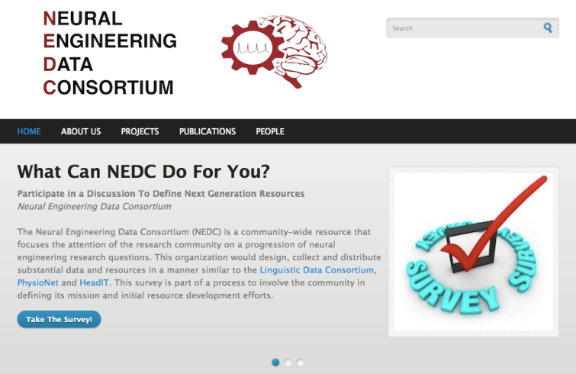
The Neural Engineering Data Consortium
Mission: To focus the research community on a progression of research questions and to
generate massive data sets used to address those questions. To broaden participation by making
data available to research groups who have significant expertise but lack capacity for data generation.
Impact:
  Big data resources enables application of state of the art machine-learning algorithms
  A common evaluation paradigm ensures consistent progress towards long-term research goals
  Publicly available data and performance baselines eliminate specious claims
  Technology can leverage advances in data collection to produce more robust solutions
Expertise:
  Experimental design and instrumentation of bioengineering-related data collection
  Signal processing and noise reduction
  Preprocessing and preparation of data for distribution and research experimentation
  Automatic labeling, alignment and sorting of data
  Metadata extraction for enhancing machine learning applications for the data
  Statistical modeling, mining and automated interpretation of big data
  To learn more, visit www.nedcdata.org

Slide 16

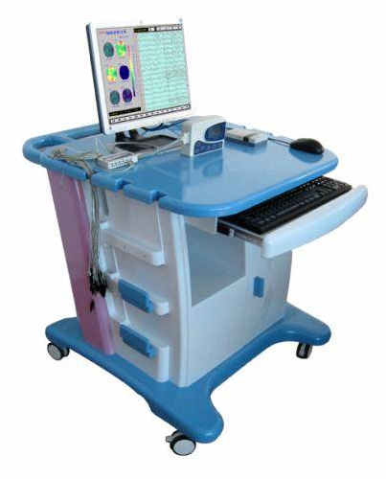
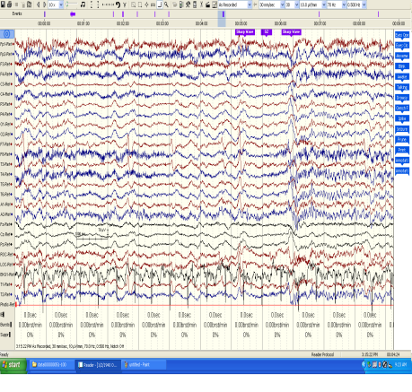
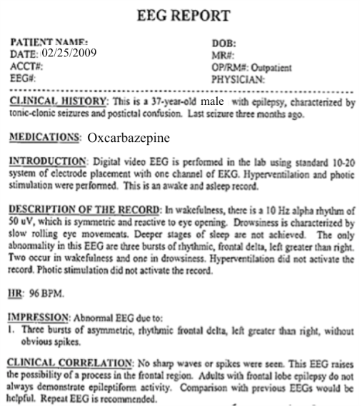
The Temple University Hospital EEG Corpus
Synopsis: The world’s largest publicly available EEG corpus consisting of 20,000+ EEGs collected
from 15,000 patients, collected over 12 years. Includes physician’s diagnoses and patient medical
histories. Number of channels varies from 24 to 36. Signal data distributed in an EDF format.
Impact:
  Sufficient data to support application of state of the art machine learning algorithms
  Patient medical histories, particularly drug treatments, supports statistical analysis of correlations between signals and treatments
  Historical archive also supports investigation of EEG changes over time for a given patient
  Enables the development of real-time monitoring
Database Overview:
  21,000+ EEGs collected at Temple University Hospital from 2002 to 2013 (an ongoing process)
  Recordings vary from 24 to 36 channels of signal data sampled at 250 Hz
  Patients range in age from 18 to 90 with an average of 1.4 EEGs per patient
  Data includes a test report generated by a technician, an impedance report and a physician’s report; data from 2009 forward inlcudes ICD-9 codes
  A total of 1.8 TBytes of data
  Personal information
  has been redacted
  Clinical history and medication history are included
  Physician notes are captured in three fields: description, impression and correlation fields.

Slide 17
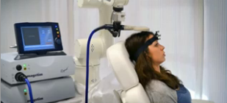
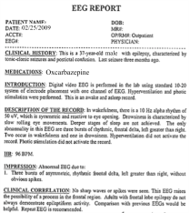
Automated Interpretation of EEGs
Goals: (1) To assist healthcare professionals in interpreting electroencephalography (EEG) tests,
thereby improving the quality and efficiency of a physician’s diagnostic capabilities; (2) Provide
a real-time alerting capability that addresses a critical gap in long-term monitoring technology.
Impact:
  Patients and technicians will receive immediate feedback rather than waiting days or weeks for results
  Physicians receive decision-making support that reduces their time spent interpreting EEGs
  Medical students can be trained with the system and use search tools make it easy to view patient histories and comparable conditions in other patients
  Uniform diagnostic techniques can be developed
Milestones:
  Develop an enhanced set of features based on temporal and spectral measures (1Q’2014)
  Statistical modeling of time-varying data sources in bioengineering using deep learning (2Q’2014)
  Label events at an accuracy of 95% measured on the held-out data from the TUH EEG Corpus (3Q’2014)
  Predict diagnoses with an F-score (a weighted average of precision and recall) of 0.95 (4Q’2014)
  Demonstrate a clinically-relevant system and assess the impact on physician workflow (4Q’2014)

