Slide 1
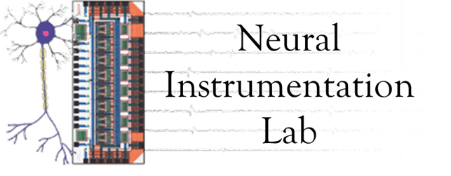
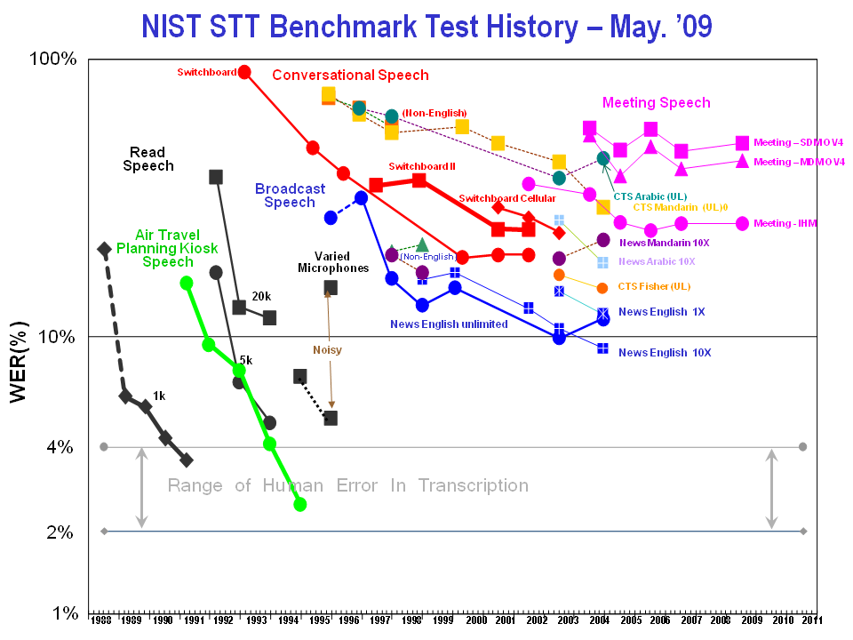
Accelerating the Rate of Technology Development in Neural Engineering Through a Common Evaluation Paradigm
Iyad Obeid PhD, Joseph Picone PhD
Temple University, Philadelphia, Pennsylvania
Abstract
The Neural Engineering Data Consortium (NEDC) is being launched to focus the research community on high-impact, common-interest neural engineering research questions. Critically, the NEDC will also generate and curate massive data sets to support statistically significant data-driven solutions to those problems. Competition-based evaluations on common data will drive progress by incentivizing innovation, especially from unfunded groups that are unable to generate their own data. NEDC’s first dataset will be the Temple University Hospital EEG Corpus (TUH-EEG), which will be the world’s largest publicly available database of clinical EEG data. The complete corpus is expected to be freely available by the end of 2013.
Proposed Research & Funding Model
Proof-of-Concept EEG Big Data Project
Industry
Data Corpus with 22,000 Clinical EEG records
Clinical data from Temple University Hospital
Over ten years of records
De-identified but fully annotated
Demographic data, medical history, presenting complaint, medications all included
Rich patient demographics and medical conditions
Will be made freely available
Expected Completion in Late 2013
PI
Funding Agencies
Research Questions
Neural Engineering Data
Consortium
Fees
Funded
PI
Unfunded
PI
Data
Data Design
Results
Funded
PI
Unfunded
PI
Data Generation
Funded
PI
Unfunded
PI
Results Scoring
Communal resources are pooled, allowing NEDC to create massive datasets, orders of magnitude larger than what any individual PI could generate
Data is custom tailored to resolve specific questions of interest to the community
Performance claims are easier to compare
Research community is focused on common problems
Existing Research & Funding Model
Funding Agencies
PI
Data
A Proven Paradigm
Research Question
Methods
Money
Results
PI
Data
Research Question
Methods
Money
Results
Organization
PI
Data
Board of Directors
Operations
Data Design
Data Collection
Data Delivery & IT Support
Research Question
Methods
Money
Results
There is a fundamental limit to how much data any single lab or group can produce
Each lab uses its own experimental protocols
Results between labs are hard to compare
Existing Funding Model
Comparison to Existing Resources
Progress
Over $200M spent by NIH & NSF alone on BCI & neural engineering in past decade
Additional investments by DARPA, ONR, others
Over 1700 peer-reviewed journal papers
Limitations
Relatively little commercial technology development
Relatively little translation from academia into industry
Risk of alienating the funding community
Is there a better way to invest resources?
Repositories
Physionet
Collaborative Research in Computational Neuroscience (CRCNS)
HeadIT (UCSD)
International Electrophysiology Portal (UPenn)
Swartz Center for Computational Neuroscience
NSF Data Sharing Policy
None are “common protocol”
We are not proposing just another repository!
Prize-Based Research
Berlin BCI Contest
X-Prize, Netflix, others
Speech processing field
Linguistics Data Consortium (LDC)
Massive common data corpora
Benchmark evaluations
Tiered consortium membership fees
Community resource serving academia and industry
Credited with enabling commercial technology development
Summary
NSF, DARPA seed funding in place
Recruiting Board of Directors
Seeking partners
Acknowledgements
Take the Survey!
What are your Big Data needs?
How can Big Data accelerate your research?
How could membership benefit you?
DARPA/MTO (D13AP00065)
NSF (CNS-1305190)
Temple University (College of Engineering and Office of Research)
www.nedcdata.org

