Slide 1
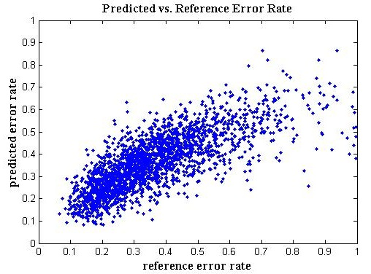
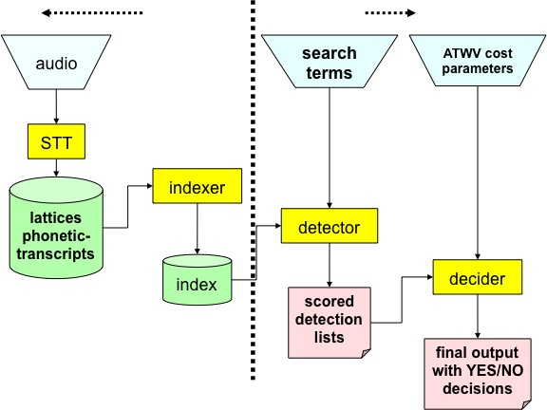
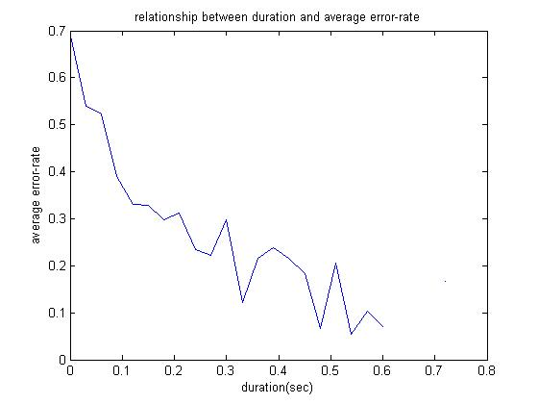
ASSESSING SEARCH TERM STRENGTH IN SPOKEN TERM DETECTION Amir Harati and Joseph Picone
Institute for Signal and Information Processing, Temple University
www.isip.piconepress.com
Introduction
Searching audio, unlike text data, is approximate and is based on likelihoods.
Performance depends on acoustic channel, speech rate, accent, language and confusability.
Unlike text-based searches, the quality of the search term plays a significant role in the overall perception of the usability of the system.
Goal: Develop a tool similar to how password checkers assess the strength of a password.
Core Features
Results
Duration Length No. of Syllables No. of Vowels No. of Consonants Phoneme Frequency BPC and CVC Frequency | Length/Duration No. Syllables/Duration No. Vowels/No. Consonants Start-End Phoneme 2-Grams of Phonemes 2-Grams of BPC 2- and 3-Grams of CVCs
Maximum correlation is 46%, which explains 21% of the variance.
Many of the core features are highly correlated.
KNN demonstrates the most promising prediction capability.
Data set is not balanced. Number of data points with low error rate is much more than points with high error rate which reduce the accuracy of the predictor.
A significant portion of the error rate is related to factors beyond the spelling of the search term, such as speech rate.
Features | Train |  |  | Eval
 | Reg | NN | DT | Reg | NN | DT
Duration | 0.46 | 0.43 | 0.48 | 0.44 | 0.40 | 0.45
Duration + No. Syllables | 0.46 | 0.45 | 0.53 | 0.46 | 0.38 | 0.46
Duration + No. Consonants | 0.46 | 0.46 | 0.54 | 0.46 | 0.46 | 0.39
Duration + No. Syllables + No. Consonants | 0.46 | 0.43 | 0.60 | 0.46 | 0.37 | 0.41
Dur. + Length + No. Syllables /Dur. | 0.47 | 0.45 | 0.80 | 0.46 | 0.40 | 0.29
Dur. + # Consonants + CVC2 + Length/Dur. + #Syllables/Dur. | 0.47 | 0.48 | 0.83 | 0.45 | 0.42 | 0.34
Class | Phone
Stops (S) | b p d t g k
Fricative (F) | jh ch s sh z zh f th v dh hh
Nasals (N) | m n ng en
Liquids (L) | l el r w y
Vowels (V) | iy ih eh ey ae aa aw ay ah ao ax oy ow uh uw er
Figure 5. Correlation between the predicted and reference error rates.
K | Train | Eval
1 | 0.97 | 0.32
3 | 0.74 | 0.43
100 | 0.54 | 0.53
400 | 0.53 | 0.51
Word | tsunami
Phonemes | t s uh n aa m iy
Vowels | uh aa iy
Consonants | t s n m
Syllables | Tsoo nah mee
BPC | S F V N V N V
CVC | C C V C V C V
Table 1- The correlation between the hypothesis and the reference WER for both training and evaluations subsets.
Figure 1. A screenshot of our demonstration software:
http://www.isip.piconepress.com/projects/ks_prediction/demo
Table 2. KNN’s predictions show a relatively good correlation with reference WER.
Spoken Term Detection (STD)
STD Goal: “…detect the presence of a term in large audio corpus of heterogeneous speech…”
STD Phases:
Indexing the audio file.
Searching through the indexed data.
Error types:
False alarms.
Missed detections.
Machine Learning Algorithms
Using machine learning algorithms to learn the relationship between a phonetic representation of a word and its word error rate (WER).
The score is defined based on average WER predicted for a word:
Strength Score = 1 − WER
Algorithms: Linear Regression, Feed-Forward Neural Network, Regression Tree and K-nearest neighbors (KNN) in the phonetic space.
Preprocessing includes whitening using singular value decomposition (SVD).
Two-layer, 30-neuron neural network that used back-propagation for training.
Experimentation
Duration is the most significant feature with around 40% correlation.
Summary
The overall correlation between the reference and predictions is not large enough.
One of the serious limitation for the current work was the size and quality of the data set.
Despite of all problems the developed system works and can help the users to choose better keywords.
Future Work
Use data generated from acoustically clean speech with proper speech rate and accent .
Finding features with small correlation to the existed set of features.
Using more complicated models such as nonparametric Bayesian models (e.g. Gaussian process.) for regression.
An extension of this work is currently under development with promising results.
Data Set | NIST Spoken Term Detection 2006 Evaluation Results
Sites | BBN | IBM | SRI
Sources | Broadcast News (3hrs) | Conversational Telephone Speech (3 hrs) | Conference Meetings (2 hrs).
Figure 3. An overview of our approach to search term strength prediction that is based on decomposing terms into features.
Figure 2. A common approach in STD is to use a speech to text system to index the speech signal (J. G. Fiscus, et al., 2007).
Figure 4. The relationship between duration and error rate shows that longer words generally result in better performance.

