Slide 1
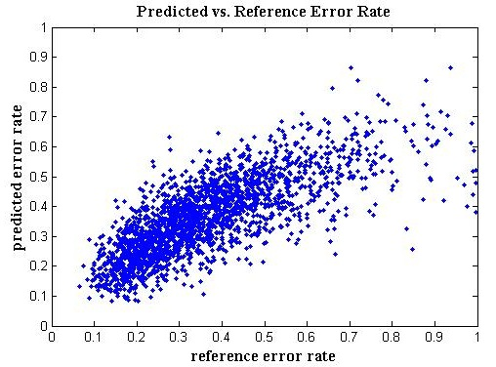
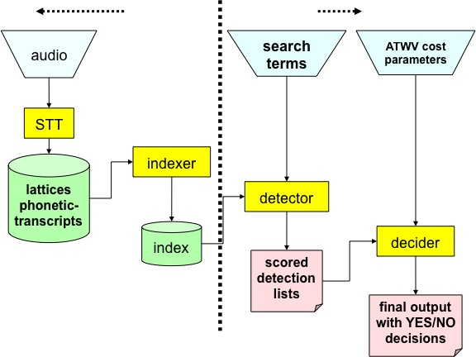
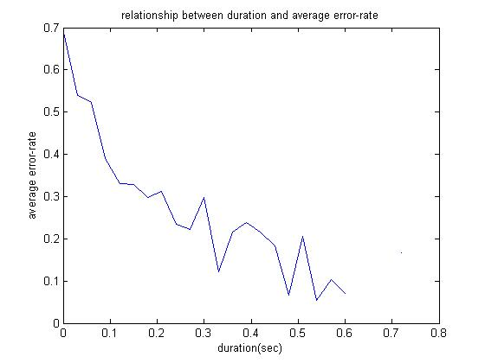
College of Engineering
Temple University
ASSESSING SEARCH TERM STRENGTH IN SPOKEN TERM DETECTION Amir Harati and Joseph Picone
Institute for Signal and Information Processing, Temple University
www.isip.piconepress.com
Introduction
Searching audio, unlike text data, is approximate and is based on likelihoods.
Performance depends on acoustic channel, speech rate, accent, language and confusability.
Unlike text-based searches, the quality of the search term plays a significant role in the overall perception of the usability of the system.
Goal: Develop a tool similar to how password checkers assess the strength of a password.
Search Term Strength Prediction
Using machine learning algorithms to learn the relationship between a phonetic representation of a word and its word error rate (WER).
Algorithms : Linear Regression, Neural Network, Regression Tree and K-nearest neighbors (KNN) in the phonetic space.
Features such as: Duration, #Syllables, #Consonants, broad phonetic class (BPC) frequencies. Biphone frequencies, 2-grams of the BPC.
Preprocessing includes whitening of the features using singular value decomposition (SVD).
The final strength score is defined as 1-WER.
Results
Features | Train |  |  |  |  |  | Eval
 | Regression |  | NN |  | DT |  | Regression |  | NN |  | DT
 | MSE | R | MSE | R | MSE | R | MSE | R | MSE | R | MSR | R
Duration | 0.045 | 0.46 | 0.057 | 0.43 | 0.044 | 0.48 | 0.045 | 0.46 | 0.060 | 0.40 | 0.046 | 0.45
Duration + No. Syllables | 0.045 | 0.46 | 0.055 | 0.45 | 0.041 | 0.53 | 0.045 | 0.46 | 0.060 | 0.38 | 0.046 | 0.46
Duration + No. Consonants | 0.045 | 0.46 | 0.055 | 0.46 | 0.040 | 0.54 | 0.046 | 0.46 | 0.058 | 0.41 | 0.051 | 0.39
Duration + No. Syllables + No. Consonants | 0.045 | 0.46 | 0.056 | 0.43 | 0.036 | 0.60 | 0.046 | 0.46 | 0.060 | 0.37 | 0.050 | 0.41
Duration + Length + No. Syllables /Duration | 0.044 | 0.47 | 0.055 | 0.45 | 0.021 | 0.80 | 0.045 | 0.46 | 0.059 | 0.40 | 0.068 | 0.29
Duration +#Consonants + Length/Duration + #Syllables / Duration +CVC2 | 0.044 | 0.47 | 0.049 | 0.48 | 0.018 | 0.83 | 0.046 | 0.45 | 0.054 | 0.42 | 0.065 | 0.34
Table1- Results for feature based method over NIST 2006.
Correlation between the prediction and reference is not satisfactory.
Insufficient amount of data.
Training data is not based on clean speech.
K | Train |  | Eval
 | MSE | R | MSR | R
1 | 0.00 | 0.97 | 0.05 | 0.32
3 | 0.02 | 0.74 | 0.03 | 0.43
100 | 0.03 | 0.54 | 0.03 | 0.53
400 | 0.03 | 0.53 | 0.03 | 0.51
Figure 1. A screenshot of our demonstration software:
http://www.isip.piconepress.com/projects/ks_prediction/demo
Figure 3. An overview of our approach to search term strength prediction that is based on decomposing terms into features.
Figure 5. The predicted error rate is plotted against the reference error rate, demonstrating good correlation between the two.
Table2- Results for KNN in Phonetic space for BBN dataset.
Spoken Term Detection (STD)
STD Goal: “…detect the presence of a term in large audio corpus of heterogeneous speech…”
STD Phases:
Indexing the audio file.
Searching through the indexed data.
Error types:
False alarms.
Missed detections.
Experimentation
Data: NIST Spoken Term Detection 2006 Evaluation results which includes BBN, IBM and SRI sites.
Correlation (R) and mean square error (MSE) are used to assess the prediction quality.
Duration is the most significant feature with around 40% correlation.
A duration model based on N-gram phonetic representation developed and trained using TIMIT dataset.
Observations
Prediction accuracy for the NIST 2006 results is relatively poor. Maximum correlation around 46% means just around 21% of the variance in the data is explained by the predictor.
Features used in this work are highly correlated.
KNN on phonetic space shows a better prediction capability.
Part of the error rate related to factors beyond the “structure” of the word itself. For example, speech rate or acoustic channel are greatly effect the error rate associated with a word.
Since the data used in this research is not restricted to acoustically clean data and with standard accent and speech rate, the trained models have some intrinsic inaccuracy.
Despite relatively low correlation the system can still be used in practice to help users to choose better search words.
Future Work
Use data generated carefully from acoustically clean speech with proper speech rate and accent for training.
Finding features with small correlation to the existed set of features. Among the candidates are confusability score and expected number of occurrences of a word in the language model.
Combining the outputs of several machines using optimization techniques such as particle swarm optimization (PSO).
Using more complicated models such as nonparametric Bayesian models (e.g. Gaussian process.) for regression.
We have developed algorithms based on some of these suggestions which improves the correlation to around 76% which corresponds to explaining 58% of the variance of the observed data. The results will be published in the near future.
Figure 2. A common approach in STD is to use a speech to text system to index the speech signal (J. G. Fiscus, et al., 2007).
Figure 4. The relationship between duration and error rate shows that longer words generally result in better performance.

