Slide 1
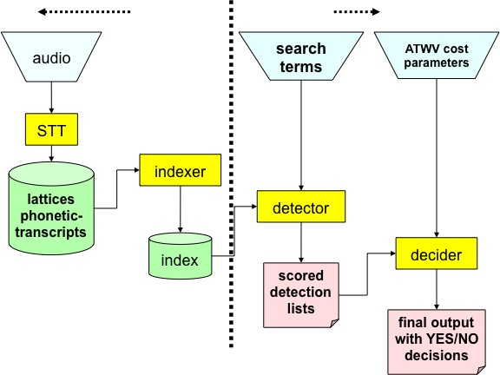
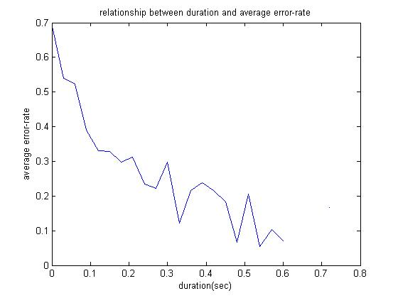
ASSESSING SEARCH TERM STRENGTH IN SPOKEN TERM DETECTION Amir Harati and Joseph Picone
Institute for Signal and Information Processing, Temple University
www.isip.piconepress.com
Introduction
Searching audio, unlike text data, is approximate and is based on likelihoods.
Performance depends on acoustic channel, speech rate, accent, language and confusability.
Unlike text-based searches, the quality of the search term plays a significant role in the overall perception of the usability of the system.
Goal: Develop a tool similar to how password checkers assess the strength of a password.
Search Term Strength Prediction
Using machine learning algorithms to learn the relationship between a phonetic representation of a word and its word error rate (WER).
Phonetic Space: Linear Regression, Neural Network, Regression Tree and K-nearest neighbors (KNN)
Features include: Duration, #Syllables, #Consonants, #vowels, monophone, broad phonetic class (BPC) and consonant-vowel-consonant (CVC) frequencies. Biphone frequencies, 2-grams of the BPC and CVC frequencies, and 3-grams of the CVC frequencies. (…. Reword this …)
Results
Correlation between the prediction and reference is not satisfactory.
Insufficient amount of data.
Training data is not based on clean speech.
Observations
Prediction accuracy for the NIST 2006 results is relatively poor. Maximum correlation around 46% means just around 21% of the variance in the data is explained by the predictor.
Using more data, better algorithms (random forest and KNN in acoustic space ), new features (count) and combining different approaches (using PSO optimizer), the predictions improve significantly. Correlation around 76% means predictor can explain around 57% of the variance in the data.
Part of the error rate related to factors beyond the “structure” of the word itself. For example, speech rate or acoustic channel are greatly effect the error rate associated with a word. Since the data used in this research is not restricted to acoustically clean data and with standard accent and speech rate, the trained models have some intrinsic inaccuracy.
Features | Train |  |  | Eval
 | LR | NN | DT | LR | NN | DT
Duration | 0.46 | 0.43 | 0.48 | 0.46 | 0.40 | 0.45
Duration + No. Syllables | 0.46 | 0.45 | 0.53 | 0.46 | 0.38 | 0.46
Duration + No. Consonants | 0.46 | 0.46 | 0.54 | 0.46 | 0.41 | 0.39
Duration + No. Syllables + No. Consonants | 0.46 | 0.43 | 0.60 | 0.46 | 0.37 | 0.41
Duration + Length + No. Syllables /Duration | 0.47 | 0.45 | 0.80 | 0.46 | 0.40 | 0.29
Duration + No. Consonants + Length/Duration + No. Syllables / Duration + CVC2 | 0.47 | 0.48 | 0.83 | 0.45 | 0.42 | 0.34
Table1- Results for feature based method over NIST 2006.
K | Train | Eval
3 | 0.74 | 0.03 | 0.43
100 | 0.54 | 0.03 | 0.53
400 | 0.53 | 0.03 | 0.51
Figure 1. A screenshot of our demonstration software:
http://www.isip.piconepress.com/projects/ks_prediction/demo
Figure 3. An overview of our approach to search term strength prediction that is based on decomposing terms into features.
Table2- Results for KNN in Phonetic space for BBN dataset.
Spoken Term Detection (STD)
STD Goal: “…detect the presence of a term in large audio corpus of heterogeneous speech…”
STD Phases:
Indexing the audio file.
Searching through the indexed data.
Error types:
False alarms.
Missed detections.
Experimentation
Data: NIST Spoken Term Detection 2006 Evaluation (… summarize stats …)
Assessment: correlation (R)
Duration is the most significant feature (quantify this …).
A duration model based on N-gram representation developed and trained using TIMIT dataset. (…reword this…)
Future Work
Use data generated carefully from acoustically clean speech with proper speech rate and accent for training.
Finding features with small correlation to the existed set of features (“count” was such a feature). Among candidates is confusability score.
Using more complicated models such as nonparametric Bayesian models (e.g. Gaussian process.) for regression.
Figure 2. A common approach in STD is to use a speech to text system to index the speech signal (J. G. Fiscus, et al., 2007).
Figure 4. The relationship between duration and error rate shows that longer words generally result in better performance.

