Slide 1
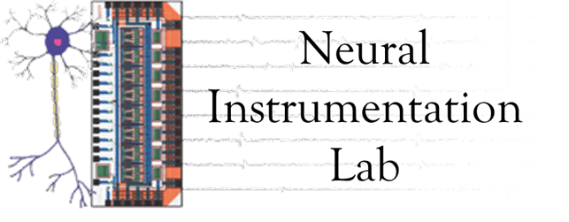
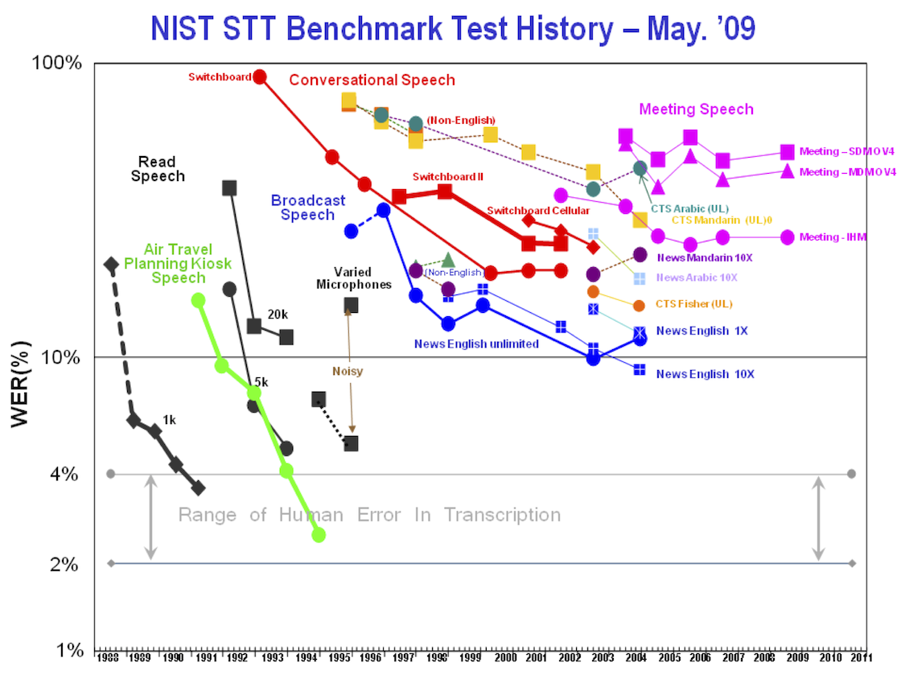
Bringing Big Data to Neural Interfaces
Iyad Obeid PhD, Joseph Picone PhD
Temple University, Philadelphia, Pennsylvania
Abstract
We present a new community-wide research resource called the Neural Engineering Data Consortium (NEDC). The NEDC will accelerate BCI research by creating, curating, and archiving massive common-protocol neural datasets. The need for massive datasets is justified by the innate variability in neuronal activity. By pooling the resources of the neural engineering community and making such data available, we will enable investigators to improve BCI performance metrics and increase robustness. A proof of concept data corpus comprising 20,000 clinical EEGs is presently under development.
Proposed Research & Funding Model
A Proven Paradigm
Industry
PI
Funding Agencies
Research Questions
Data
Consortium
Fees
Funded
PI
Unfunded
PI
Data
Data Design
Results
Funded
PI
Unfunded
PI
Data Generation
Funded
PI
Unfunded
PI
Results Scoring
Existing Research & Funding Model
Communal resources are pooled, allowing NEDC to create massive datasets, orders of magnitude larger than what any individual PI could generate
Data is custom tailored to resolve specific questions of interest to the community
Performance claims are easier to compare
Research community focused on common problems
Speech processing field
Linguistics Data Consortium (LDC)
Massive common data corpora
Benchmark evaluations
Tiered consortium membership fees
Community resource serving academia and industry
Credited with enabling commercial technology development
Funding Agencies
PI
Data
Research Question
Methods
Money
Results
PI
Data
Research Question
Methods
Money
Results
PI
Data
Research Question
Methods
Comparison to Existing Resources
Money
Results
There is a fundamental limit to how much data any single lab or group can produce
Each lab uses its own experimental protocols
Results between labs are hard to compare
Repositories
Physionet
Collaborative Research in Computational Neuroscience (CRCNS)
Swartz Center for Computational Neuroscience
NSF Data Sharing Policy
None are “common protocol”
We are not proposing just another repository!
Prize-Based Research
Berlin BCI Contest
X-Prize, Netflix, others
Proof-of-Concept EEG Big Data Project
Data Corpus with 20,000 Clinical EEG records
Clinical data from Temple University Hospital
De-identified but fully annotated
Demographic data, medical history, presenting complaint, medications all included
Will be made freely available
Expected Completion in Early 2014
Existing Funding Model
Progress
Over $200M spent by NIH & NSF alone on BCI & neural engineering in past decade
Additional investments by DARPA, ONR, others
Over 1700 peer-reviewed journal papers
Limitations
Relatively little commercial technology development
Relatively little translation from academia into industry
Risk of alienating the funding community
Is there a better way to invest resources?
Organization
Board of Directors
Operations
Data Design
Data Collection
Data Delivery & IT Support
Summary
NSF, DARPA seed funding in place
Recruiting Board of Directors
Seeking partners

