Slide 1
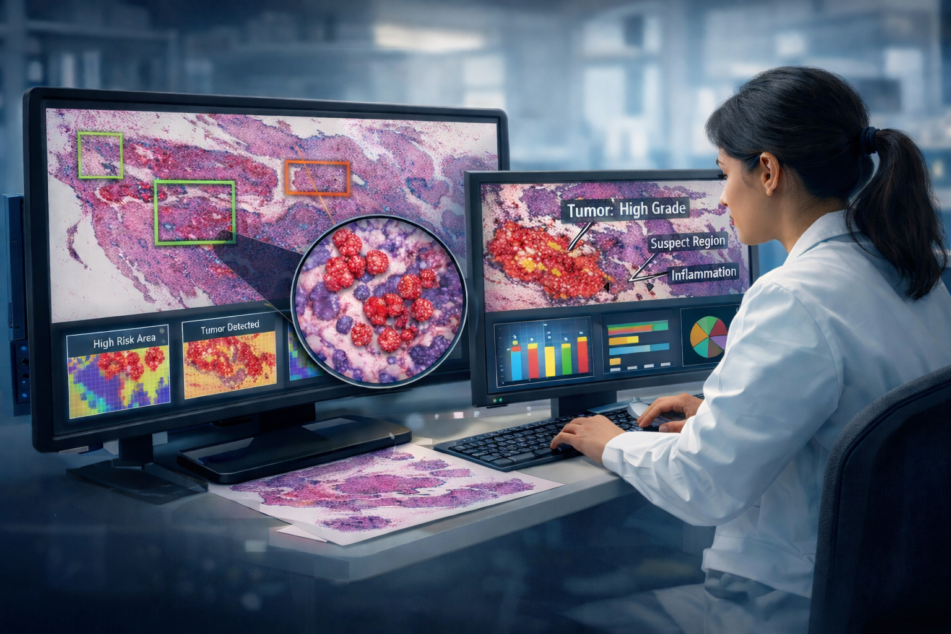

NEBEC 2026 | April 16, 2026
Automated Interpretation and Visualization in Digital Pathology
M.A. Al Mamun, S. Purba, I. Obeid and J. Picone
The Neural Engineering Data Consortium
Temple University, Philadelphia, PA

Slide 2
Conflict of Interest Disclosure
The authors have nothing to disclose.
This work was supported by the National Science Foundation (grants 2211841,1726188, 1925494), the Temple University Catalytic Collaborative Funding Initiative, and the PA Breast Cancer Coalition.

Slide 3
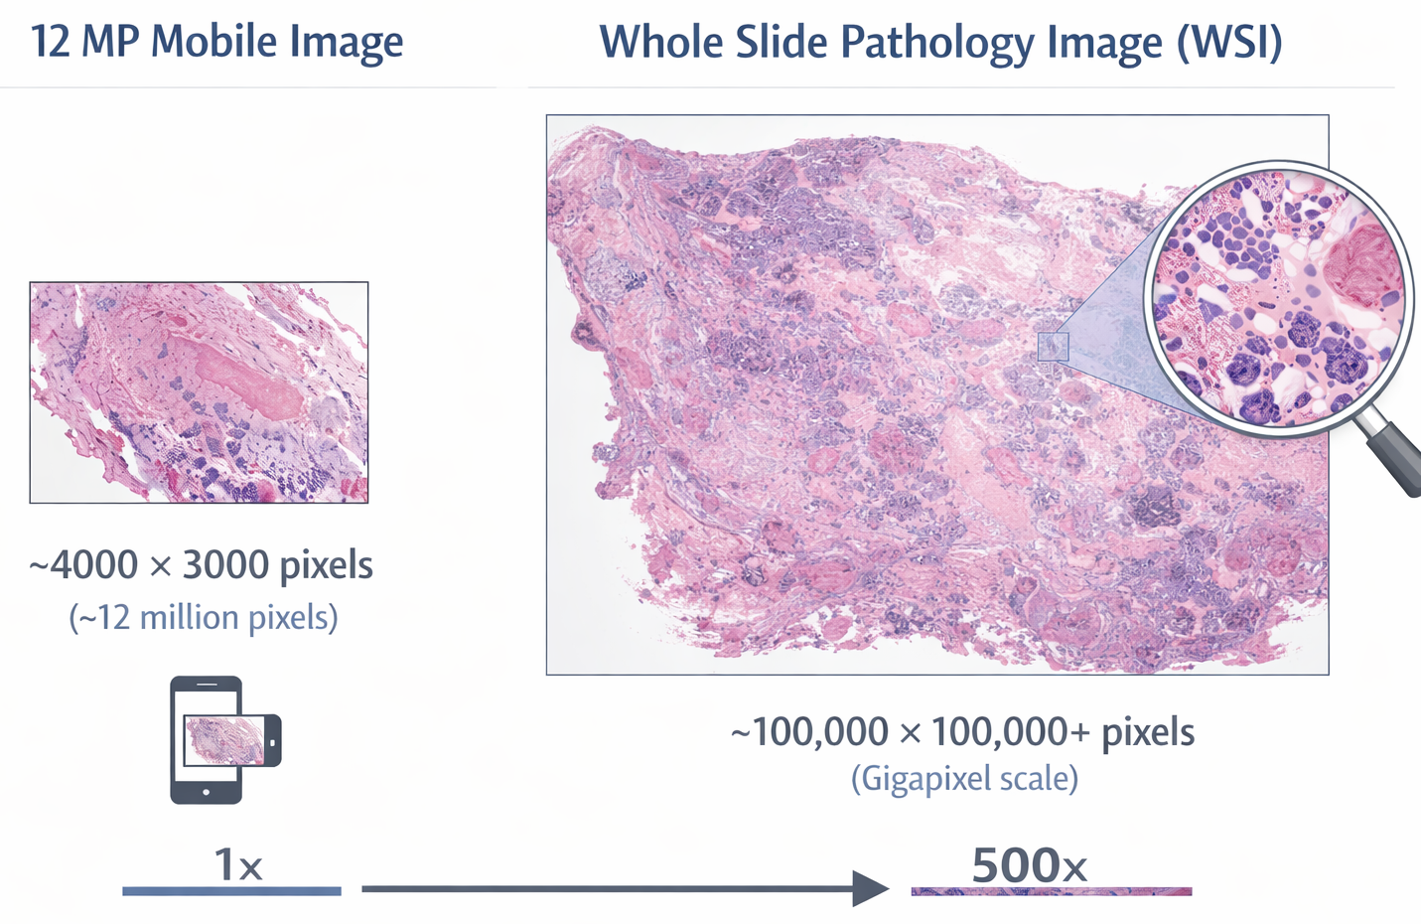
The Challenge
1 WSI: 50K x 50K pixels
~2.5 billion pixels per image
~2% of tissue is annotated
Extreme class imbalance
Caseloads up 25%
Workforce not keeping pace
Not a standard image classification problem —
an engineering challenge at gigapixel scale

Slide 4


Open Source Data
TUBR
Temple University Hospital
FCBR
Fox Chase Cancer Center
3,505 WSIs, 296 patients
~1.2 TB of H&E-stained images
22,241 polygon annotations
Avg ~6.3 annotations/slide
1,463 oncology-focused WSIs
~336 GB from ~1,397 patients
20,086 polygon annotations
Avg ~13.7 annotations/slide
dcis
indc
nneo
infl
norm
susp

Slide 5
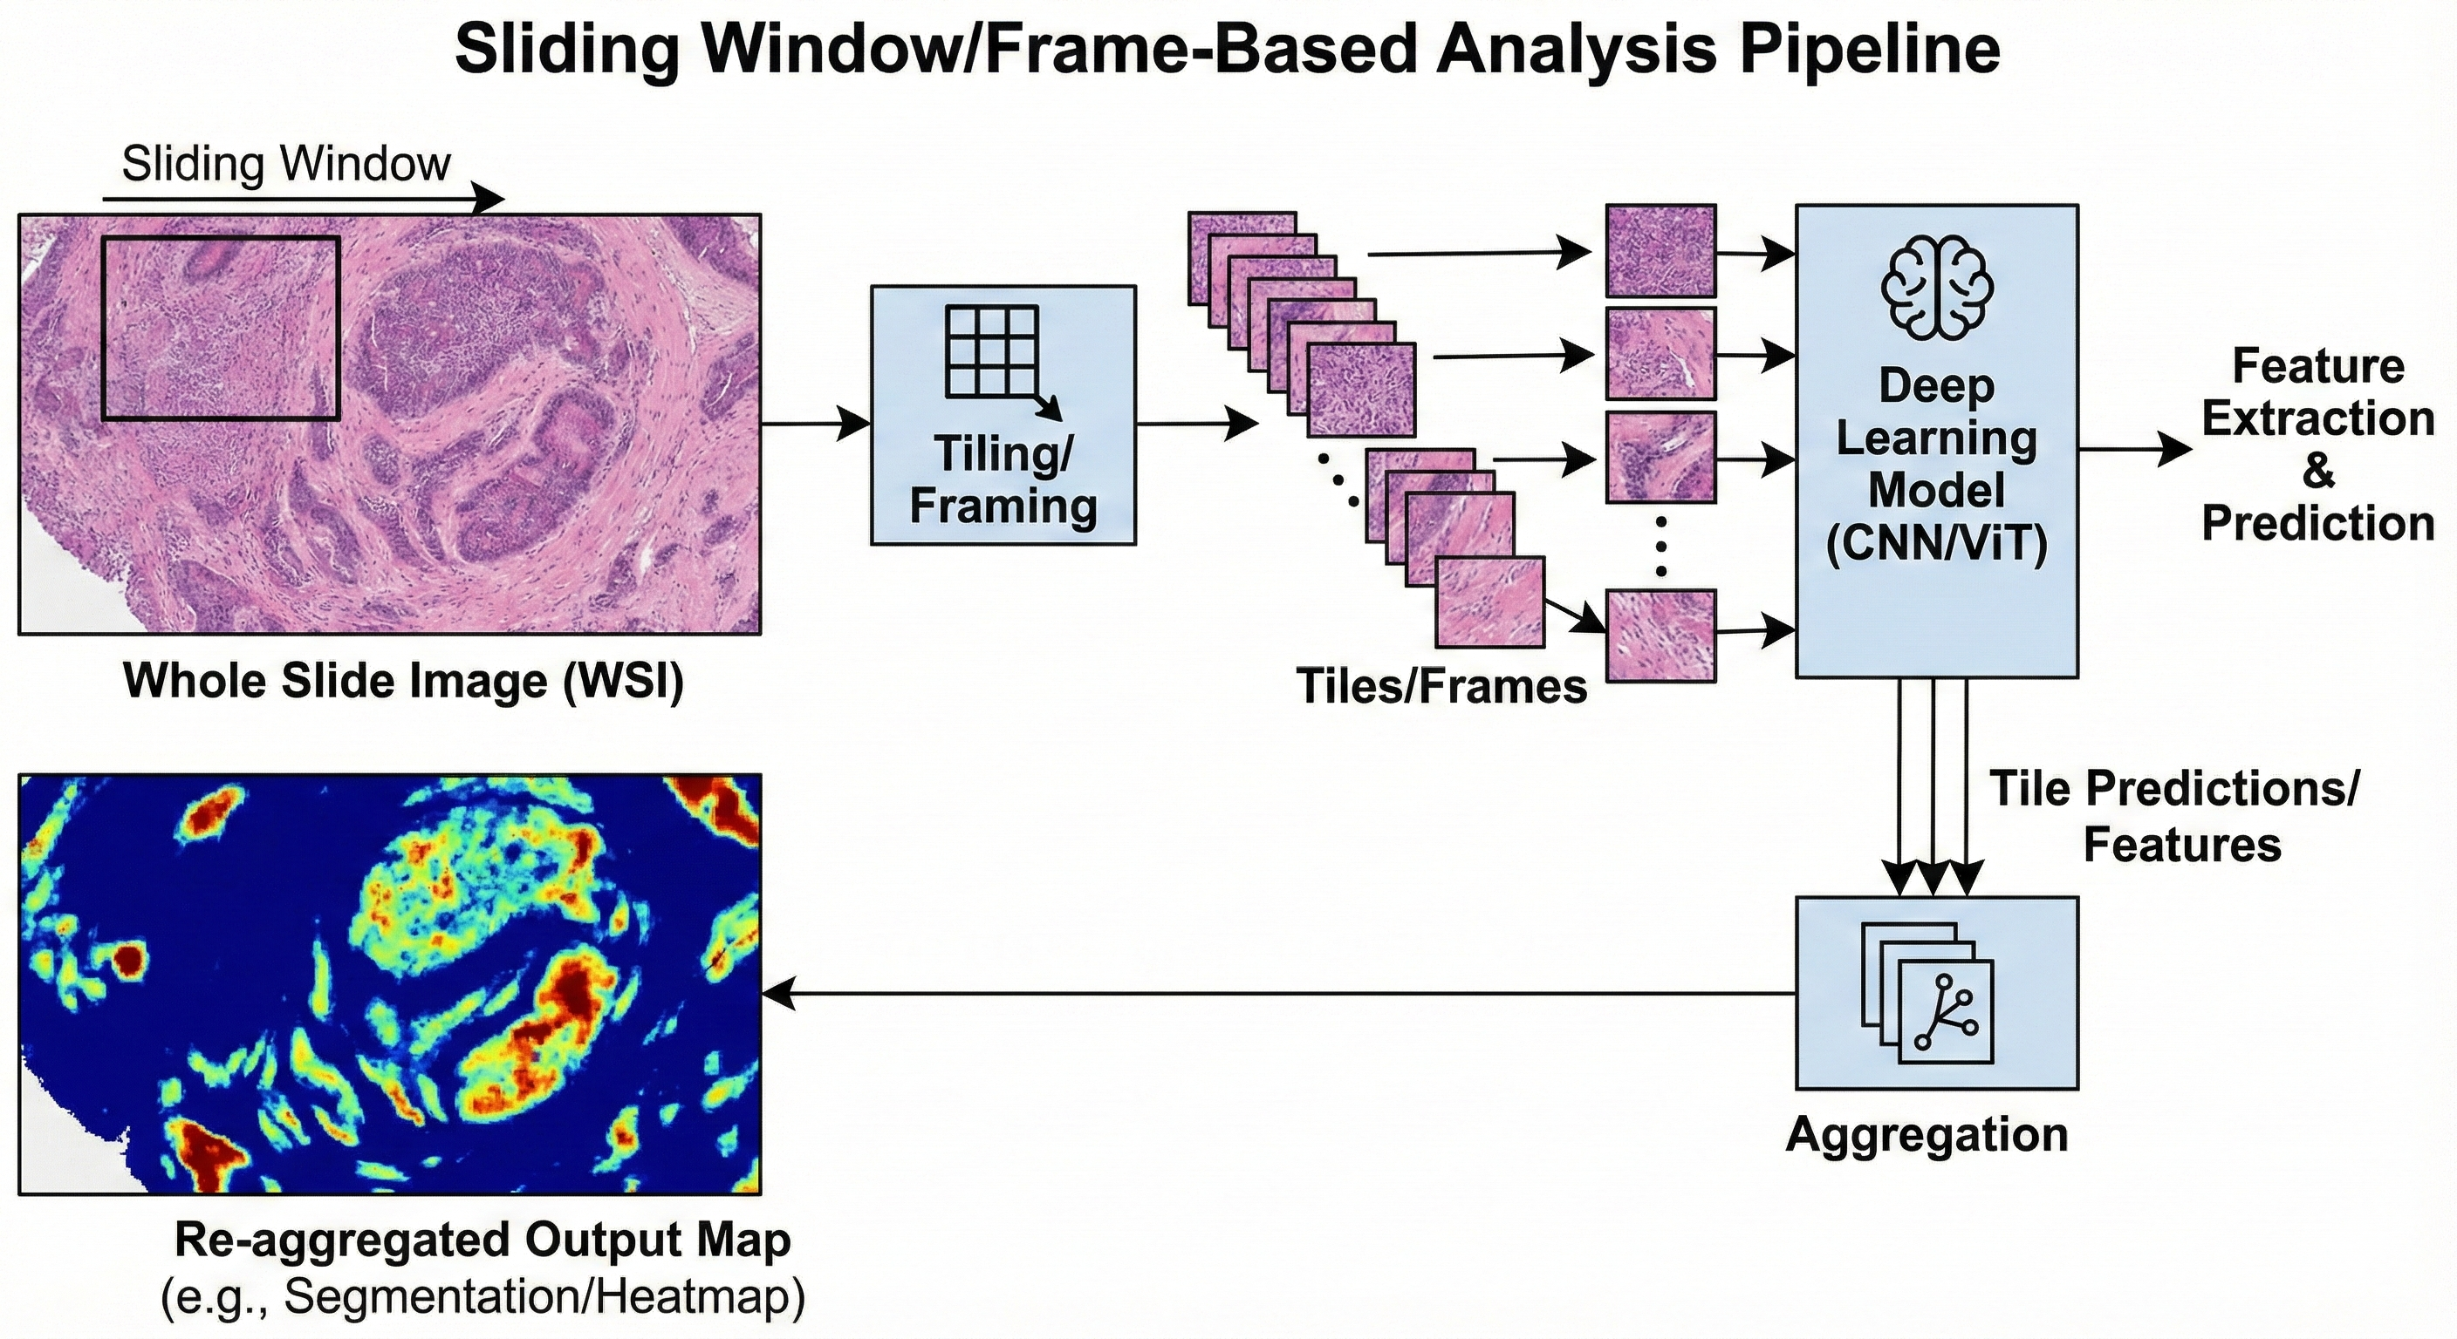
System Architecture
1
Preprocessing
Tile WSI into | 1024×1024 patches | Background removal
▶
2
Decoding
Sliding window | Classification | EB0 default engine
▶
3
Post-Processing
Open source (nedcdata.org)
Modular design
Swap any model or algorithm
Frame aggregation | Smoothing | Boundary refinement
▶
4
Visualization
Interactive GUI | Heatmap overlay | Confidence metrics

Slide 6
Model Selection and Engineering Trade-offs
Architecture | Parameters | MDICE TUBR | MDICE FCBR | Decode Speed
ResNet-18 | 11.69M | 33.28 | 42.11 | 1.0x
EB0 | 5.03M | 46.76 | 49.34 | 0.9x
EB7 | 66.35M | 43.81 | 55.82 | 2.1x
ViT-16 | 86.60M | 44.72 | 25.07 | 1.9x
ViT-32 | 88.20M | 41.39 | 28.06 | 2.3x
Key Finding: EB0 (5M params) outperforms models 17× its size. Smaller model + sparse annotations = less overfitting. Selected as default for speed + accuracy.

Slide 7
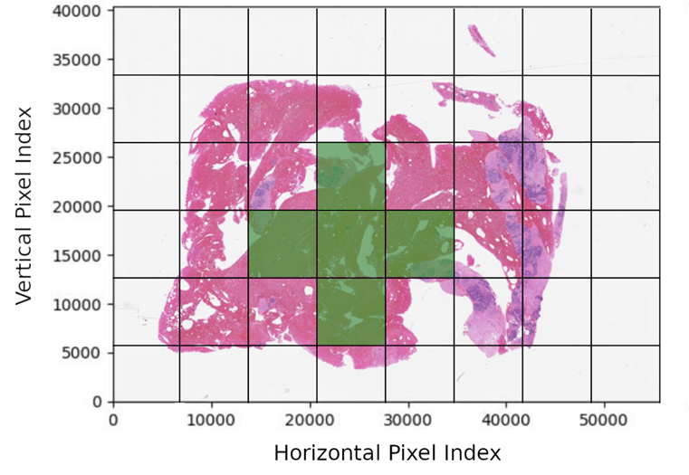
Post-Processing
→
Raw Patch Predictions
Identifying Enclosed Region
Post-Processed (Holes Filled)
Smoothing refines each prediction via weighted neighbor consensus. MDICE: 46.76% on TUBR vs. 40.56% with dilation.

Slide 8

A Demonstration Video
Load WSI → Visualize(pan around/zoom) → Decode → Post-process → Visualize & Compare

Slide 9
Results and Impact
Quantitative Results
25.50% Weighted Error, TUBR (EB7)
25.00% Weighted Error, FCBR (EB7)
46.76% Best MDICE, TUBR (EB0)
55.82% Best MDICE, FCBR (EB7)
Clinical Impact
Automated Triage
Prioritize high-risk slides
Diagnostic Consistency
Standardized second opinion
Training Platform
Residents study tissue morphology
Workforce Relief
Less searching, more interpreting
First published benchmarks on these tasks

Slide 10
Summary and Future Directions
Streaming Architectures
Process slides incrementally without full WSI in memory
Crystallization Analysis
Detect microcalcifications (Type I vs. II) as prognostic biomarkers
Multimodal Integration
Combine morphology with molecular and genomic data
"The goal was never to build another black box —
it was to build a tool where pathologists can
see what the AI sees."

Slide 11


Dataset, Code and Models
Open-source Dataset, Code, Models are available on
nedcdata.org
isip.piconepress.com

Slide 12
Appendix
WSI → Whole Slide Image
H&E → Hematoxylin and Eosin (staining)
TUBR → Temple University Breast Repository (contextual dataset name)
FCBR → Fox Chase Breast Repository (contextual dataset name)
kNN → k-Nearest Neighbors
MDICE → Modified Dice Coefficient
EB0 / EB7 → EfficientNet-B0 / EfficientNet-B7
GUI → Graphical User Interface
AI → Artificial Intelligence
NSF → National Science Foundation
NEBEC → Northeast Bioengineering Conference
SPMB → Signal Processing in Medicine and Biology Symposium
TB → Terabyte
GB → Gigabyte

Slide 13
Acknowledgements
This material is based on work supported by several organizations over the years, including the National Science Foundation (grants nos. CNS-1726188 and 1925494), the Temple University Catalytic Collaborative Funding Initiative and most recently by the Pennsylvania Breast Cancer Coalition Breast and Cervical Cancer Research Initiative. Any opinions, findings, and conclusions or recommendations expressed in this material are those of the author(s) and do not necessarily reflect the views of these organizations.
Many people have contributed to this work including (listed alphabetically):
Undergraduate Students: Maria Bagritsevich, Ben Doshna, Dmitry Hackel, Dylan Heathcote, Zoe Wevodau and several generations of annotators.
Graduate Students: Claudia Dumitrescu. Somayeh Seifi Shalamzari and Nabila Shawki
Medical Professionals: Many members of the Temple University Health System have contributed to this project including Denise Connolly, Tunde Farkas, Nirag Jhala, Yuri Persidsky and Chao Wu.

Slide 14
Selected References
Hackel, D., Bagritsevich, M., Dumitrescu, C., Al Mamun, Md. A., Purba, S. A., Heathcote, D., Obeid, I., & Picone, J. (2026). Enabling Microsegmentation: Digital Pathology Corpora for Advanced Model Development. In Signal Processing in Medicine and Biology: Applications of Artificial Intelligence in Medicine and Biology (Vol. 1, p. 50). Springer. url: https://isip.piconepress.com/publications/book_sections/2026/springer/dpath/.
Al Mamun, A., Purba, S., Obeid, I., & Picone, J. (2026). Automated Interpretation and Visualization in Digital Pathology. Proc. of the North-east Bioengineering Conf. (NEBEC), 1–3. url: https://isip.piconepress.com/publications/conference_presentations/2026/nebec/dpath.
Dumitrescu, C., Hackel, D., Obeid, I., & Picone, J. (2025). Crystallization Signatures as Predictive Biomarkers in Histopathology. Proceedings of the IEEE Signal Processing in Medicine and Biology Symposium (SPMB), 1, 1–6. doi: 10.1109/SPMB67169.2025.11345371.
Bagritsevich, M., Hackel, D., Obeid, I., & Picone, J. (2024). Annotation of the Fox Chase Cancer Center Digital Pathology Corpus. Proceedings of the IEEE Signal Processing in Medicine and Biology Symposium, 1–4. doi: 10.1109/SPMB62441.2024.10842255.
Shalamzari, S. S., Bagritsevich, M., Melles, Anne-Mai, Obeid, I., Picone, J., Connolly, D., Wu, C., Brown, B., James, J., Gong, Y., & Wu, H. (2023). Big Data Resources for Digital Pathology. Proceedings of the IEEE Signal Processing in Medicine and Biology Symposium (SPMB), 1–19. doi: 10.1109/SPMB59478.2023.10372721.
Simons, J., Wevodau, Z., Doshna, B., Obeid, I., & Picone, J. (2021). The Temple University Hospital DPATH Corpus: Annotation Guidelines (p. 18). Temple University. url: https://isip.piconepress.com/publications/reports/2021/tuh_dpath/annotations/.
Doshna, B., Wevodau, Z., Jhala, N., Akhtar, I., Obeid, I., & Picone, J. (2021). The Temple University Digital Pathology Corpus: The Breast Tissue Subset. In I. Obeid, I. Selesnick, & J. Picone (Eds.), Proceedings of the IEEE Signal Processing in Medicine and Biology Symposium (SPMB) (pp. 1–3). IEEE. doi: https://doi.org/10.1109/SPMB52430.2021.9672275.
Shawki, N., Shadhin, M. G. M., Elseify, T., Jakielaszek, L., Farkas, T., Persidsky, Y., Jhala, N., Obeid, I., & Picone, J. (2020). The Temple University Digital Pathology Corpus. In I. Obeid, I. Selesnick, & J. Picone (Eds.), Signal Processing in Medicine and Biology: Emerging Trends in Research and Applications (1st ed., pp. 67–104). doi: 10.1007/978-3-030-36844-9.
Hunt, I., Husain, S., Simons, J., Obeid, I., & Picone, J. (2019). Recent Advances in the Temple University Digital Pathology Corpus. I. Obeid & J. Picone (Eds.), Proceedings of the IEEE Signal Processing in Medicine and Biology Symposium (SPMB) (pp. 1-4). doi: 10.1109/SPMB47826.2019.9037859.

Slide 15
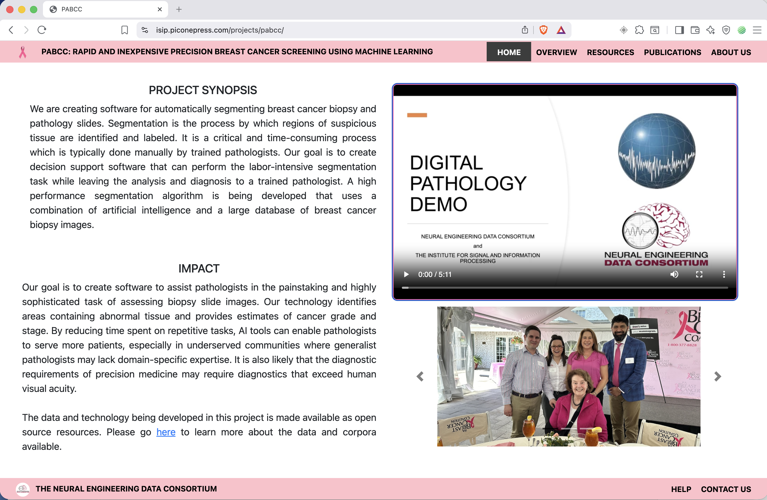
A Demonstration Video

