Slide 1


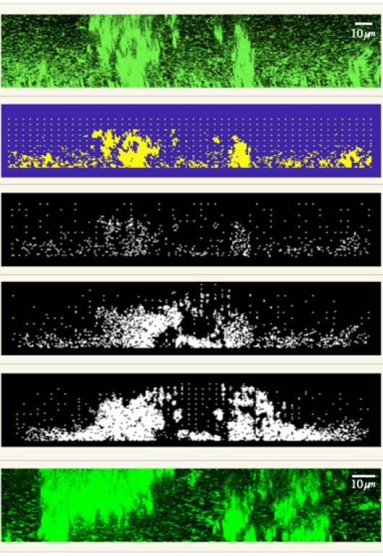
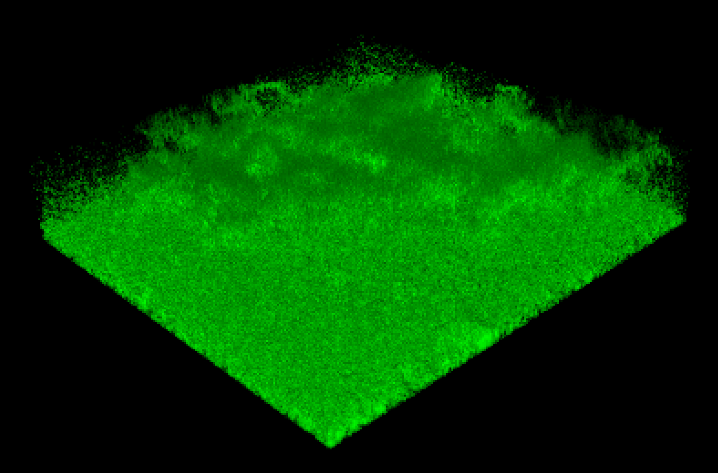
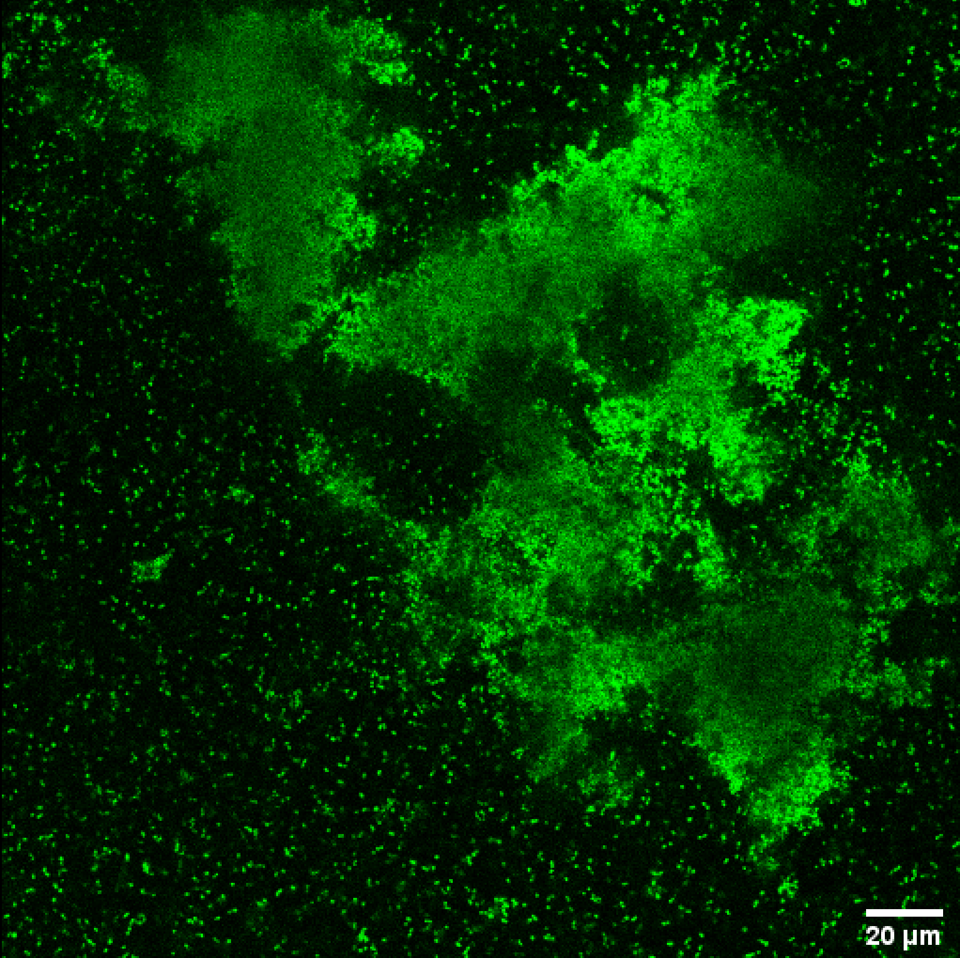
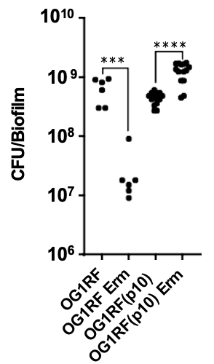
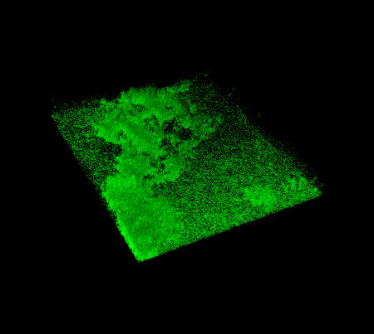
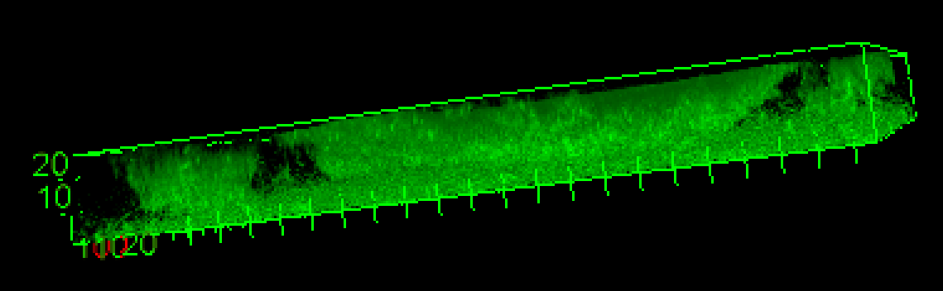
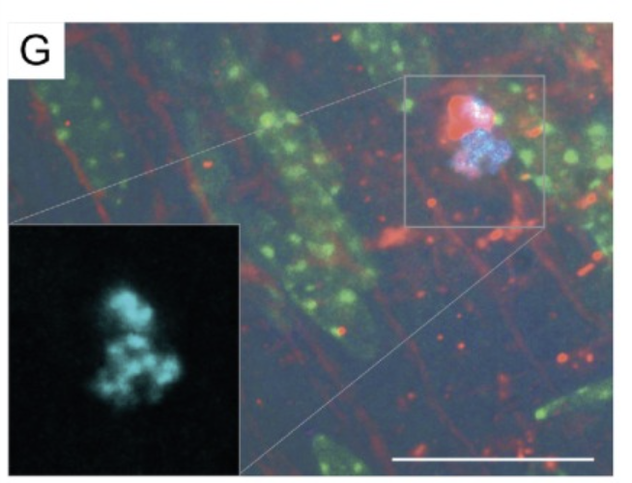
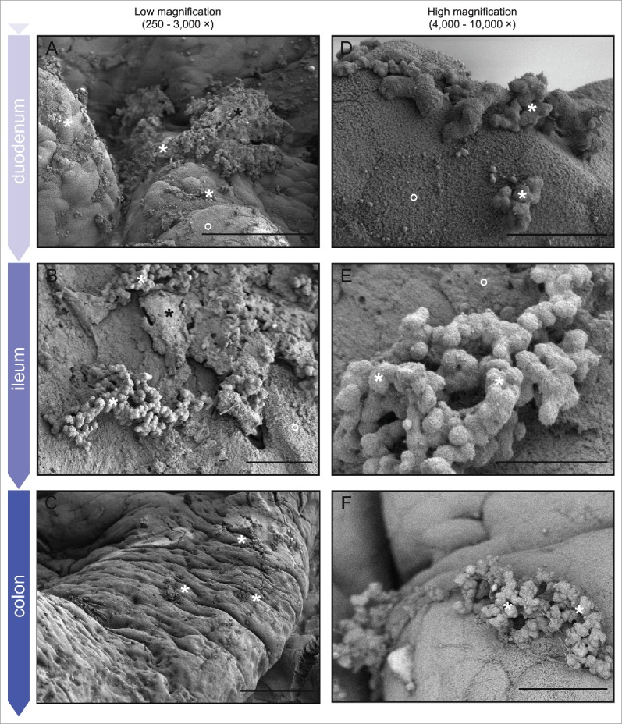

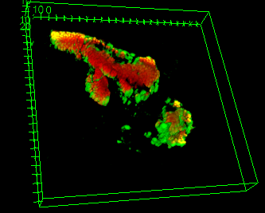
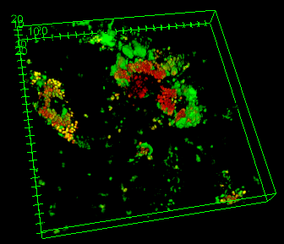
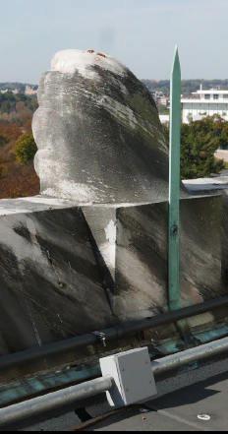
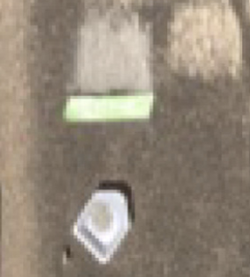
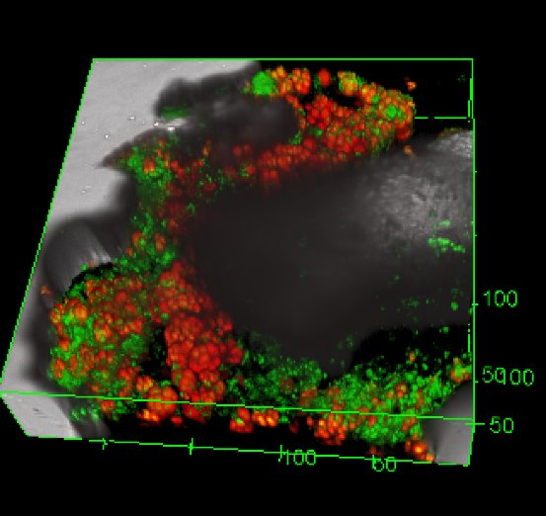
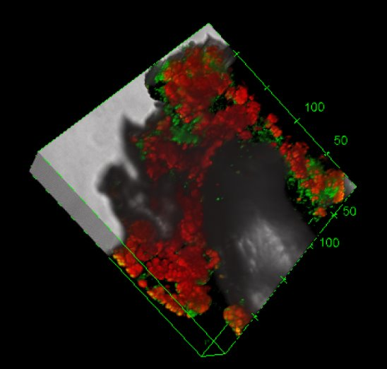
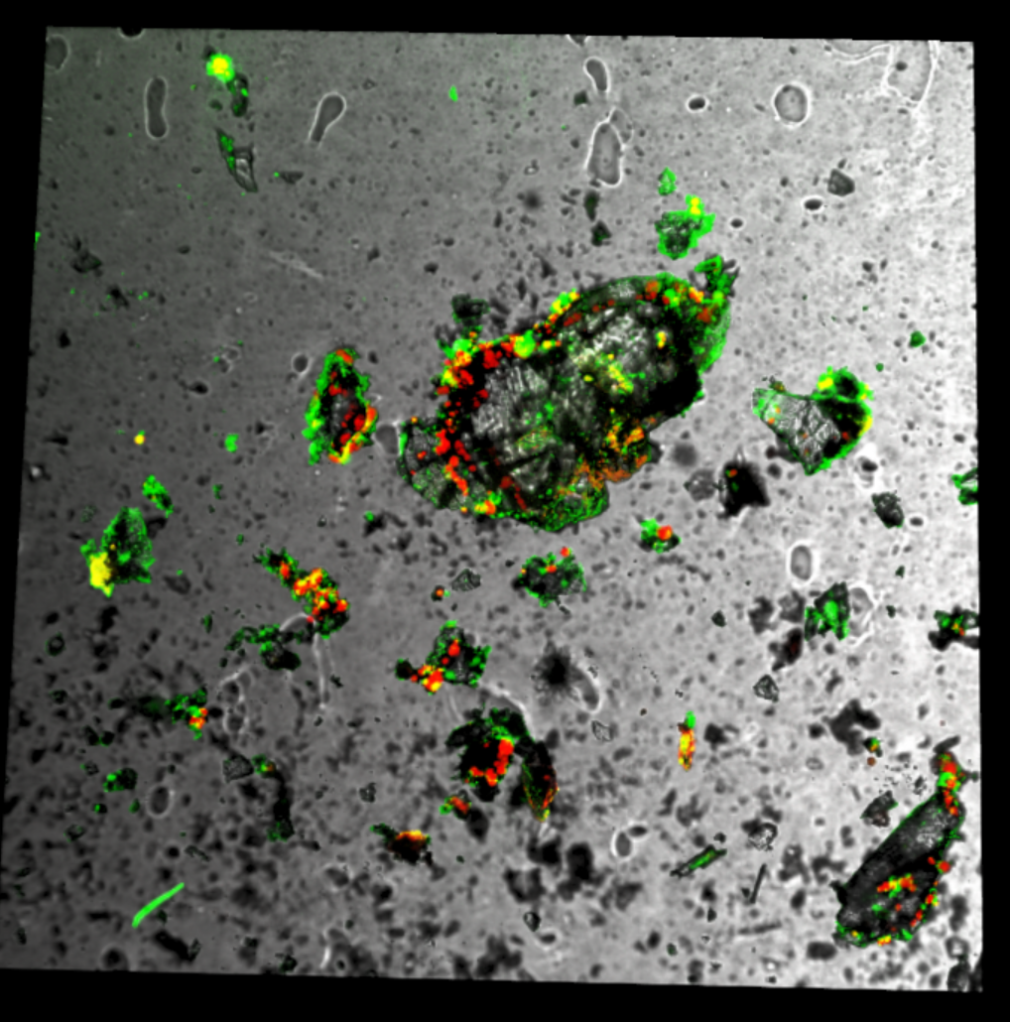
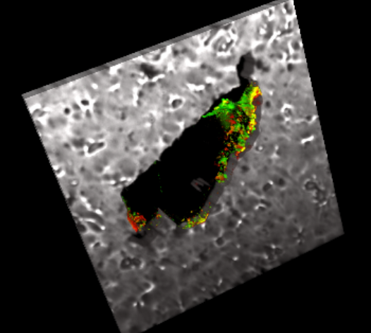
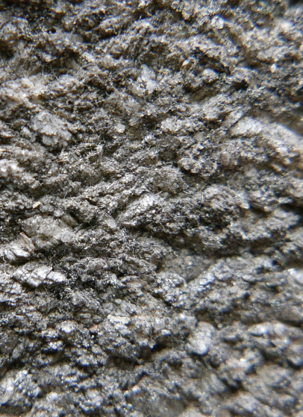
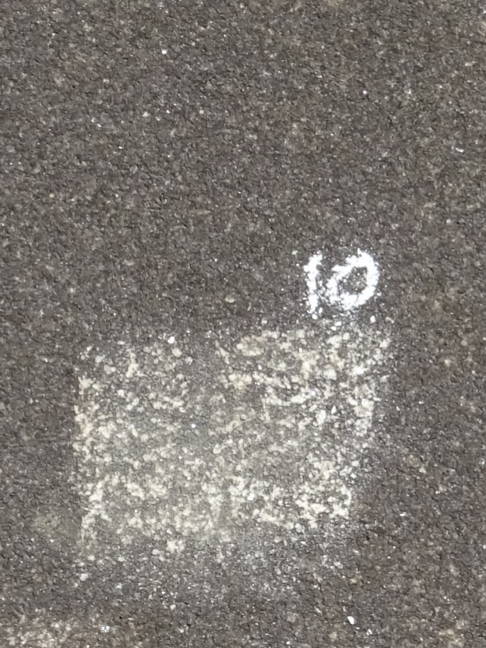

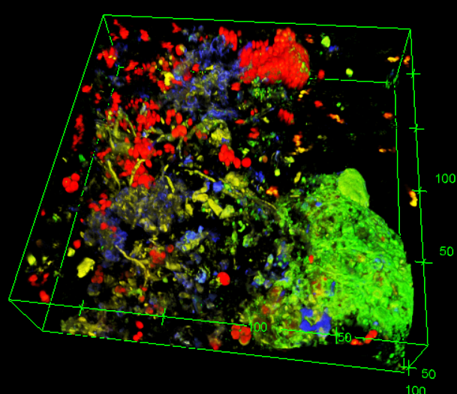
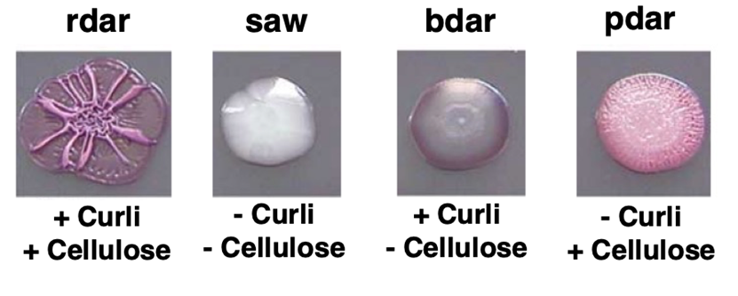
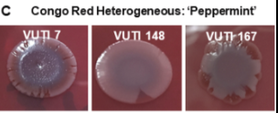
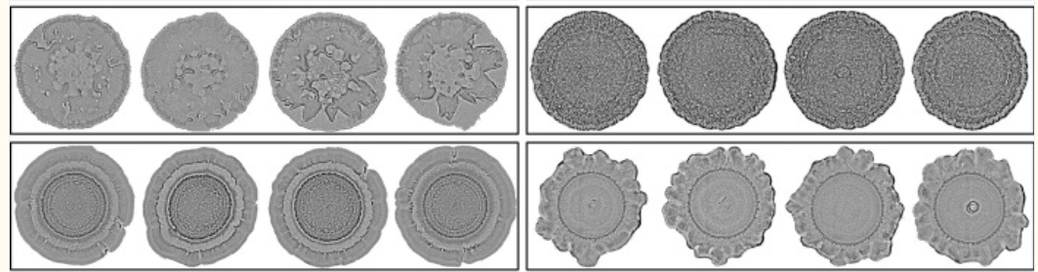
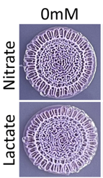
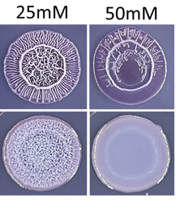
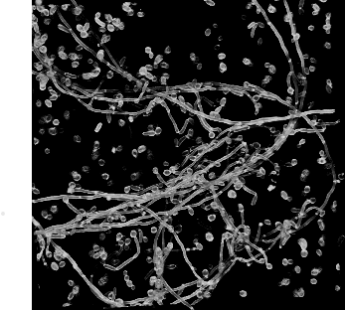
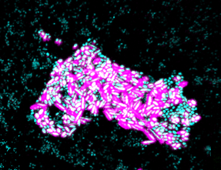
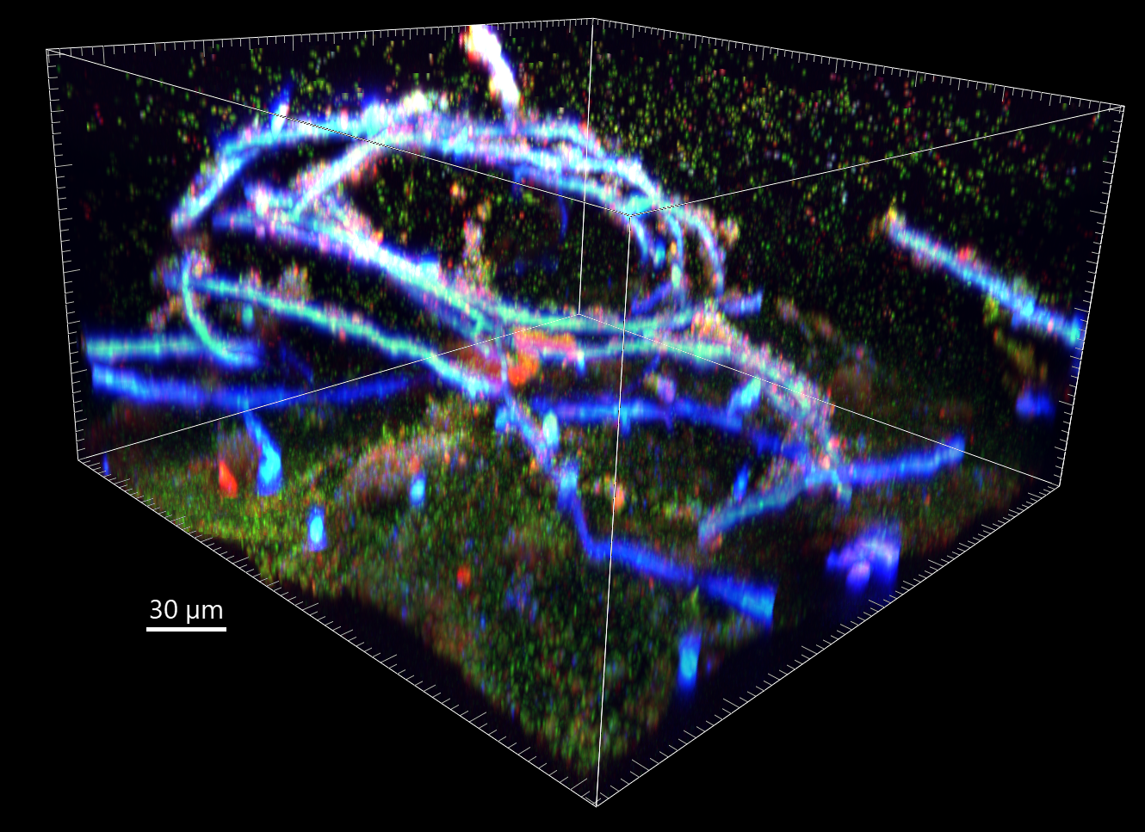
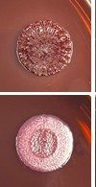
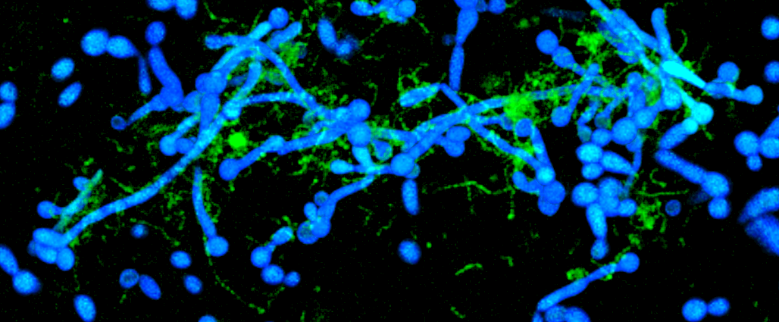
Why do we need a Biofilm Imaging Library?
(A Community Discussion – What to study?)
Bettina Buttaro¹ , Heidi Smith², Al Parker^{2,3} and Joseph Picone⁴
¹ Lewis Katz School of Medicine, Temple University; ² Center for Biofilm Engineering, MSU;
³ Department of Mathematical Sciences, MSU; ⁴ College of Engineering, Temple University
Purpose
Protection from Antibiotics or Toxic Assaults
To accurately explain behavior of complex microbial biofilm communities and their ability to resist toxic assaults, one needs to combine mathematical simulation models to predict bacterial behavior coupled with machine learning to recognize structures and their organization. The Biofilm Imaging Library (BIL) is a collaboration between multidisciplinary teams of biologists, 3-D imaging specialists, applied mathematicians and machine learning researchers working to curate large data sets necessary for machine learning based models to predict biofilm behavior based on 3-D structural, spatial and temporal arrangements.
Complex structures with aggregated bacteria and an eDNA cover
Protection from 100X MIC antibiotic erythromycin
Math simulation model
BIL and Machine Learning
Training sets for ML to quantitate aggregates in biofilms and determine if they are organized to protect against antibiotics and toxic assaults.
Developing math models to predict protection by aggregate organization and using contributions from other biofilm components.
Doubling bacterial population
Increased volume of aggregates
Untreated Biofilm Image
Computational Grid
Multi-kingdom
Laboratory Models
Mold and yeast: Uvitex 2B Bacteria: Live/Dead (SYTO9+PI)
82/113
Aggregates only
A. Alternata mold
C. Parapsilosis yeast
M. petrolearium
M. invictum
S. desiccabilis
S. maltophilia
20 μm
Aggregates + eDNA Diffusion
20 μm
20 μm
Aggregates + eDNA Diffusion/Reaction
Mold and yeast:
Uvitex 2B
Bacteria:
SYTO9
Using stochastic cellular automata to model and define sufficient conditions for the survival of Enterococcus faecalis biofilms with the pCF10 plasmid under erythromycin treatment. Madison Shoraka, Herby Jean-Baptiste, Bettina Buttaro, Gillian Queisser, PLOS Comp Biol, revised and resubmitted.
20 μm
Ghazal Vahidi, PhD
100 μm
15 μm
Treated Biofilm Image
Multispecies Biofilms: Arrangement of Interdependent Subcommunities
Scaling Across Large Areas
Subaerial Biofilms
Cyanobacteria (red) fix all the carbon for the system
Mathematical model: Heterotrophs can get carbon from small released organic acids as a byproduct of photosynthesis and buffer pH for continued Cyanobacterial growth
  Tenore A, Russo F, Jacob J, Grattepanche JD, Buttaro B, Klapper I. Bull Math Biol. 2024
Mathematical model: Water activity is required for growth.
  Tenore A, Wu Y, Jacob J, Bittermann D, Villa F, Buttaro B, Klapper I. Sci Total Environ. 2023.
Live Cooperation?
Multispecies Laboratory Models
On a surface sometimes you see biofilms sometimes you don’t – why?
Initial colonization is stochastic (single or multiple species of bacteria must land on it).
The environment needs to be right (e.g., can it bind, is there enough water, nutrients, how much competition is present).
What do these biofilm communities look like over the whole gastrointestinal tract or industrial system or garment or a marble monument?
Rhodotorula mucilaginosa
Yeast CFW
Psuedomonas aeruginosa
Bacteria Live/Dead (SYTO9+PI)
Surrounding heterotrophs producing eDNA help with water?
Interdigitated heterotrophs help with buffering pH?
20 μm
30 μm
Dead
Competition?
Mold and yeast: Uvitex 2B Bacteria: Live/Dead (SYTO9+PI)
Germ-free mouse colonization model
E. faecalis OG1RF (Cyan)
Polysaccharides(Red, WGA)
GI epithelium (Autofluorescence Green)
Dunny Laboratory. Virulence. 2017 PMID: 27562711
200 μm
BIL: macroscale modeling using machine learning to bridge the scales
30 μm
30 μm
Top
Bottom
200 μm
2x3 cm
sample
Scrap and laser scanning confocal imaging of particles
Ongoing: 16S rRNA sequencing and hybridization for species
30 μm
Ghazal Vahidi, PhD
30 μm
200 μm
BIL and Machine Learning:
Building tools to group bacteria into interdependent subcommittees and predict interactions based on experiments, models, metabolomic and transcriptomic data.
200 μm
200 μm
Black/grey biofilm
1 cm
Colony Morphologies as Diagnostic Tools to predict Clinical Outcomes
Quantitation of Fungal Hyphae
Large databases of clinical strains and associated patient data are being collected.
Appearance of colony biofilms is influenced by expression of virulence factors such as amyloids (patterned rigid regions), types and amounts of extracellular polysaccharides (mucoid appearance), and lipoproteins.
Hypermutable strains and phase variation leads to vectored colony morphologies and high colony morphology switching rates.
Morphology differences can be seen due to differences in growth conditions including nutrients (agar types) and temperatures.
Strains can be classified by colony morphology using machine learning.
Studies have revealed that colony phenotypes can correlate with disease severity outcomes.
BIL: string-like structures formed by fungal hyphae and bacterial chains can be difficult to quantitate – machine learning needs to be trained on as many images as possible to be accurate
Fungal hyphae are string-like structures of varying lengths and can be extremely long.
Hyphae can tangle and form knots.
Hyphae an be part of multi-species biofilms.
Hyphae be interwoven with bacterial chains, which are also hard to quantitate.
Fungi (Yellow) Cyanobacteria
(Red)
Bacteria
(Green)
New virulence factor discovery
Escherichia coli UPEC Clinical Isolates
Machine learning for classification of Pseudomonas aeruginosa strains
Tükel Laboratory Temple University
Candida albicans Yeast round
Hyphae string-like structures
Yeast=round Molds=rods
Bacteria mix of cocci (round) and rods (bacilli)
Mold and yeast:
Uvitex 2B
Bacteria:
SYTO9
50 μm
Fungi (Blue)
Bacteria (Green)
28ºC
20 μm
Schmitz JE Lab. Intra-strain colony biofilm heterogeneity in uropathogenic Escherichia coli and the effect of the NlpI lipoprotein. Biofilm. 2024 PMID: 39184815
E. coli
Salmonella enterica
Typhimurium
C. albicans blue E. faecalis green
Brown SP Lab. Machine learning identification of Pseudomonas aeruginosa strains from colony image data. PLOS Comput Biol. 2023 PMID: 38091365.
37ºC
BIL: Use of machine learning to quantify and classify colony morphologies using them as diagnostic tools to associate strains with known virulence factors and clinical outcomes.
20 μm
20 μm
30 μm
Ghazal Vahidi, PhD

