Slide 1



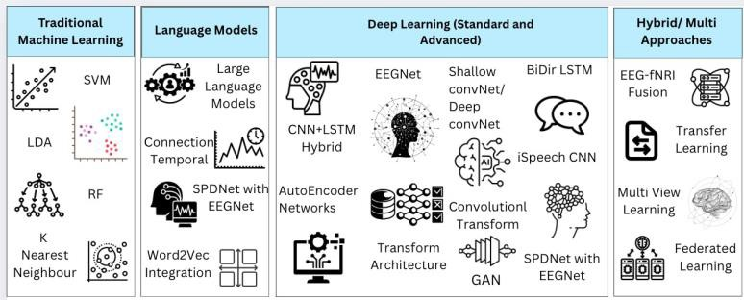
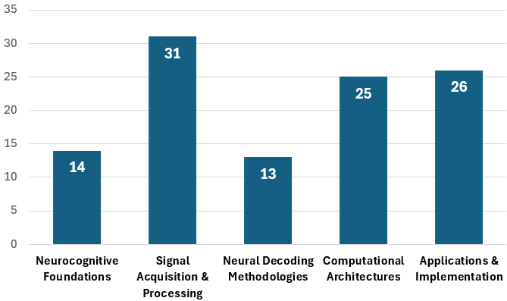
Fluency in Imagined Speech Decoding Using Non-Invasive Techniques: A Review
S. Shrividya^{1,2}, S. Thundiyil¹ and J. Picone³
Computational Neuroscience and Engineering Research Lab, BMS Institute of Technology & Management
College of Engineering, Northeastern University
Neural Engineering Data Consortium, Temple University
www.nedcdata.org
https://bmsit.ac.in
https://cnerlab.github.io/
Abstract
Imagined speech is the internal simulation of speaking without producing audible sound, offering a promising communication channel for individuals with severe speech impairments through brain-computer interfaces (BCIs).
Current approaches predominantly target word or phoneme level classification using EEG, MEG, and fNIRS modalities, achieving 60-95% accuracy for small vocabularies (3-5 words) .
Research gap: Continuous, coherent, and contextually relevant imagined speech decoding remains challenging, particularly achieving fluency.
Review scope: This paper synthesizes 109 research articles across neurocognitive foundations, non-invasive neural modalities, signal processing methodologies, computational architectures, and fluency-specific evaluation metrics.
Key focus: This work emphasizes fluency-specific challenges including lexical continuity, syntactic coherence, and real-time decoding constraints.
Methodology
Signal Acquisition
13 studies reviewed on non-invasive neural decoding using EEG, MEG, and fNIRS modalities.
EEG predominates due to superior temporal resolution, portability, and cost-effectiveness compared to MEG (expensive, requires shielded rooms) and fNIRS (latency constraints).
Signal Processing (31 studies reviewed):
Pre-processing pipeline: Signal collection > Artifact reduction using ICA > Regression and adaptive filters.
Feature extraction: Traditional approaches use fixed windows with spectral features (power spectral density, band power).
Modern approaches: Sliding windows with deep learning to capture temporal dependencies.
Classification and Decoding:
Traditional methods: 60-95% accuracy for small vocabularies (3-5 words) using spectral features.
Deep learning architectures: CNNs, Bidirectional LSTMs, and transformers (EEGformer) for multiclass performance.
Hybrid approaches: CTNet combines CNN-transformer strengths. Transfer learning leverages binary tasks to improve multi-class decoding.
Post-Processing:
NLP model integration: Pre-trained language models and RNNs enable contextual smoothing.
Techniques: Beam search, probabilistic decoding, GPT-style autocorrection for coherent sentence generation.
Performance and Evaluation
Current Classification Metrics:
Small vocabulary tasks (3-5 words): 60-95% accuracy using feature extraction and deep learning methods.
Subject-independent MEG decoding approaches subject-dependent accuracy levels through domain adaptation and curriculum learning.
Fluency Metrics:
Words per Minute (WPM) - measures decoding speed.
Sentence Coherence Score - evaluates syntactic and semantic continuity.
Latency - real-time response delay.
Perplexity - language model confidence in predictions.
Evaluation Challenges:
Subjective assessments (user satisfaction, perceived naturalness) complement objective metrics but lack standardization across studies.
Developing benchmark tasks and combined fluency indices is critical for rigorous evaluation.
Benchmark Datasets:
Chinese Imagined Speech Corpus (Chisco): 20,000+ sentences of high-density EEG recordings from healthy adults.
Facilitates large-scale model training and standardized evaluation.
Current Limitations:
Most systems confined to word-level or phoneme-level classification.
Continuous, coherent, and contextually relevant speech decoding remains challenging.
Gap between isolated word accuracy and fluent sentence generation.
Background and Methods
Imagined speech is a motor-grounded, hierarchically organized cognitive process.
Core brain regions involved in silent speech decoding include the inferior frontal gyrus (Broca's area), supplementary motor area, and superior temporal gyrus which interact via the phonological loop to support imagined speech production.
Fluency requirements include rapid lexical retrieval, seamless syntax assembly, and dynamic working memory updates are essential for continuous, coherent imagined speech generation.
Papers emphasizing recent advances in deep learning architectures, transfer learning, and language model integration were commonly used in this process.
Current findings are drawn from 109 papers, organized into five thematic sections. The number of papers reviewed, and their corresponding focus areas are presented in the figure below.
Summary
Current achievement: Non-invasive BCIs using EEG achieve 60-95% accuracy for small vocabulary (3-5 words) imagined speech classification through deep learning and hybrid architectures.
Critical gap: Transitioning from isolated word-level classification to continuous, fluent, and contextually coherent imagined speech decoding remains the primary challenge.
Requirements for fluency: Progress demands integration of high-quality neural recording, advanced decoding architectures (CNNs, transformers), powerful language models for post-processing, and standardized evaluation frameworks.
Evaluation needs: Standardized benchmark datasets (like Chisco with 20,000+ sentences) and combined fluency metrics (WPM, coherence, latency, perplexity) are critical for rigorous assessment.
Future direction: Decoding imagined speech using non-invasive BCIs requires continued advancement in signal processing, cross-subject generalization, real-time processing optimization, and NLP integration to enable practical communication systems.
Dataset and future updates will be available at: github.com/cnerlab/brain-to-text
Acknowledgements
We acknowledge CNER Lab at BMS Institute of Technology & Management, Bengaluru, for providing facilities that are funded by the Vision Group of Science and Technology, Karnataka, India (Grant No. GRD1116). Thanks to the Neural Engineering Data Consortium at Temple University for collaboration and support.
Computational Theme | Key Approaches & Examples | Application Insight
Traditional Machine Learning | SVM, LDA, Random Forests, KNN etc | Used for simpler, low-vocabulary classification tasks.
Deep Learning (Standard and Advanced) | EEGNet, CNNs, BiDiR LSTM,, Transformer Architecture, GAN | Strong multiclass performance by modeling temporal and frequency dependencies.
Language Models / Post-Processing | Large Language Models, Connection Temporal, Word2Vec Integration, GPT-style autocorrection. | Address fluency challenges, Helping transform word-level predictions into coherent sentence strings.
Hybrid/Multi Approaches | EEG-fNIRS Fusion, Multi View Learning | Enhance generalization and efficiency

