Slide 1
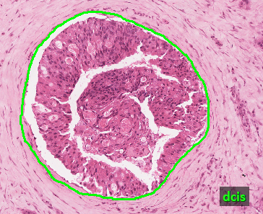
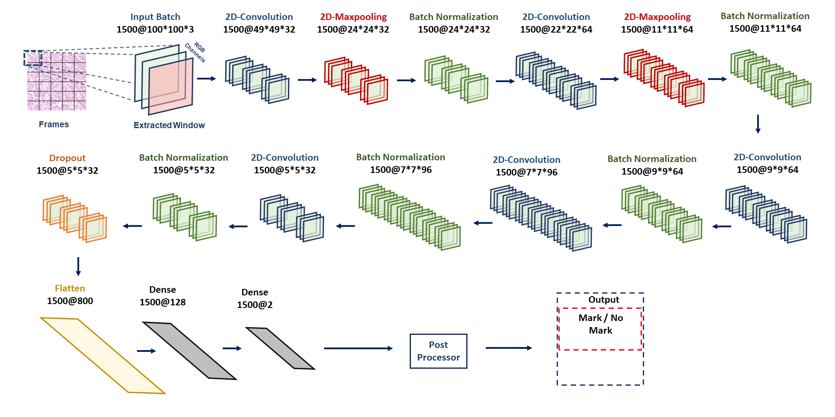
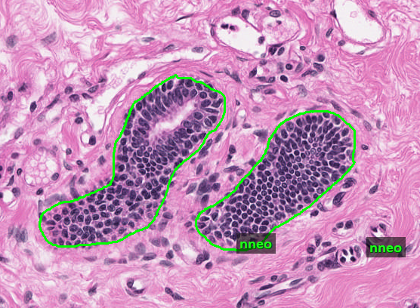
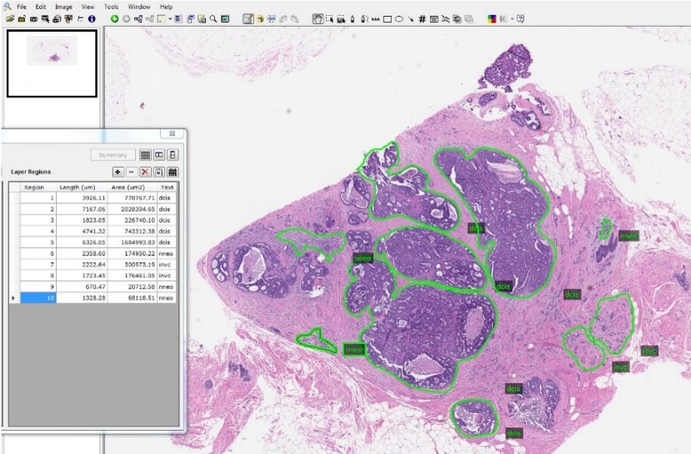
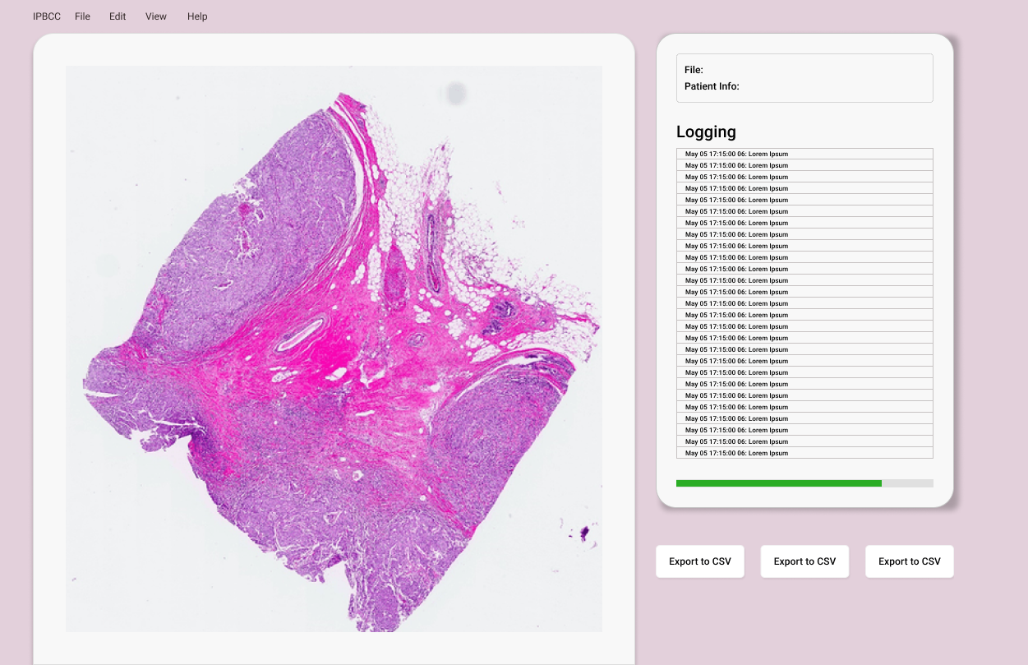
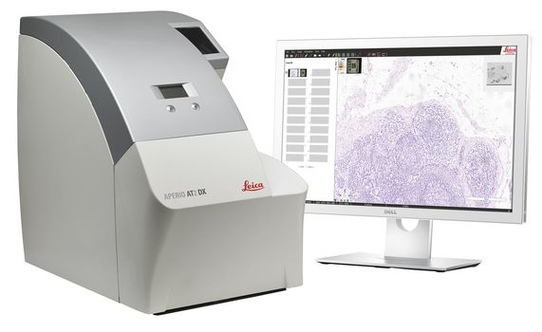
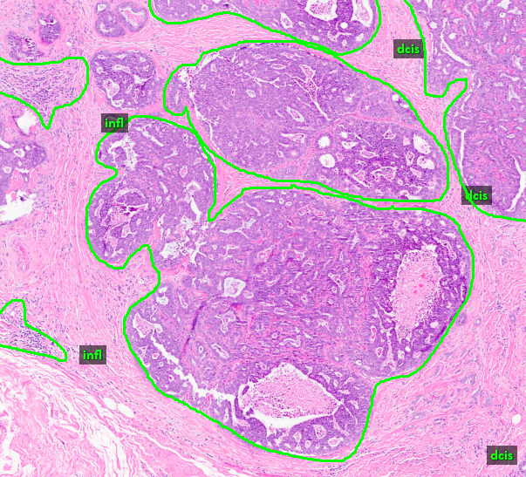
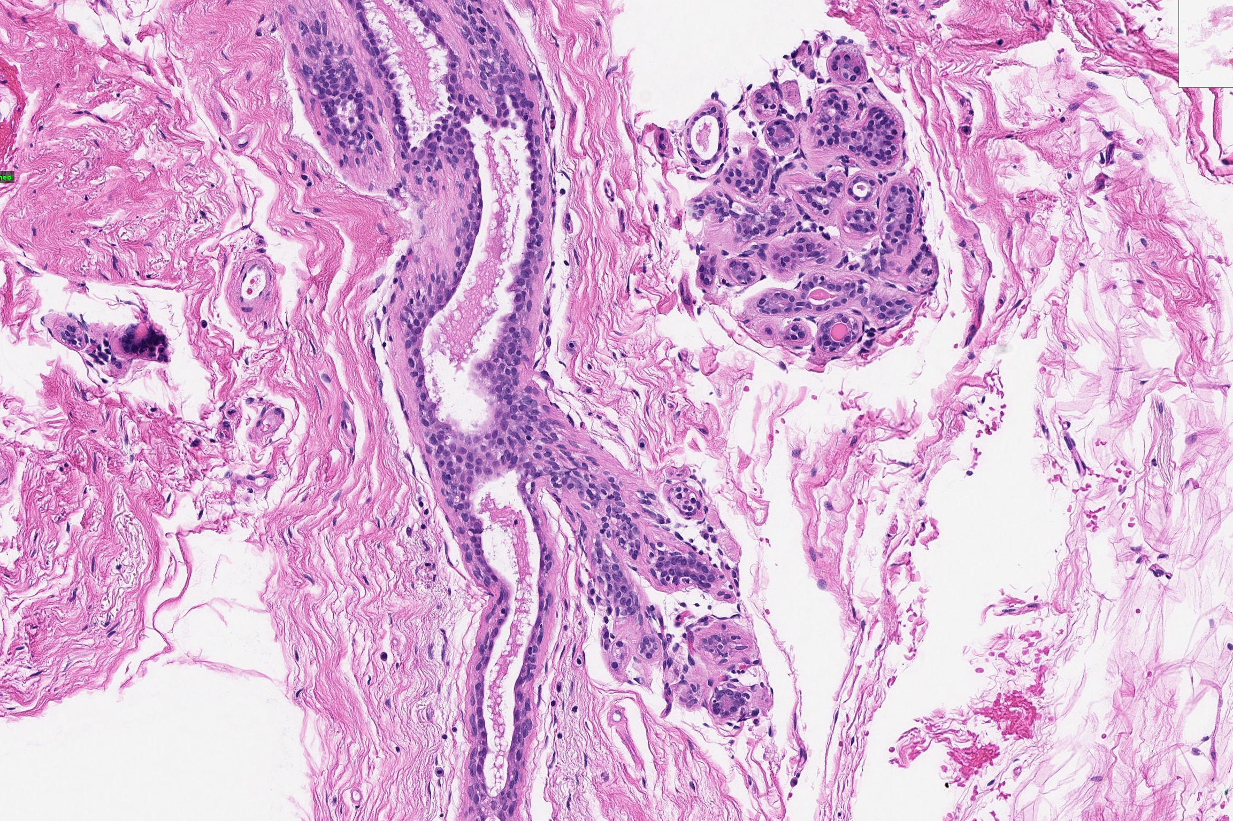
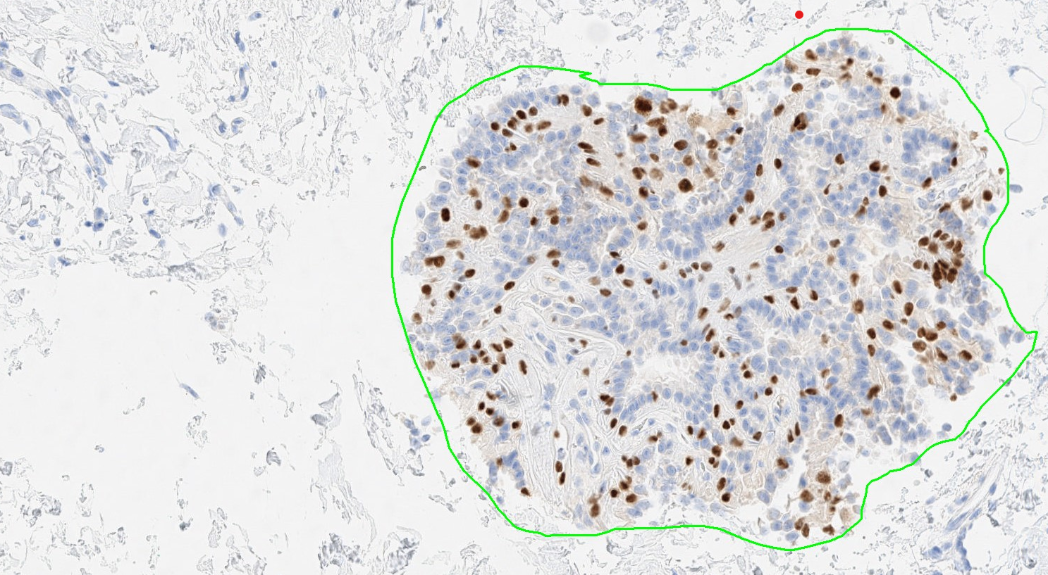
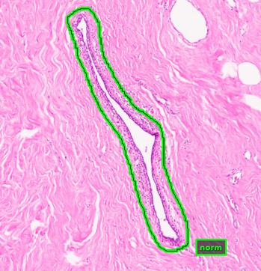
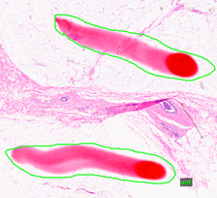
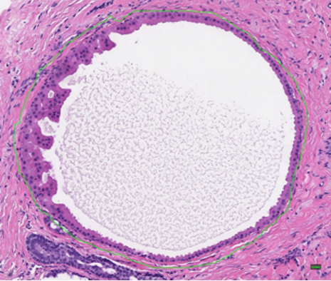
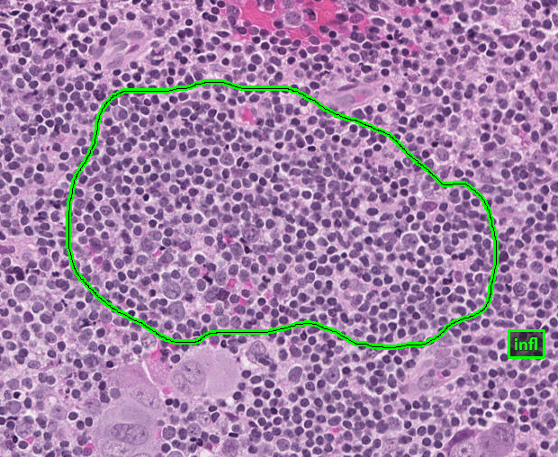
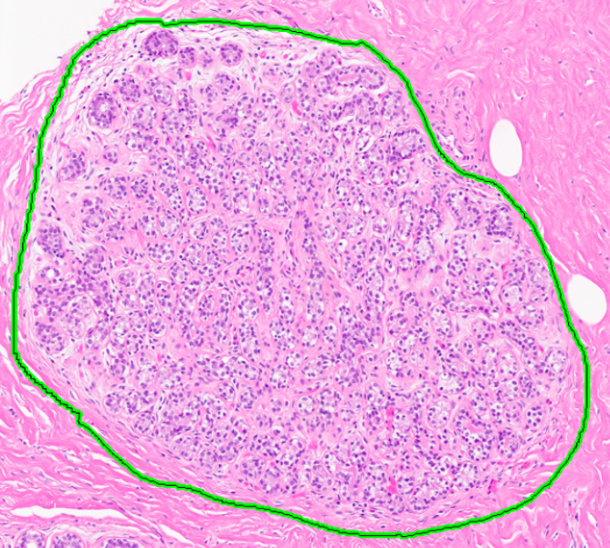
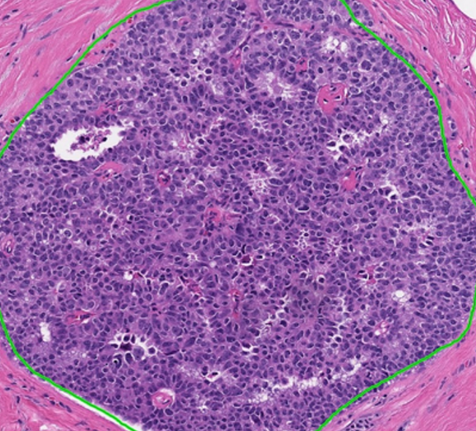
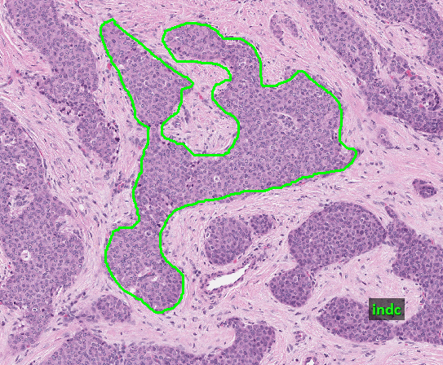
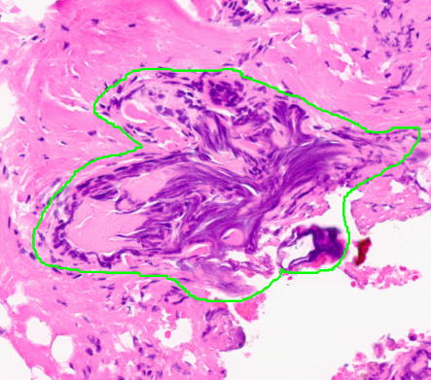
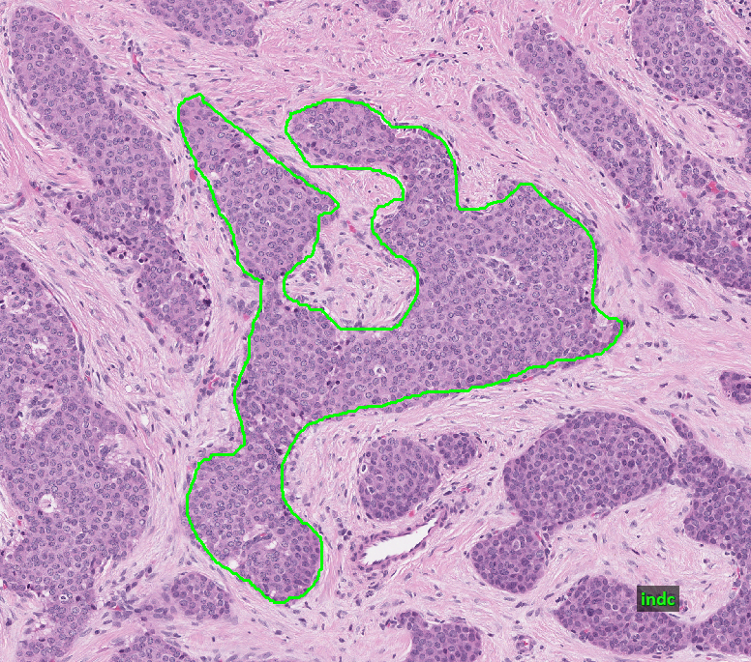
Annotation of the Fox Chase Cancer Center Digital Pathology Corpus
M. Bagritsevitch, D. M. Hackel, I. Obeid, and J. Picone
The Neural Engineering Data Consortium, Temple University
www.nedcdata.org
Abstract
The Neural Engineering Data Consortium (NEDC), has previously released the Breast Tissue subset of the Temple University Digital Pathology Corpus (TUDP), containing 3,505 partially annotated images.
In this abstract, we introduce a new annotated subset of images from the Fox Chace Cancer Center (FCCC) Biosample Repository: 14,288 which include 1,463 partially annotated images.
Annotators identified five to ten regions of interest in each slide with a goal of including a range of histological features that can be used to ensure precise classification of cancerous, non-cancerous, and pre-cancerous structures.
A comparison of annotations between the FCDP and TUDP datasets reveals significant differences in cancer prevalence:
FCDP, with its emphasis on oncological cases, contains a greater proportion of cancerous slides, including more instances of non-neoplastic, ductal carcinoma in situ, and invasive carcinoma.
TUDP offers a broader spectrum of tissue types.
Together, these datasets allow for more nuanced understanding of cancerous tissue characteristics.
Annotation of FCCC Breast Tissue Subset
Annotators receive limited patient information and diagnosis metadata, including:
This information guides annotators in identifying key structures and reduces ambiguity, enhancing the accuracy and quality annotations.
Annotation of an entire image is slow and expensive.
Therefore, we typically only annotate 5 to 10 regions of interest and a few examples of ‘background’ to maximize efficiency and productivity.
High-quality annotations with precise margin delineation and diverse structure types enhance a machine learning model’s ability to detect malignancies.
These well-curated datasets enable accurate segmentation of pathological features, driving rapid and robust cancer detection across varied tissues and staining conditions.
Analysis of v2.0.0 FCCC Data Corpus
Some key statistics about the annotations:
Total Number of Labels: 14,083
Average No. Labels/Image: 9.63
Avg. Annotated Area/Image: 0.57%
There are more instances of non-neoplastic structures than v1.0.0.
Challenging cases in v1.0.0 were reviewed in this update.
Label imbalance poses a real challenge for machine learning algorithms. Our goal in revisiting annotations was to improve the balance of cancer-related labels.
norm artf nneo infl
susp dcis indc null
Refining Non-neoplastic vs DCIS
One major difference between v1.0.0 and v2.0.0 is redefinition of the nneo and dcis labels:
These labels have been refined for greater accuracy:
Non-neoplastic structures present irregular cell composition with varying nuclear sizes, lesions of different shapes and sizes, loosely packed cells within ducts and inconsistently defined lumens.
Ductal Carcinoma in situ is defined by uniform cellular composition, similar-sized nuclei consistent cribriform lesions, comedonecrosis, or surrounding necrosis, and distinct luminal features.
Immunostaining
Staining aids in the identification of histological structures by providing distinct appearances that help differentiate between cellular components.
There are two primary immunostaining techniques that assist in the diagnosis of carcinogenic structures.
The inclusion of both immunostains allows models to capture a broader range of cellular structures.
Deep Learning Technology
A baseline CNN architecture (ResNet-18) developed that can classify small patches with an F1 score greater than 80% and whole slides at 94% accuracy:
Uses a randomization strategy and a weighted loss function (based on the number of samples in each class) to address the class imbalance problem.
The model scans images in 128x128 pixel frames, with a 256x256 pixel analysis window.
Computational infrastructure has been developed to accelerate I/O through multithreading, facilitating large-scale experiments.
Alternative models based on Vision Transformers (ViT) will be released in the near future, offering improved segmentation and patch-level accuracy.
Interactive demo:
Automatically labels images with minimal latency.
Patches, of interest are localized that support a diagnosis.
Allows pathologists to prioritize images for review.
Information | Description | Example
Malignancy vs Non-Malignancy | Described whether the cancer in the slides has spread or can spread. Accompanied by a number that identifies the cancer according to the international Classification of Diseases for Oncology (ICD-O). | MALIG-PRIMARY, 8500/3
Tissue Grade | Refers to the histological grade of a the tumor, which indicates how abnormal the cancer appears. A higher grade indicates a greater differentiation from normal tissue. | Grade III poorly differentiated.
Region | This refers to the anatomical site where the biopsy was performed, along with its relationship to adjacent structures. | Regional to Lymph Nodes, lower-inner quadrant
Immunostaining | Describes the immunostaining of the image. | 0hne – Hematoxylin and Eosin (H&E) stain
Cancer Type | Describes the type of cancer identified in the image or notes the absence of cancer if no malignancy is detected. | Ductal Carcinoma NOS: Cancer of the milk duct, unspecified type.
Patient History | Describes the patients ethnicity, sex, family history, and habits that put them at higher risk of developing breast cancer. | No history of alcohol use, Family history: Yes
Atypical Ductal Hyperplasia:
can be indicative of carcinogenic signs,
is a non-neoplastic form that causes epithelial cells to grow into the ducts.
Ductal Carcinoma in Situ:
is a carcinogenic structure that causes the abnormal growth of epithelial cells into the ducts.
can eventfully invade the surrounding tissue.
Digital Pathology
One key challenge of digital pathology is detecting tiny regions of interest within an ultra-high-resolution image. Our primary objective is to efficiently localize information that significantly contribute to a diagnosis.
Annotators highlight areas of interest by marking regions with significant pathological features. Precise annotation takes place with difficult annotations being escalated to professional evaluation.
The FCCC Breast Tissue Subset consists of 1,463 images annotated using a 4-way classification system:
Label | Description / Features
Normal (norm) | normal ducts and lobules
Background (bckg) | stroma, no ducts or lobules
Artifact (artf) | grease pen marks, stitches, foreign bodies
Non-Neoplastic (nneo) | fibrosis, hyperplasia, intraductal papilloma, adenosis, ectasia
Inflammation (infl) | areas of inflammation
Suspected (susp) | regions that are at risk of developing into cancerous regions
Ductal Carcinoma in Situ (dcis) | ductal carcinoma in situ, and lobular carcinoma in situ
Invasive Ductal Carcinoma (indc) | invasive ductal carcinoma, invasive lobular carcinoma, and invasive mammary carcinoma
Indistinguishable (null) | indistinguishable tissue, normally due to issues with the cut/stain
Summary and Future Work
This abstract introduces a substantial corpus that can be used to develop high-performance machine learning (ML) systems for digital pathology.
Based on these findings, we are re-annotating both the TUH Breast Tissue and FCCC datasets to increase the number of cancer-related labels per slide.
We are investigating how the TUH and FCCC sets can be optimally combined to improve ML performance.
Currently we are developing more sophisticated classification systems based on self-attention (Vision Transformers) and long-term contextual models.
We are also exploring annotation of urinary tract tissue samples to support research aimed at detecting prostate cancer.
Acknowledgments
This material is based upon work supported in part by the National Science Foundation under grants under grants nos. CNS-1726188 and 1925494, by the Temple University Office of the Vice President for Research, by the Temple University College of Engineering Summer Research Experience for Undergraduates program, and most recently by the Pennsylvania Breast Cancer Coalition (PABCC). Any opinions, findings, and conclusions or recommendations expressed in this material are those of the author(s) and do not necessarily reflect the views of the National Science Foundation, Temple University or the PABCC.
Label | No. Labels | %
Norm | 164 | 1.16%
Bckg | 25 | 0.18%
Artf | 110 | 0.78%
Nneo | 625 | 4.44%
Infl | 854 | 6.06%
Susp | 24 | 0.17%
Dcis | 1,223 | 8.68%
Indc | 10,908 | 77.46%
Null | 150 | 1.07%
Labels
norm | infl | indc
artf | susp | null
nneo | dcis | bckg
Tissue Sample
Cancer
Ductal carcinoma in situ (dcis)
Invasive carcinoma (indc)
No Cancer
Non-neoplastic (nneo)
Normal (norm)
Hematoxylin and Eosin (H&E) stain is preferred for viewing cellular and tissue structure.
Hematoxylin stains nuclei a purplish blue; eosin stains the extracellular matrix pink.
H&E distinguishes tissue architecture, nuclear detail, and tumor margins.
Immunohistochemical (IHC) stains use antibodies to target antigens and receptors (ER, PR, HER2) within the cells, enabling precise identification of molecular pathology.
This results in a brown or red background color (DAB brown or AP red).
To learn more about our resources, please use this URL:
https://www.nedcdata.org

