Slide 1
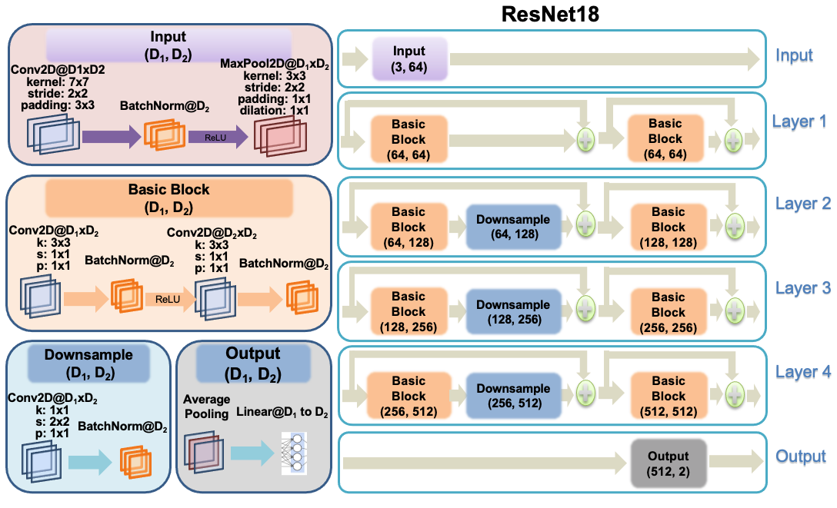
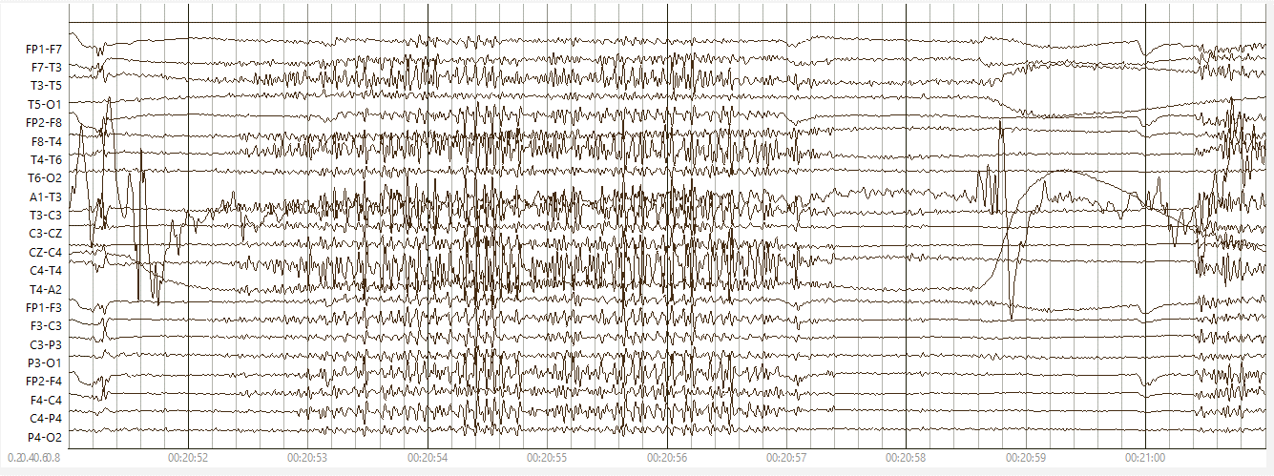
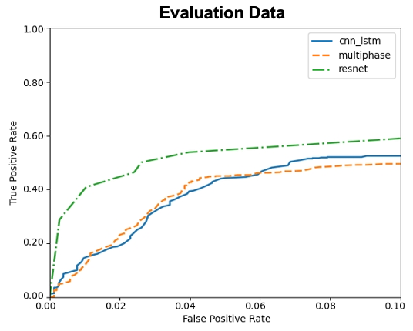
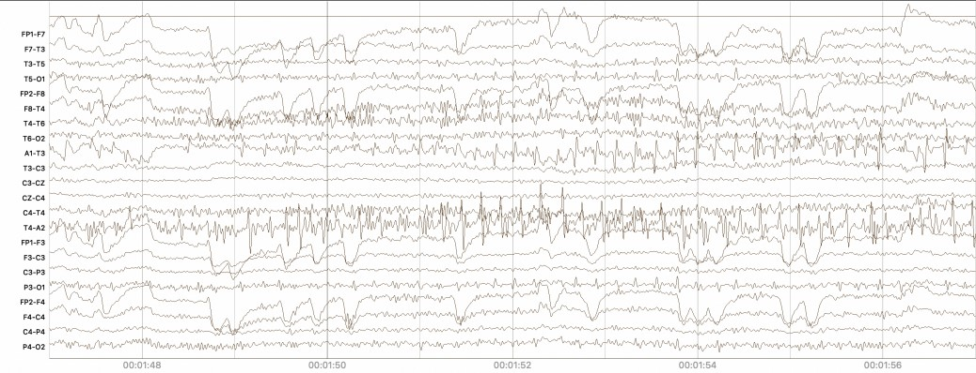
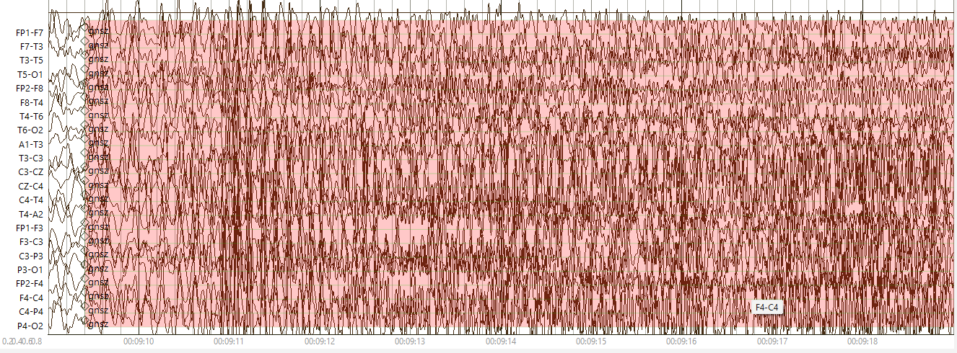
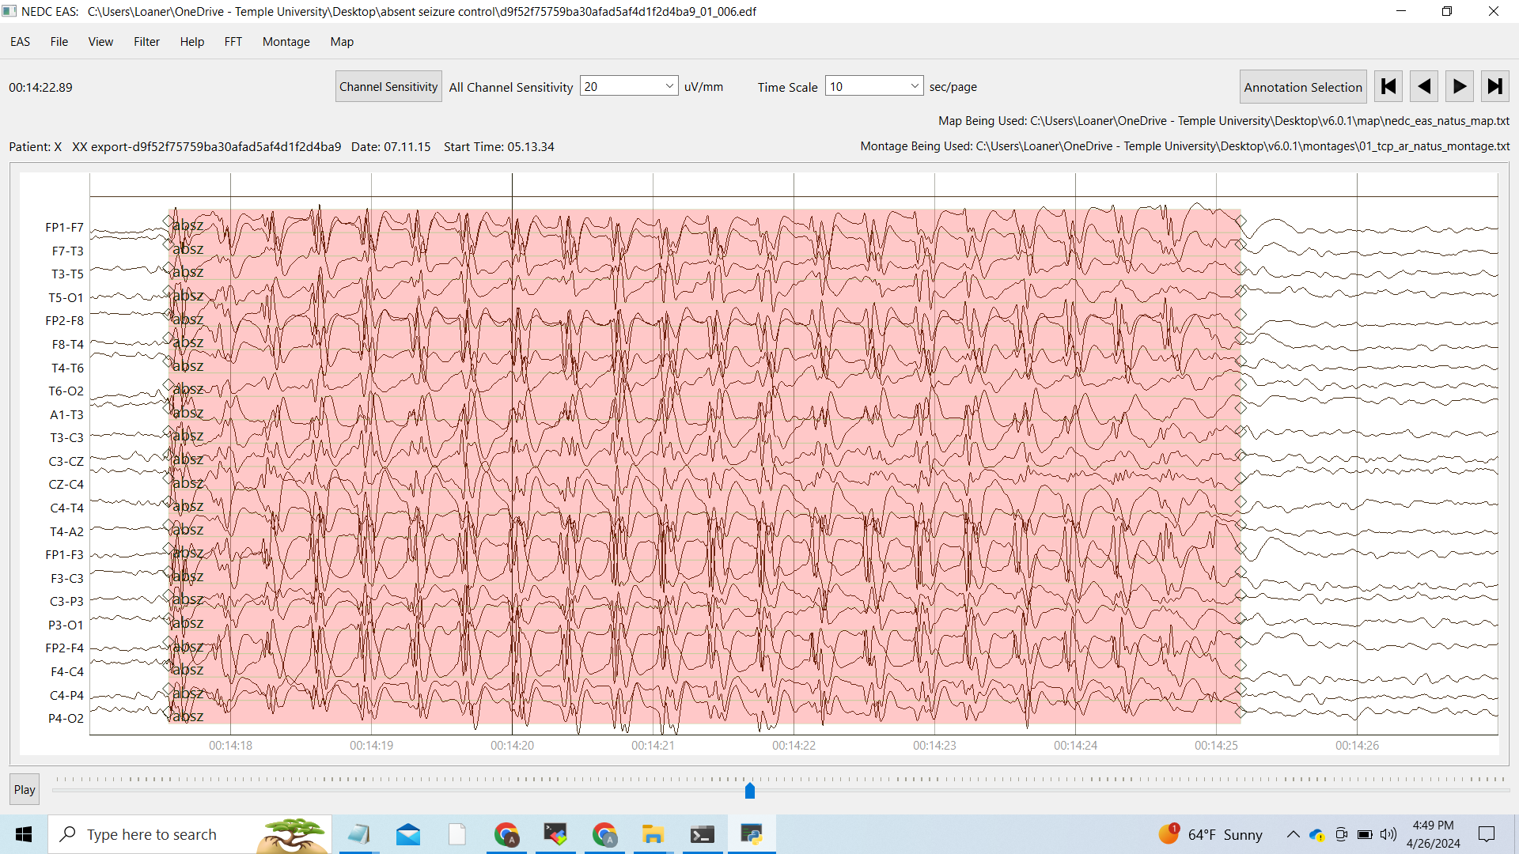
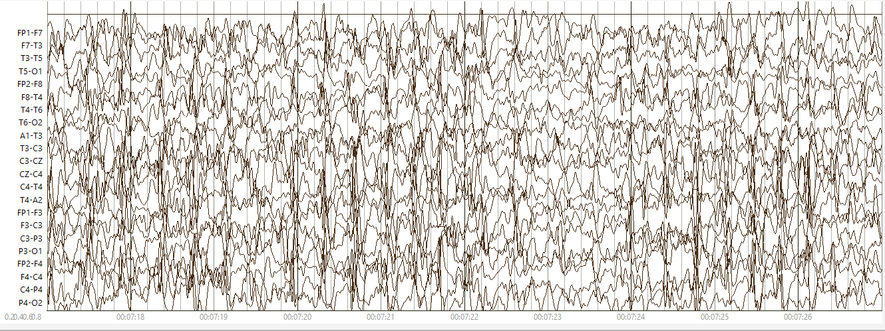
Annotation of Ambulatory EEGs
A. Melles, M. Paderewski, R. Oymann, V. Shah, I. Obeid, and J. Picone J. Salazar
The Neural Engineering Data Consortium, Temple University Natus Medical Incorporated
www.nedcdata.org
Abstract
The Neural Engineering Data Consortium (NEDC) began annotating large amounts of EEG data in 2012.
TUEG v2.0.1, consists of 26,846 sessions from 14,987 patients, and has over 10,000 subscribers.
TUEG, however, are pruned recordings in which gaps have been discarded, preventing the development of technology requiring continuous recordings.
Natus Medical Inc. has collected continuous ambulatory EEG data – over 1,400 studies consisting of 72-hour recordings. We refer to this as the Natus Medical Ambulatory EEG (NMAE) Corpus.
We are annotating NMAE according ACNS 2021 guidelines that emphasize new events such as rhythmic and periodic patterns (RPPs) and brief potentially ictal rhythmic discharges (BIRDs).
The Natus Medical Ambulatory EEG (NMAE) Corpus will support the development of a new generation of seizure prediction technology and accurate assessment of false alarm rates for existing systems.
The NMAE Corpus
1,400 studies containing 72 hours of data per subject.
15,529 uniformly annotated seizure onset annotations marked as “sz onset.”
The data follows our standard Temporal Central Parasagittal layout in a 10-20 system (01_tcp_ar bipolar montage).
There are two different sample frequencies – 200 Hz (86%) and 250 Hz (14%).
There are 35 unique channel labels with 6 electrode configurations:
Base labels that are consistent across all configurations:
Some unique channel configurations:
These seizure annotations were used to down-select studies of interest for collaborative scoring.
The initial set of studies selected for annotation were selected as studies with the highest identified seizure counts – we refer to this as high-yield data.
We have annotated 3,503 files (30 studies):
2,828 contained only background
675 contained seizures: 52 focal, 200 generalized, 434 absence
TUSZ (v2.0.3) consists of 8,239 files;:
1,391 contained seizures:
805 focal, 439 generalized, 18 absence, 5 simple partial, 168 complex partial, 11 tonic, 22 tonic-clonic
The differences between TUSZ and NMAE underscores the importance of collecting ambulatory EEG data since it increases the likelihood of observing absence seizures.
The Annotation Pipeline
We are developing two documents that track our decisions about how to annotate the data:
Reports where we document all the decisions we have made and notes about RPPs for future work.
Interesting activities that could be confused for ictal activity.
Some examples of challenging waveforms:
Shivering: usually occurs with underlying ictal activity but in this case it had no spike and wave activity that could indicate a seizure.
A closer examination reveals:
Seizures of patients with Lennox-Gastaut syndrome (LGS) are difficult to spot since the background is slow spike and wave activity with intermittent bursts of sharp spikes.
The snapshot above shows a generalized seizure in an LGS patient, while the image below shows the normal background EEG pattern for LGS.
Progress To Date
An annotator can typically process approximately 2.5 hours of data in one hour (.4xRT).
Annotations are reviewed by a project manager, who selects data for review based on observed patterns.
The team also meets weekly to discuss challenging cases and arrive at a committee consensus. Each patient is reviewed in detail, with 3 to 8 files typically needed to make a decision out of the 132 total files.
This far we have annotated ~2,500 hours of data.
We triage the data with an EEG system based on a ResNet18 architecture:
This system has a low false alarm rate (5.78 FAs/24H) and a reasonable sensitivity (42.05%).
This is a real-time system that has approximately 120 secs of latency.
It was tuned to have a higher FA rate but a low false negative rate.
We are in the process of adapting this system to NMAE to assess the improvement in performance achieved by adaptation and to compare performance on NMAE to TUSZ.
Section of the reports document:
Patient number: 6705f62cc8919954be3ef9d0f93c0ecb
Seizures: generalized, activities that come across as focal seizure, however, waxing and waning – not prominent enough: decided not to annotate.
RPPs: LPDs and GPDs can be confused as focal seizure but frequency is < 2.5 Hz.
Patient number: 7d109c9692eca076f3b5813dc7ded0ca
Seizures: generalized seizures with long post-ictal phase that includes GPDs- chose to annotate 2 seconds in the post-ictal phase because otherwise too long. Annotated more prominent seizures, onset seems to be long. Looked into the activity with unipolar montage and it cleared out that there are no focal seizures but everything is generalized.
RPPs: GPDs in post-ictal phase
Continuous Ambulatory EEGs
Ambulatory EEG data is collected using portable equipment while patients go about their daily activities.
Stationary EEG data is collected in a clinical setting under controlled conditions.
The absence of an EKG channel makes it hard to distinguish between EKG artifacts (often found on A1 and A2 channels) and brain activity.
The lack of clinical reports complicates identifying the type of seizure.
This also allows researchers to capture seizures and related events, such as absence seizures and BIRDs that are hard to spot in stationary settings.
Frontal: FP1, FP2, FPZ (sometimes missing), F7, F8, F3, F4, FZ
Temporal: T3, T4, T5, T6
Central: C3, C4, CZ
Parietal: P3, P4, PZ
Occipital: O1, O2
Ears: A1, A2
Other: X1, X2, EDF ANNOTATIONS
Channel Configs | Additions
25 | None
26 | DIF1
27 | OSAT, PR
28 | DIF2
34 | DIF3, DIF4, DC1, DC2, DC3, DC4
35 | FPZ
Summary and Future Work
Annotated ambulatory EEG data represents a great opportunity to improve seizure prediction and seizure detection technology, and to better explain our what our models have learned.
Future work will involve annotating RPPs and BIRDs, which will pave the way for a new generation of software that provides neurologists with much more relevant information about a patient’s health.
The development of machine learning technology to detect RPPs and BIRDs in addition to seizures represents an exciting new research direction that will be enabled by this work.
We will also be able to explore how we can simultaneously leverage TUEG and NMAE to develop more robust seizure detection technology.
Acknowledgments
The material presented in this abstract was supported by Natus Medical Incorporated. Any opinions, findings, conclusions, or recommendations expressed in this material are those of the author(s) and do not necessarily reflect the views of our sponsors.
TUSZ | NMAE | Common
spsz | oirda | bckg
cpsz | tirda | seiz
tnsz | frida | fnsz
cnsz | grda | gnsz
tcsz | lpd | absz
gped | gpd | intr
pled | bird
artf
To learn more about this project, please use this URL:
https://isip.piconepress.com/projects/natus_eeg/

