Slide 1
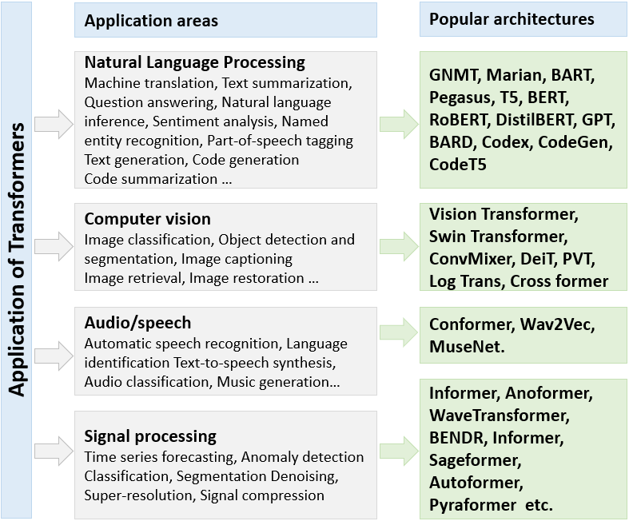
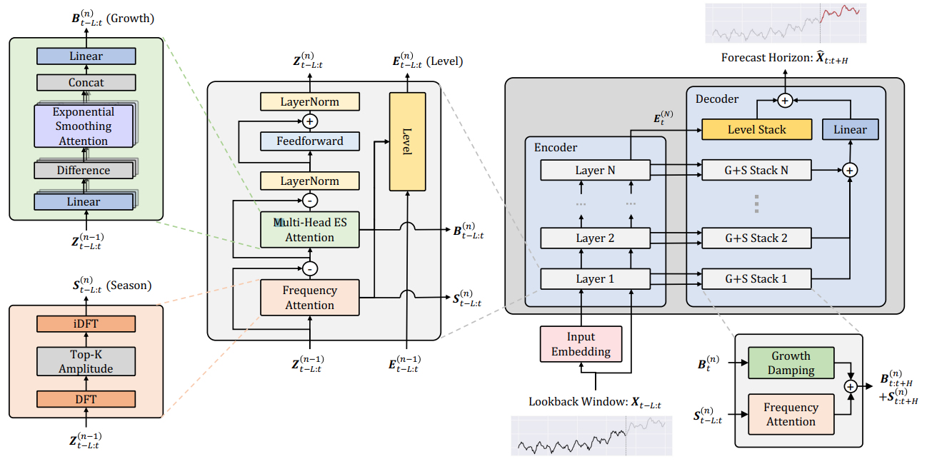
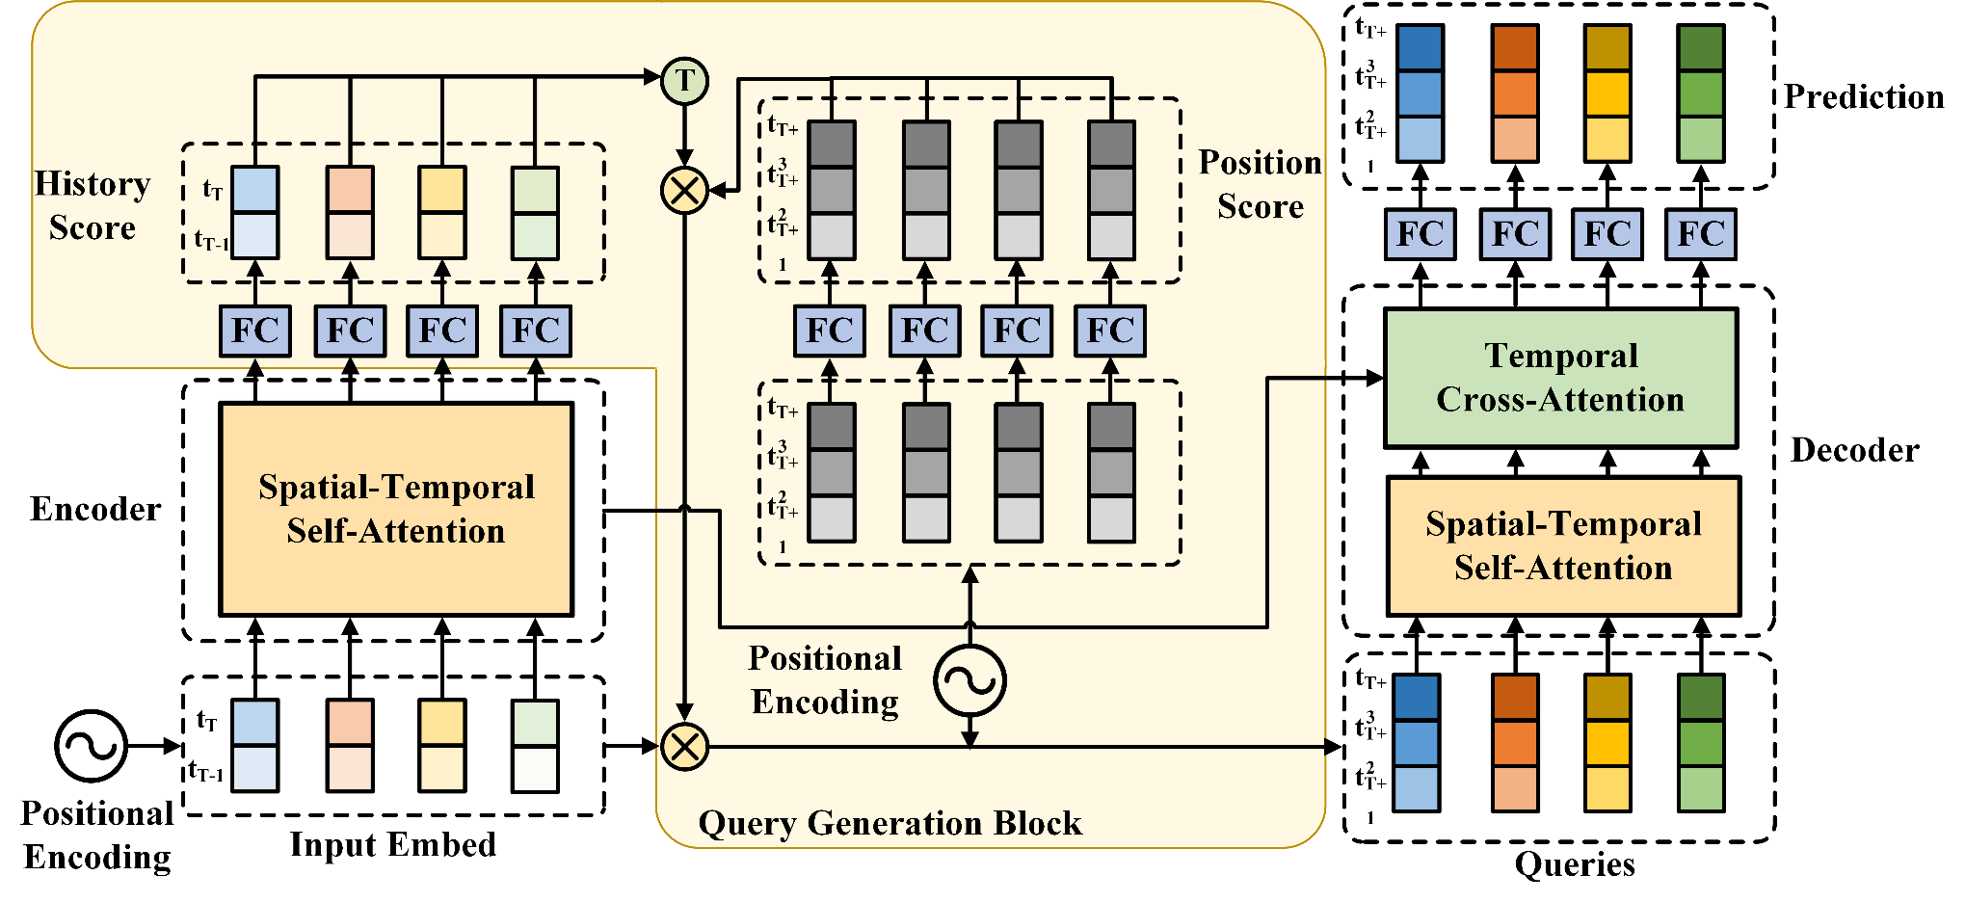
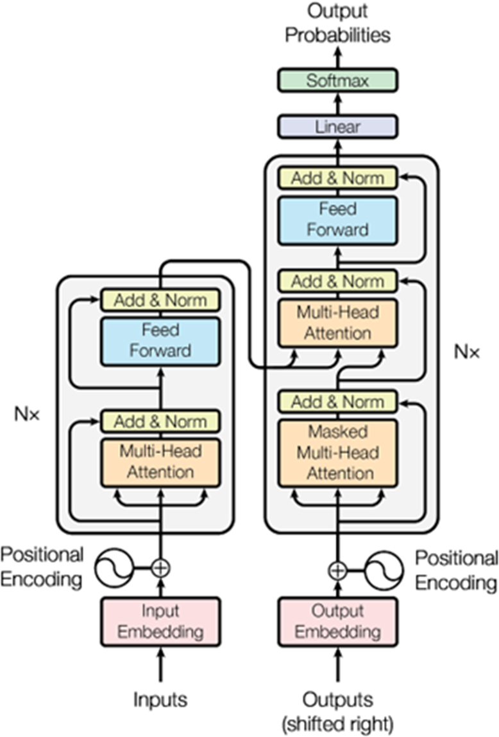
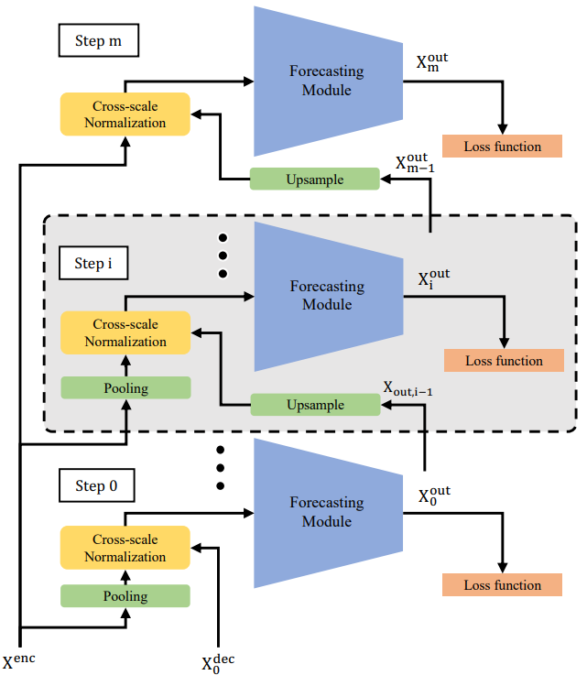
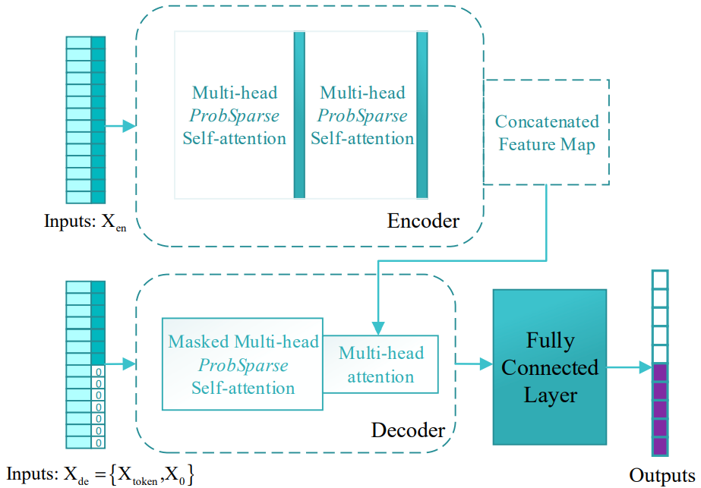
Transformers for Modeling Long-Term Dependencies in Time Series Data: A Review
S. Thundiyil¹, S.S. Shalamzari², J. Picone² and S. McKenzie³
1. Department of Electronics and Communication Engineering, BMS Institute of Technology and Management, Bengaluru, India
2. The Neural Engineering Data Consortium, Temple University, Philadelphia, Pennsylvania, USA
3. University of New Mexico Health Sciences, Albuquerque, New Mexico, USA
www.nedcdata.org
Abstract
Long-term dependencies play a crucial role in the analysis of the time series data in applications such as healthcare, climate change, finance etc.
The emergence of transformer-based technologies such as ChatGPT have demonstrated the potential for analyzing time series data in which modeling of long-term dependencies is crucial.
In this abstract, we provide a review of various transformer-based models that are used to model long-term context in time series data.
The combination of self-supervised learning and transformer models is a promising approach to improve the performance and explainability of automatic seizure detection models, especially for continuous EEG data.
Application Areas
A summary of various application areas where transformer-based architectures have been successful along with the most popular architectures for each application:
Comparison to Time Series Models
Transformer models have shown improvements in terms of accuracy, computational efficiency while handling long term dependencies.
Traditional time series models often have lower computational complexity but may require additional steps for trend and seasonality decomposition, which can increase the overall computation time.
The self-attention module in standard Transformers has a quadratic time and memory complexity, posing a computational bottleneck for long sequences.
To address this, models like LogTrans and Pyraformer introduce a sparsity bias in the attention mechanism, while models like Informer and FEDformer utilize the low-rank properties of the self-attention matrix to reduce complexity​​.
Traditional models have a limited memory mechanism and can remember and utilize only a fixed number of previous data points. This inherently restricts their ability to capture long-range dependencies effectively.
While Transformer models offer higher accuracy and better handling of long-range dependencies, they often come with higher computational costs compared to traditional time series models. A comparison of computational efficiency for 12 different time series data sets is shown below:
Advancements and Innovations
Standard transformer designs excel in capturing global dependencies, but do not fully exploit the characteristics of time-series data, such as local structures that are better captured by conventional approaches such as convolutional or recurrent architectures.
Interpretability remains a challenge, raising questions about their trustworthiness and bias.
Recent innovations in transformer architectures, particularly those focusing on long-term time series forecasting, have introduced several significant advancements.
Recent developments in attention mechanisms and efficiency enhancements have led to the introduction of more sophisticated time-series forecasting models. ETSFORMER, for instance, leverages exponential smoothing attention and frequency attention to improve efficiency.
NAST, on the other hand, employs a non-autoregressive architecture with a unique spatial-temporal attention mechanism.
Innovative Decomposition and Trend Analysis Techniques have been used in TDFormer, Differential Attention Fusion Model and FEDFORMER.
Enhanced Multiscale and Long-Sequence Forecasting have been implemented in Scaleformer and Informer architectures.
Limitations and Challenges
Computational Demands: Transformers are computationally intensive due to their complex architecture, which can be challenging for long sequence time-series forecasting. They often require high computational resources, particularly for training large models, which can be a limiting factor.
Need for Large Datasets: Transformers typically require large datasets to train effectively due to their numerous trainable parameters. This need for extensive data can be a challenge in scenarios where data is scarce or expensive to acquire, such as many bioengineering or health sciences applications.
Overfitting Issues: There is a risk of overfitting, especially when dealing with time series data that has complex patterns. Overfitting can lead to models that perform well on training data but poorly generalize to new, unseen data.
Quadratic Time Complexity: The self-attention mechanism has a quadratic time complexity with respect to the sequence length, which can be prohibitive for very long time series. This issue limits the scalability of models in certain applications.
Handling Long-Range Dependencies: While transformers are designed to capture long-range dependencies, their effectiveness can vary depending on the nature of the time series data. Application-specific adaptations are required.
Context Window Length: While models learn long-term dependencies, they are limited by temporal coherence and context fragmentation.
Introduction
Traditional methods such as autoregressive integrated moving average (ARIMA), long short-term memory networks (LSTM), gated recurrent units (GRUs) and recurrent neural networks (RNN) have provided robust frameworks in the analysis of time series data
These methods have limitations when applied to big data sets and when used to model long-term dependencies.
Systems based on an attention mechanism leverage positional embedding modules and have been effectively employed in raw EEG data classification related to motor imagery tasks.
A Typical Transformer Architecture
Summary
Compared to traditional models, a transformer architecture can be effective in analyzing long-term dependencies in time series data.
Long-term dependencies in the data are useful in several applications, such as natural language processing, computer vision, and audio signal processing, as well as in various domains such as healthcare, climate studies, and finance.
Innovations in transformer models are focusing on efficient ways to model long-term context, which poses a combinatorial problem, and prevents efficient integration of long-term and local constraints.
This latter point is particularly important in sequential physical signal data such as speech, cardiology or EEG signals.
Acknowledgements
This material is supported in part by the National Science Foundation under grant no. 2211841. Any opinions, findings, and conclusions or recommendations expressed in this material are those of the author(s) and do not necessarily reflect the views of the National Science Foundation
A transformer architecture relies solely on attention mechanisms that allow the model to process inputs and outputs in parallel.
The transformer follows an encoder-decoder structure, employing stacked self-attention and point-wise fully connected layers.
An attention function in the model maps a query and a set of key-value pairs to an output, computed as a weighted sum of the values.
A transformer utilizes multi-head attention and incorporates positional encodings to maintain information about the order of sequence tokens.
Transformers can handle raw input data without the need for extensive feature engineering. (minimal preprocessing and postprocessing).
Updates to this review will be available on GitHub at https://github.com/sanect/timeSeries_transformers

