Slide 1
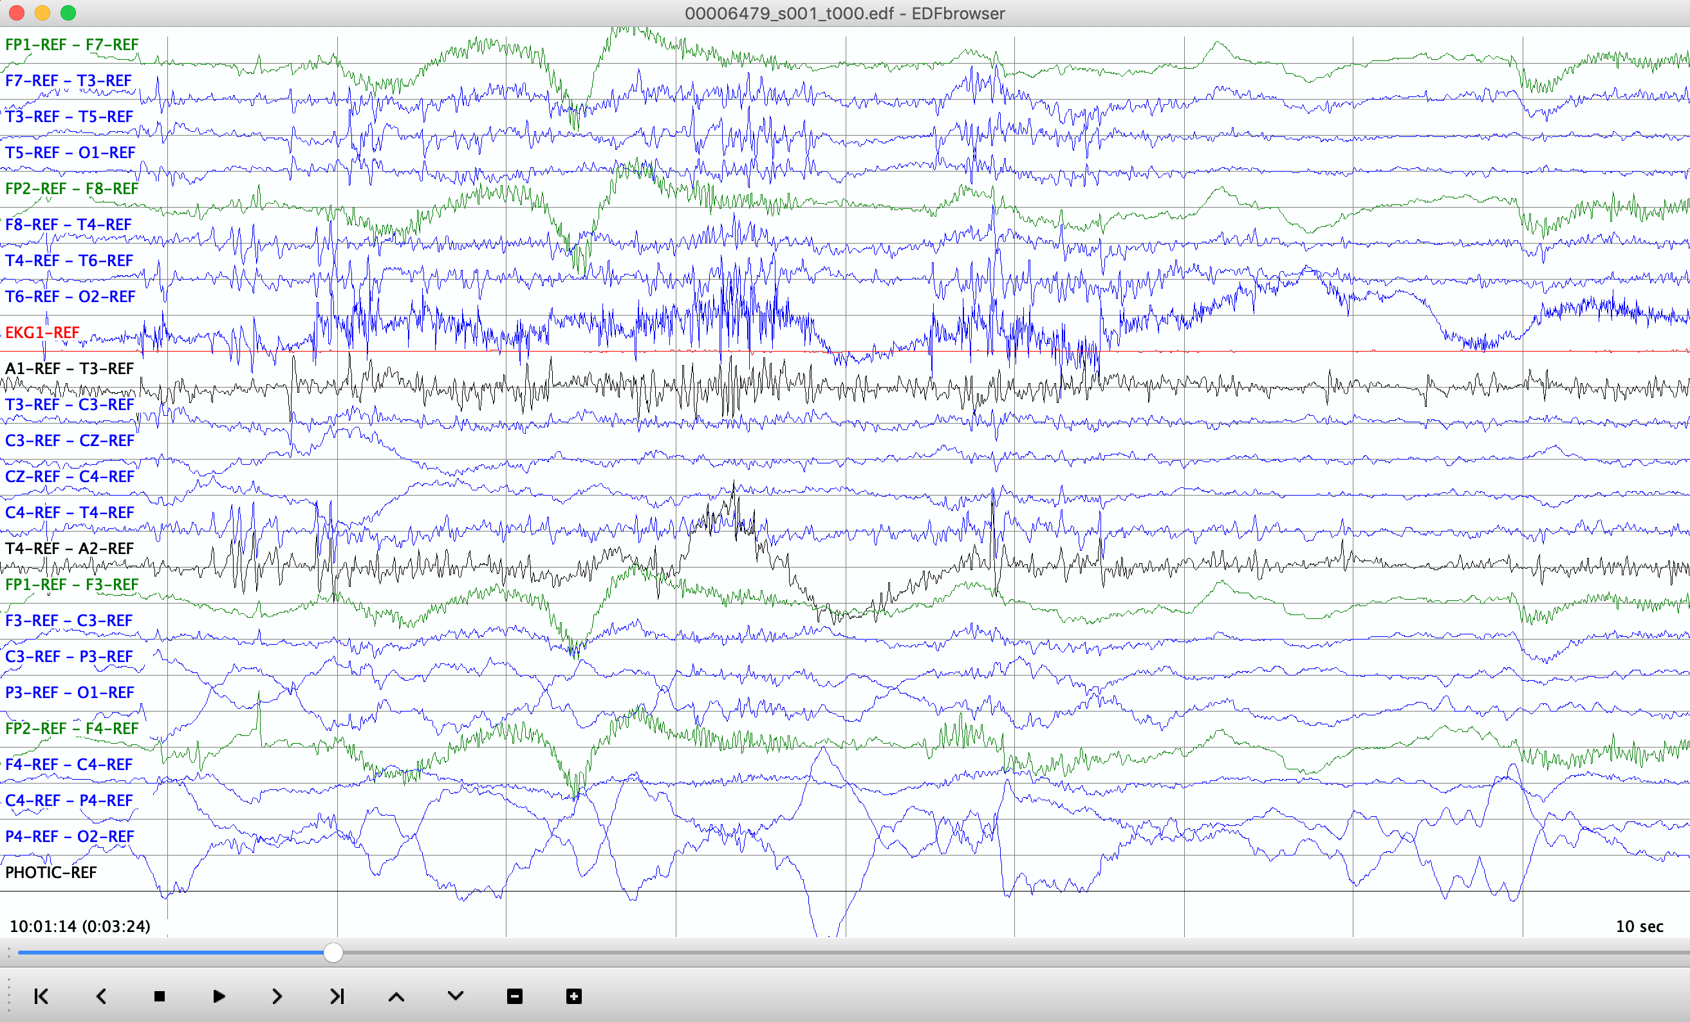
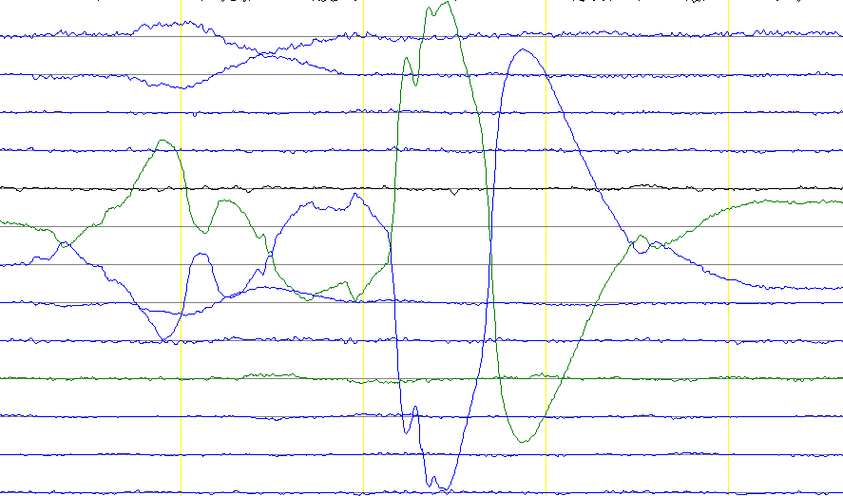
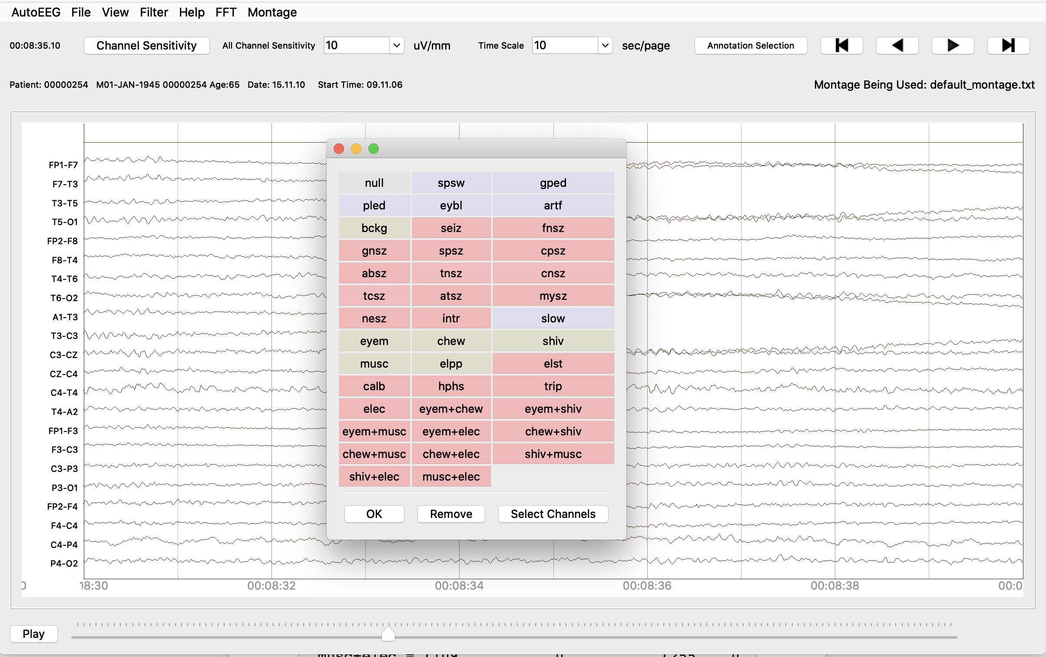
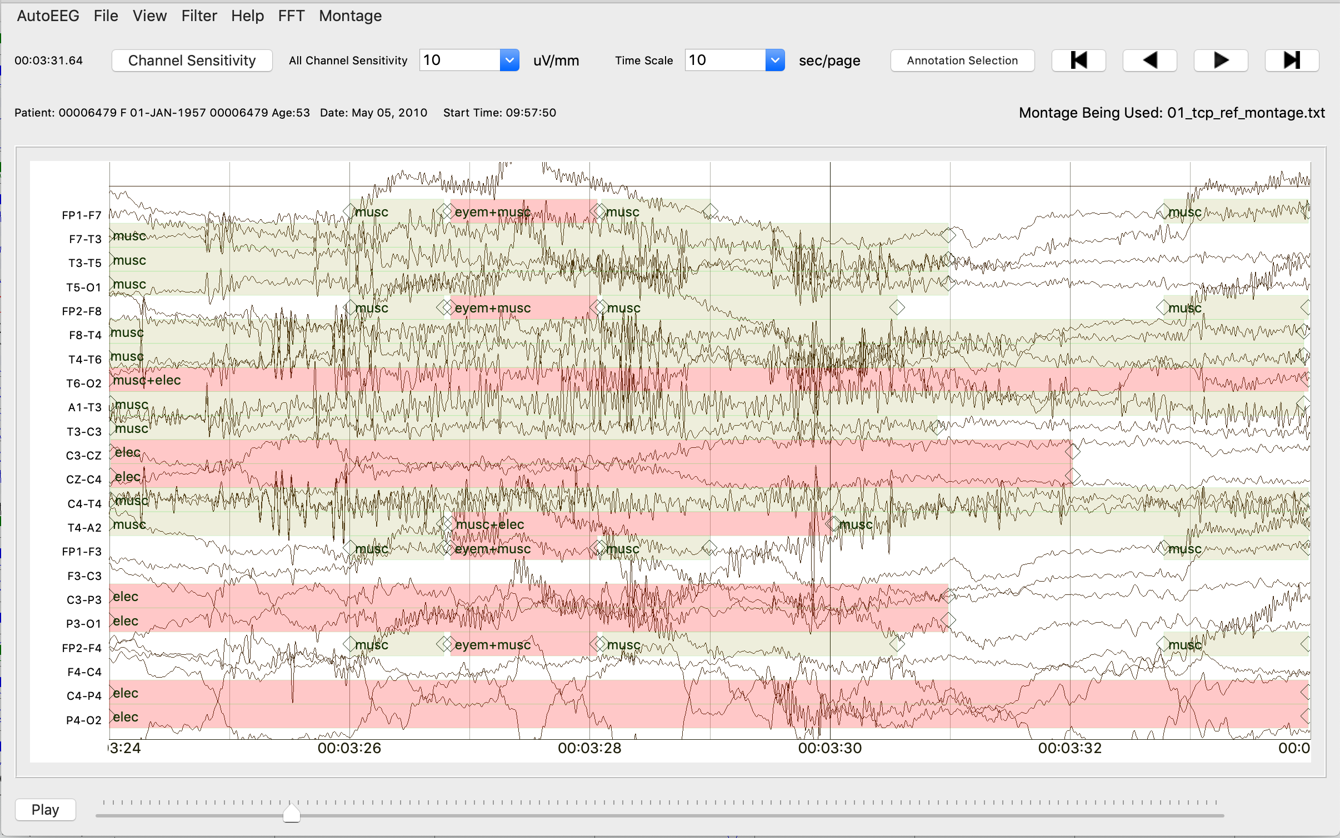
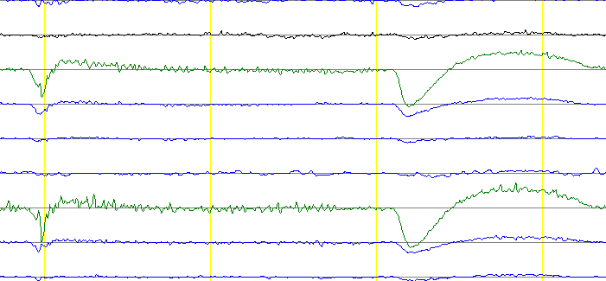
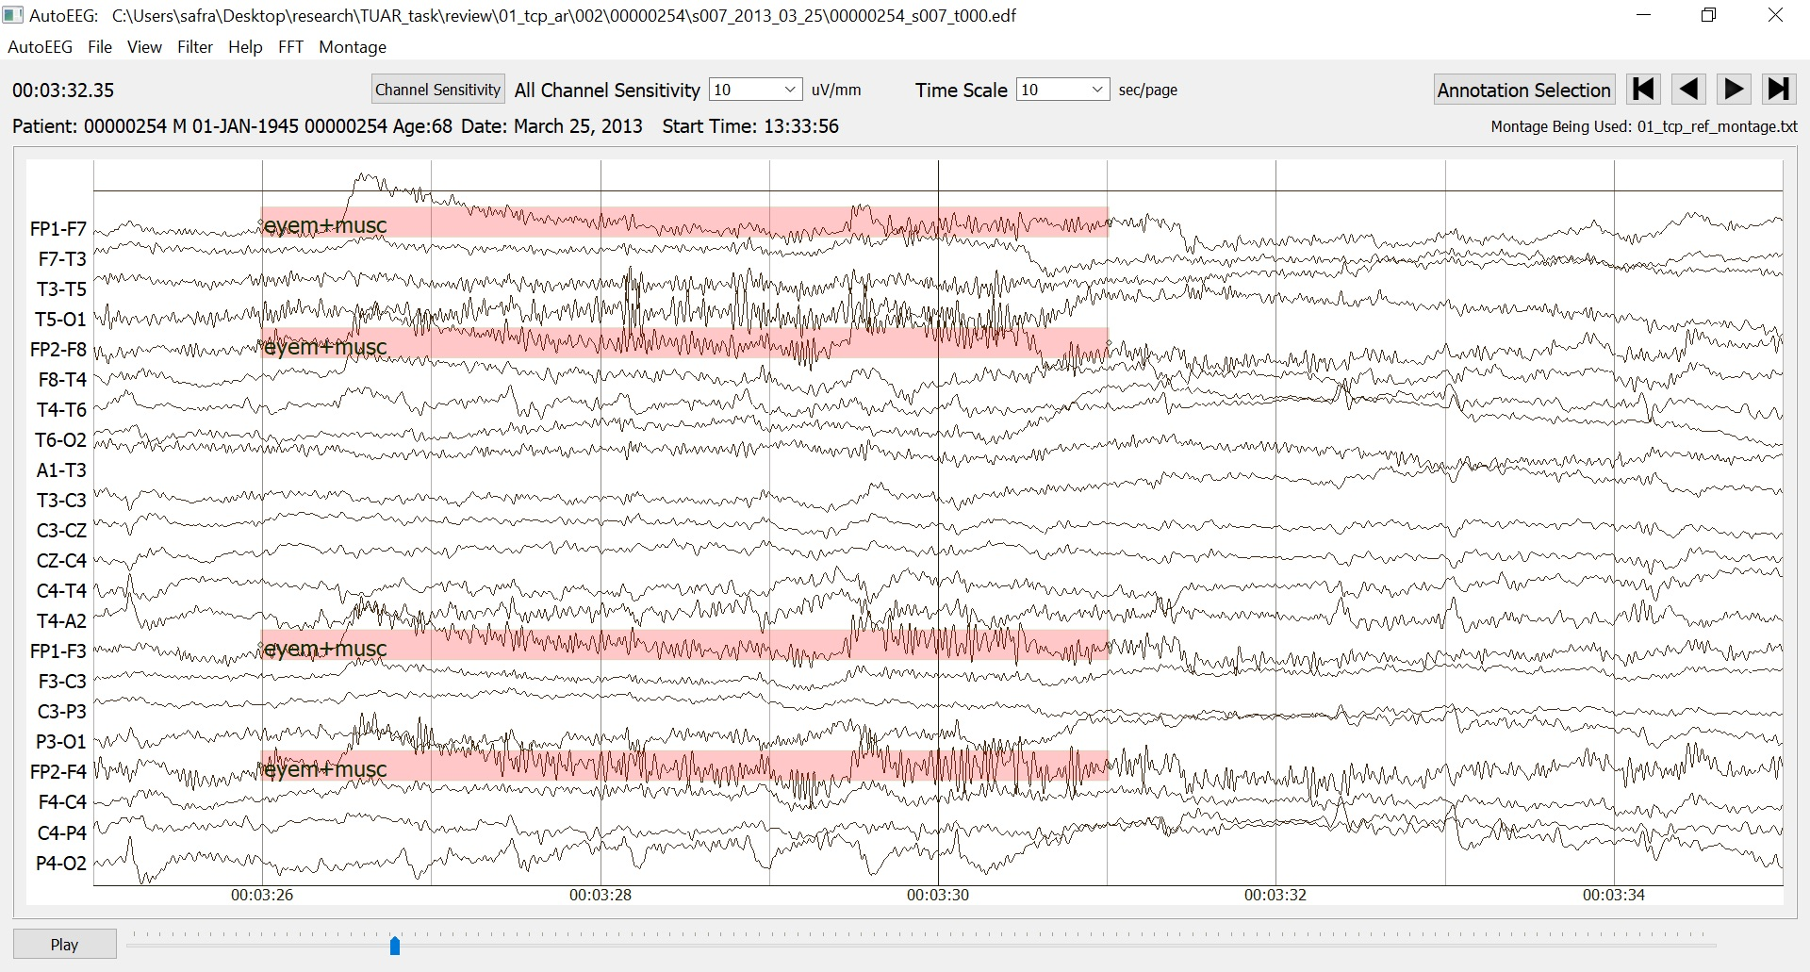
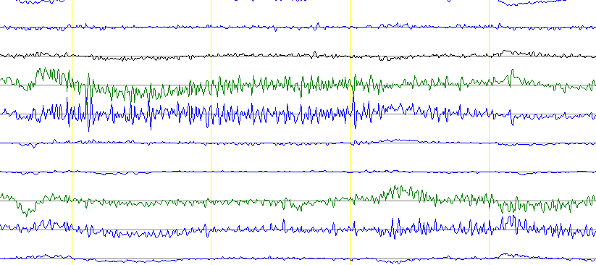
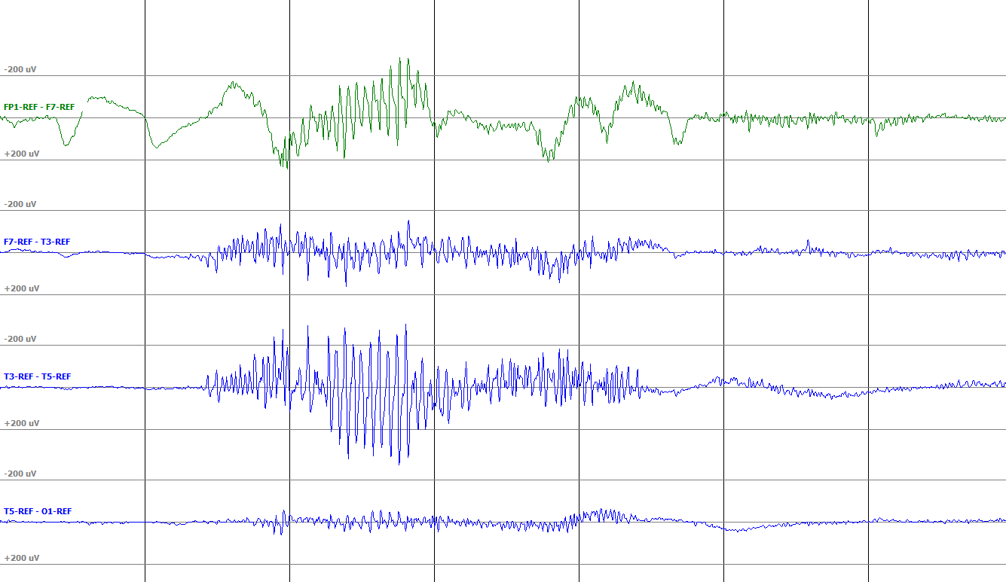
The Temple University Artifact Corpus: An Annotated Corpus of EEG Artifacts
A. Hamid, K. Gagliano, S. Rahman, N. Tulin, V. Tchiong, I. Obeid, and J. Picone
The Neural Engineering Data Consortium, Temple University
College of Engineering
Temple University
www.nedcdata.org
Abstract
A new subset of the popular open source electroencephalogram (EEG) corpus – TUH EEG:
The Temple University Artifact Corpus (TUAR) consists of high yield artifact files annotated using a five-way classification system:
Chewing (CHEW): An artifact resulting from the tensing and relaxing of the jaw muscles.
Electrode (ELEC): An artifact that encompasses various electrode related phenomena.
Eye Movement (EYEM): A spike-like waveform created during patient eye movement.
Muscle (MUSC): A common artifact with high frequency, sharp waves corresponding to patient movement.
Shiver (SHIV): A specific and sustained sharp wave artifact that occurs when a patient shivers.
EEG artifacts are waveforms that are not of cerebral origin and may have been affected by several external and physiological factors.
These artifacts cause false alarms in seizure prediction machine learning systems.
This corpus was developed to support research and evaluation of artifact suppression technology.
Five-Way Classification
Chewing (CHEW): results from the tensing and relaxing of the jaw muscles.
Electrode (ELEC): encompasses electrode related phenomena such s poor conductivity and electrostatic discharges.
Eye Movement (EYEM): caused by patient eye movement.
Muscle (MUSC): high frequency waves caused by patient movement during an EEG recording.
Shiver (SHIV): Sharp wave seen as the patient shivers during an EEG recording.
The Annotation Process
Annotated by a team of five student workers who have been trained to annotate seizures, artifacts, slowing and other common phenomena.
Inter-rater agreement for this team is very high (κ > 0.8) and continuously monitored to ensure uniformity of the annotations.
Each file is annotated by a minimum of two annotators. Difficult cases are reviewed by the group. Weekly review sessions are conducted.
Patient reports are used as references in order to develop a common interpretation between student annotators as well as neurologists.
Annotation Tool
Our open-source visualization tool, written in PyQt, supports visualization and interpretation of EEGs.
Annotations are made directly onto this visualization tool using a mouse click and drag function. Associated tags are chosen from drop-down menus.
Annotations are overlaid on the waveform and can be interactively edited.
The annotations consist of artifacts that overlap in time which require overlapping annotations.
Such annotations are completed using a concatenated labeling format (e.g., EYEM+ELEC is used to label a region where both artifacts occur).
This compensates for the limitations of the annotation tool, as well as the complexity needed in annotation data structure to represent such overlapping events.
A new format based on XML will soon be released that will handle this in a more elegant manner. Tags can overlap in time and be arranged in a hierarchy.
Annotation Challenges
When overlapping events on several channels obscure our view, it takes significantly longer to annotate a file.
Annotations that show alternating artifact events throughout the course of the file also take a significant amount of time to annotate.
The average time spent annotating a file in TUAR v2.0 is over 30 mins compared to 15 mins for v1.0 and 10 mins for TUSZ.
TUAR v2.0 Statistics
v2.0 is a major upgrade over v1.0 because every artifact event was labeled:
TUAR files have an average duration of 20 minutes in comparison to 9 minute TUSZ files. Certain files can extend to greater than 3 hours.
Specific Artifact Morphology:
CHEW is a subset of the muscle artifact class that has the same characteristic high frequency sharp waves with 0.5 sec baseline periods between bursts.
ELEC is an artifact that includes various electrode related artifacts such as pop, electrostatic discharge, lead movement and poor conductivity.
EYEM is created during patient eye movement and is usually found on all the frontal polar electrodes.
MUSC often occurs because of agitation in the patient and tends to have energy above 30 Hz.
SHIV occurs when a patient shivers, usually seen on all or most channels.
 | v1.0 | v2.0
Patients | 213 | 213
Sessions | 259 | 259
Files | 310 | 310
CHEW | 28 | 36
ELEC | 105 | 221
EYEM | 177 | 251
MUSC | 99 | 277
SHIV | 15 | 5
Total Duration (Hours) | 99.64 | 99.64
Events | 23418 | 15699
Summary
The TUAR v2.0.0 release is a fully annotated database using a five-way classification system.
The TUAR v2.0.0 consists of 310 files, 259 sessions, 213 patients and 15699 artifact events.
Overlapping events in time are annotated using a concatenated labeling system.
The data compiled in TUAR can be used to evaluate artifact reduction technology.
The data can be downloaded from
isip.piconepress.com/projects/tuh_eeg/html/downloads.shtml
which includes instructions for anonymous rsync.
Acknowledgements
Research reported in this publication was most recently supported by the National Science Foundation Partnership Program (PA CURE). Any opinions, findings, and conclusions or recommendations expressed in this material are those of the author(s) and do not necessarily reflect the official views of any of these organizations.

