Slide 1
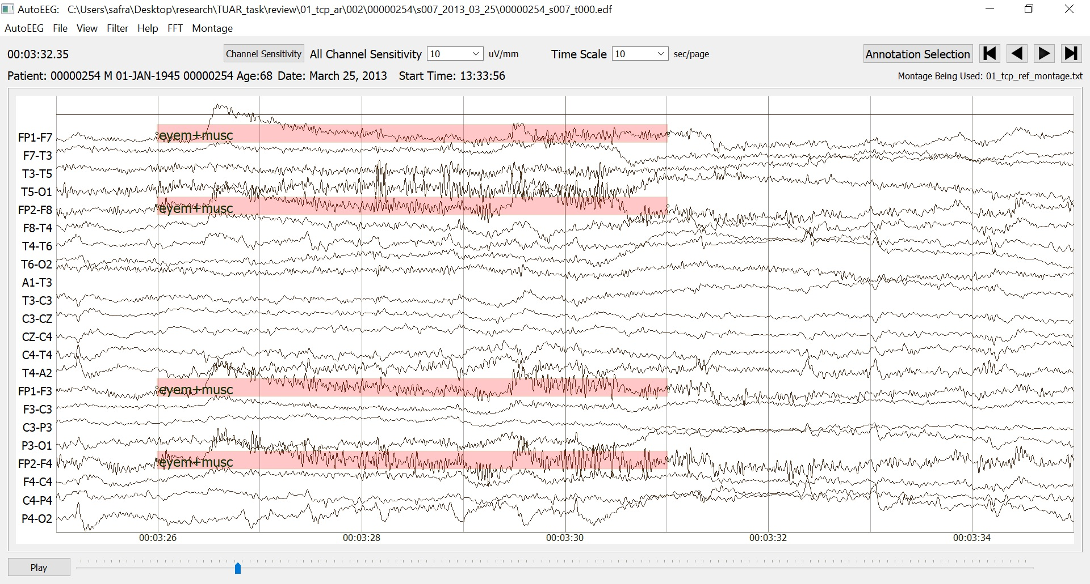
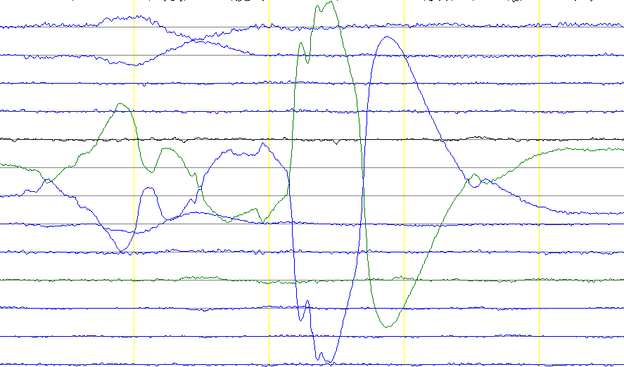
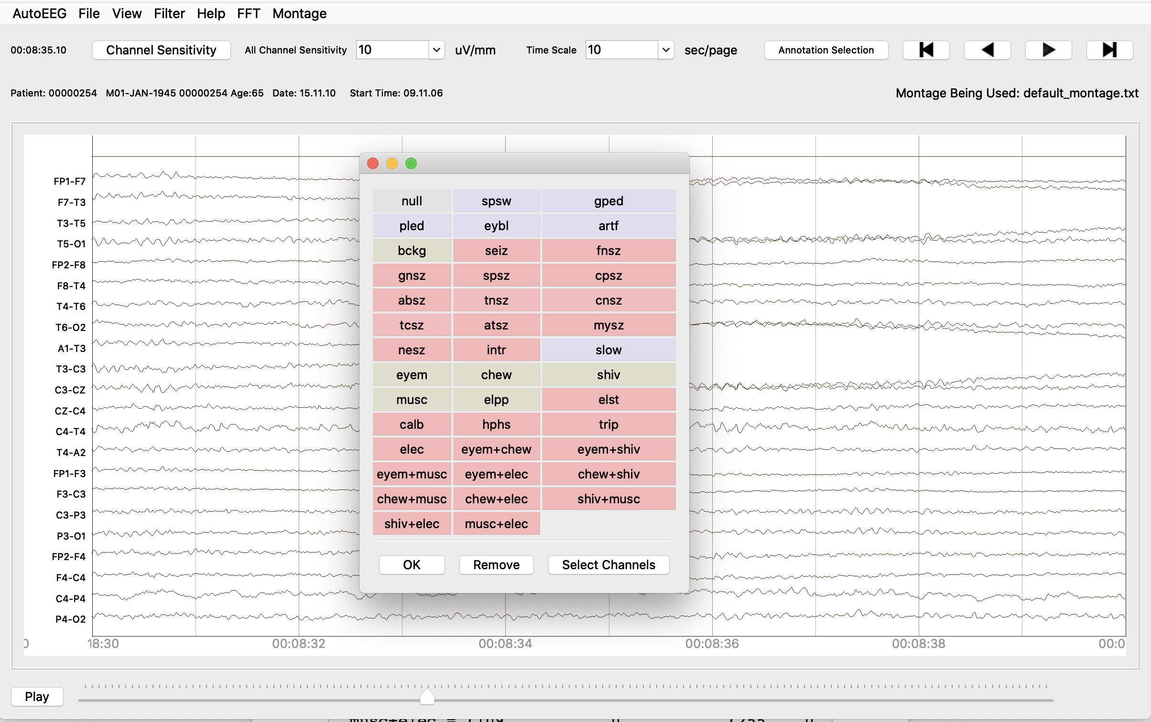
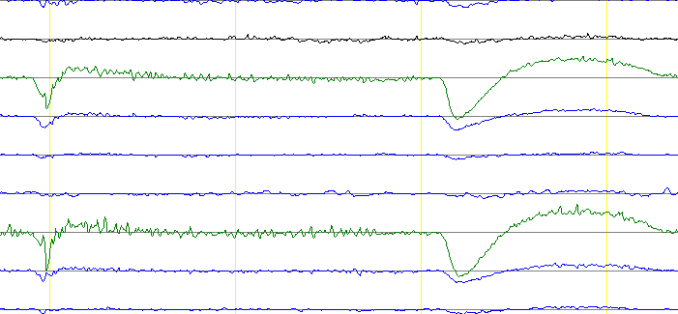
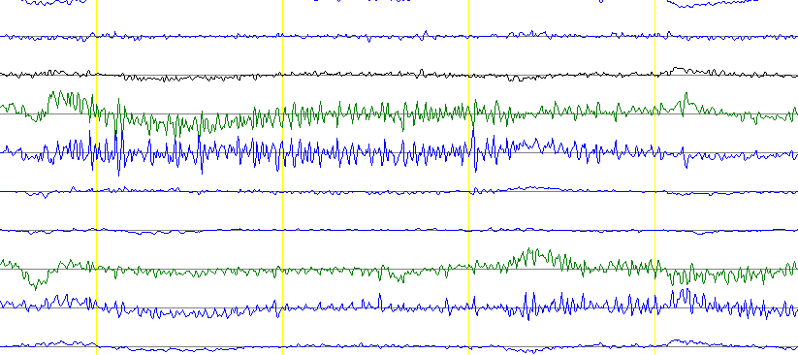
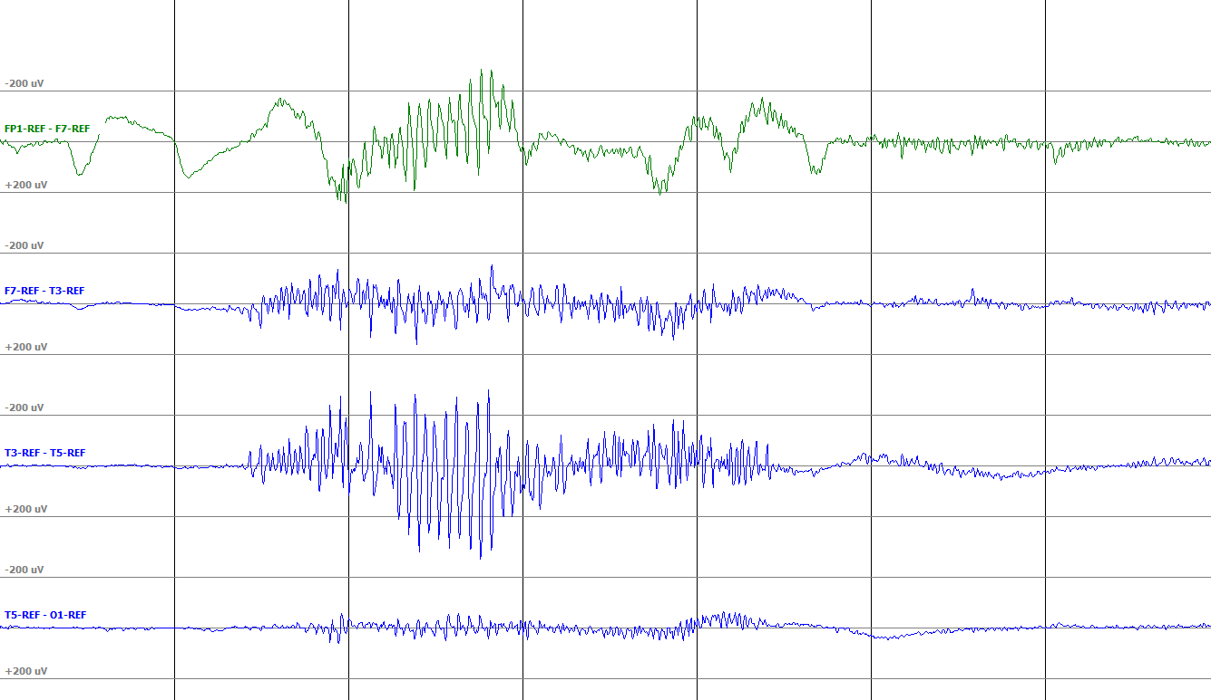
The Temple University Artifact Corpus: An Annotated Corpus of EEG Artifacts
A. Hamid, K. Gagliano, S. Rahman, N. Tulin, V. Tchiong, I. Obeid, and J. Picone
The Neural Engineering Data Consortium, Temple University
College of Engineering
Temple University
www.nedcdata.org
Abstract
An electroencephalogram (EEG) is a multi-channel signal which describes the electrical activity in the brain through electrodes placed on the scalp.
EEG artifacts are waveforms that are not of cerebral origin and may have been affected by several external and physiological factors.
These artifact signals are often mistaken as seizures due to their similarity in terms of amplitude and frequency.
Artifacts in EEG recordings are known to cause false alarms in machine learning systems and further complicate relevant research.
The Temple University artifact corpus consists of high yield artifact files obtained from Temple University Hospital.
This corpus was annotated using a five-way classification system supplemented with concatenated annotation abilities.
Annotation Process
Annotated by student workers who have been trained in artifact recognition and EEG interpretation.
Inter-rater agreements conducted in order to ensure uniformity between annotations.
Multiple annotation passes of the data are performed.
Each file is checked by a minimum of two annotators.
Groups reviews are performed on complicated files.
Patient reports are used as references in order to develop a common interpretation between student annotators as well as neurologists. Thought discrepancies between the two can occur.
Annotation Tool
This visualization tool, written in PyQt, allows for reading and analysis of EEGs.
Annotations are made directly onto this visualization tool using a mouse click and drag function. Associated tags are chosen.
The files are saved as .rec files which are ultimately used for the purposes of generating release files but are not released themselves.
Data Retrieval and Release
The Temple University artifact corpus is comprised of EEGs retrieved from the Temple Hospital clinical database.
TUAR is a subset of the more extensive TUEG Corpus, the world’s largest open-source corpus of EEG data.
The TUAR corpus was hand-selected from TUEG to contain files with a high artifact yield.
Files are de-identified using a combination of manual and automated tools prior to annotation to ensure patient anonymity.
The de-identified EEGs and corresponding physician reports are uploaded as .edf and .txt files respectively to the Neuronix cluster for annotation.
Following annotation and finalization, data is released to be used for tasks such as artifact reduction and machine learning projects.
Five-Way Classification
Chewing (CHEW): Results from the tensing and and relaxing of the jaw muscles.
Electrode (ELEC): Encompasses electrode pop, electrostatic, and lead artifact.
Eye Movement (EYEM): Caused by patient eye movement during the EEG recording.
Muscle (MUSC): High frequency waves caused by patient movement during EEG recording.
Shiver (SHIV): Sharp wave seen as the patient shivers during an EEG recording.
XML and Formatting for Concatenation
The annotations consist of artifacts that overlap in time which require overlapping annotations.
Such annotations are completed using a concatenated labeling format. This compensates for the limitations of the annotation tool, as well as the complexity needed in annotation data structure to represent such overlapping events.
XML files can handle overlapping events. This file format is used for data distribution.
Statistics of TUAR
A fully annotated database of all major artifacts.
Comparison with v1.0.0
Partially annotated database
Between v1.0.0 and v2.0.0 progression, no files were added.
The v2.0.0 release differs from v1.0.0 in the number of annotations included in each file. The same files are used in both releases.
Concatenated Label | Code
EYEM + CHEW | 100
EYEM + SHIV | 101
EYEM + MUSC | 102
EYEM + ELEC | 103
CHEW + SHIV | 104
CHEW + MUSC | 105
CHEW + ELEC | 106
SHIV + MUSC | 107
SHIV + ELEC | 108
MUSC + ELEC | 109
Artifact | Chew | ELEC | EYEM | MUSC | SHIV | Total
Files | 36 | 221 | 251 | 277 | 5 | 310
Sessions | 33 | 191 | 214 | 235 | 5 | 259
Patients | 31 | 160 | 186 | 197 | 5 | 213
Artifact | Chew | ELEC | EYEM | MUSC | SHIV | Total
Files | 28 | 105 | 177 | 99 | 15 | 310
Sessions | 23 | 97 | 166 | 90 | 14 | 259
Patients | 22 | 80 | 140 | 74 | 14 | 213
Summary
The TUAR v2.0.0 release is a fully annotated database that is annotated using a five-way classification system.
The TUAR release consist of 310 files, 259 sessions and 213 patients.
The TUAR files are hand selected and obtained from Temple University hospital.
Annotations are done via a visualization tool written in PyQt and can be run through a python environment.
Overlapping events in time are annotated using concatenated labels.
The data is annotated by students who have been trained EEG interoperation and artifact reduction.
The data compiled in TUAR can be used to evaluate artifact reduction technology.
Acknowledgements
Research reported in this publication was most recently supported by the National Science Foundation Partnership Program (PA CURE). Any opinions, findings, and conclusions or recommendations expressed in this material are those of the author(s) and do not necessarily reflect the official views of any of these organizations.

