Slide 1
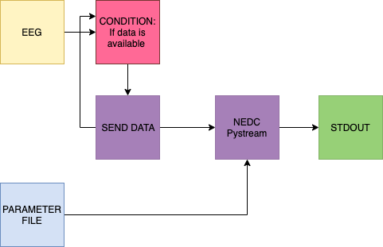
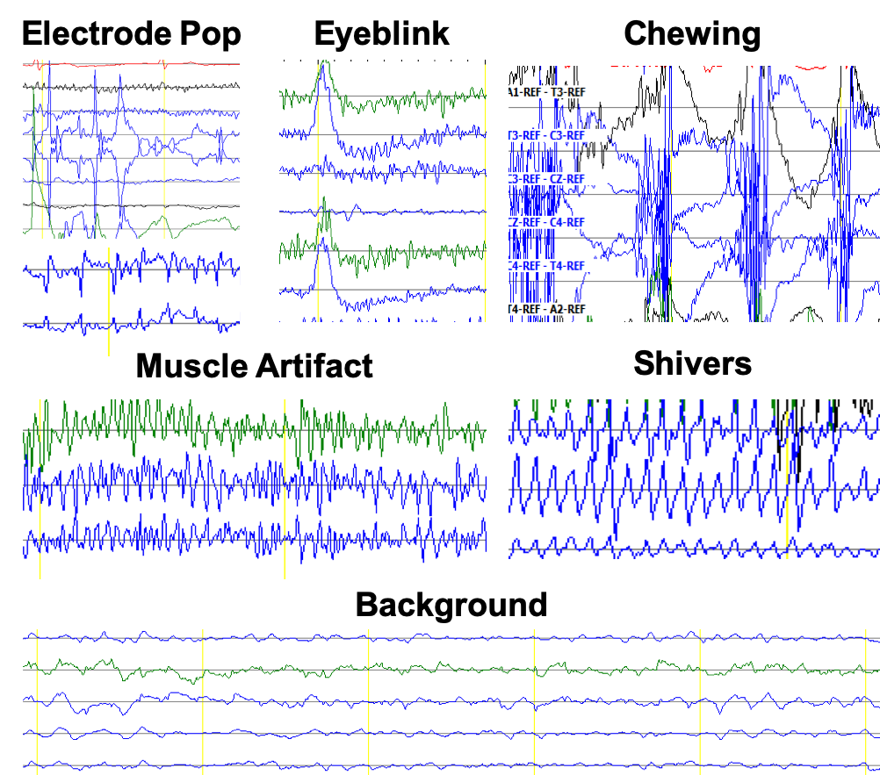
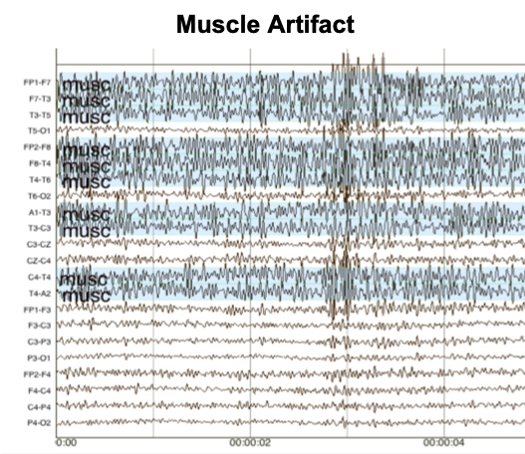
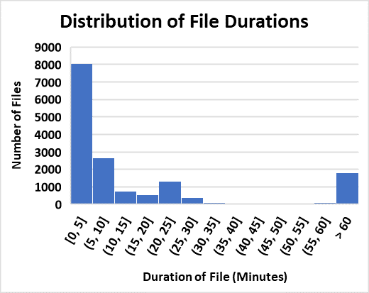
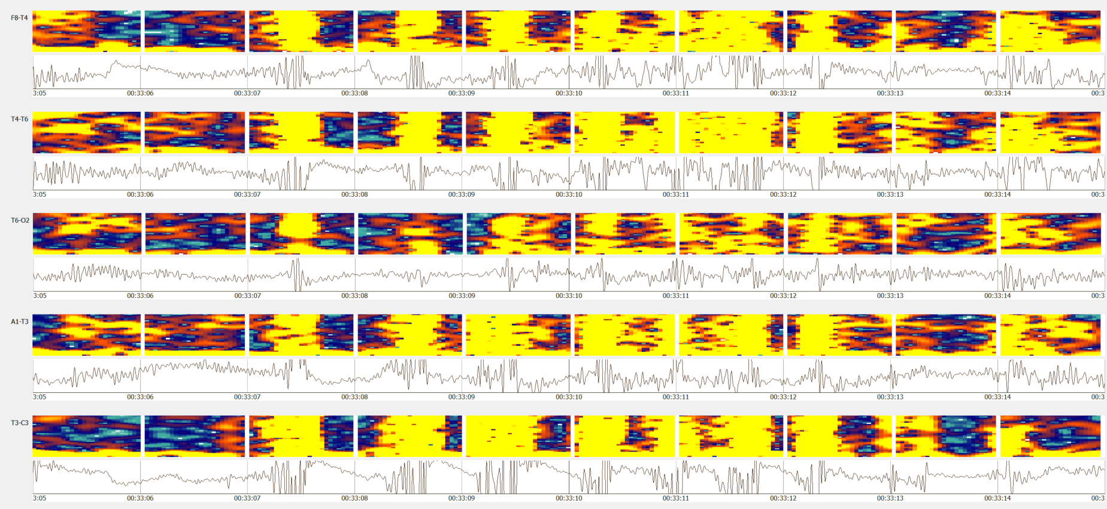
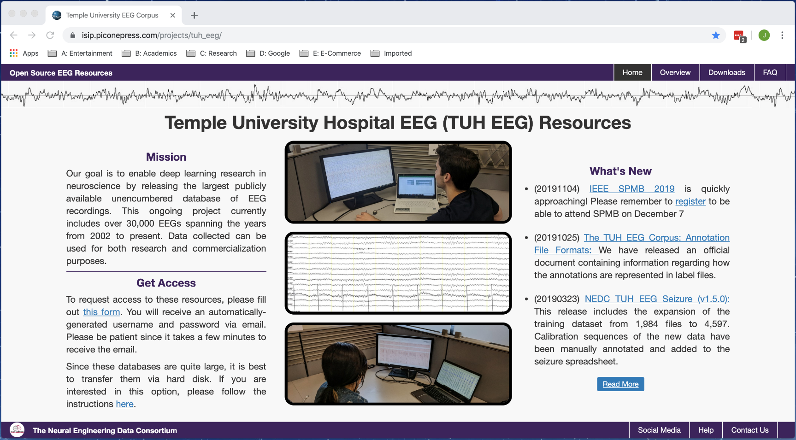
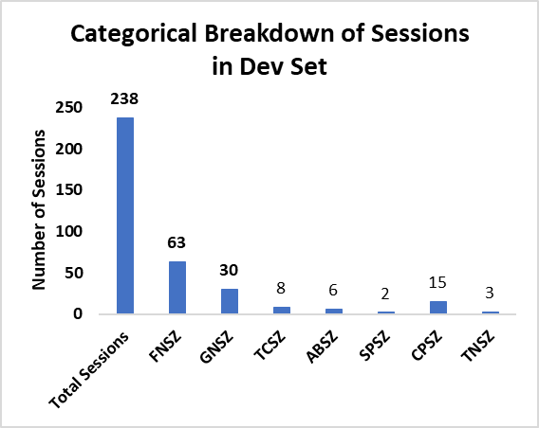
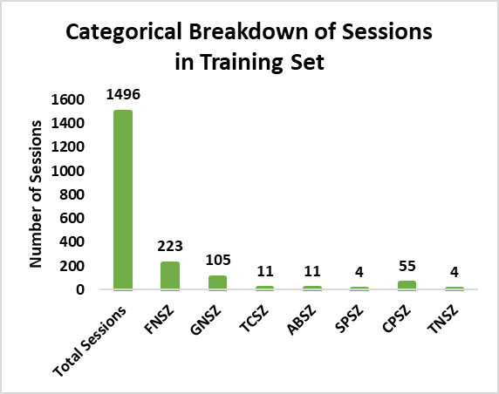
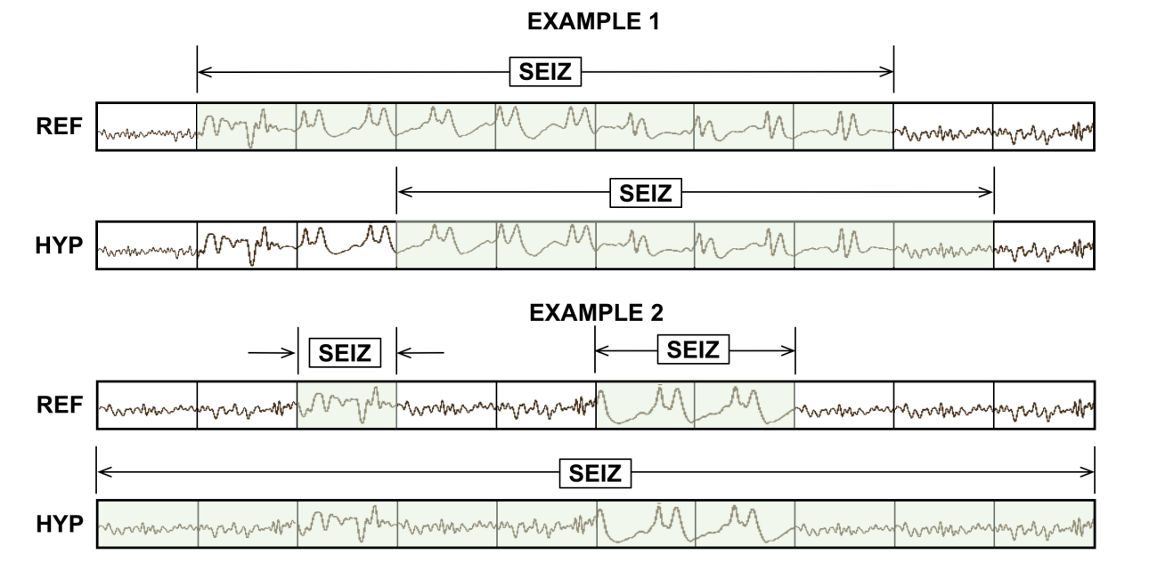
Software and Data Resources to Advance Machine Learning Research for EEGs
S. Rahman, M. Miranda, I. Obeid and J. Picone
The Neural Engineering Data Consortium, Temple University
College of Engineering
Temple University
www.nedcdata.org
Abstract
Created in 2012, the Temple University Hospital Electroencephalography Corpus (TUEG) is the world’s largest open source EEG corpus.
There are several important subsets of this corpus that were developed and updated this year:
TUH EEG Seizure Corpus (TUSZ): expanded to include a total of 739 patients and 1,620 sessions. There are 1,464 files with at least one seizure event and 3,366 seizure events. A blind evaluation set was also developed to support upcoming open source evaluations.
TUH EEG Artifact Corpus: used to develop enhanced background models. Five types of artifacts were annotated.
Several software tools were released to support research and facilitate data distribution:
NEDC PyStream: a self-contained Python script that demonstrates how to read and properly decode channels in an EEG signal using the provided channel labels.
NEDC Eval EEG: a Python-based scoring package that uses five popular scoring metrics (e.g., Time-Aligned Event Scoring).
Anonymous Rsync: a new method for distribution based on the popular tool rsync. Makes incremental download of the data relatively simple.
TUH EEG Corpus (TUEG: v1.2.0)
Increased the size of the corpus:
This new data came from mid-2015 through 2016 and consists of patients who, on the average, were monitored for a longer period of time. This manifests itself by a larger number of sessions per patient.
Our database consists of pruned EEGs – a process where technicians discard uninteresting portions of the EEG signal. This saves a significant amount of disk space.
A majority of the routine sessions are split into files shorter than 30 minutes in duration due to the pruning process.
However, the long-term monitoring (LTM) files are greater than one hour in duration.
TUH EEG Artifact Corpus (TUEV: 1.0.1)
This corpus was developed to support modeling of non-seizure events.
Five artifacts labeled:
CHEW: chewing
EYEM: eye movements
ELPP: electrode pop/electrostatic artifact/ lead artifacts
MUSC: muscle artifacts
SHIV: shivering
The data has also been cross-referenced with TUEG.
Typical examples of artifacts:
Artifacts such as chewing resemble features of tonic-clonic and complex-partial seizures.
NEDC PyStream (v1.0.0)
A self-contained EDF streaming service. It is written in Python using PyEDFlib for portability.
Demonstrates how an EDF file is correctly read by identifying channels by their associated labels.
Since channels can occur in any order in an EDF file, correct interpretation of the data requires indexing the channels by their labels.
Anonymous Rsync Downloads
The rsync command effectively synchronizes both a remote directory and a local directory and copies the selected folder from the server to the desktop.
To use the rsync command, both a username and password are needed. An automated registration process on our website provides access.
An example of a typical rsync command to access our data on our website would be:
rsync –aux nedc_tuh_eeg@www.isip. piconepress.com:~/data/tuh_eeg/ .
This command is available to both Linux and Mac users. Windows users can use the new Linux Bash shell that is available from Microsoft.
Item | TUEG (v1.1.0) | TUEG (v1.2.0) | TOTAL
No. Patients | 13,539 | 1,940 | 15,479
No. Sessions | 23,002 | 3,844 | 26,846
Avg. Sess/Pat. | 1.54 | 1.98 | 1.60
No. Files | 56,506 | 15,917 | 69,423
Hours of Data | 15,757 | 11,295 | 27,052
Size of Data | 0.964T | 0.692T | 1.656T
Introduction
NEDC’s historical archive of EEG includes every EEG collected at Temple University Hospital (TUH) since 2012:
www.isip.piconepress.com/projects/tuh_eeg
This corpus now includes over 2,339 active subscribers and has been updated regularly annually since 2012.
Documentation about the corpus has been expanded to include:
Electrodes: explains the how the data was collected (e.g., physical location of the electrodes), visualized (e.g., montages) and stored in EDF files (e.g., channel labels).
Annotations: describes the formats used to store annotation information and the way seizure events are classified.
TUH EEG Seizure Corpus (TUSZ: v1.6.0)
This is a subset of TUH EEG (TUSZ) developed for automatic seizure detection.
Each file has been manually annotated by multiple annotators and validated with a variety of machine learning experiments. Inter-rater agreement is high.
Comparisons with neurologist performance has been impressive – our UG team consistently performs well above neurologist performance.
Calibration sequences have been manually annotated and added to the seizure spreadsheet.
NEDC Eval EEG (v1.3.0)
This is a standardized Python-based scoring package that provides useful diagnostic information.
Five different scoring methods are supported:
DPALIGN: dynamic programming-based sequence alignment
EPOCH: epoch-based sampling
OVLP: assessment of the degree of overlap
TAES: time-aligned event scoring
IRA: inter-rater agreement
Standard metrics such as sensitivity, specificity and false alarms are reports for all methods.
DPALIGN is based on a well-known speech recognition package distributed by NIST.
OVLP is very popular within the seizure detection community but is misleading.
Summary
These corpora and supporting tools are open source and freely available at https://www.isip.piconepress. com/projects/tuh_eeg.
Future release plans include:
For further information, contact help@nedcdata.org.
Acknowledgements
Research reported in this publication was most recently supported by the National Human Genome Research Institute of the National Institutes of Health under award number U01HG008468. The content is solely the responsibility of the authors and does not necessarily represent the official views of the National Institutes of Health.
This research was also supported in part by a grant from the Temple University College of Engineering Research Experience for Undergraduates program and the Pennsylvania Commonwealth Universal Research Enhancement Program (PA CURE).
Item | TUSZ (v1.5.0) | New Data | TUSZ (v1.6.0)
No. Patients | 642 | 133 | 775
No. Sessions | 1,423 | 199 | 1,622
Avg. Sess/Pat. | 2.00 | 1.50 | 1.92
No. Files | 5,610 | 311 | 5,921
Hours of Data | 923 | 71 | 994
No. Seizure Events | 1,153 | 96 | 1,249
Database | Version | Description | Expected Date
TUEG | V1.3.0 | The addition of the sessions from 2017-2019. | January 2020
TUSZ | v1.7.0 | The addition of annotated seizure files from 2017- mid 2019. | January 2020
TUEG | v2.0.0 | A cumulative release of all sessions and corresponding reports to date | March 2020
EPOCH: measure similarity using a temporal sampling approach
TAES: Weight the amount of overlap between the two alignments

