Slide 1
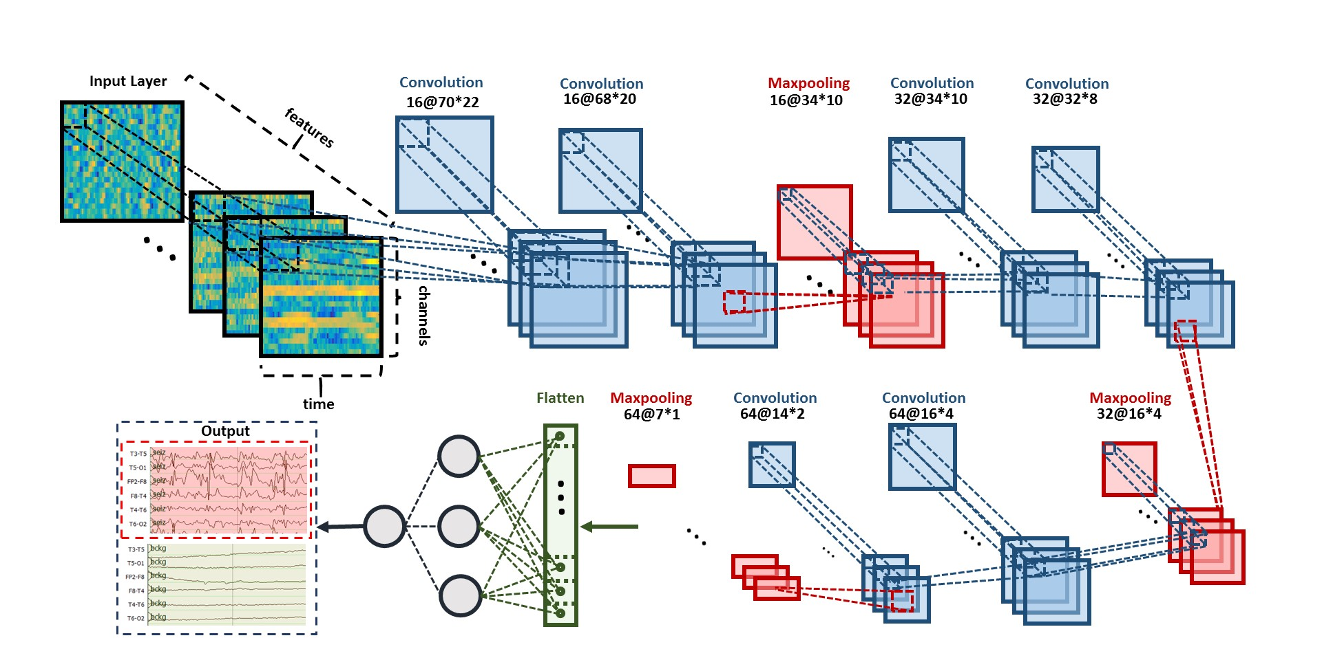
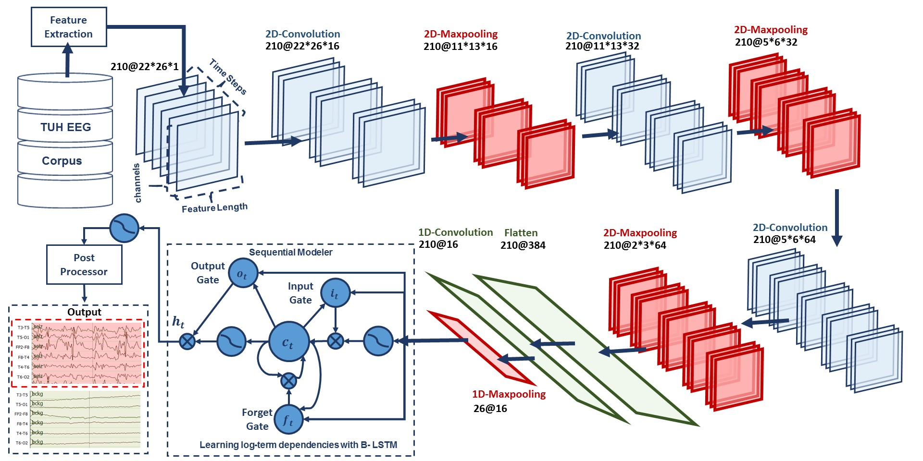
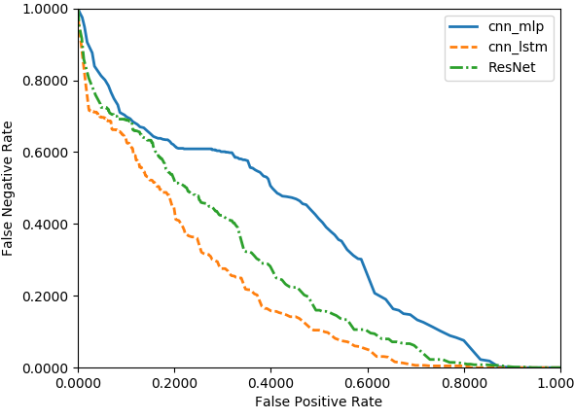
Deep Residual Learning for Automatic Seizure Detection
M. Golmohammadi, I. Obeid and J. Picone
The Neural Engineering Data Consortium, Temple University
College of Engineering
Temple University
www.nedcdata.org
Abstract
Automated seizure detection using clinical electroencephalograms (EEGs) is a challenging machine learning problem due to low signal to noise ratios, signal artifacts and benign variants.
Commercially available seizure detection systems suffer from unacceptably high false alarm rates.
Deep learning algorithms, like Convolutional Neural Networks (CNNs), have not previously been effective due to the lack of big data resources.
A significant big data resource, known as TUH EEG Corpus, has recently become available for EEG interpretation creating a unique opportunity to advance technology using CNNs.
In this study, a deep residual learning framework for automatic seizure detection task is introduced that overcomes the limitations of deep CNNs by reformulating the layers as learning residual functions with reference to the layer inputs, instead of learning unreferenced functions.
This architecture delivers 30% sensitivity at 13 false alarms per 24 hours. Our work enables designing deeper architectures that are easier to optimize and can achieve better performance from considerably increased depth.
Deep Learning Architectures
Performance on Clinical Data
Performance on TUSZ:
The results are reported in Any-Overlap Method (OVLP). TPs are counted when the hypothesis overlaps with reference annotation.
FPs correspond to situations in which the hypothesis does not overlap with the reference.
A DET curve comparing performance on TUSZ:
ResNet significantly improves the performance compared to CNN/MLP.
ResNet does not outperform CNN/LSTM (which is a hybrid recurrent neural network).
CNN/MLP: Two-dimensional decoding of EEG signals using a CNN/MLP hybrid architecture that consists of six convolutional layers, three max pooling layers and two fully-connected layers.
The input to a convolutional layer is W × H × N data where W is the window length multiplied by the number of EEG samples per second, H is the number of EEG channels and N is the length of the feature vector.
A rectified linear unit (ReLU) is applied to the output of every convolutional and fully-connected layer as non-linearity. Dropout is used for regularization.
System | Sensitivity | Specificity | FA/24 Hrs.
CNN/MLP | 39.09% | 76.84% | 77.XX
CNN/LSTM | 30.83% | 96.86% | 7.XX
ResNet | 30.50% | 94.24% | 13.78
CNN/MLP
CNN/LSTM: Deep recurrent convolutional architecture for two-dimensional decoding of EEG signals that integrates 2D CNNs, 1-D CNNs and LSTM networks.
The input data is W × H × N where in each frame W is the length of a feature vector, H is the number of EEG channels, and N is one. The input data consists of T frames where T is equal to the window length multiplied by the number of samples per second.
To overcome the problem of overfitting, dropout and Gaussian noise layers are used between layers.
To increase non-linearity, Exponential Linear Units (ELU) are used .
TUH EEG Seizure Detection (TUSZ)
Subset of the publicly available TUH EEG Corpus (www.isip.piconepress.com/projects/tuh_eeg).
Seizure event annotations include:
start and stop times;
localization of a seizure (e.g., focal, generalized) with the appropriate channels marked;
type of seizure (e.g., simple partial, complex partial, tonic-clonic, gelastic, absence, atonic);
nature of the seizure (e.g., convulsive);
Non-seizure event annotations include
artifacts which could be confused with seizure;
non-epileptiform activity;
abnormal background (e.g. triphasics);
CNN/LSTM
x
There are two obstacles for increasing the depth of CNN: (1) the convergence problem created by vanishing/exploding gradients; and (2) the degradation problem in which accuracy saturates when the number of layers is increased.
ResNet introduces an “identity shortcut connection” that skips layers.
Denoting the desired underlying mapping as H(x), we map the stacked nonlinear layers using F(x) = H(x) - x. The original mapping is recast into F(x) + x.
It is easier to optimize the residual mapping than to optimize the original, unreferenced mapping.
Weight Layer
 | Train | Eval
Patients | 264 | 50
Sessions | 584 | 239
Files | 1989 | 1015
Seizure (hrs.) | 21 | 16
Non-Seizure (hrs.) | 309 | 155
Total (hrs.) | 330 | 171
F(x)
Activation
Weight Layer
F(x) + x
+
Activation
Summary
For the first time, a deep residual learning structure was developed for automatic seizure detection. As a result we can train deeper neural networks successfully on large datasets.
The ResNet structure improves the performance of CNN/MLP. However CNN/LSTM, a hybrid recurrent neural network, delivers better results than ResNet.
Future work will include developing a residual framework for hybrid structures like CNN/LSTM, decreasing the depth and increasing the width of residual blocks using wide residual networks (WRN).
Acknowledgements
Research reported in this poster was supported by National Human Genome Research Institute of the National Institutes of Health under award number 3U01HG008468-02S1.
The content is solely the responsibility of the authors and does not necessarily represent the official views of the National Institutes of Health.
Residual learning block
The architecture consists of 14 layers of convolution followed by a fully connected layer and a sigmoid as the last layer.
The network consists of 6 residual blocks with two 2D convolutional layers per block.
The 2D convolutional layers all have a filter length of (3, 3). The first 7 layers of 2D-CNN have 32 and the last layers have 64 filters.
Except for the first and last layers of the network, before each convolutional layer we apply ReLU. We apply Dropout between the convolutional layers and after ReLU.
We use the Adam optimizer with parameters of lr = 0.00005, beta_1 = 0.9, beta_2 = 0.999, epsilon = 1e-08, decay = 0.0001.
Deep Residual Learning Structure

