Slide 1
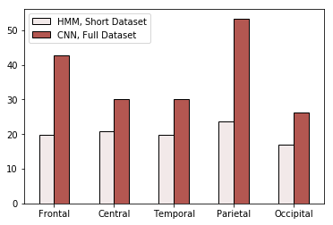
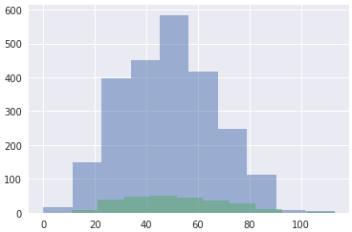
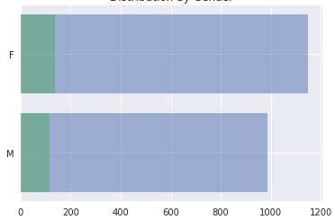
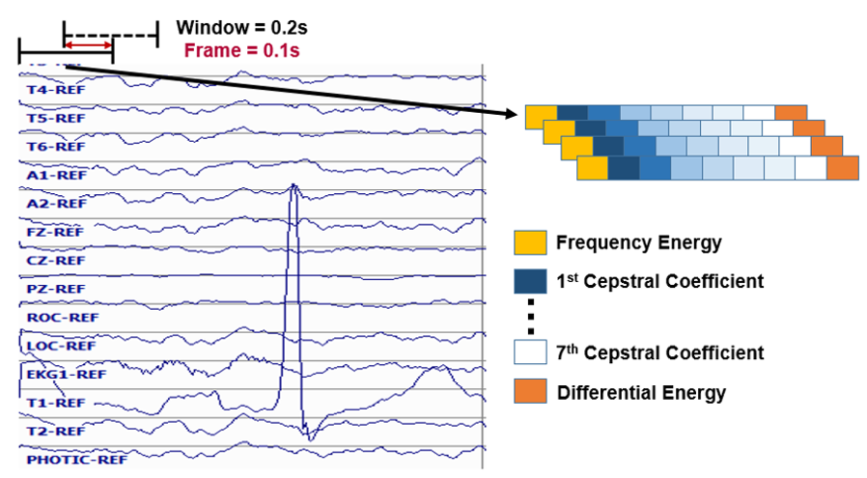
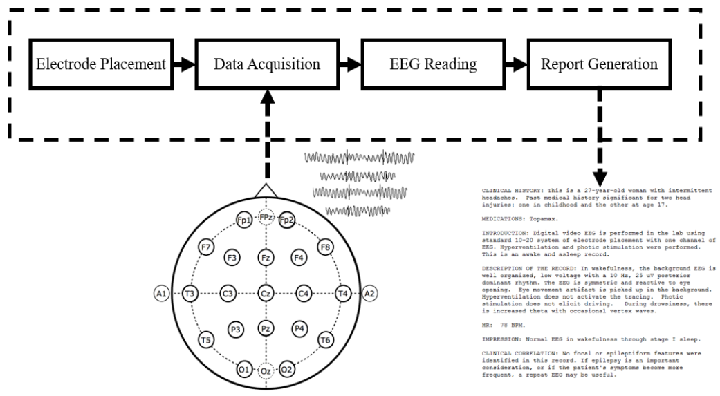
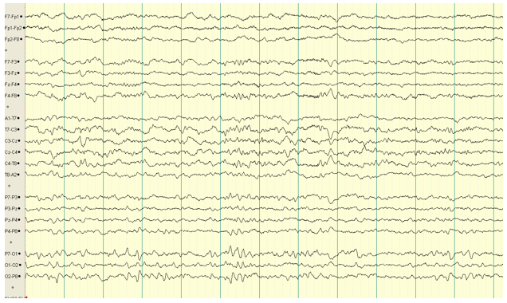
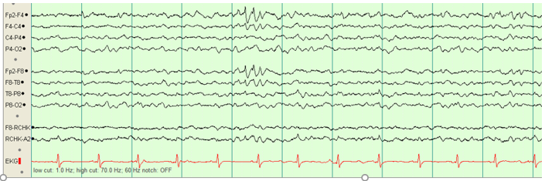
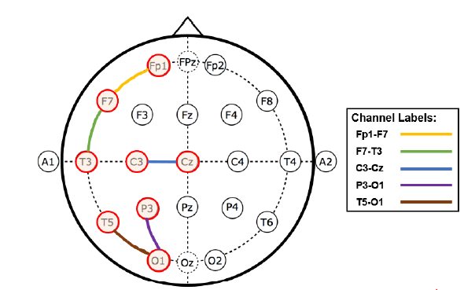
Automated Interpretation of Abnormal Adult Electroencephalograms
S. López, I. Obeid and J. Picone
The Neural Engineering Data Consortium, Temple University
College of Engineering
Temple University
www.nedcdata.org
Abstract
Interpretation of electroencephalograms (EEGs) is a process that is dependent on the subjective analysis of the examiner and has low interrater agreement.
This study establishes a baseline for automated classification of abnormal adult EEGs using machine learning and a big data resource.
2,785 and 280 files from TUH EEG Abnormal were used for training and evaluation respectively. The first T seconds of data were used from a selected number of channels.
The performance of three systems is evaluated:
hidden Markov Models (HMMs) (error rate: 26.1%)
HMM with a Stacked Denoising Autoencoder (HMM-SdA) (error rate: 24.6%)
a Convolutional Neural Network with a Multilayer Perceptron (CNN-MLP) (error rate: 21.2%).
[... Try again ... Stick to comparisons to human performance or some such basic science statement... Don’t focus on deep learning issues such as the amount of training data...]
The TUH EEG Abnormal Corpus
This data source consists of a set of EEG sessions (signals and their reports) that are annotated as either normal (NRML) or Abnormal (ABNM).
The dataset was developed by selecting a subset of sessions from TUH EEG using natural language processing of the medical reports, and then performing manual review by a team of highly-trained undergraduate students.
GMM-HMM Systems
To exploit the sequential nature of the data, Hidden Markov Models were utilized for EEG decoding.
Note that initial experimentation led to setting T=10s, HMM States=3 and Gaussian Mixtures=3.
The systems implemented are described as follows:
HMM: sequentially analyzes windows of data and outputs a decision after the first T seconds.
Epoch-Based HMM / Majority Vote: decodes one second epochs and generates a decision for each epoch. Majority voting is used to postprocess the epoch outputs for the final decision.
Epoch-Based HMM / SdA: same as 2, but an SdA postprocesses the posterior probabilities with a deep learning system.
All systems showed the best performance for channel T5-O1.
CNN-MLP
CNNs leverage sparse interactions and parameter sharing, which benefits the EEG decoding task:
The locality in the units of convolutional layers allows more robustness in the computation of feature maps for signals with many artifacts in selected frequency bands.
Weight sharing, combined with pooling, minimizes the differences between input patterns when there are slight frequency shifts.
In practice, the analysis of EEGs is conducted through the observation of 10 secs of data.
For the decoding of EEGs through a CNN, the best temporal resolution was achieved by feeding the system 7 seconds of data at a time.
Occipital channels showed the best performance.
These results justify the use of deep networks for this task, but show that increasing the complexity of the model requires more training samples.
Locality Analysis
Performance was investigated as a function of the location of the channels on the scalp to determine if the system was automatically learning similar information to that used by neurologists.
Best performance was obtained by channels located in the occipital region.
This is consistent with the way neurologists make this decision.
Error Rate by Channel Region
Age Distribution
Gender Distribution
Training
Evaluation
Training
Evaluation
Conclusions and Future Work
This study shows that it is possible to automatically classify abnormal adult EEGs considering only the background information with an error rate of 21%.
CNN-MLP outperforms all hybrid HMM approaches for this task.
The features that exhibited the most discriminative power for this task were the ones extracted from the occipital region of the scalp, which is consistent with the way in which neurologists classify EEGs.
Since POSTS were one of the leading causes of confusion across models, identifying sleep state of the patient prior to classification would improve the overall performance.
Example:
Acknowledgements
Research reported in this poster was supported by National Human Genome Research Institute of the National Institutes of Health under award number 3U01HG008468-02S1.
The content is solely the responsibility of the authors and does not necessarily represent the official views of the National Institutes of Health.
EEG Interpretation
Manual interpretation of an EEG is performed by a board-certified neurologist. It takes several years to receive this certification. However, interrater agreement is low
Increasing the interrater agreement for EEG interpretation is one of the advantages of an automated technique.
Characteristics of the Normal Adult EEG
Reactivity: Response to certain physiological changes or provocations.
Alpha Rhythm: Waves originate in the occipital lobe (predominantly) with frequencies that are typically between 8-13 Hz and voltage ranges of 15-45 μV.
Mu Rhythm: Central rhythm of alpha activity commonly exhibiting frequencies between 8-10 Hz. This activity is visible in 17% to 19% of adults.
Beta Activity: Faster activities in the frequency bands of 18-25 Hz, 14-16 Hz and 35-40 Hz.
Theta Activity: Traces of 6-7 Hz activity present in the frontal or frontocentral regions of the brain.
Features and Dimensionality Reduction
HMM Experiments took one channel as an input, while the CNN took 4 channel groups.
A 26 dimensional feature vector was used as input. Of these, 9 were base features and the remaining were the first and second derivatives.
POSTS (benign variant)
Bifrontal Epileptiform Spikes
Only the first T seconds of a given channel of the signal were used.
The window length and the channel regions were defined as two of the research parameters of the study.
Channels were selected from different scalp regions.
$L_{i}$ is the convolutional layer, $F$ is the fully connected layer

