Slide 1
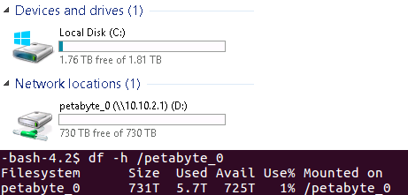
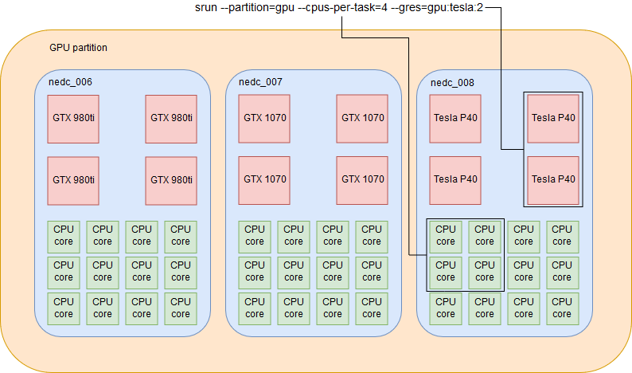
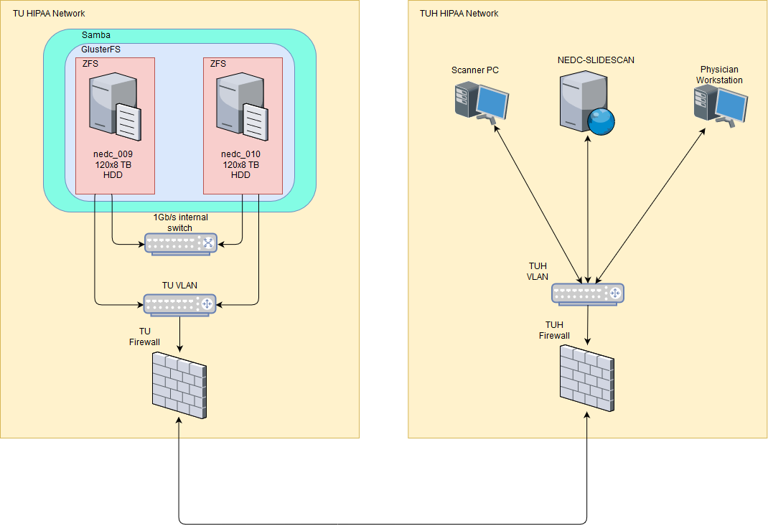
Expanding an HPC Cluster to Support
the Computational Demands of Digital Pathology
C. Campbell, N. Mecca, T. Duong, I. Obeid and J. Picone
The Neural Engineering Data Consortium, Temple University
College of Engineering
Temple University
www.nedcdata.org
Abstract
NEDC is currently developing an open source corpus of 1M digital pathology images as part of its NSF-funded Major Research Instrumentation grant.
This project required a cost-effective approach to hosting and backing up 1 Petabyte of online storage.
Purchasing cloud-based storage typically costs $0.01/GB/month, while our on-premises solution cost of $0.06/GB. This is a much lower cost when prorated over a three or five-year period.
To implement this storage platform, we purchased two storage nodes, each connected to 960TB of raw disk space to house the pathology corpus, as well as a 96TB storage node to provide additional storage space for our computing environment.
Because our network is heterogenous, we created a Storage Area Network (SAN) using GlusterFS, with individual storage nodes using ZFS. Although the storage nodes in the SAN run Linux, the storage pool can be used by Windows machines.
To handle the management of compute resources and improve job throughput, we are using SLURM as our job submission platform.
Cross-platform Petabyte-scale Storage
At the hardware level, each storage node is attached via a SAS 8644 cable to two external chassis which can hold 60x 8TB HDD, for a total of 480 TB/chassis.
ZFS was then used to provide the backend filesystem, as well as the RAID implementation. Each storage node has a separate ZFS filesystem.
To create the SAN, GlusterFS was used. Volumes are distributed (combines the available disk space of all nodes) or replicated (data is written to all nodes).
Two separate pools in the same SAN were created: the primary pool and the backup pool. Either pool can be mounted from either machine.
A Gluster pool is mounted from a Windows machine using a Samba share.
Managing Compute Resources
Due to the computationally-demanding deep learning algorithms we use to process the data, a powerful and flexible job scheduler is needed.
This scheduler needs to support (list some key features such as multiple GPUs.
For example, one of our compute nodes has 384 GB of RAM and 4x NVIDIA Tesla P40 GPUs (24GB DDR5 RAM each).
SLURM allows users to request and allocate resources according to a number of parameters (e.g. number of CPU cores or number of GPUs). ... Be more specific here ...
Fill this space... Fill this space... Fill this space.. Fill this space... Fill this space... Fill this space.. Fill this space... Fill this space... Fill this space..
Fill this space... Fill this space... Fill this space.. Fill this space... Fill this space... Fill this space.. Fill this space... Fill this space... Fill this space..
Fill this space... Fill this space... Fill this space.. Fill this space... Fill this space... Fill this space.. Fill this
Job Scheduling
In addition to handling compute resources, the other important function performed by SLURM is scheduling jobs.
In cluster computing settings, it is very common for multiple users, or groups of users, to run jobs on the same resources, so it is important that the job scheduler be able to schedule jobs to run in a fair and reasonable manner.
SLURM has multiple mechanisms to support different scheduling scenarios, including grouping users into accounts and organizations, with the ability to set job priority for a specific user, group, or organization.
Beyond a user’s association, SLURM can determine job priority and schedule according to any number of parameters, including how long the job has been queued, the amount of resources requested, which queue the job was submitted to, and the user’s history of resource usage.
The Neuronix Use Case
Using SLURM as our job manager, we can exert a very fine degree of control over the physical resources that a job will have allocated to it.
Neuronix compute nodes are grouped by general purpose as SLURM partitions. Within a particular partition nodes can be chosen with specific features or ???GRES??? (e.g. GPU).
Using the ZFS/GlusterFS storage pool, the total storage available to our HPC cluster is 96TB, with all 7 dedicated compute nodes able to access the pool without needing any of their own local storage.
A very modest file server (... Give some specs ... Give some specs ...) is able to support the entire cluster.
Cost effectiveness: the two petabyte machines were purchased for $90k in total, which yields $0.045/GB of raw disk space, and $0.06/GB of usable filesystem space. This compares very favorably to cloud-based solutions, especially at this scale where prices can run beyond $10K/month, especially for high-availability storage.
Scalability and Future Expansions
Both solutions discussed were designed with horizontal scalability in mind.
When the storage nodes are fully loaded, identical machines can be configured the same way with ZFS, and added to the Gluster pool.
The Neuronix cluster’s storage space has been expanded to 96TB using the same strategy as the petabyte machines, so the total available storage (how much???) can be expanded indefinitely.
We are looking into switching from 1Gb/s Ethernet to Infiniband, which provides extremely high network throughput with low latency.
CPU and GPU nodes can be added to the SLURM cluster without the need to reboot the cluster.
Add one more interesting point ... Add one more interesting point ...
SLURM can be configured to work with cloud-based compute nodes, and custom hooks can be written to allocate and release resources on platforms like AWS or Azure as jobs start and stop, allowing for the integration of techniques like bursting.
Fig. 2: The primary pool mounted on both Windows and Linux machines.
Introduction
Digital pathology presents unique computational demands due to the high resolution images required (e.g., 5K x 5K pixels consuming 5GB in disk space).
Much of the software which supports clinical and research use cases of digital pathology has been written specifically for Windows.
However, many of the open source HPC, machine learning and storage toolkits and platforms are designed to work on Linux/UNIX systems, so a storage platform which could work equally well with Windows and Linux systems is required.
This system must be able to function in a hospital setting, where the system has to span multiple HIPAA-secured networks and firewalls, and reside in multiple physical locations.
[say something smart about firewalls, routing rules and/or authentication... Fill up this space with something intelligent... Fill up this space with something intelligent...
Summary
A new system architecture was developed using fully open-source tools that ... Say what the goal was in doing this....
ZFS, Gluster and Samba were used to create a petabyte-scale storage platform that is both highly scalable and cross-platform.
SLURM allows compute resources to be demarcated for specific types of jobs, which ensures that jobs requiring more computing power are able to request the appropriate resources and nodes.
Both the computing and storage systems developed can be easily implemented, as well as scaled up or down to accommodate almost any type of computing or workload-requirement.
Fig. 4: Running a job via ssh (left), and via SLURM (right)
Fig. 5: A map of the Neuronix compute nodes
Acknowledgements
Research reported in this publication was most recently supported by the National Human Genome Research Institute of the National Institutes of Health under award number U01HG008468. The content is solely the responsibility of the authors and does not necessarily represent the official views of the National Institutes of Health.
This material is also based in part upon work supported by the National Science Foundation under Grant No. CNS-1726188. Any opinions, findings, and conclusions or recommendations expressed in this material are those of the author(s) and do not necessarily reflect the views of the National Science Foundation.
Fig. 3: Example of resource selection in SLURM on the Neuronix cluster
Fig. 1: A heterogeneous storage solution

