Slide 1
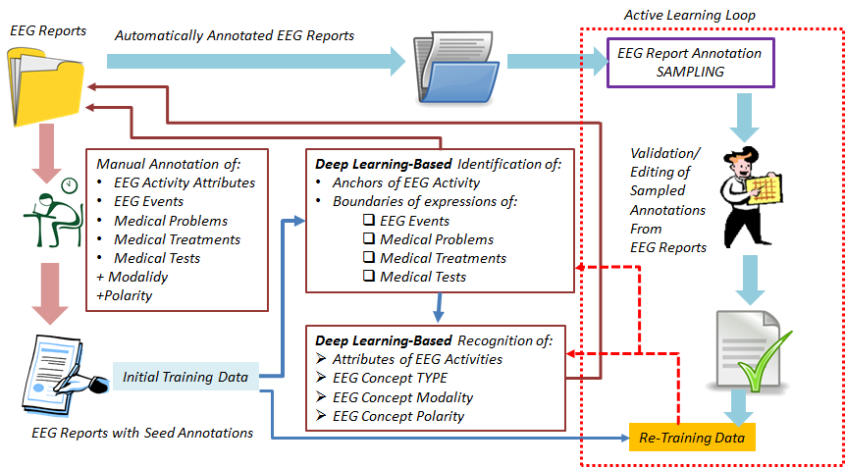
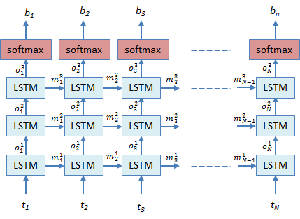
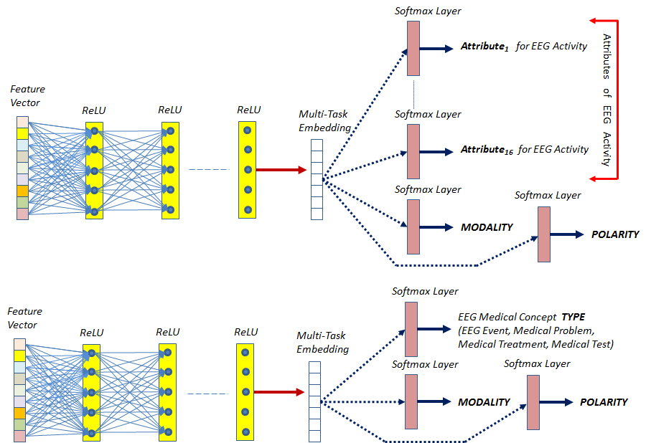
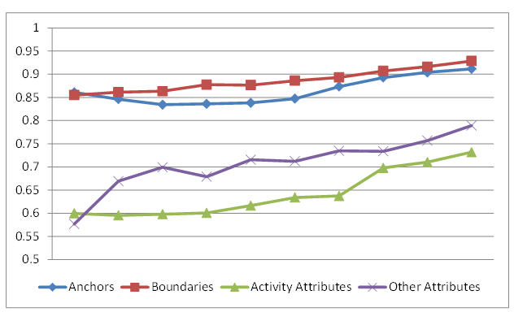
Active Deep Learning-Based Annotation of Electroencephalography Reports for Patient Cohort Retrieval
Human Language Technology Research Institute
Sanda Harabagiu, PhD, Travis Goodwin, Ramon Maldonado, Stuart Taylor
The Human Language Technology Research Institute
University of Texas at Dallas
www.hlt.utdallas.edu
Abstract
The annotation of a large corpus of Electroencephalography (EEG) reports is a crucial step in the development of an EEG-specific patient cohort retrieval system. The annotation of multiple types of EEG-specific clinical concepts is challenging, especially when automatically performed on Big Data. To address this challenge, we developed a novel framework which combines the advantages of active and deep learning. Our Multi-task Active Deep Learning (MTADL) paradigm performs concurrently multiple identification tasks for: (1) EEG activities and their attributes, (2) EEG events, (3) medical problems, (4) medical treatments and (5) medical tests, along with their inferred forms of modality and polarity.
An important step of the MTADL paradigm was the design of the deep learning architectures capable to identify multiple forms EEG-specific clinical concepts. We experimented with two deep learning architectures. The first architecture aims to identify (1) the anchors of all EEG activities; as well as (2) the boundaries of all mentions of EEG events, medical problems, medical treatments and medical tests. The second architecture was designed to recognize multiple attributes considered for each EEG activity, as well as the type of the EEG-specific medical concepts. In addition, the second deep learning architecture identifies the modality and the polarity of EEG-specific concepts. The ability to learn jointly multiple types of concepts and attributes was made possible by the sampling mechanism used in the MTADL paradigm, based on the rank combination protocol, which combines several single-task active learning selection decisions into one.
The Multi-task Active Deep Learning (MTADL) paradigm requires the following 5 steps:
STEP 1: The development of an annotation schema;
STEP 2: Annotation of initial training data;
STEP 3: Design of deep learning methods that are capable to be trained on the data;
STEP 4: Development of sampling methods for Multi-task Active Deep Learning system
STEP 5: Usage of the Active Learning system which involves:
Step 5.a.: Accepting/Editing annotations of sampled examples
Step 5.b.: Re-training the deep learning methods and evaluation the new system.
Annotation Schema: The annotation schema that we have developed considered EEG events, medical problems, treatment and tests to be annotated in similar ways as in the 2012 i2b2 challenge, namely by specifying (1) the boundary of each mention of concepts; (2) the concept type; (3) its modality and (4) its polarity. However, the EEG activities could not be annotated in the same way. First, we noticed that EEG activities are not mentioned in a continuous expression. To solve this problem, we annotated the anchors of EEG activities and their attributes. Since one of the attributes of EEG activities, namely, morphology, best defines these concepts, we decided to use it as an anchor. We considered three classes of attributes for EEG activities, namely (a) general attributes of the waves, e.g. the morphology, the frequency band; (b) temporal attributes and (c) spatial attributes. All attributes have multiple possible values associated with them. When annotating the morphology attribute we considered a hierarchy of values, distinguishing first two types: (1) Rhythm and (2) Transient. In addition, the Transient type contains three subtypes: Single Wave, Complex and Pattern. Each of these sub-types can take multiple possible values.
Architecture of the Multi-Task Active Deep Learning for annotating EEG reports
Design of Deep Learning Architectures: The second deep neural architecture is designed to recognize (i) the sixteen attributes that we have considered for each EEG activity, as well as (ii) the type of the EEG-specific medical concepts, discriminated as either an EEG event (EV), a medical problem (MP), a medical test (Test) or a medical treatment (TR). In addition, the second deep learning architecture identifies the modality and the polarity of these concepts.
Design of Deep Learning Architectures: The first architecture aims to identify (1) the anchors of all EEG activities mentioned in an EEG report; as well as (2) the boundaries of all mentions of EEG events, medical problems, medical treatments and medical tests.
Example A: CLINICAL HISTORY: 58 year old woman found [unresponsive]₂, history of [multiple sclerosis]₂, evaluate for [anoxic encephalopathy]₂.
MEDICATIONS: [Depakote]₂, [Pantoprazole]₂, [LOVENOX]₁.
INTRODUCTION: [Digital video EEG]₂ was performed at bedside using standard 10.20 system of electrode placement with 1 channel of [EKG]₂. When the patient relaxes and the [eye blinks]₂ stop, there are frontally predominant generalized [spike and wave discharges]₁ as well as [polyspike and wave discharges]₁ at 4 to 4.5 Hz.
Example B: CLINICAL HISTORY: 58 year old woman found [unresponsive]<TYPE=MP, MOD=Factual, POL=Positive>, history of [multiple sclerosis]<TYPE=MP, MOD=Factual, POL=Positive>, evaluate for [anoxic encephalopathy]<TYPE=MP, MOD=Possible, POL=Positive>.
MEDICATIONS: [Depakote]<TYPE=TR, MOD=Factual, POL=Positive>, [Pantoprazole]<TYPE=TR, MOD=Factual, POL=Positive>, [LOVENOX]<TYPE=TR, MOD=Factual, POL=Positive>.
INTRODUCTION: [Digital video EEG]<TYPE=Test, MOD=Factual, POL=Positive> was performed at bedside using standard 10.20 system of electrode placement with 1 channel of [EKG]<TYPE=Test, MOD=Factual, POL=Positive>. When the patient relaxes and the [eye blinks]<TYPE=EV, MOD=Factual, POL=Positive> stop, there are frontally predominant generalized [spike and wave discharges]<MORPHOLGY=Transient>Complex>Spike and slow wave complex, FREQUENCYBAND=Delta, BACKGROUND=No, MAGNITUDE=Normal, RECURRENCE=Repeated, DISPERSAL=Generalized, HEMISPHERE=N/A, LOCATION={Frontal}, MOD=Factual, POL=Positive> as well as [polyspike and wave discharges]<MORPHOLGY=Transient>Complex>Polyspike and slow wave complex, FREQUENCYBAND=Delta, BACKGROUND=No, MAGNITUDE=Normal, RECURRENCE=Repeated, DISPERSAL=Generalized, HEMISPHERE=N/A, LOCATION={Frontal}, MOD=Factual, POL=Positive> at 4 to 4.5 Hz.
Development of Sampling Methods: The choice of sampling mechanism is crucial for validation as it determines what makes one annotation a better candidate for validation over another. Multi-task Active Deep Learning (MTADL) is an active learning paradigm for multiple annotation tasks where new EEG reports are selected to be as informative as possible for a set of annotation tasks instead of a single annotation task. The sampling mechanism that we designed used the rank combination protocol, which combines several single-task active learning selection decisions into one. The usefulness score $s_{X_{j}}(α)$ of each un-validated annotation $α$ from an EEG Report is calculated with respect to each annotation task $X_{j}$ and then translated into a rank $r_{X_{j}}(α)$ where higher usefulness means lower rank (examples with identical scores get the same rank). Then, for each EEG Report, we sum the ranks of each annotation task to get the overall rank $r\left(α\right)= \sum_{j=1}{r_{X_{j}}(α)}$. All examples are sorted by this combined rank and annotations with lowest ranks are selected for validation. For each annotation task, we score an EEG Report $d$: $s_{X_{j}}\left(d\right)= \frac{1}{\left|d\right|}\sum_{a∈d}{H(α)}$ where $α$ is an annotation from$d$ and $\left|d\right|$ is the number of annotations in document $d$, and $H\left(α\right)=−\sum_{c}{q_{c}^{α}\log{q_{c}^{α}}}$ is the Shannon Entropy of $α$. This protocol favors selecting documents containing annotations the model is uncertain about from all annotation tasks.
Deep Learning architecture for the identification of (1) the EEG activity anchors and
(2) the boundaries of expressions of (a) EEG events, (b) medical problems;
(c) tests and (d) treatments.
Attributes & Attribute Values | A | P | R | F₁
Morphology | 0.99 | 0.75 | 0.70 | 0.72
DISORGANIZATION | 0.97 | 0.88 | 0.78 | 0.83
POLYSPIKE_AND_WAVE | 0.99 | 0.22 | 0.40 | 0.28
AMPLITUDE_GRADIENT | 0.99 | 0.83 | 1.00 | 0.90
SPIKE_AND_SLOW_WAVE | 0.99 | 0.94 | 0.97 | 0.95
SPIKE | 0.99 | 0.85 | 0.70 | 0.77
PLEDS | 0.99 | 0.75 | 0.50 | 0.60
LAMBDA_WAVE | 1.00 | 1.00 | 1.00 | 1.00
K_COMPLEX | 0.99 | 1.00 | 0.75 | 0.85
POLYSPIKE | 0.99 | 0.75 | 0.52 | 0.62
SLOW_WAVE | 0.99 | 0.94 | 0.92 | 0.93
RHYTHM | 0.92 | 0.81 | 0.91 | 0.86
Attributes & Attribute Values | A | P | R | F₁
SLEEP_SPINDLE | 0.99 | 1.00 | 0.91 | 0.95
SHARP_AND_SLOW_WAVE | 0.99 | 0.60 | 0.50 | 0.54
SUPPRESSION | 0.99 | 0.91 | 0.84 | 0.88
PHOTIC_DRIVING | 0.99 | 1.00 | 0.94 | 0.97
TRIPHASIC_WAVE | 0.99 | 1.00 | 0.90 | 0.95
SHARP_WAVE | 0.98 | 0.88 | 0.96 | 0.92
WICKET | 1.00 | 1.00 | 1.00 | 1.00
EPILEPTIFORM_DISCHARGE | 0.98 | 0.89 | 0.88 | 0.88
SLOWING | 0.99 | 0.96 | 0.95 | 0.95
BREACH_RHYTHM | 0.99 | 1.00 | 0.58 | 0.73
VERTEX_WAVE | 1.00 | 1.00 | 1.00 | 1.00
Magnitude | 0.90 | 0.80 | 0.71 | 0.75
Learning Curves for
All Annotations
Deep Learning Architectures for Automatic Recognition of (1) attributes of EEG activities; (2) type for all
the other clinical concepts expressed in EEG reports; and (3) modality and polarity for all concepts
Acknowledgements: Research reported in this poster was supported by the National Human Genome Research Institute of the National Institutes of Health under award number 1U01HG008468. The content is solely the responsibility of the authors and does not necessarily represent the official views of the National Institutes of Health

