Slide 1

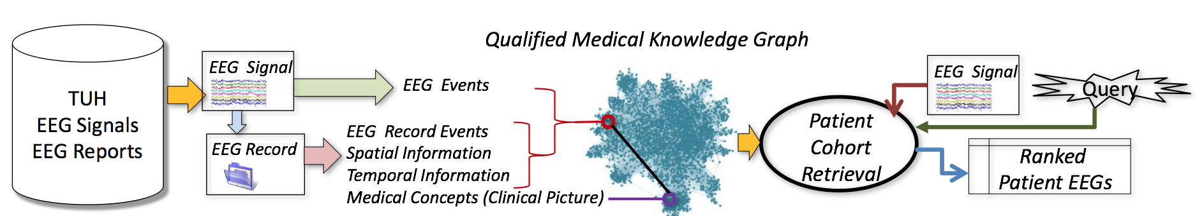
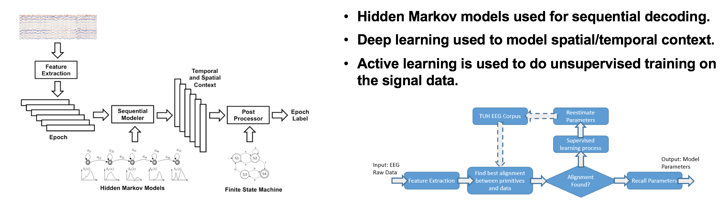
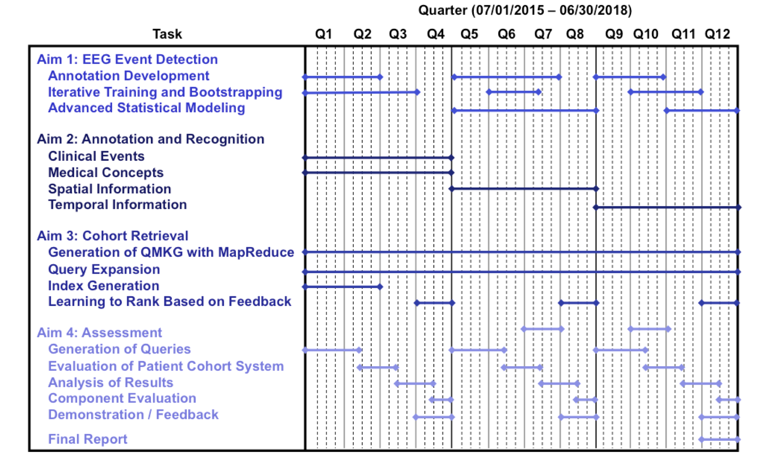
Automatic Discovery and Processing of
EEG Cohorts from Clinical Records
Mission: Enable comparative research by automatically uncovering clinical knowledge from a vast BigData archive of clinical EEG signals and reports. This will greatly increase accessibility for non-experts in neuroscience, bioengineering and medical informatics, and demonstrate the transformative potential of data mining.
Aims:
  Automatically recognize and time-align EEG events that contribute to a diagnosis.
  Automatically recognize critical concepts in EEG reports to accurately annotate clinical events.
  Automatic patient cohort retrieval by processing EEG signal events the narratives of EEG reports.
  Evaluate and analyze the results of patient cohort retrieval using clinical experts.
Impact:
  The world’s largest publicly available annotated EEG signal corpus.
  High-performance BigData tools that allow rapid development of other bioengineering applications.
  Accurate annotations with clinical events, medical concepts as well as spatial and temporal information.
  A patient cohort retrieval system operating on a very large corpus of EEG signals and EEG reports.
  Evaluation through clinical expert judgments using over 300 queries.

Slide 2
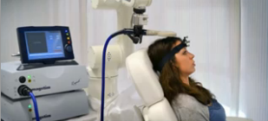
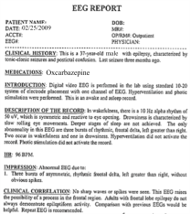
Automated Interpretation of EEGs
Goals: (1) To assist healthcare professionals in interpreting electroencephalography (EEG) tests,
thereby improving the quality and efficiency of a physician’s diagnostic capabilities; (2) Provide
a real-time alerting capability that addresses a critical gap in long-term monitoring technology.
Impact:
  Patients and technicians will receive immediate feedback rather than waiting days or weeks for results
  Physicians receive decision-making support that reduces their time spent interpreting EEGs
  Medical students can be trained with the system and use search tools make it easy to view patient histories and comparable conditions in other patients
  Uniform diagnostic techniques can be developed
Milestones:
  Baseline hidden Markov model-based system operating at 98% accuracy on research data (1Q’2014)
  Events labeled at 95% detection accuracy with a 5% false alarm rate on the TUH EEG Corpus (3Q’2014)
  Portable Python-based demonstration system with live input, montages and event search (4Q’2014)
  NIH award for cohort retrieval (2Q’2015)
  Enhanced architecture that includes improved feature extraction and integrated deep learning (3Q’2015)
  Real-time seizure detection (4Q’2015)

Slide 3
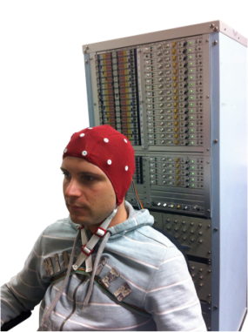
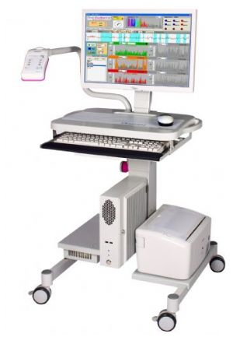
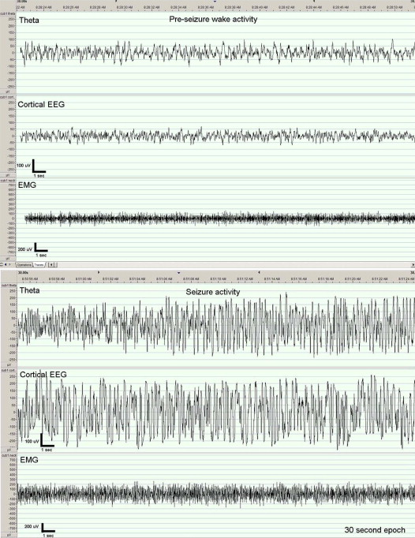
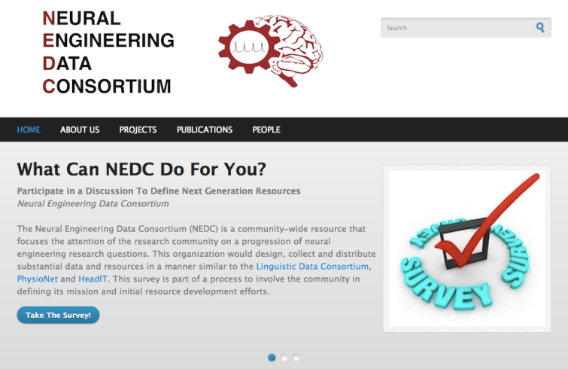
The Neural Engineering Data Consortium
Mission: To focus the research community on a progression of research questions and to
generate massive data sets used to address those questions. To broaden participation by making
data available to research groups who have significant expertise but lack capacity for data generation.
Impact:
  Big data resources enables application of state of the art machine-learning algorithms
  A common evaluation paradigm ensures consistent progress towards long-term research goals
  Publicly available data and performance baselines eliminate specious claims
  Technology can leverage advances in data collection to produce more robust solutions
Expertise:
  Experimental design and instrumentation of bioengineering-related data collection
  Signal processing and noise reduction
  Preprocessing and preparation of data for distribution and research experimentation
  Automatic labeling, alignment and sorting of data
  Metadata extraction for enhancing machine learning applications for the data
  Statistical modeling, mining and automated interpretation of big data
  To learn more, visit www.nedcdata.org

Slide 4
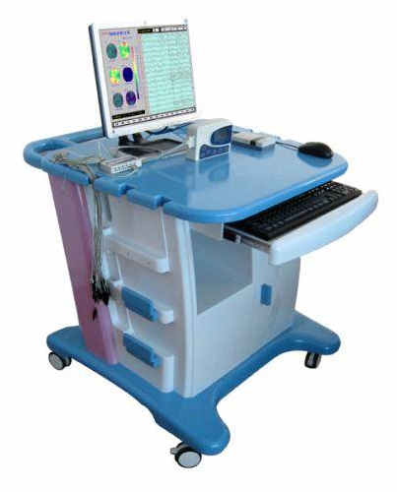
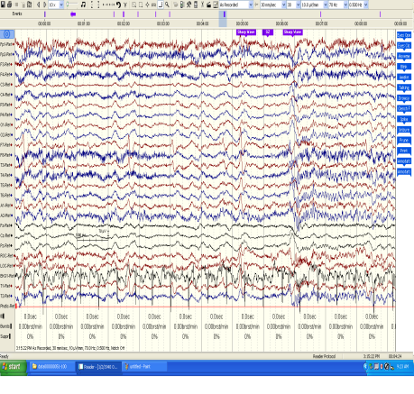
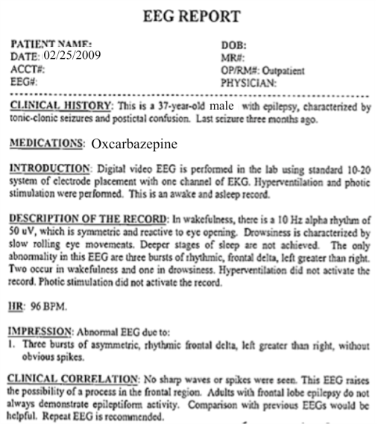
The Temple University Hospital EEG Corpus
Synopsis: The world’s largest publicly available EEG corpus consisting of 28,000+ EEGs collected
from 15,000 patients, collected over 14 years. Includes EEG signal data, physician’s diagnoses
and patient medical histories. A total of 1.4 Tbytes of data. Release v1.0.0 in Fall 2015.
Impact:
  Sufficient data to support application of state of the art machine learning algorithms
  Patient medical histories, particularly drug treatments, supports statistical analysis of correlations between signals and treatments
  Historical archive also supports investigation of EEG changes over time for a given patient
  Enables the development of real-time monitoring
Database Overview:
  28,000+ EEGs collected at Temple University Hospital from 2002 to 2015 (an ongoing process)
  Recordings vary from 24 to 36 channels of signal data sampled at 250 Hz
  Patients range in age from 18 to 90+ with an average of 1.6 EEGs per patient
  72% of the patients have one session; 16% have two sessions; 12% have three or more sessions
  Data includes a test report generated by a technician, an impedance report and a physician’s report
  Personal information
  has been redacted
  Clinical history and medication history are included
  Physician notes are captured in three fields: description, impression and correlation fields.

