Slide 1
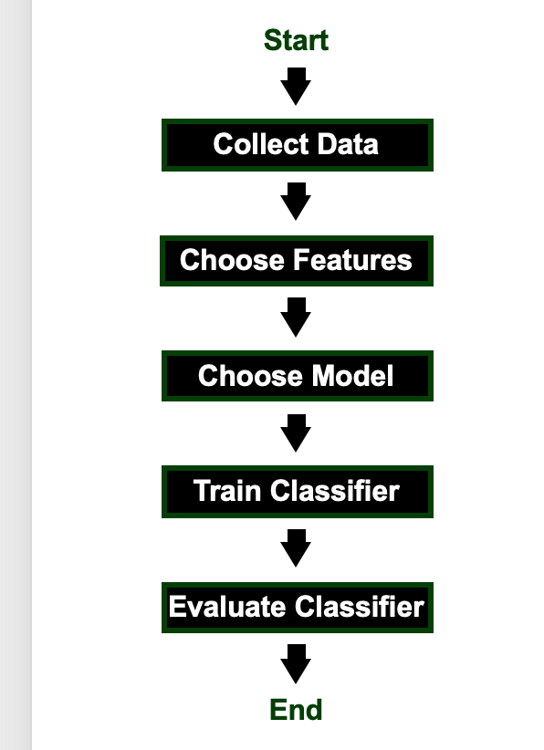

Slide 2
Blind Evaluation
Select Model
Train
Collect Data
Feature Extraction
Validate
Blind Evaluation
Select Model
Train
Collect Data
Feature Extraction
Validate
Blind Evaluation
Select Model
Train
Collect Data
Feature Extraction
Validate

Slide 3
0.91
0.97
0.88
0.77
0.82
0.87
0.61
0.57
0.72
0.99
0.6
Probabilistic filtering (Threshold = 0.75)
0.91
0.97
0.88
0.77
0.82
0.87
0.665
0.99
0.6
Duration filtering (Threshold = 3 Sec.)
0.91
0.97
0.88
0.77
0.82
0.87
0.632
Target aggregation (Margin = 3.54 Sec.)
0.91
0.97
0.88
0.82
0.632
Posterior
Seizure
Posterior
Background
4 Seconds
Time scale

