Slide 1
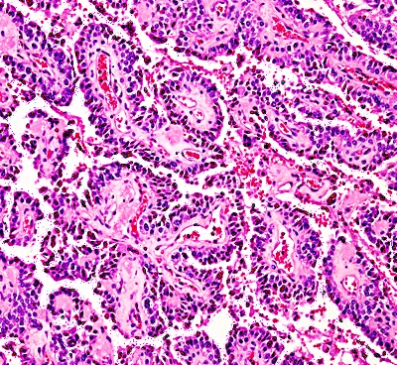
Input Batch
2D-Convolution
2D-Maxpooling
Batch Normalization
2D-Convolution
2D-Maxpooling
1500@100*100*3
1500@49*49*32
1500@24*24*32
1500@24*24*32
1500@22*22*64
1500@11*11*64
RGB Channels
Frames
Extracted Window
2D-Convolution
Batch Normalization
2D-Convolution
Batch Normalization
2D-Convolution
Batch Normalization
Batch Normalization
1500@7*7*96
1500@9*9*64
1500@9*9*64
1500@11*11*64
1500@5*5*32
1500@5*5*32
1500@7*7*96
Dropout
Flatten
1500@5*5*32
1500@800
Dense
1500@128
Dense
Output
1500@2
Post Processor

