Slide 1
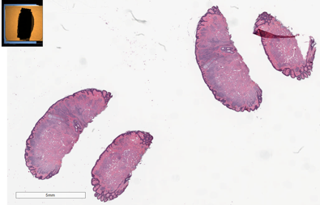
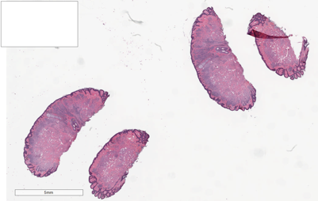
Data Anonymization
Case Reports
Digital Slides
Patient’s name
MRN
Specimen ID
Anonymizing slide labels’ information

