Slide 1
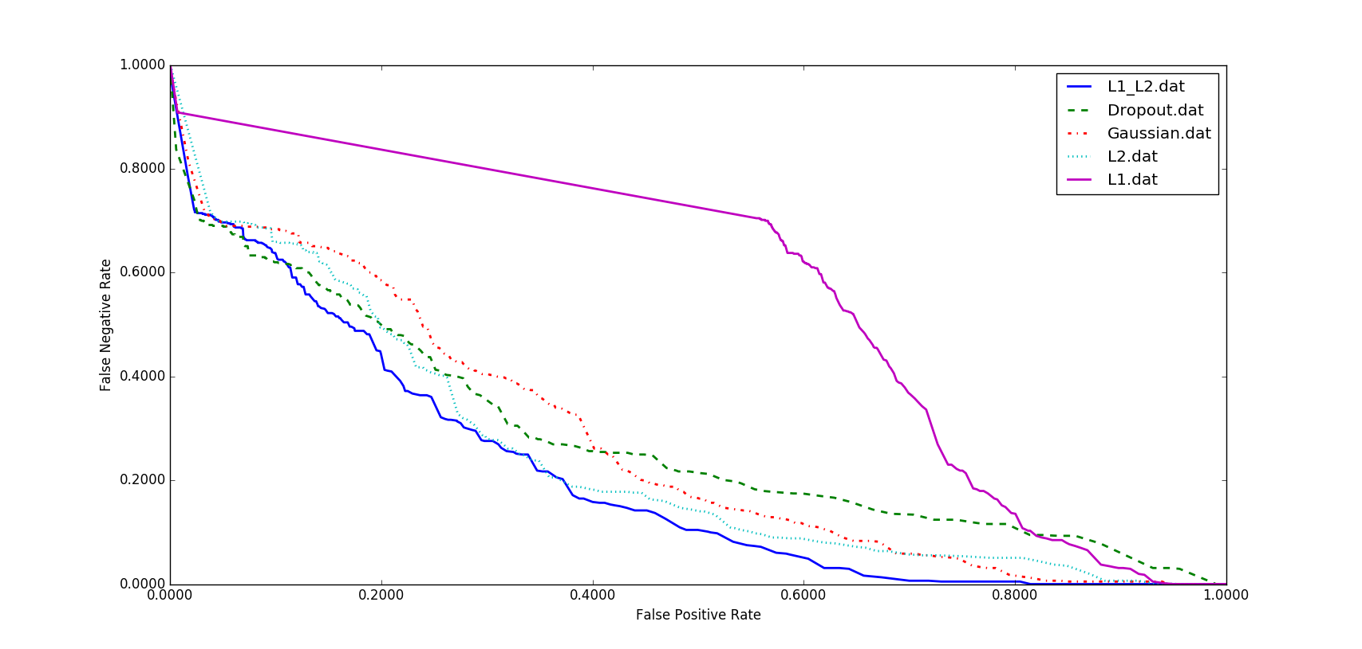
1.00
L1_L2
Dropout
Gaussian
L2
L1
0.80
0.60
False Negative Rate
0.40
0.20
0.00
0.00
0.20
0.40
0.60
0.80
1.00
False Positive Rate

