Slide 1

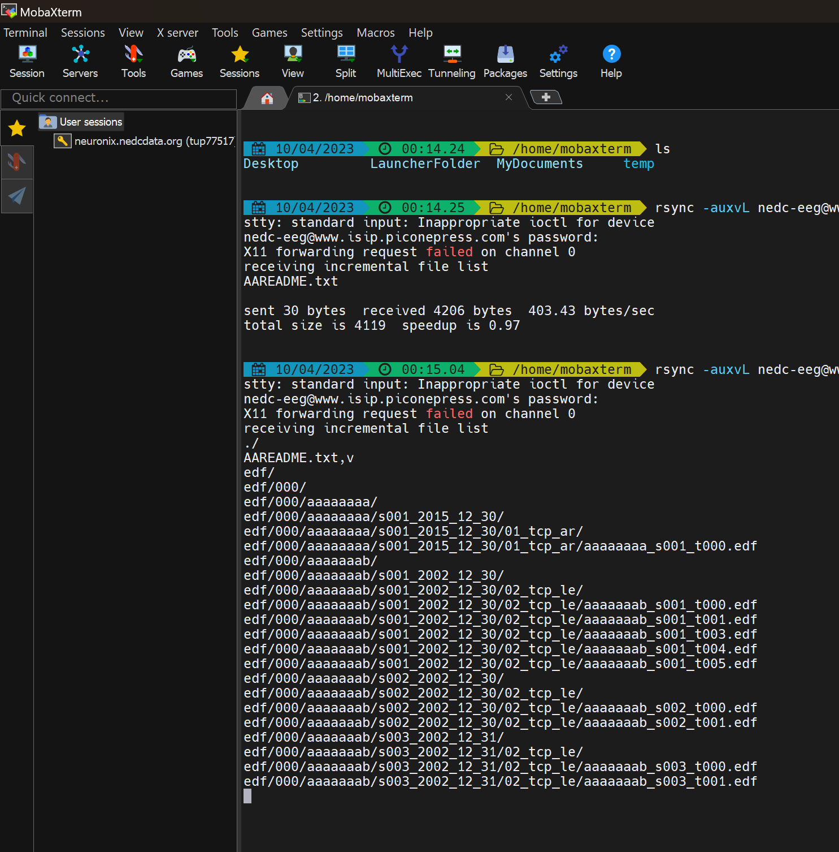
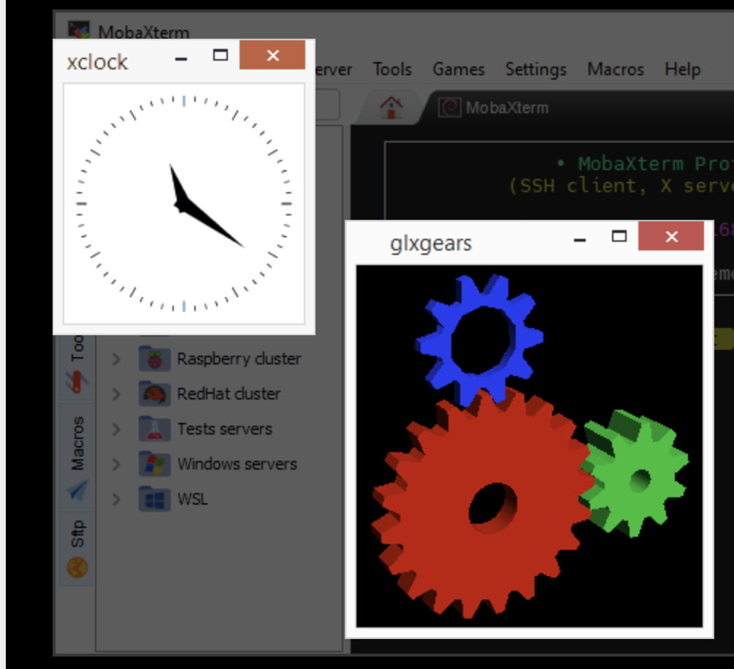

How to Download NEDC Resources
From the NEDC Anonymous Rsync Server:
A Detailed Tutorial for Windows Users
B. Thai and J. Picone
Neural Engineering Data Consortium
Temple University

Slide 2
Quick Overview
Rsync Command Example:
rsync –auxL nedc-eeg@www.isip.piconepress.com:data/eeg/tuh_eeg/v2.0.0/AAREADME.txt .
Special Notes:
-L flag: follows symbolic links, connects data to server
-v flag: verbose, information while downloading
-vv flag: more detailed information
-vvv flag: even more information for debugging
Command
Username
Hostname
Source
Flags
*Period is the Destination*
rsync -auxL
rsync -auxvL
rsync -auxvvL
rsync -auxvvvL

Slide 3
A Typical Download
Use this command to debug your download process:
rsync -auxvL nedc-eeg@www.isip.piconepress.com:data/eeg/tuh_eeg/v2.0.0/AAREADME.txt .
In our experience, when this command fails, it is due to either a typo or networking issues with your institution.
Additional Notes:
Note that the space before the last character, “.”, is critical since it instructs rsync to transfer the files to your current working directory.
In the video located here:
https://isip.piconepress.com/projects/nedc/data/eeg/tutorials/mobaxterm/00_install_moba_and_rsync.mp4
we demonstrate how to install MobaXterm and use rsync to download data.

Slide 4
Support
If you need additional help, please contact us at:
help@nedcdata.org
We usually respond to emails with 24 hours.

