Slide 1
Humanitarian Technology Challenge
Richard J. Baseil
IEEE

Slide 2
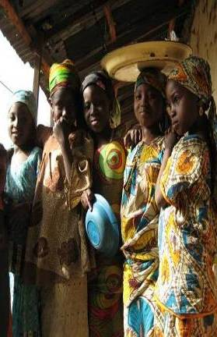

Do You Wonder Why . . .
With all our electrical power technology, people in the world still don’t have night-time lighting for work or education?
With all our medical and health care technology, people still get inadequate treatment and suffer from curable diseases?
One African Country Example:
11% of the world maternal mortality
> 1100 deaths per 100,000 live births
Lifetime risk of dying in childbirth: 1 in 13
  Poverty
  Early marriage
  High illiteracy
  Low contraceptive use
  High fertility
Why can’t the world better apply technology to basic human needs?

Slide 3
It’s a Complicated Puzzle
First Responders
Users
Governments
Funders
Humanitarians
(NGO)
Product Developers
Consultants
Technologists

Slide 4
Humanitarian Technology Challenge
United Nations Foundation and IEEE partnership
Bring a more systematic approach to applying technology to solve world problems
Identify three challenges and drive solutions that are implementable and sustainable
Involve both humanitarians and technologists in formulating solutions
Use combination of workshops and online collaboration tool
Define repeatable methodologies to address challenge-oriented, large scale efforts

Slide 5
We Are Trying to Help
Users
First Responders
Governments
Funders
Humanitarians
(NGO)
Product Developers
Consultants
Technologists

Slide 6
Need Identification
Conducted Four Focus Groups with Humanitarians, Identifying 37 Critical Needs
Prioritization Criteria
Scope of challenge and number of people impacted
Magnitude of anticipated benefits
Breadth and complexity of potentially applicable technologies
Probability of success
Scalability of the solution
Needs 1-37
Top 3 Needs for
Initial Focus

Slide 7
Initial Challenges to be Addressed
Challenge | Description
Reliable Electricity | Availability of electric power for lighting and other electronic devices in resource-constrained environments. Important for education, communications, and economic development.
Data Connectivity of Rural District Health Offices | Capability of exchanging data among remote field offices and central health facilities. Important for accessing treatment protocols, creating and monitoring health trends, and sharing results of treatments.
Individual ID Tied to Health Records | Consistent availability of patient medical records. Important for ongoing treatment of patients, especially migrants and those with long-term diseases.

Slide 8
Some Potential Focus Areas
Reliable Electricity | Data Connectivity | Patient ID
One Kilowatt Power Generator | Extend Backbone Connectivity of Major Cities to Rural Areas | Biometrics as Patient ID
Intelligent Charging and Load Management System | Establish Common Standards and Protocols | Medical Records – Data Storage and Management
Improved Utilization of Current Electricity Sources | Monitoring and Maintenance of Network and Equipment | Legal and Ethical Issues on Collection and Storage of Patient Data
Smart Next-Generation Energy Systems | Establish Viable Business Models that Drive Deployment | Establishment of Standards

Slide 9
Project Definition and Milestones
Communications
Phase 1
Phase 2
Phase 3
Phase 4
Phase 5
Project
Framework
Definition
Challenge
Formulation
Solution
Formulation
Deploy.
&
Eval.
Product
Develop.
Focus Groups,
Web Surveys
Solution Workshops
Challenge Validation
Web Site,
Tool Support
Detailed Challenge Definition
Solutions Conference
Product Interoperability Conference
Analysis, Challenge
Modeling & Selection
Challenge Conference
2Q08
4Q08
2009
2010
2011
2012
Samples of activities that will be conducted – options
may change with the nature of solutions formulated
We are here

Slide 10
June 1-2 Conference Highlights
153 attendees total
  60 of the 153 from outside the US
  Approximately equal mix of humanitarian and technology representatives
  Mix of organizations: Academia, Foundations, Government, Consulting Firms, NGO's (Non-Governmental Organizations), R&D Organizations/ Laboratories, Undergraduate and Graduate students, IEEE members, Trade Press and bloggers
Presentations by humanitarians experienced in implementing technology in developing countries
Finalized documentation of the three challenges, ratified by working groups in a pre-conference meeting of 25 volunteers
Initial working groups formed for solutions, with members encouraged to reach out and broaden participation by others unable to attend the conference
Work will continue through the use of an online collaboration tool, Spigit, and periodic conference calls and workshops

Slide 11

What Does It Take to Solve a Challenge?
Evereadii
Eatius
Accelleratii
Incredibus
Road Runner cartoons created by Chuck Jones for Warner Brothers, Inc.

Slide 12

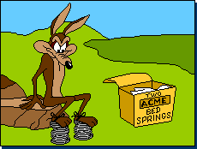
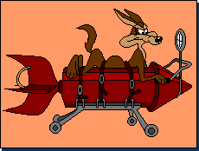
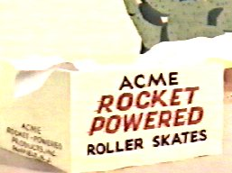

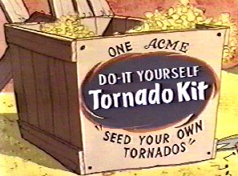
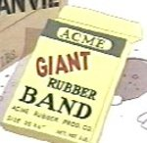

Solution Technology
Road Runner cartoons created by Chuck Jones for Warner Brothers, Inc.

Slide 13
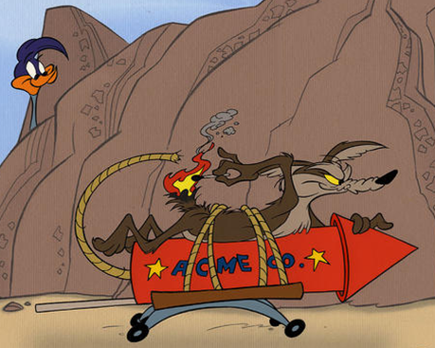


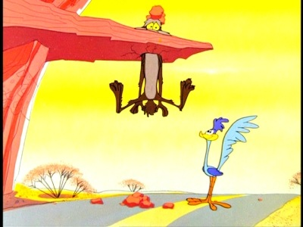
Operational Issues
Road Runner cartoons created by Chuck Jones for Warner Brothers, Inc.

Slide 14


Economic Plans
Road Runner cartoons created by Chuck Jones for Warner Brothers, Inc.

Slide 15

What Does It Take to Solve a Challenge?
Likely one or more “Solutions,” consisting of:
  A hardware and/or software product, and/or a well-defined process,
  Meeting agreed-upon standards,
  With a corresponding Operations, Administration and Maintenance Plan, and
  Driven by an Economic Implementation Plan

Slide 16
HTC “Solution”
Enables
Production
Technology Product Description
Standards
O, A, & M Plan
Enables
Implementation
Economic Implementation Plan

Slide 17

There is Likely to Be More Than One Solution
“Solution Set”
Technology Product Descriptions
. . .
Standards
O, A, & M Plans
Economic Implementation Plans
Solution
1
Solution
2
Solution
3
Solution
N

Slide 18
Phase I Solution Definition Effort
“Solution Set”
I. Formulate and document somewhat independent Solutions, with these elements:
. . .
Technology Product Description
Standards
O, A, & M Plan
Economic Implementation Plan
Solution
1
Solution
2
Solution
3
Solution
N

Slide 19
Phase II Solution Definition Effort
“Solution Set”
II. Formulate and document integrated cross-solution elements:
. . .
Technology Product Descriptions
Standards
O, A, & M Plans
Economic Implementation Plans
Solution
1
Solution
2
Solution
3
Solution
N

Slide 20
2009/2010 Target Milestones
June – October, 2009: Solution idea proposals, refinement and selection
October, 2009: Multi-day solution workshop, possibly also webcast
November, 2009: Draft Phase I Solution descriptions
January/February, 2010: Second Solution Workshop
February, 2010: Draft Phase II Solution Set descriptions (Phase I descriptions bundled, and common “horizontal” areas worked)
April, 2010: Completed Phase II Solution Set descriptions
June, 2010: Solutions Conference
2010+: Product development and implementation
20

Slide 21
We Invite You to:
Learn more about the project at www.ieee.org/go/htc
Obtain a Spigit ID and participate in the project – email: htc@ieee.org
Actively contribute to solution formulation
Identify and motivate others to contribute
Contacts: Rich Baseil: r.baseil@ieee.org
Harold Tepper: h.tepper@ieee.org
➔ Discussion topic: How can we motivate more student participation in this project?

Slide 22
Humanitarian Technology Challenge
Richard J. Baseil
IEEE

Slide 23
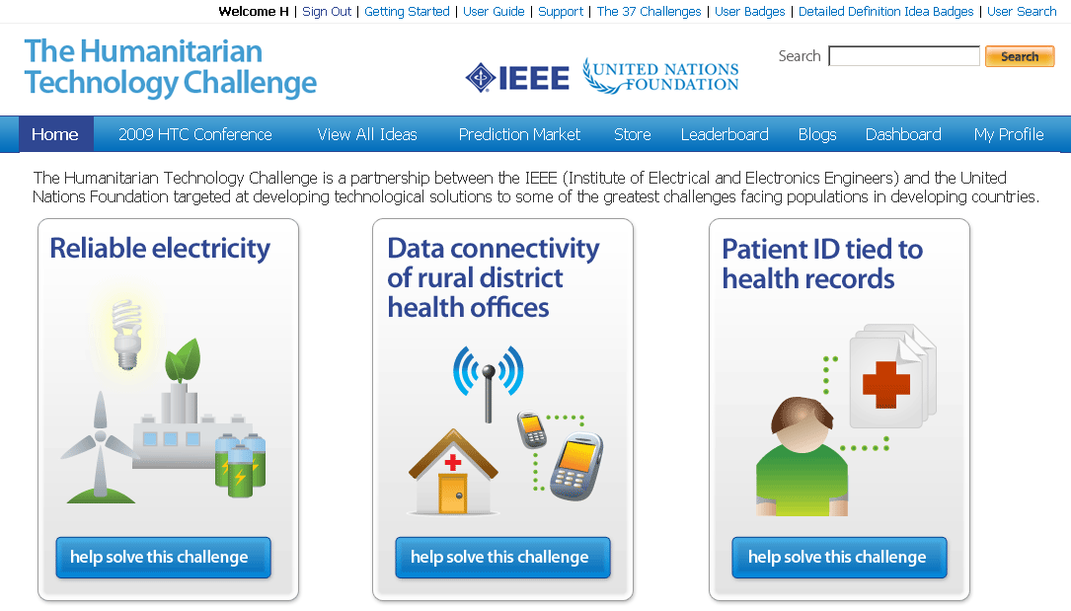
Email htc@ieee.org for Spigit ID
ieee.spigit.com

Slide 24
We Must Assimilate Different Operating Models
Off-the-shelf technology usage
No association structure like IEEE
Some on-the-ground, with good experience but limited accessibility
Disfavor proprietary solutions
Maximize productivity of funds
Typical focus on initial, not sustaining, funding
Funders
Some altruistic, some commercial, expecting return on investments
Humanitarians
(NGO)
Product Developers
Requirements oriented
Technologists
Standards are dual-edged sword
Seek optimal, universal solutions
“If we build it, they will come”
Invention often favored over reuse
Prefer extensions of current products
Want “edge” over competitors

Slide 25
2008/2009 Project Milestones
Formalized partnership between the United Nations Foundation and IEEE
Conducted focus groups and identified 37 humanitarian needs that could potentially be addressed through technology
Prioritized top five needs for focus, balancing objectives of IEEE and UNF
Validated prioritized challenges with Earth Institute at Columbia University and others
Narrowed challenges to top three based upon experience and expertise of humanitarians and technologists
Formed three Challenge Definition groups of humanitarians and technologists
Conducted Conference June 1-2, 2009, validating Challenge Definitions and launching the Solution Development Process

