Slide 1
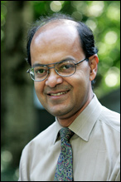
“I have never had a policy. I have just tried to do my very best each and every day.” ~ Abraham Lincoln
Saroj Biswas
ECE Chair 2004 – 2009

