Slide 1
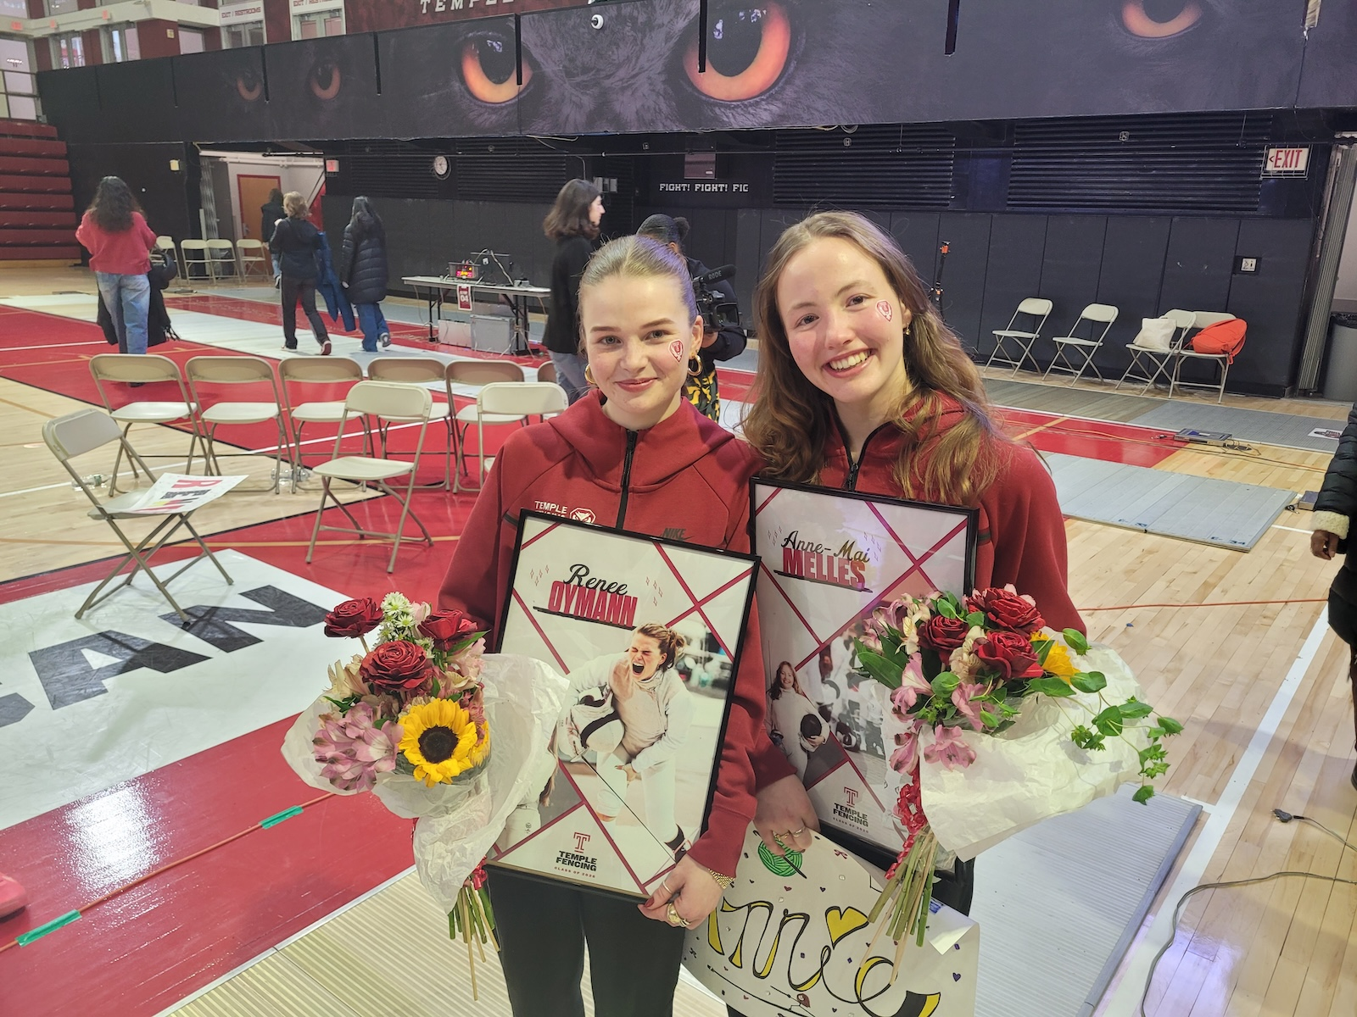
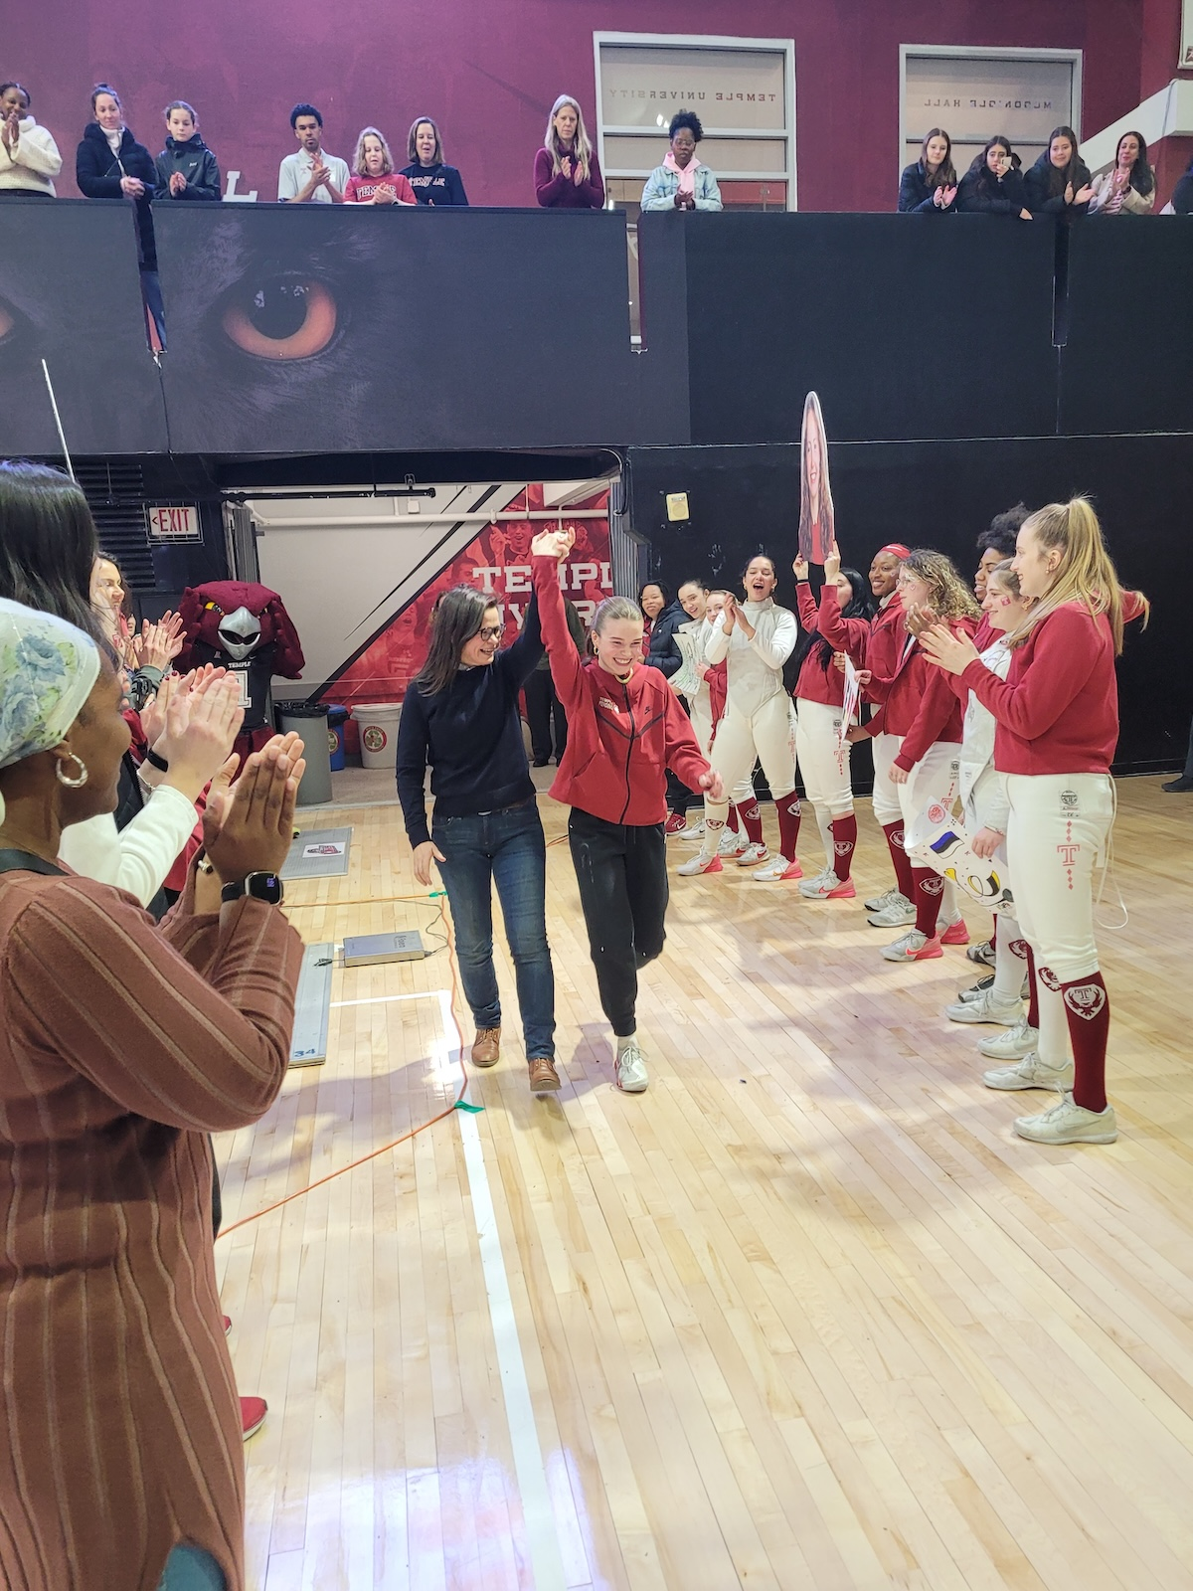
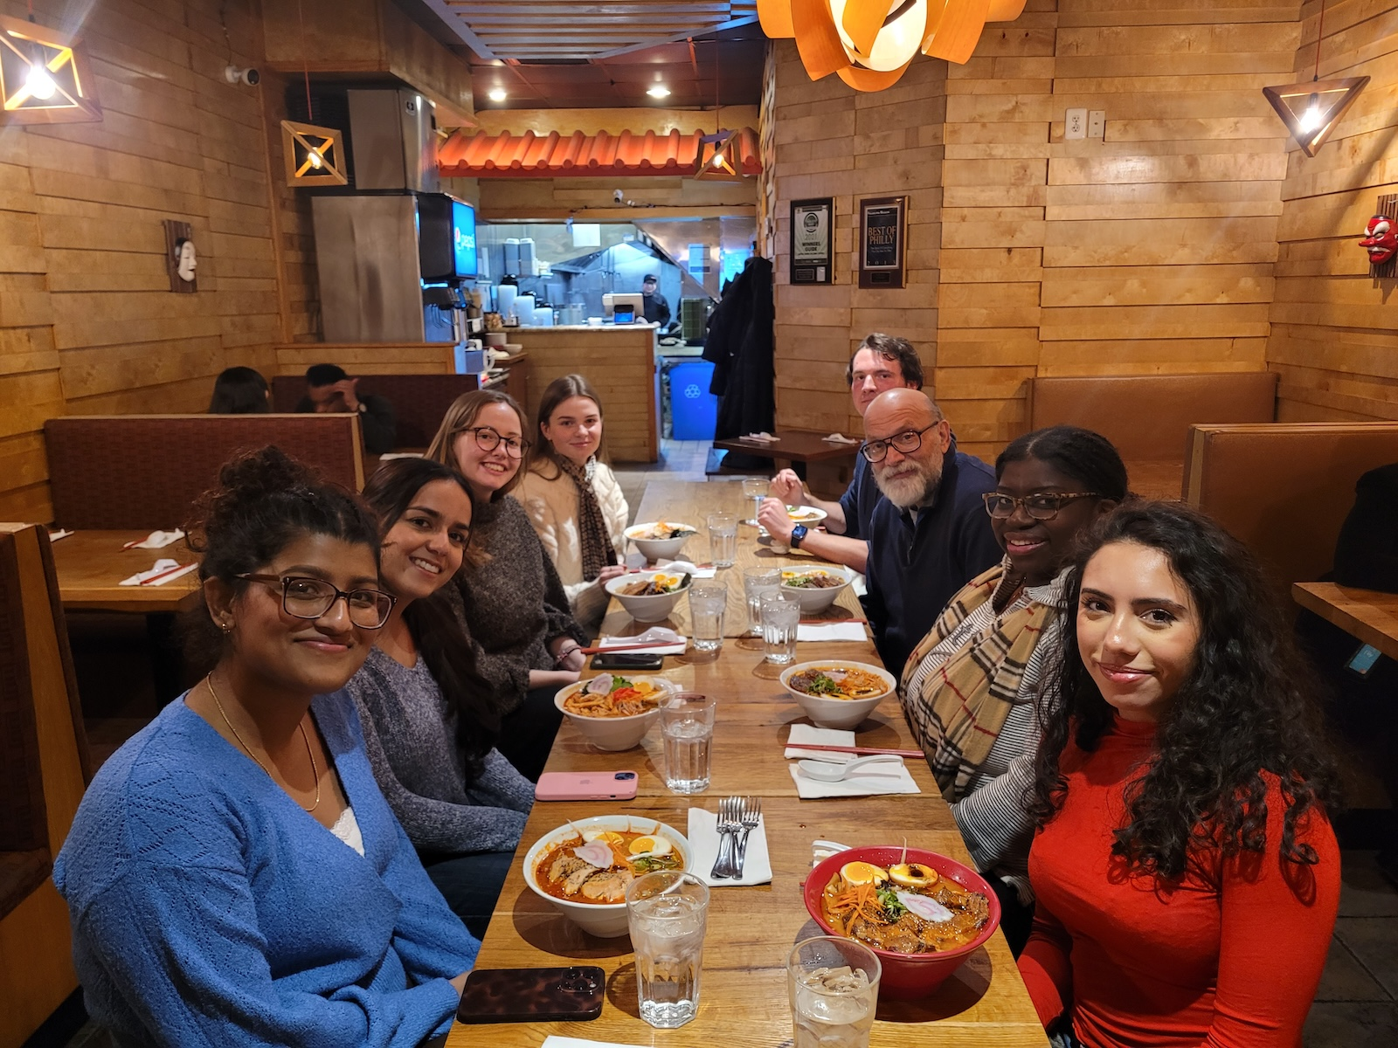
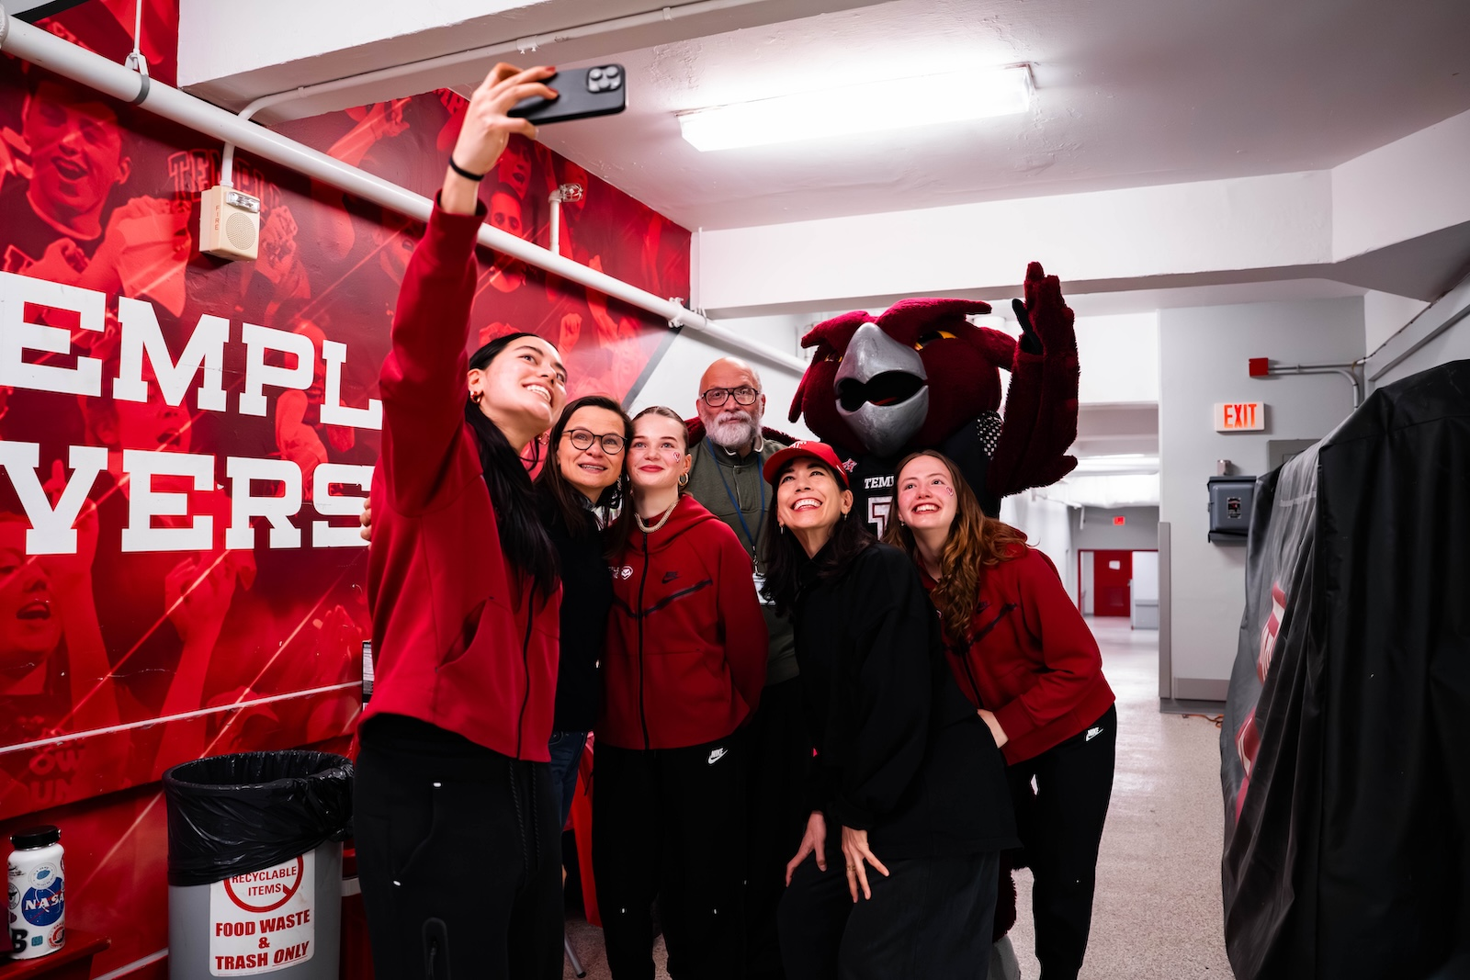


Dear Renee,
You joined us as a time when we were really struggling to build a strong annotation team. You and Anne deserve an enormous amount of credit for creating our best annotation team ever. From your very first email, we knew you were something special, and yet you still managed to exceed our lofty expectations. Two things I always remember from your time in ISIP was the fencing team (of course) and the couch ;)
...Many, Many, Many EEG Corpora
The Golden Voice of ISIP
The ISIP Fencing Team
Congratulation on graduating Renee! Thank you for being such a great team member. I appreciate your hard work and guidance. I wish you the very best :)
Sophie
Renee! Congrats and thanks for all your dedication and hard work. Best of luck out there! --Iyad
Congratulations, Renee! Your work on the DPATH demo video was amazing. I wish you a successful career ahead.- Sadia
My dear fencing college and friend Renee,
It has been pleasure to have you by my side to annotate EEGs together. Our endless dinner table talks before bed about if an absence seizure in the file is prominent enough to annotate or if we are looking at the tonic-clonic seizure or is it just muscle activity...
Thanks for all your contributions and I am glad that among all other journeys, we were able to share the ISIP journey as well. Without you, I would have to had courage to conduct my first interviews or present my first poster. <3
All my love,
Anne-Mai Melles
Subject: Interest in Joining NEDC as an Undergraduate Student Researcher
Date: Sat, 5 Aug 2023 19:20:59 -0400
From: Renee Louisa Oymann <renee.oymann@temple.edu>
To: Joseph Picone joseph.picone@temple.edu
Dear Professor Picone,
...My name is Renee Louisa Oymann, and I am reaching out to express my genuine interest in becoming a part of the NEDC research team as an undergraduate student researcher. I heard of this offer through Anne-Mai Melles a fencing college and friend of mine.
Though my academic background is in Economics with a minor in Psychology, I am genuinely captivated by the field of neuroscience...
I am not seeking an easy job, but rather a challenging opportunity that pushes me to grow. As an athlete competing on Temple’s fencing team, I have developed a strong work ethic and discipline that I bring to my academic pursuits as well...
Recently, I completed an internship with a startup in my home country Germany (Berlin), where I collected and organized target market-specific data for their market access strategy...
Best regards,
Renee Louisa Oymann (916202834)
Congratulations Renee! It was great working with you this semester and thank you so much for all your guidance and support. I know you're going to dominate the economics/political world one day. I wish you luck for your future!
-Thisumi
Congratulations Renee! Thank you for all your support and guidance (especially for the clinical reports) I wish you all the best!! --Gianna
Congrats on graduating Renee! I had fun recording the DPATH demo video with you :) Good luck, and I hope you achieve everything you want to!
- Erielle
Congratulations on this huge milestone! Watching you grow throughout this journey has been truly inspiring. I wish you continued success in all your future endeavors --Abdullah
Congratulations on your graduation! It’s been great having you as a teammate, and I’ve enjoyed working together. Wishing you nothing but the best in everything that you do next! - Andrew
Spring 2026

