Slide 1
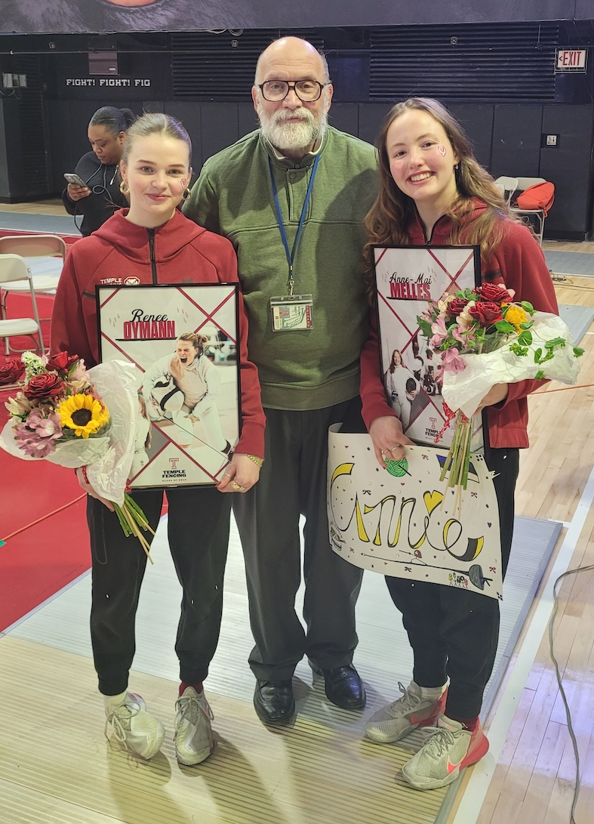
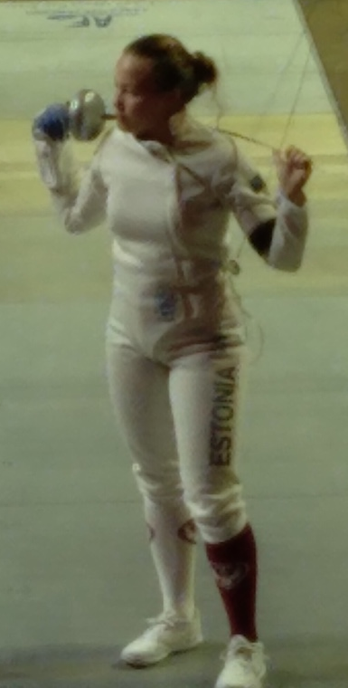
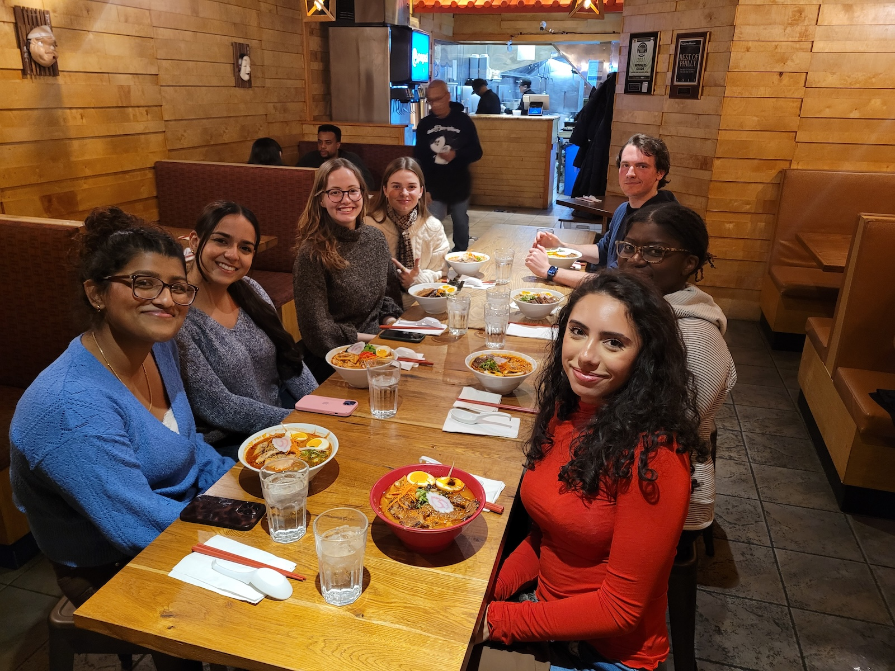
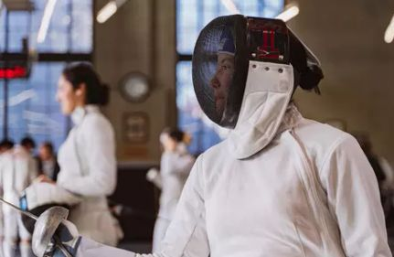


...Many, Many, Many EEG Corpora
Leader, TUH EEG Annotation Team
The ISIP Fencing Team
Congratulations on graduating! Your dedication to the EEG annotation work never went unnoticed, the care and precision you brought every single day made a real difference. Wishing you all the best in your next chapter!
--Abdullah
Anne, congratulations on graduating! You are an amazing leader and I appreciate all the help you have given me. I will miss our pre-meeting chats. I wish you the best for your future!
-Thisumi
Dear Anne,
While I’m genuinely happy for you as you reach this exciting milestone, I have to admit I’m also saddened knowing it means you’ll be leaving us. It’s difficult to put into words just how much you’ve meant to this group and how much I’ve valued our collaborations.
Our conversations have been incredibly rewarding — not only the technical discussions, where I learned a great deal, but also our exchanges on management, people, and broader perspectives. Those moments were just as meaningful.
If there’s one lesson I’ll take from this experience, it’s that maybe I should turn down every applicant at least four times first 😊.
I wish you all the best in what comes next. And selfishly, I hope we can find a way to bring you back to ISIP someday.
Anne, congrats on graduating! You were one of the first people I met at ISIP, and I could tell how much you meant to the group. Good luck on your future endeavors!
- Erielle
Anne, Congratulations on graduating!! I genuinely appreciate your leadership and the hard work you put into this team. I know you'll go far and I wish you the best moving forward in your career!
Sophie
Subject: Digital pathology data annotation project
Date: Sun, 1 Jan 2023 19:50:23 -0600
Dear Dr. Joseph Picone,
I saw your email about Digital Pathology Data Annotation project and I would be intrested to introduce myself and ask for further information.
I am an international student from Estonia. My name is Anne-Mai Melles. I am a student-athlete and it will be my second semester at Temple University. My major is Psychology and my minor is Political Science. However, I am interested in Artificial Intelligence because I am very keen on helping people by contributing to science and it seems like this project will do that. I am a fast learner and I do things with dedication.
Could you please tell me what the tasks exactly are and what are the work hours I have to take into consideration when taking part in this project? In addition, will this project be paid for?
I am looking forward to hearing from you.
Kind regards,
Anne-Mai Melles
anne-mai.melles@temple.edu
Fencing
College of Liberal Arts
Anne, you are a gem of a person. It is a pleasure to work with you, and I hope we will stay connected, because I will be needing your expertise to help unlock consciousness using quantum entanglement ;) Congratulations, and best of luck! Any employer would be lucky to have you.- Sadia
Dear Anne, Congratulations on graduating! I am extremely grateful for your support, guidance, and leadership, especially for the EEG annotation team. I will miss our team meetings :( I wish you all the best!
--Gianna
Anne, congratulations on your graduation! It has been a pleasure working alongside you, and I am so grateful for all the support and guidance you’ve shared with me. We’ll certainly miss your presence on the team, I know you’ll achieve great things in anything you do next. Wishing you the very best of luck with everything ahead! :) - Andrew
Anne! Congrats and thanks for all your dedication and hard work. I don't know how Joe is going to manage without you. Best of luck out there! --Iyad
Spring 2026

