Slide 1
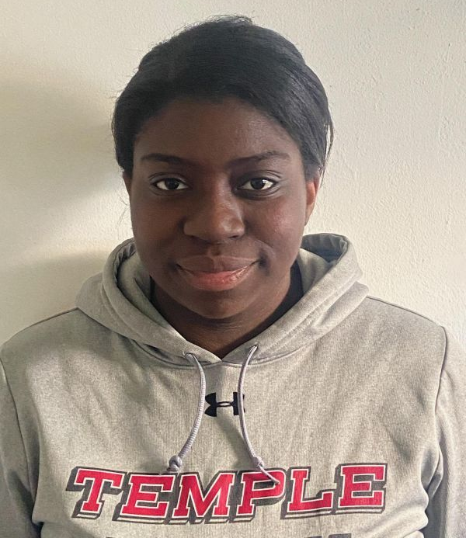
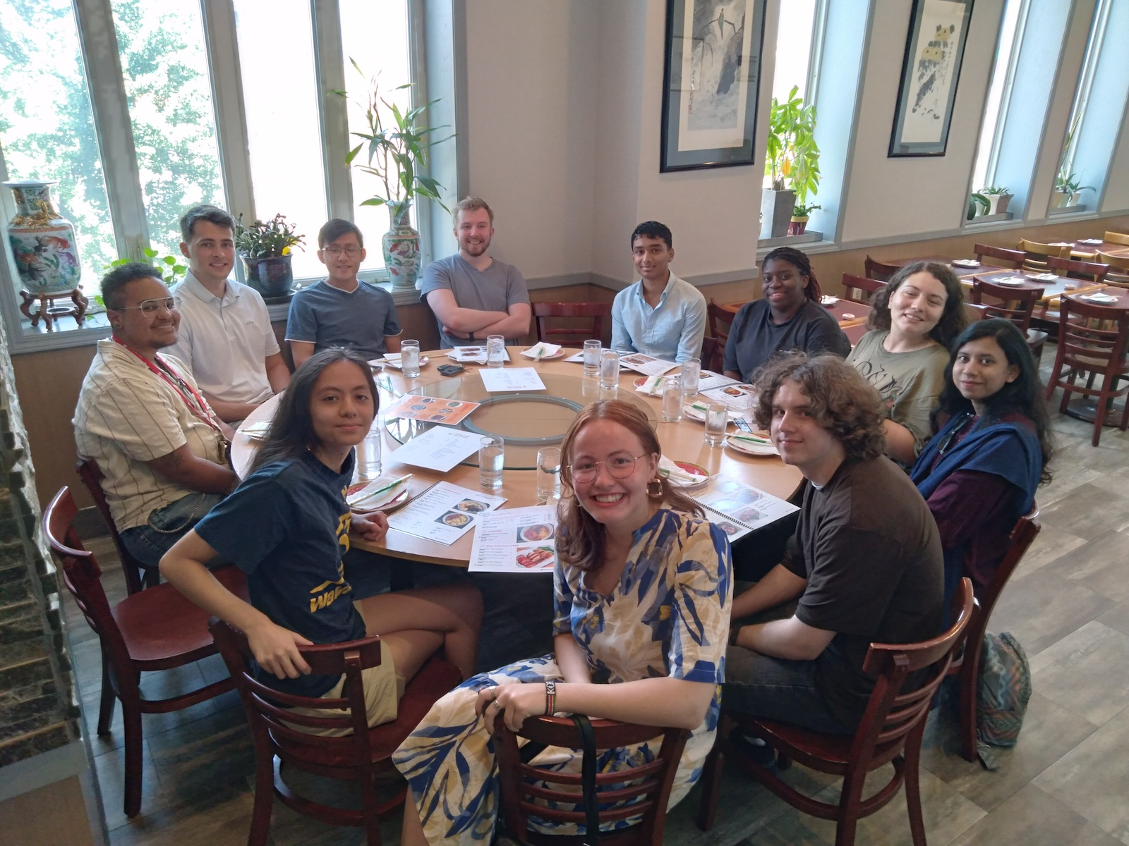
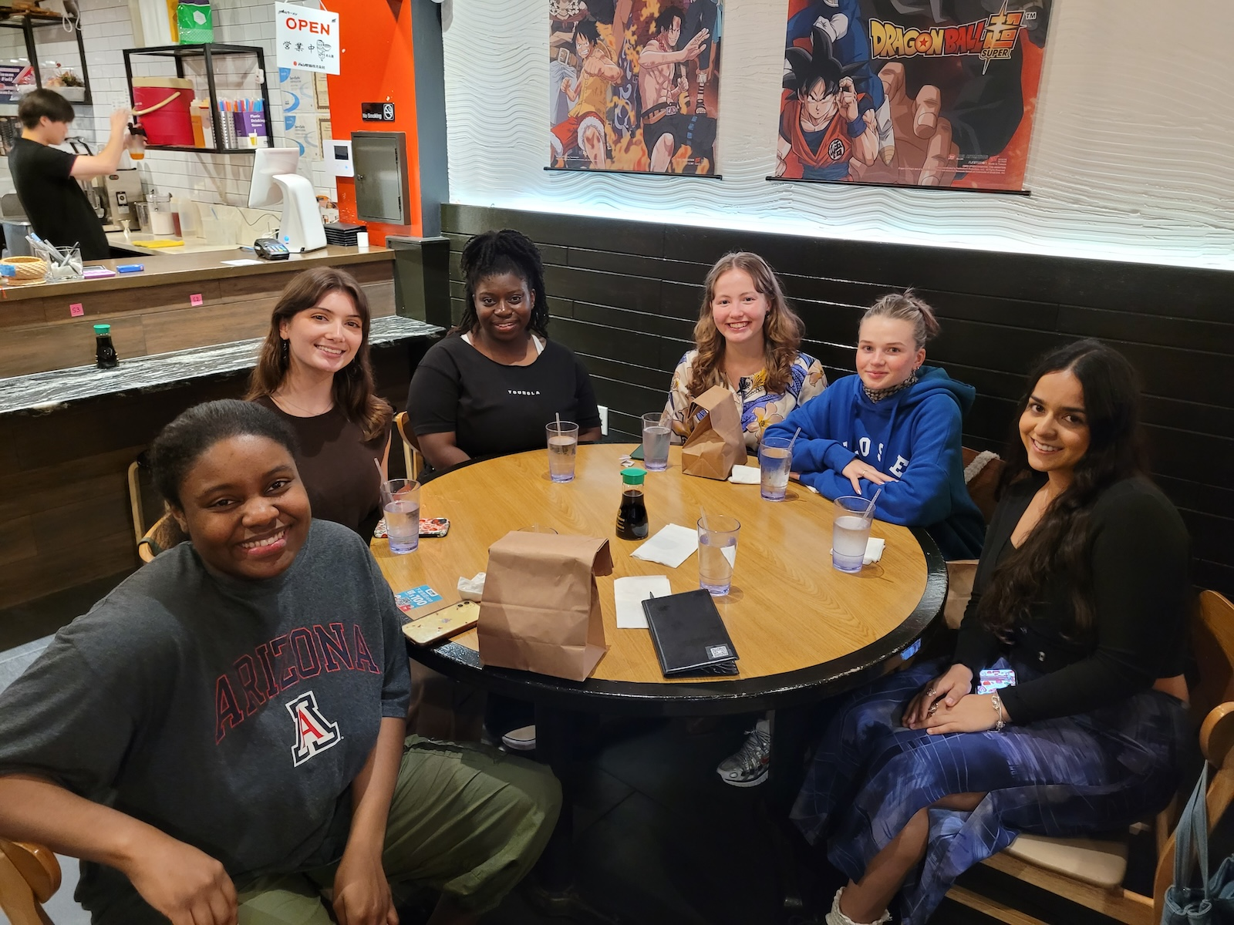


TUEP v3.0.0, v3.1.0
TUSZ v2.0.3 – v2.0.6
Senior Member, EEG Annotation Team
Congratulations on your graduation! As you step into the next chapter of your lives, carry that same curiosity and work ethic with you. Wishing you nothing but success ahead! --Abdullah
Congratulations on graduating Tanaka!! It was a pleasure working with you especially because you are so fun to be around. I know you'll succeed but I wish you the best of luck anyways!
Sophie
Tanaka, Congrats and thanks for all your dedication and hard work. Best of luck out there! --Iyad
Congratulations Tanaka!! It has truly been a pleasure working with you and learning from you. I wish you all the best in your future endeavors! --Gianna
Subject: Re: Handshake Application: NEDC Undergraduate Researcher
Date: Tue, 25 Jun 2024 00:13:13
From: Tanaka Manhede <tanaka.manhede@temple.edu>
To: Joseph Picone joseph.picone@temple.edu
Hello,
Thank you for getting back to me! I am interested in this lab because the work I complete in my current research lab is centered on behavioral and cognitive neuroscience looking to understand the effects of threat and social media on memories. I would like to branch into a different sector of neuroscience where I can learn more about EEG signals and Linux. Additionally, I recently came across the problem of not having enough data to work with for my lab's most recent work on TikTok scrolling to see a significant difference. I would like to learn more about a world in which massive data sets are prepared for researchers.
-Tanaka
Dear Tanaka,
You were an integral part of the strongest EEG annotation team we have ever had. Thanks to your hard work, we now have gold standard EEG annotations, and have clustered the EEG reports by medical histories. We are fast approaching 14,00 users of the data you have generated. You made a very substantial scientific contribution.
I hope the next chapter of your life is even more exciting, and I expect we will hear more about your great accomplishments in the future.
Best of luck Tanaka! Congratulations on your graduation. Thank you for your great work on EEG project. - Sadia
Tanaka, it has pleasure to have you in my team for almost 2 years. Your contributions have been truly impactful. You never hesitate to ask very good questions and therefore, you have helped everyone else to improve as well. (PS! Buying a mouse to annotate EEGs was a game changer, wasn't it?)
It has been so impressive how you manage to take all those physics and neuro classes while giving you 100% to both labs. I know that future will hold great things for you and the next lab that will have you should consider themselves very very lucky.
Thank you so much for all the work. Let's keep in touch! :)
-Anne-Mai Melles
Tanaka, congratulations on graduating! It was wonderful getting to work with you, I know you're going to achieve everything you hope to because you're such a passionate, hardworking person. Good luck with everything!
-Thisumi
Congratulations on your graduation! You’ve been such a great person to have on the team, and I know you’re going to do big things in your future. Best of luck with everything that comes next! - Andrew
Spring 2026

