Slide 1
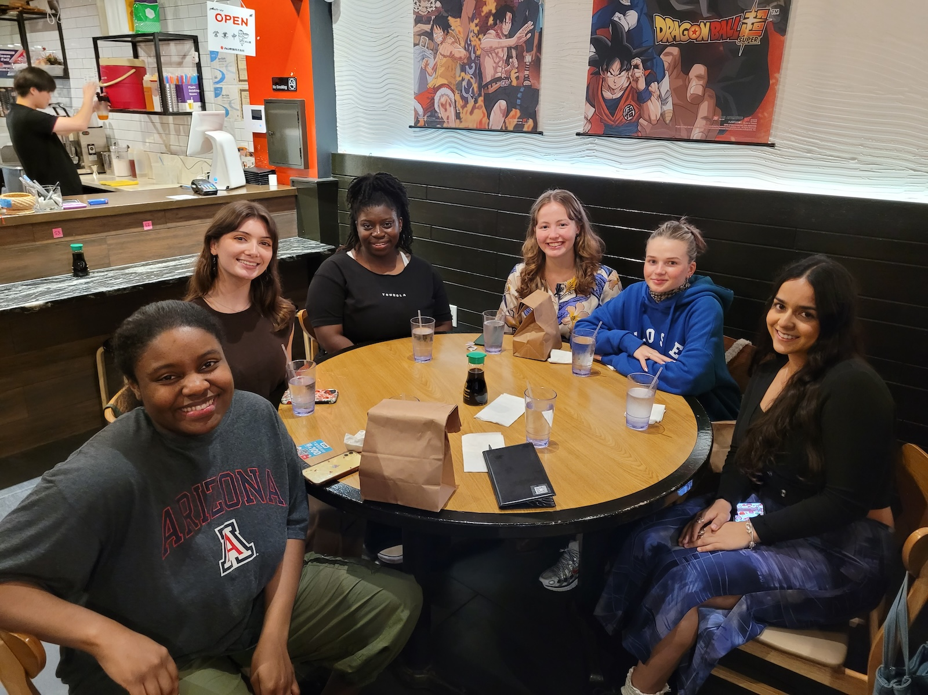


You were an integral part of the strongest EEG annotation team we have ever had. From your very first, very comprehensive email, we knew you were ISIP material ☺ The annotation team’s work is highly-regarded throughout the world, so all your excellent work has had a huge impact. I hope the next chapter of your life is even more exciting, and I expect we will hear more about your great accomplishments in the future.
TUSZ v2.0.3 and v2.0.5
The Natus AEEG Corpus (v1.0.0)
TUH EEG Annotation Team
Congratulations on your graduation! Best of luck to you in your future. Thank you for everything you have done for our team. - Andrew
Nyah,
Congratulations and best wishes for a successful and happy future! Thank you for everything you've done for the NEDC. Joe and I really appreciate it.
--Iyad Obeid
10/2024 – 12/2025
Subject: NEDC: Research Position
Date: Wed, 2 Oct 2024 18:37:18 -0400
From: Nyah Nicole Harden <nyah.harden@temple.edu>
To: Joseph Picone <joseph.picone@temple.edu>
Good afternoon Professor Picone:
My name is Nyah Harden. I'm an undergraduate Neuroscience major, and I am emailing because I recently applied for the NEDC Student Researcher position that was advertised on Temple’s Handshake... I believe that with my academic pursuits, previous work and collaborative experiences/training, and career interests, I would be an excellent match for your research center. ...
Furthermore, I have former work experience in the assisting and furthering of my family’s company, Harden Family Cleaning LLC, as an assistant, employee, and receptionist. These roles have instilled collaboration and teamwork experience in me that I have utilized with both fellow employees and other companies’ managers alike. ...
Please consider my request for a personal interview to further discuss my qualifications...
Sincerely,
Nyah Harden
Thank you so much for your contributions. You have been an amazing team member by always participating in discussions and asking questions. From the beginning, you were very interested in annotation of EEGs which made teaching you easy! I wish you the best for your next endeavors and I hope that you can treat everything that life throws to your way with curiosity! 🙂
-Anne
Nyah,
Congratulations! It was wonderful getting to work with you over the last semester. I wish you the very best with you future endeavors!
-Thisumi
Nyah, Thank you so much for your dedication to our lab. You have been a great addition for our team and all our meetings and I wish you all the luck for what is next on your journey!
-Renee
Best of luck! Congratulations on your graduation. Thank you for your great work on EEG project. - Sadia
Congratulations Nyah!! I wish you the best of luck moving forward, it was a pleasure working with you :) - Sophie
Best of luck with your next journey. Congratulations on your graduation. We appreciate your hard work on EEG data annotation. --Abdullah
Nyah!!
It is amazing to see how much you have grown with the us! I am very grateful that you joined the team! I always appreciated when you asked questions because you essentially advocated for me without you knowing it. I enjoyed your presence because you are very personable, and I love how you add to the group dynamic. I will miss you and your fun personality. I wish you the best of luck after graduation, but you do not need it; you're stellar!!
- Tanaka
Congratulations! Thank you for being such a great member of our team, and for helping me and the other new students learn and adjust. Wishing you all the best!
-Gianna
Fall 2025

