Slide 1
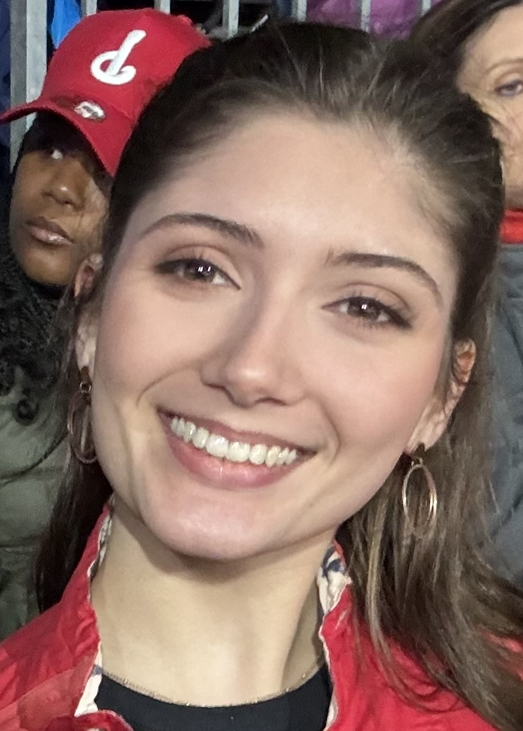


Dear Makeda,
We will always share a memory of the Union Public House and Jim Thorpe ☺ Thanks for being a key member of our best EEG annotation team. Good luck in your future endeavors – you have a bright future ahead of you that will take you to many interesting places.
The TUH EEG Annotation Team
The TUH EEG Seizure Corpus
The Natus Ambulatory EEG Corpus
09/15/2023 – 05/15/2025
Subject: EEG RA Position
Date: Fri, 15 Sep 2023 15:54:02 -0400
From: Makeda Sol Paderewski <makeda.paderewski@temple.edu>
Hello Professor Picone,
I received your email about the RA opportunity for the EEG project. The email was buried among the mountain of back-to-school emails I had been sent, so I just learned of the opportunity. Nevertheless, I am very interested in this position, as an aspiring neuroscience researcher...
I am the first in my family to attend university and have a limited perspective in the area...
Kind regards,
Makeda Paderewski
Makeda, Congratulations and best of luck. Thanks for all the hard work.
Congrats Makeda! You did it!! I am rooting for you and your endeavors. Thank you for being patient enough to teach me the ropes of annotating EEG files.
Best,
Tanaka Manhede
You were one of the first people I hired and one of few that stayed from our original group. It’s been a ride! I admire your ability to teach the material to our new members and there is no doubt that you are best for the teaching job! I truly hope to see you in the future as Dr. Paderewski, inspiring the next generation of bright, passionate individuals—just like yourself. You are incredibly intelligent and discussing what the hell is going on with those EEGs has been a pleasure. Thank you so much for being such a lovely and dedicated team player!
-Anne-Mai Melles
Congratulations on your graduation and the successful completion of your time in the lab. Wishing you continued success and fulfillment in all your future endeavors.
-Abdullah
Good luck Makeda!
- Shane McNicholas
Congratulations and best of luck for your future endeavor! - Sadia
Congratulations on the graduation! Have a bright future ahead!
-Claudia D.
Thank you so much for your work here! I can still remember your interview and how Annie and I closed our laptop and immediately knew that you were going to be an amazing addition to this team. I know you will do amazing things in the future and I wish you all the best for what is to come!
We will miss you a lot!!
-Renee Oymann
Your sharp insight, teaching talent, and collaborative spirit have left a lasting impression. Congratulations and good luck
–Dylan Heathcote
Thank you! I really appreciate you teaching me everything I know about EEGs! You’re an amazing teacher! Thank you!!- Nyah
Hi Makeda,
Congrats on your graduation!!! It has been such a privilege to get to work with you. You were a wonderful teacher and I have learned so much from you! I wish you the best in your future and know you will do amazing things! We will miss you <3
Tara
Spring 2025

