Slide 1
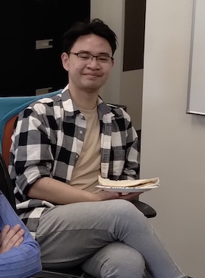

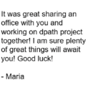

Dear Phuykong,
Not bad for a computer scientist! ☺ It is hard to explain the impact you have had on our group over the years in a small space. I will miss our Friday evening discussions about software design. I’ll think of you every time I hit our home page.
The ISIP Web Site
The ML Tools Library
The NEDC EEG Annotation Tool
08/13/2021 – 05/15/2025
Subject: NEDC Undergraduate Researcher Position
Date: Fri, 13 Aug 2021 18:03:19 -0400
From: Phuykong Meng <phuykong.meng@temple.edu>
To: Joseph Picone <joseph.picone@temple.edu>
Good evening,
I am Phuykong Meng, a freshman(international) undergraduate student majoring in Computer Science at Temple University. I am interested in the software developer role for the Handshake Job Description. I would like to learn more about machine learning and get hands-on experience with it as I am currently following a course on it in my off-time...
Best,
Phuykong Meng
Phuykong! Congratulations on a great run. You’ve been a huge asset to our team and we’ll miss having you around. Best of luck.
I am forever grateful that I had an opportunity to share an office with you! From the beginning you have answered all my (sometimes silly) questions patiently. You are very easy to talk to regardless if we are discussing techniques of fencing or nedc_eas. You have been here for me from the beginning and tracking down all the bugs! I will miss you greatly and all the candy you brought to the lab.
Anne-Mai Melles
Phuykong, during my "interview" with you and Lucas, most of it was us talking about building keyboards :) I knew then that I would get along with you guys. I wish you well, and I will miss our conversations about food and keyboards! - Erielle
From debugging chaos to sparking breakthroughs, you’ve always led with curiosity and brilliance. May your journey ahead be filled with problems worth solving and dreams worth chasing. We’ll miss your spark in the lab!
-Abdullah
Thank you for all your contributions to ml_tools! You've made the experimental process so much easier for us. You're leaving behind a great legacy in the lab. Best of luck with your new endeavor.I’m confident you’ll do a great job in your professional life! - Sadia
I'll start by thanking you for all the help you offered to DPATH — you might not realize it, but you're the first help we graduates have ever received here. You've consistently been one of the fastest and most responsive people in the group, and that made a huge difference. Hands down one of the best hiring manager, too!
You will definitely be missed by me, and probably by your inbox, which just got 24% quieter without all my emails.
- Claudia D.
Thank you for all your help and guidance over the past year. Your huge contributions to the lab have always inspired me to go the extra mile! Congratulations, and best of luck with your future endeavors. –Dylan Heathcote
Thanks for all your help the past couple of years. I have learned a lot from you, and wish you the best of luck going forward.
- Shane McNicholas
Spring 2025

