Slide 1
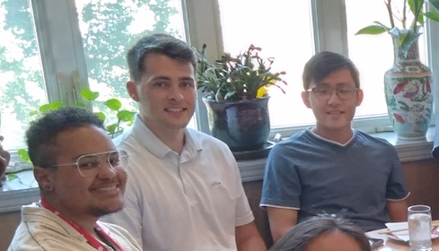


Dear Shane,
The 1990’s called and they want IMLD back ☺ It took a while to find your calling in our group, but the work you have done on IMLD and the leadership you brought to that project was great! Good luck in your future endeavors – we expect great things from you.
The Web-Based IMLD Demo (v4.0.0)
SMILE EEG Autoannotation
ECE 1111 Peer Mentor
05/15/2023 – 05/15/2025
Subject: RE: ISIP Job Opportunity:
software engineer
Date: Tue, 21 Mar 2023 18:41:34
From: Shane McNicholas
...
Hi Dr. Picone,
I was planning on contacting you about your research lab at the end of the semester, but I figured now would be a good time in the wake of your email. As you might expect, software is my biggest interest at this point in my academic career and is something I want to pursue through research and internships. I have also taken an interest in machine learning, deep learning, and AI.
...
As for the summer opportunity, I am scheduled to take my polygraph for an NSA internship this coming Monday.
...
Thanks,
Shane
Shane, Thanks for the years of hard work and dedication. Its been fun having you as a student and collaborator. Best of luck out there!
You’ve got great debugging skills. Best of luck with the next chapter! - Sadia
Though I joined the team recently, it’s clear that your presence has had a meaningful impact on the lab. Congratulations on your graduation, and may your journey ahead be filled with growth, opportunity, and success.
-Abdullah
I admire your work ethic, leadership skills and your dedication to your work. I wish you the best of luck.
– Dylan Heathcote
I wish you the best of luck with your future endeavors!
-Anne-Mai Melles
Thank you for your help when I joined the group. Wish you luck and congrats on the graduation!
- Claudia D.
Spring 2025

