Slide 1
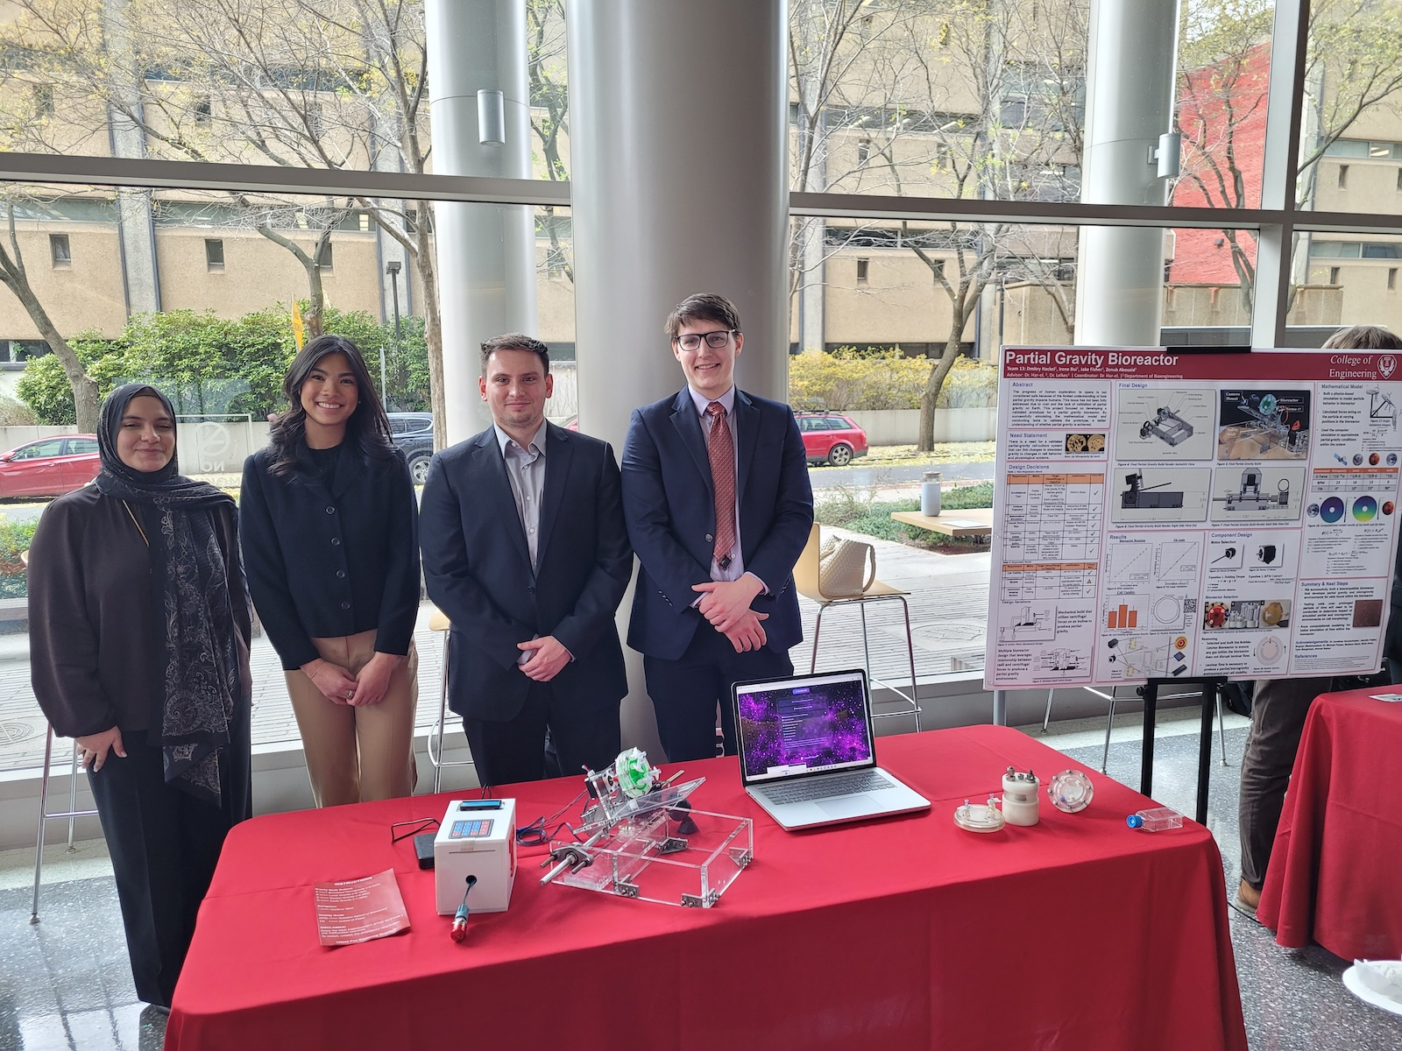


Crystallization
Digital Pathology Technology
The TUH/FCCC Breast Cancer Corpora
01/2023 – 12/2025
Subject: Undergraduate Research Opportunity Date: Wed, 4 Jan 2023 17:30:19 -0600 From: Dmitry M Hackel <dmitry.hackel@temple.edu> To: Joseph Picone joseph.picone@temple.edu
Good Evening, My name is Dmitry Hackel. I am a current junior bioengineering student at Temple University. I am very interested in your research. I think the development and innovation of medical devices and digital pathology can change the way research and medicine are performed (for the better). Attached is my resume, the most relevant experience I have is my work as a medical scribe at Jefferson Health. Feel free to reach out to me with any questions. Thank you for your time, Dmitry Hackel
Congratulations on your graduation! We’ll miss your dedication and positive energy wishing you success in all your future endeavors. --Abdullah
Congratulations! You have undoubtedly made a remarkable impact on the group and I am certain you will make many more waves wherever you go – Dylan
Every good student who graduates from our group leaves their unique mark. The pathology corpus nearly killed us, but through your hard work, expertise and steady leadership, we managed to finish it. We never quite turned you into a programmer, but there is still time ☺ Good luck in your future endeavors – there is a lot more of your story to be written.
Thanks for all your great work on the SPMB paper. Your digital pathology skills are one of a kind. Best of luck, and hope we collaborate again! -- Sadia
Congrats on surviving your stint in our group! Best wishes for lots of success in the future. --Iyad Obeid
Dimitry:
Thank you for your work and I am glad we were able to work on a paper together. 🙂 I hope you take everything you learned in this lab and apply it confidently in your future work. Best of luck!
-Anne
You have finally made it successfully to the end of your undergraduate experience!
I will surely remember the days when you probably cursed my very existence for giving you tasks that had to be solved… well, now :) While the tasks may be over, the skills you’ve gained will stay with you. Your patience, perseverance, and discipline are what truly set you apart, and I am very glad I had the opportunity to work with you.
- Claudia D.
Congratulations on graduating Dmitry, you are a very hard-working person! Thank you for being nice, it was very easy to talk to you :) - Erielle
Fall 2025

