Slide 1
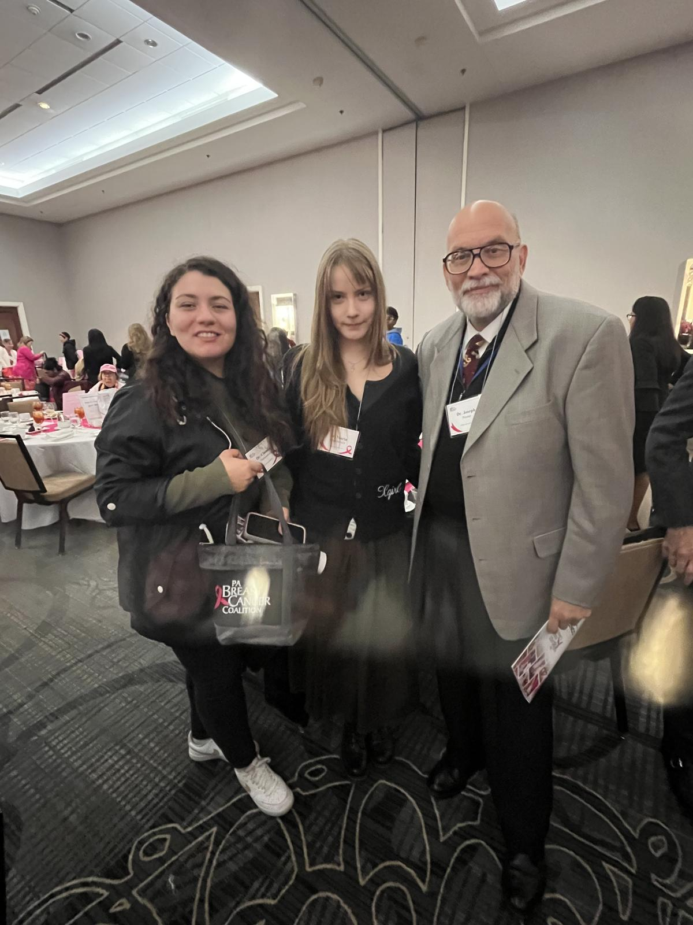


Dear Maria,
You brought a great work ethic and a tremendous amount of knowledge to our DPATH project. The databases you have developed are a substantial lasting contribution to the field. It was a pleasure to work with you all these years!
DPATH Annotation Team Leader
TUH DPATH Breast Subset v3 – v5
Aperio Slide Scanning
Maria! Thanks for all the years of service and excellence. You made a big impact and leave big shoes to fill. Best of luck to you!
It’s always inspiring to see young researchers reach this important milestone. Thank you for your efforts during your time in the lab. I wish you all the best in your future academic or professional pursuits.
-Abdullah
08/02/2022 – 05/15/2025
Subject: JOB APPLICATION
Date: Wed, 3 Aug 2022 10:06:43 -0400
From: Maria Bagritsevich <maria.bagritsevich@gmail.com>
To: joseph.picone@gmail.com <joseph.picone@gmail.com>
Good morning!
My name is Maria Bagritsevich and I am a second year Biology major at Temple University. I am looking to start working as a pathology data annotator if still possible. I am open to any other positions as well. My resume is attached to this email.
Thank you,
Maria Bagritsevich
Good luck Maria!
- Shane McNicholas
You have a really deep understanding of what you do. Congrats and best of luck! - Sadia
You were the first person I met when I joined the group. You introduced me to scanning the breast cancer slides in Temple hospital, I was very confused and happy that I never had to do it alone. It was very nice working with you for a little bit in pathology and then working alongside you as project manager. You’ve grown to be an amazing leader because your heart is in the right place and you have an enviable work ethic.
Anne-Mai Melles
Although a mess as our interaction on DPATH started, always bringing bad news, massacring the book chapter and suspicions that labels were mixed; you and Dmitry were always there to happily prove me wrong and to answer all sorts of question I had (and we all know I didn't limit to just a few of them).
I know I'll remember your contributions and I'm happy that I had the opportunity to get to know you and share a though or two.
May your career be as smooth as possible and keep up the good work, as you're on the right path!
- Claudia D.
Maria,
I am so proud of you and forever thankful for the guidance you have provided for me and the rest of the dpath team. Can't wait to see what you accomplish next!
Sean
As you step into the next chapter of your journey in pathology data science, we’re excited to see the impact you’ll make. Wishing you all the best—congratulations and good luck! – Dylan Heathcote

