Slide 1
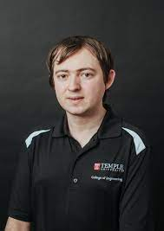


The Neuronix Cluster
Python Package Management
TUHS HIPAA-Secure Infrastructure
Dear David,
Thank you so much for your help with rsync! I wish you the best in your future plans! :)
-Grace
Dear David,
Your time with us has gotten us through a lot of rsync issues. Thank you for always being patient with us. Best of luck to you in all your endeavours.
-Sid
Dear David,
I have greatly enjoyed working with you over the years and watching you progress from an undergraduate to an IT professional. Sys admins have always played a critical role in our research, and you rank among the very best we have ever had. You will be greatly missed – I have no one left to argue with ☺
Dear David,
We have not spoken in person but I would like to say thank you for helping me with my troubles on the cluster. I learned a lot from reading the email you sent. Again, Thank you for all of your hard work and time spent helping our group :)
- Phuykong Meng
Dear David,
You’ve been such a great colleague. Thanks for looking out for us and being part of the fabric of the college. You’ll be missed! They might hire your replacement, but you’ll never be replaced!
--Iyad
Dear David,
Thank you very much for taking care of our cluster over the past couple of years! We were able to work in the cluster with peace in our minds because of your exceptional skills. I wish you all the best for your future endeavors!
Best,
Nabila
Dear David,
You brought a new culture to our IT group. We received many benefits from your efforts. Every group you are a member of can be assured about the reliability and stability of its computational infrastructure.
I wish you the best in your future career.
Vahid
Dear David,
Thank you for all the immense insight you have thrown my way. You’ve helped push the boundaries of our knowledge. Best of luck to your future endeavors.
Javier
April 2022

