Slide 1
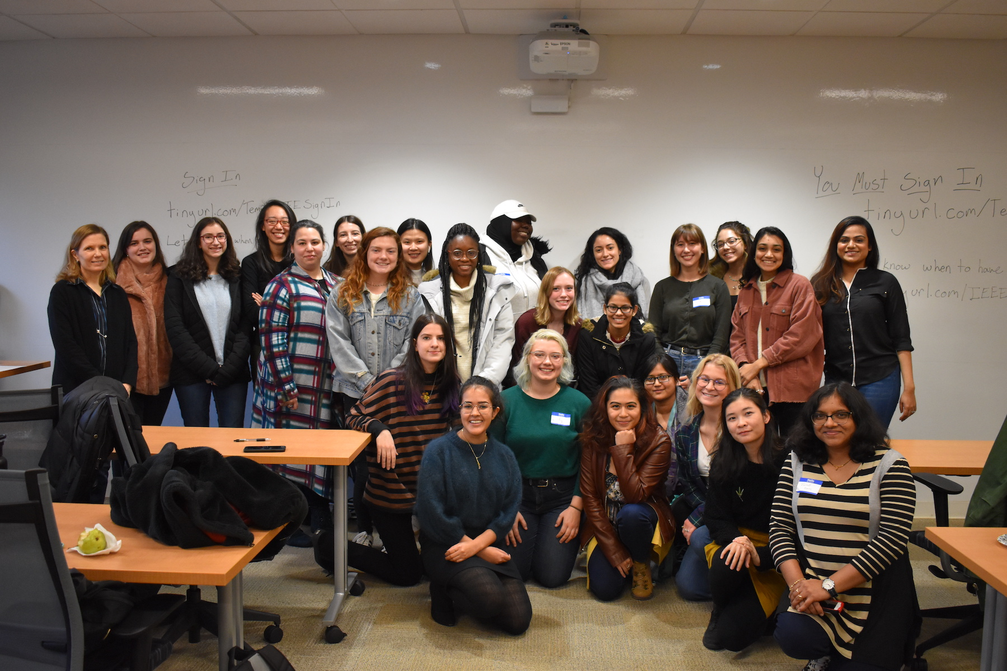
Software Tools Independent Study
The ISIP Machine Learning Demo
Software Engineering of the NFC Environment
Lynn,
Congratulations on your well-deserved success. Take pictures. Take your time celebrating. Take it easy for a while. Then get ready to take on the world!
-Meysam
Dear Lynn,
Who would have ever thought that a chance introduction by Shawn Fagan would result in such a fantastic collaboration? You entered our group in perhaps the most non-traditional way, but in the short time you were with us, you had a big impact.
But what I will miss most about you is that you are the only other person in the group who knows what are Hammond B3 organ and a Leslie amplifier.
I look forward to hearing about your future successes. It is always sad when we lose someone who really understands the ISIP way!
Lynn,
Congrats on graduating! It’s been a pleasure having you as a student and a member of our team. You have nothing but success ahead of you. Best of luck, and don’t forget to stay in touch.
--Iyad
Hi Lynn, you made it!
It’s been a great time working with you as a team last summer. I wish you all the best and enjoy your future journey!
-Thao
Lynn,
Congrats on making it to the end. We’ve never met before, but I’m the guy who started the fantastic IMLD! Dr.Picone told me you were upset with how bad the comments/code was and I ask for your forgiveness. Hopefully, if we meet during graduation, we can leave that in the past! Congrats and keep working hard.
-Shmyrde
Dear Lynn,
Congratulations on your graduation! I enjoyed working with you on NEDC TOOLS. We will miss having you around.
Wish you all the best!
- Nabila
We didn't get to talk very much, but you always seemed cool. I thought it was funny how many similarities we had both in terms of school, and ending up in NEDC! Best of luck in the future!
- Lilly Veloso
May 2021

