Slide 1
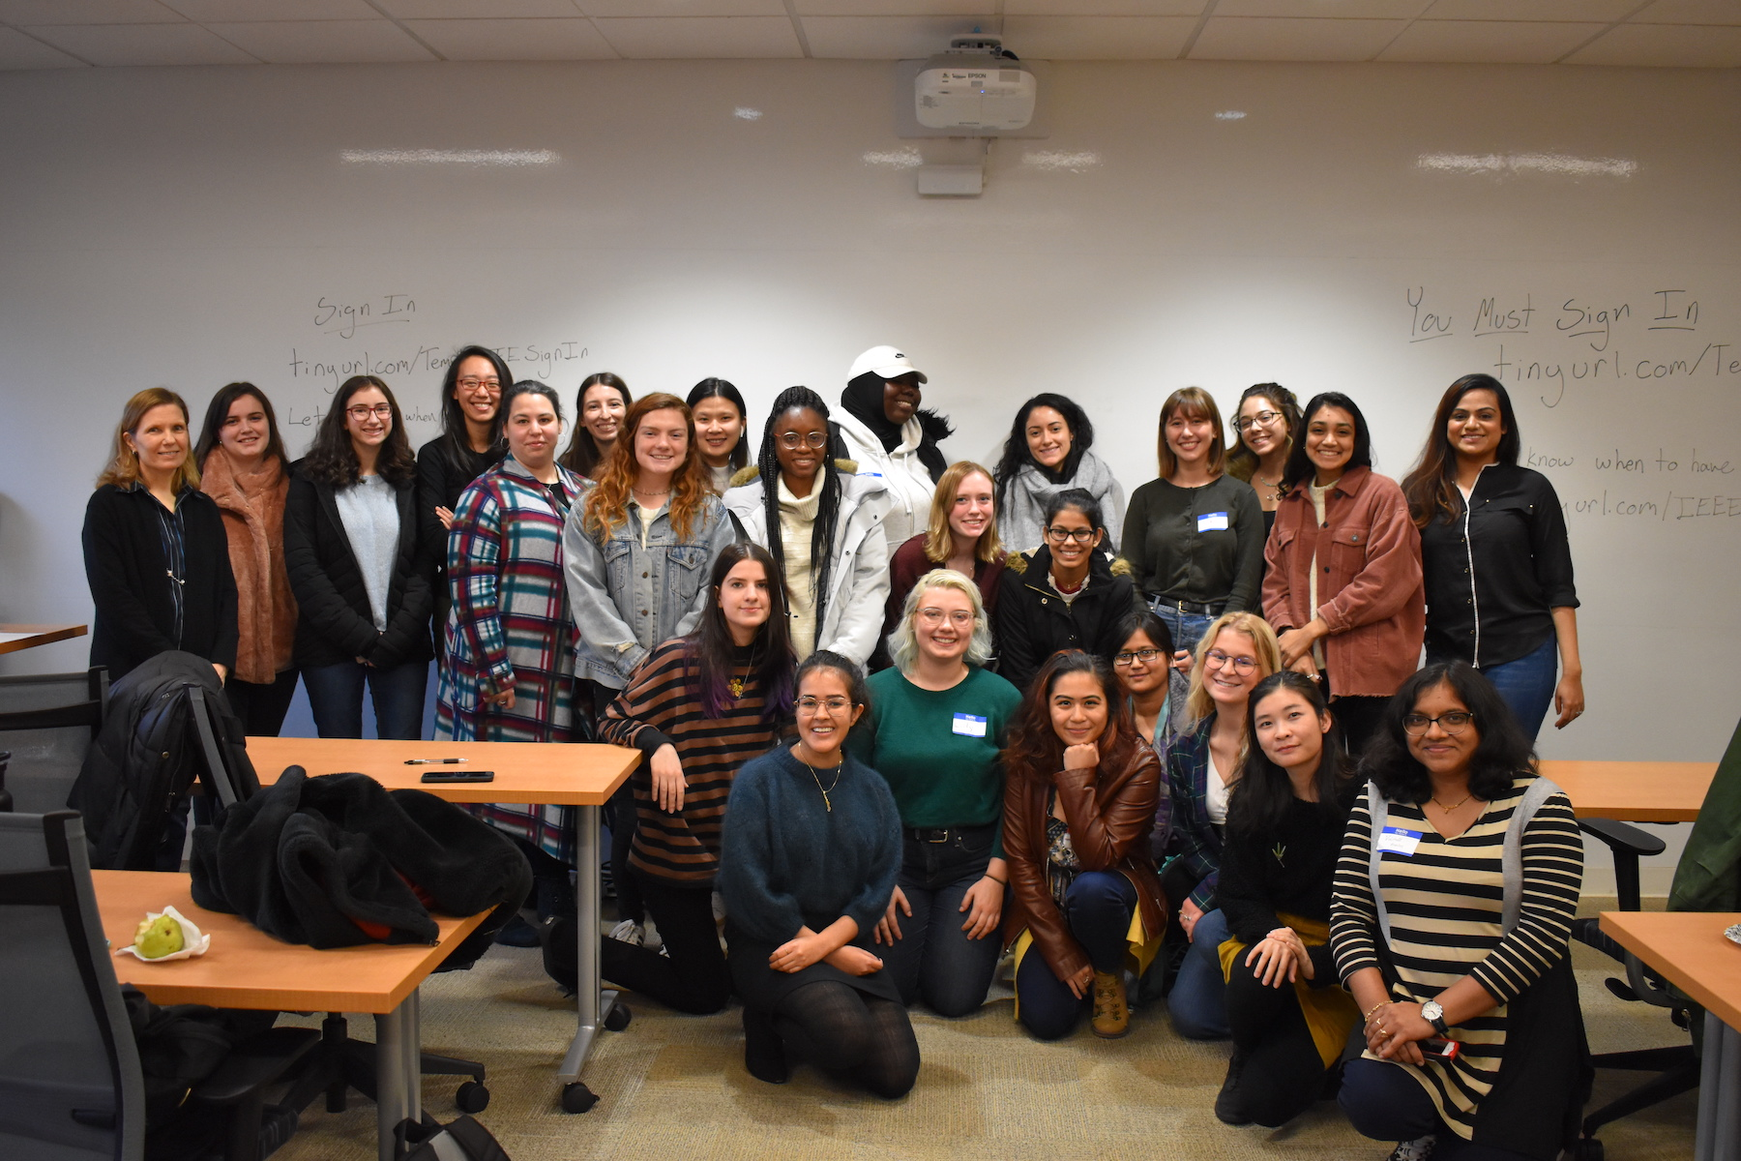
Hi Lily, I don’t think we’ve ever talk but
I always admire what you have accomplished.
I first knew you from Temple IEEE and I’m always impressed about your straightforward personality. You are one of my female role models that I want to look up, especially in this field. Wish you the best on your journey.
-Thao
EEG Data Acquisition at Temple Hospital
ECE 1111 UG Peer Mentor
IEEE Student Chapter President
Lilly,
Congratulations today and best wishes for all your tomorrows. May you always dare to do great things with your life.
-Meysam
Dear Lilly,
You have the distinction of following one of our most non-traditional paths to success in ISIP. I still remember your dedication to the database project at the hospital. But you should be most proud of the mentoring work you did in ECE 1111. You had a major impact on many students’ lives. Your contributions in that course were amazing… and mostly archived for posterity on the listserv ☺
You will be gone from our group, which makes me sad, but never forgotten. You constantly challenged me to be a better teacher and mentor.
Signed,
The Old Guy
Lilly,
Congrats! Despite being terrified of your weekly checkoffs, I really appreciated your wisdom during my hour of hell. You've taught me all I know about pointers, 2D arrays, seg faults, and how to get down in the debugger. You'd see me on the 7th floor and constantly check up on me to see if I'd started the lab yet, or you'd give me life advice as I did work for my other classes. Now you're off to do even bigger things, but you've left us with a high standard of what it means to be a TA.
-Daniel
Lilly,
Well done! Congrats on graduating and for making such a positive impact on our group. We’re going to miss having you around. Thanks for everything you’ve done for us. Don’t forget to swing by and visit!
--Iyad
Lilly,
Congrats on that EE degree, we did not interact much, but I could tell you were a hard worker. Sorry for always procrastinating when it came to fixing your AWS problems! Hopefully, you’ve forgotten about those days. I wish you the best in your future endeavors and stay safe.
-Shmyrde
Lilly,
Congratulations on all your hard work finally paying off! I know I can say with absolute certainty that you are the reason I passed ECE 1111. Thank you so much for being a mentor to me during and after the class!
-Justin
Dear Lilly,
You are one of the kindest souls I have ever met. I was always amazed by both your people skill and coding prowess which improved our lab experience. I think I can fill up this whole page if I start writing about how you made a difference in the lives of our students for three semesters. I enjoyed reading the email threads between you and Dr. Picone (I was always 5 emails behind you guys :).
I wish you all the best and hope to see you on the other side of the country (and this Friday)!
- Nabila
Congratulations Lilly! We didn't get to talk too much, but I know your unique and positive spirit will bring you success and happiness in the future.
-Lynn
May 2021

