Slide 1
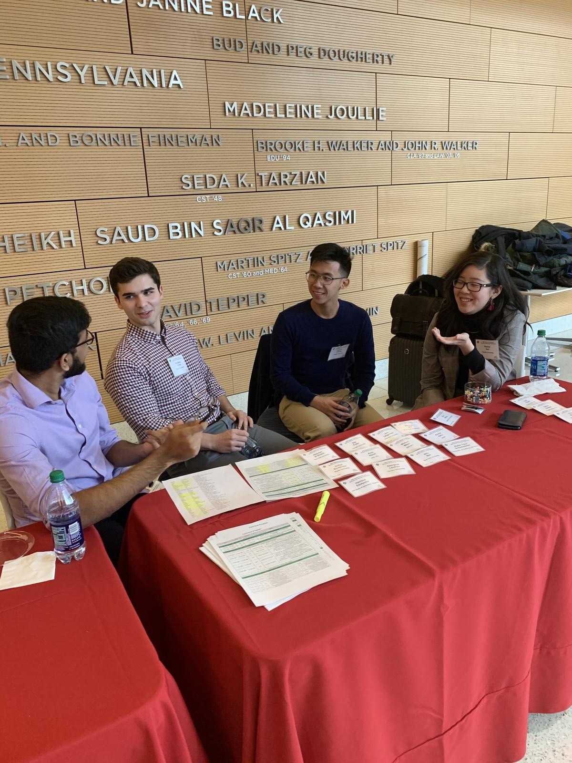
The TUH EEG Artifact Corpus
The TUSZ Corpora (v1.5.x)
The EEG Annotation Team
Hey Vincent, I’ve enjoyed working with you this past year. I just wish we met pre-covid so we could have gotten to know each other better. Best of luck in your future endeavors.
-Nikita
Vincent!
Congratulations on your graduation and best wishes for your next adventure! Keep on growing. Keep adding to the goodness and beauty in the world. Keep developing those unique dreams and talents that make you who you are!
-Meysam
Dear Vincent,
You have been one of our most senior members of the EEG annotation team, which has been internationally-recognized for its excellent work. Your dedication and excellent annotation skills will be missed. Good luck in your pursuit of an MS degree.
Vinny my Boi!
Congrats on getting that BS Degree. I know how crazy the engineering department can get so I’m happy you made it. We had a lot of fun times (especially pre-covid). It was always fun having you around. From funny stories to just entertaining my BS. I’m thankful for all you’ve done especially for this group, and I wish you the best. Stay well out there and good luck with your Masters!
-Shmyrde
Vincent,
Congrats on graduating and making through our program. Good luck out there!
--Iyad
Hi Vincent,
Congratulations on your graduation. I enjoyed those conversations with you either in-person or virtually. Wish you all the best!
-Thao
Vincent,
Congratulations on your graduation and best of luck on your future endeavors!
-Nabila
Vincent,
Congratulations! I wish you the most happiness in your life after graduation.
- Lynn
Vincent,
Congratulations on graduating. Wishing you the best of luck on your next adventure.
-Sidney
Vincent,
Congratulations on graduating! Wishing you the best of luck in the future.
-Sarah
May 2021

