Slide 1
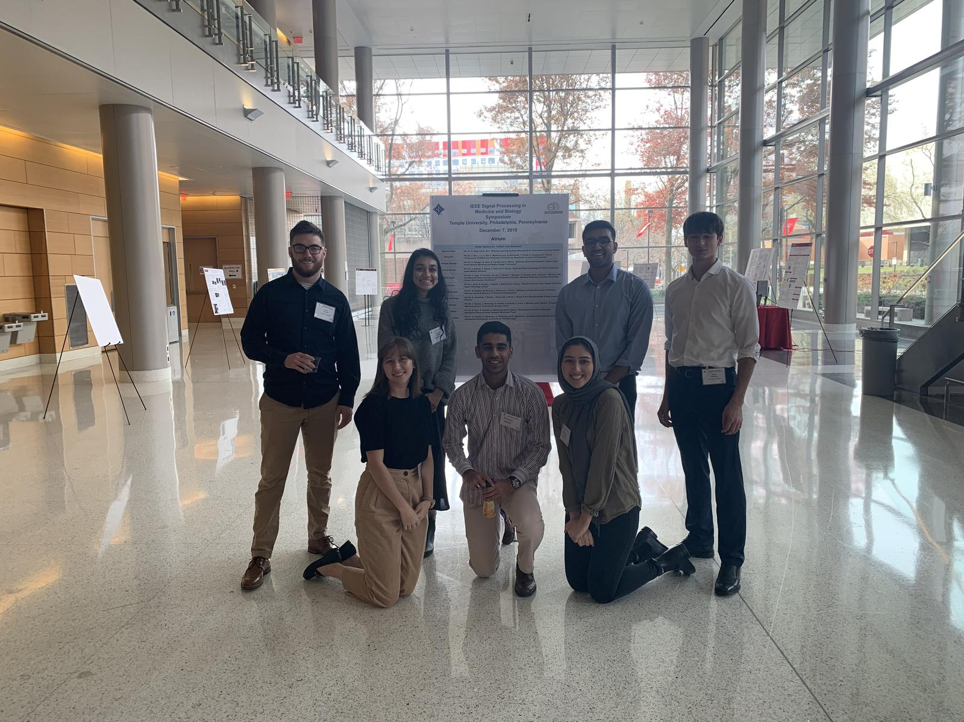
The TUH Digital Pathology Breast Tumor Corpus (v1.0.0)
The Leica Aperio AT2 Scanner
The NEDC Web Team
Julien,
Congratulations today and best wishes for all your tomorrows. May you always dare to do great things with your life.
-Meysam
Dear Julien,
You brought a lot of stability to the DPATH team and certainly became the master of the Aperio scanner. The impact of the DPATH data will be seen over the next couple of years. Working in our group has been an important part of your academic journey. I look forward to seeing what you accomplish in your career as a data scientist.
Julien,
Congrats on graduating and making through our program. Good luck out there!
--Iyad
Julien,
You have had a very positive influence on my life. When we met I was in a rough spot, and your friendliness and referral to Dr. Picone helped me to climb out of that hole. I enjoyed working with you tremendously, and wish you all the best in your future endeavors!
-Nikita
Julien (aka Cash),
I don’t even know where to start, our relationship started as co-workers and expanded to fellow investors. Thanks for answering all my questions and helping me out. I’ve come out of retirement seeing how you never gave up. I can’t either! In all seriousness, we had some fun times . Wish you the best and keep grinding!
- Shmyrde
Julien,
Congratulations on graduating and your great job in digital pathology.
It is because of your neat and precise job that we are now able to make our cancer recognition system.
Wish you the best!
-Vahid
Julien,
We met when the group was desperately trying to annotate DCIS in 500 slides! From there, now we have 3600 annotated slides and you made it happen! Thank you for your prompt communication and dedication toward the database.
I wish you all the best!
- Nabila
Julien,
Congratulations! I wish you the most happiness and success in your life after graduation.
- Lynn
May 2021

