Slide 1
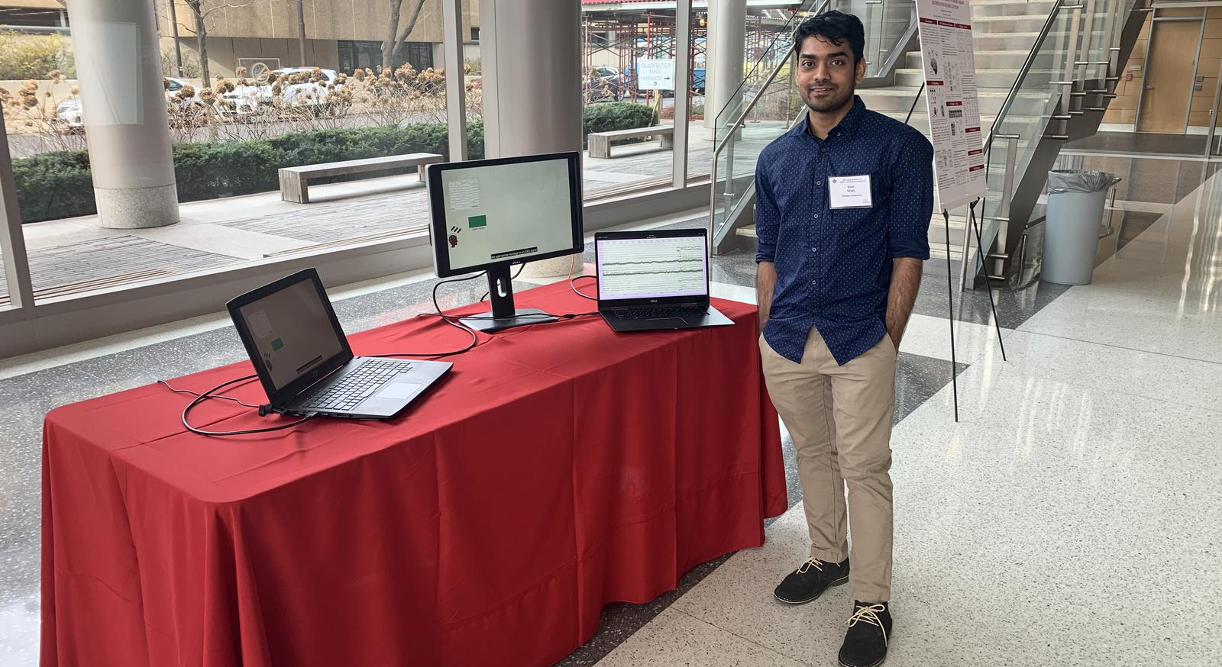
Congratulation Vinit, you finally made it,
Thank you for being the person that I always came to pick your brain about Machine Learning. My journey of first entering the group would be tough without you. Wish you all success in your future endeavors! Don’t forget to do Yoga after COVID-19 is over.
-Thao
The TUH EEG Seizure Detection Corpora
AutoEEG: Real-Time Seizure Detection
The NEDC Staff Neurologist
Vinit,
It's been a long and steep climb. And I can't imagine a better companion than you for this journey. I appreciate all of your hard work. Without your enormous contributions, none of my accomplishments would have been feasible. It's time to celebrate all the hard work that led to this joyful occasion. Congratulations!
-Meysam
Vinit,
The path to a PhD is never easy and never as quick as one would like it to be. But there is a lot to be said for your perseverance.
Your contributions to the group have been immeasurable. The way you learned about EEG science and translated it into engineering technology was impressive.
I expect to hear about your many great accomplishments in years to come.
Vinit!
I never thought I’d have another roommate again, but here we are! I’m thrilled you’re finally graduating, and sad to lose your company and great sense of intellectual adventure. Its been fun having you around and we’re incredibly grateful for everything you’ve done for us. Stay in touch.
--Iyad
Vinit,
Where to begin! You are like a celebrity not just in our group but also around the campus! You were always there to help any of us. Thank you for being the kindest and wisest friend I could have ever asked for. I am going to miss your sage advice and can-do attitude in all situations. I hope we will work together someday again. Congratulations on finishing your PhD and best of luck on your future endeavors!
- Nabila
Vinit,
Congratulations on graduating!
As the first person in the group that I have met, and the first person in the group that I have entered with into the country, and the only friend that with together have done many memorable things (you read it crazy things!), I wish you the best in your life!
Friend forever!
- Vahid
I hope you finally get some sleep- you deserve it.
- Lilly Veloso
Vinit,
Thank you for always being a terrific help to me when I was in the group. I know you will be just as valued wherever you end up.
- Lynn
VINIT!
Congrats my guy, I can’t even fit all the things I want in here. We’ve been through a lot, from those restless summers or just complaining about how life & Dr.Picone was out to get us. Talking to you was always enjoyable and knowledgeable. Thanks for teaching the basics to ML and always entertaining my convos. I wish you the best buddy.
-Shmyrde
June 2021

