Slide 1
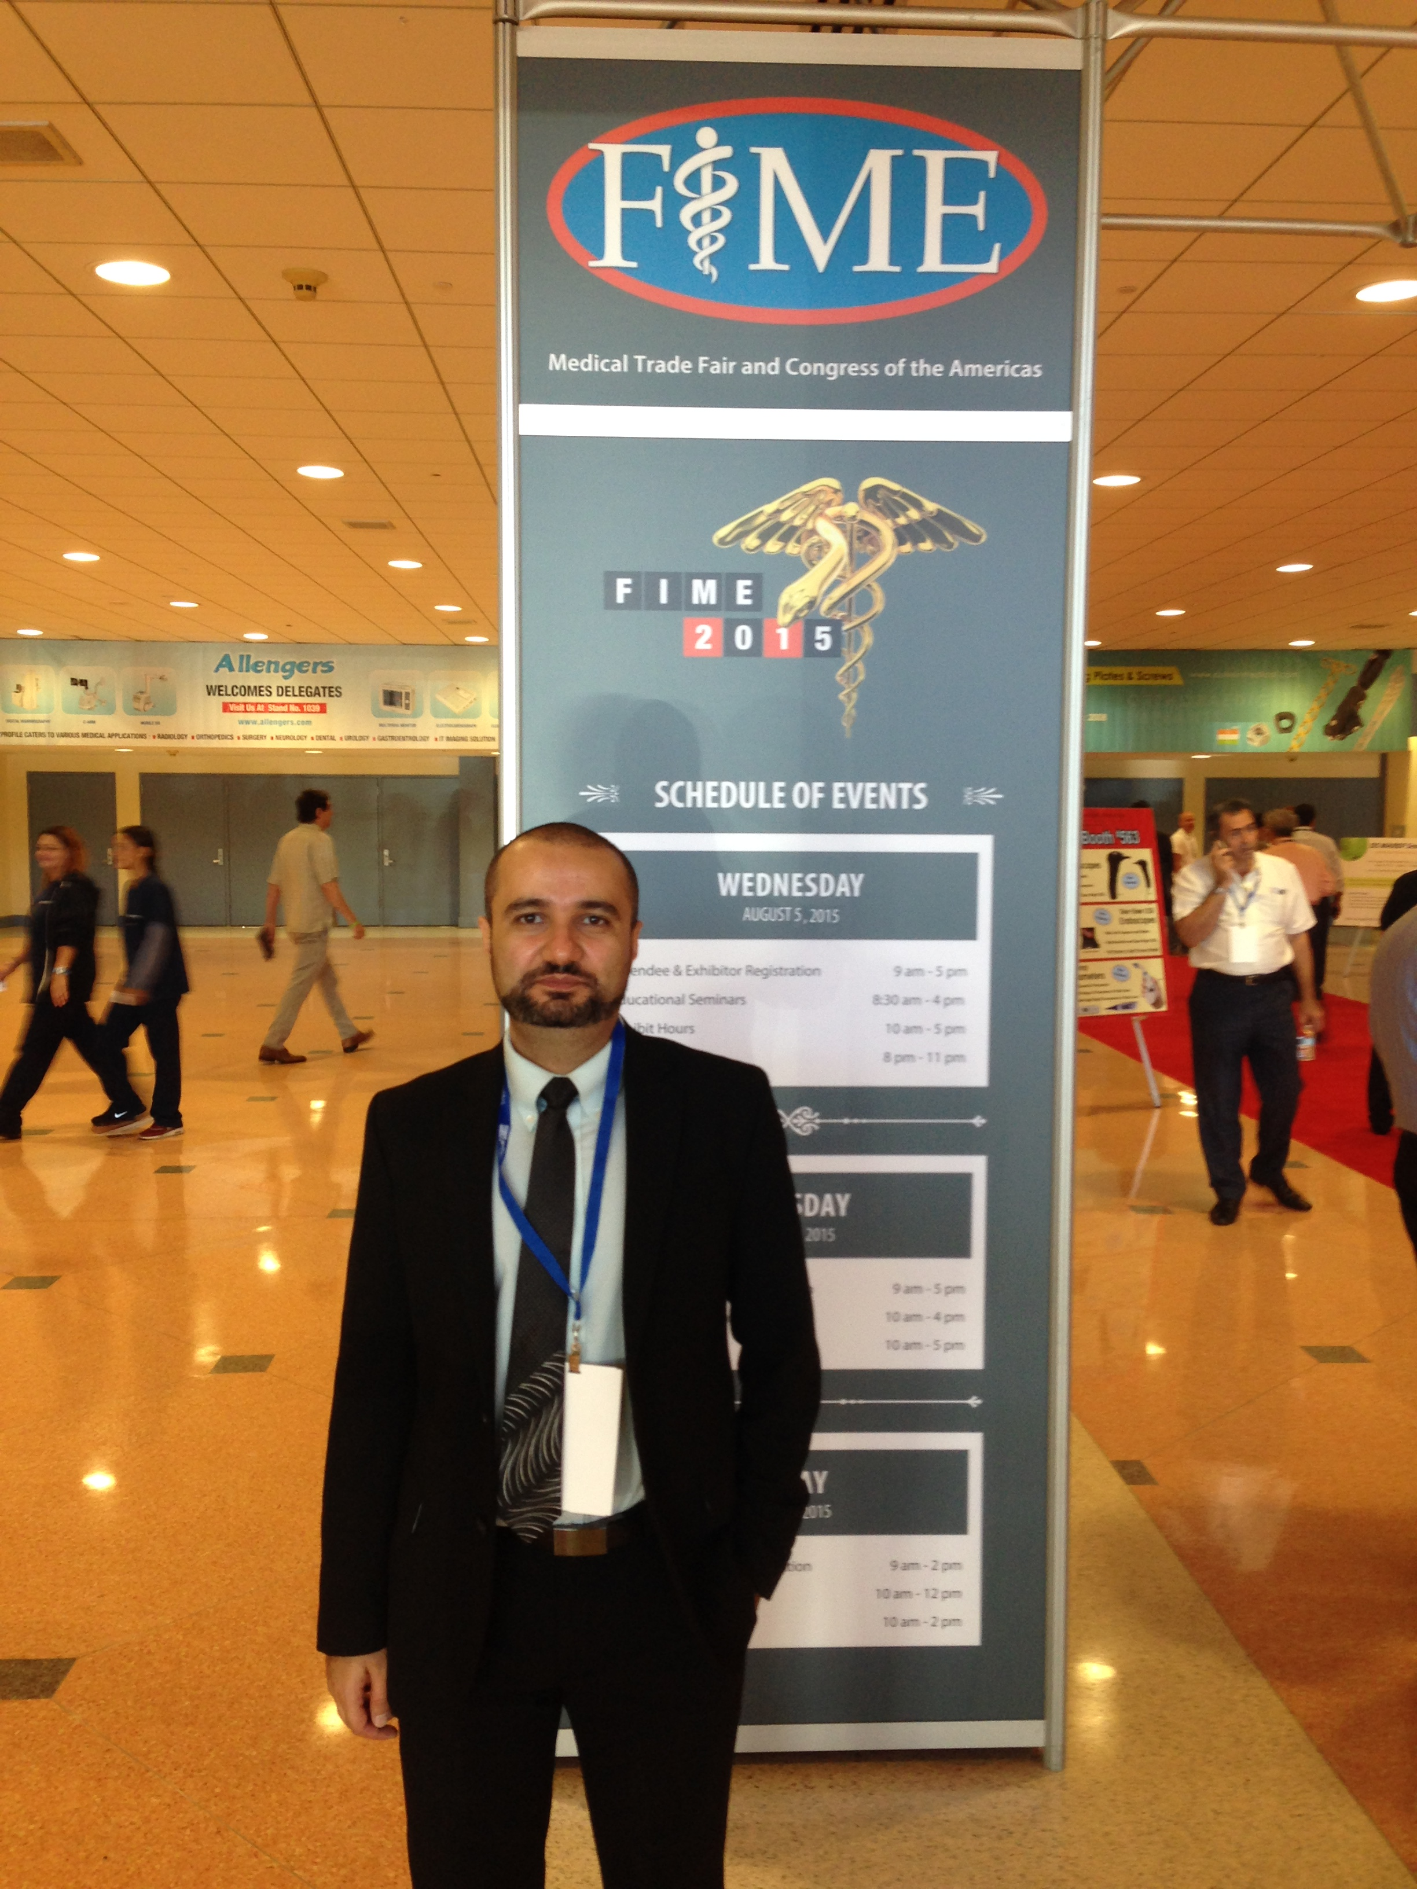
The First NEDC EEG Visualization Tool
Classification of EEG Signals Using Deep Learning
Chief Technical Officer, BioSignal Analytics, Inc.
Meysam,
Congrats on reaching the end of your Journey. Sadly, we’ve only met once but I’m one of the ITs for the group! I hope we (the IT team) made your life somewhat easy while you launched experiments. Sorry for those times slurm was inactive, slurm just doesn’t like PhD students for some reason. I wish you the best and stay healthy!
-Shmyrde
Congrats Meysam,
Wish you best wishes for your future adventure.
-Thao
Meysam,
It has been a long journey that started with a Python-based demo and ended up with technology and a start up company. There are many highlights of your time in NEDC. I think my favorite is the I-Corps boot camp – you did an amazing job on that project, and that was an extremely tough project.
Though you have been gone for a while, a day doesn’t go by that we don’t miss your presence in our group.
Meysam!
You’re graduating! Its been a real joy sharing this journey with you. You’ve done a great job and brought so much success to the group and to yourself. Good luck out there and don’t forget to visit us!
--Iyad
Meysam,
I never had the chance to work with you, but I know it could have been very valuable. All the researches in NEDC on EEG after you were somehow the continuation of what you have founded. I appreciate the strong foundation that you have made for the group.
Wish you the best!
- Vahid
Dear Meysam,
We didn’t get a chance to work together but your contribution in the group always inspired us. Congratulations on your graduation and best of luck!
- Nabila
June 2021

