Slide 1
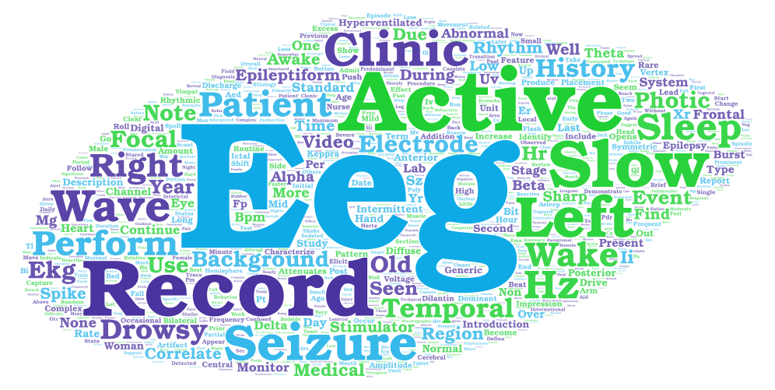
Lilly Veloso: The TUH EEG Corpus
EEG Data Ingestion
Study Abroad – Italy, Spring 2018
December 2017

